Slide 1





ROME
April 11^{th |} 12th 2019
MIMOD
Mixed-Mode Designs for Social Surveys
FINAL WORKSHOP
Discussion
WP3 Case Management Systems
Martin Zeleny
Czech Statistical Office

Slide 2


Integrated systems
  across surveys
  across modes
  across survey lifecycle
    questionnaire specification
    questionnaire testing
    data collection
    (post-collection data processing)
    (dissemination)
MIMOD project - Mixed-Mode Designs in Social Surveys
Rome, 11-12 April 2019

Slide 3
Ways / degree of components integration
  one integrated multi-functional application
  set of components with joint metadata / data repository
  set of more stand-alone tools with defined metadata / data interfaces
  Pros &cons of these approaches for the surveys world ?
MIMOD project - Mixed-Mode Designs in Social Surveys
Rome, 11-12 April 2019

Slide 4
Outsourced vs. in-house development solutions
  fully outsourced
  in-house system integration combining in-house development and external applications
  fully in-house development of targeted application(s)
  Pros &cons of these approaches for the surveys world ?
MIMOD project - Mixed-Mode Designs in Social Surveys
Rome, 11-12 April 2019

Slide 5
Is there a case for some joint development activities?
  opportunities
  challenges
  What can be standardized to form a common ground?
MIMOD project - Mixed-Mode Designs in Social Surveys
Rome, 11-12 April 2019

Slide 6
Survey implementation process
  actors
  their tasks / events they handle
  metadata / data they work with
  tools they use
  A case for more investigation towards a shareable generic architecture?
MIMOD project - Mixed-Mode Designs in Social Surveys
Rome, 11-12 April 2019

Slide 7
Potential areas for standardization
  questionnaire specification metadata
    DDI compatible metadata model (?)
  survey case lifecycle coding
    final disposition and temporary contact codes
  actors and their roles in the survey process
MIMOD project - Mixed-Mode Designs in Social Surveys
Rome, 11-12 April 2019

Slide 8
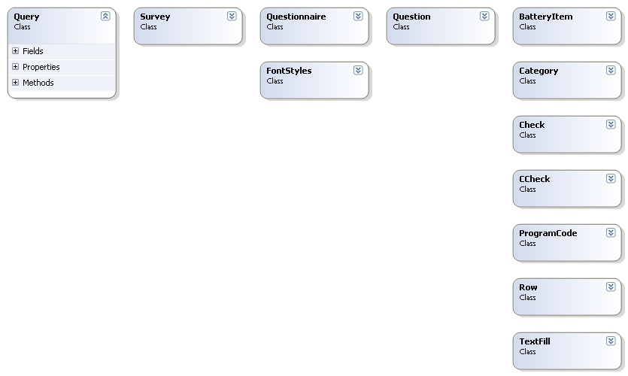
MIMOD project - Mixed-Mode Designs in Social Surveys
Rome, 11-12 April 2019

Slide 9
Questionnaire specification interface
Questionnaire documentation
Questionnaire metadata
Questionnaire program code compilation
Post-collection
data processing
center
Metadata
repository
Aggregate results dissemination
MIMOD project - Mixed-Mode Designs in Social Surveys
Rome, 11-12 April 2019

Slide 10
The way forward
  modularization
  shared repository of metadata and survey process models (?)
  dedicated workshops bringing together the staff involved
    questionnaire specification metadata
    survey case lifecycle modeling … as promising topics
  open / shareable code libraries based on common standards
    but, are these flexible enough to adapt to heterogeneous circumstances?
MIMOD project - Mixed-Mode Designs in Social Surveys
Rome, 11-12 April 2019

