Slide 1
Users of statistics
Who are they and what do they need?
Ineke Stoop
Chair ESAC

Slide 2

The ESAC (European Statistical Advisory Committee) shall assist the European Parliament, the Council and the Commission in ensuring that user requirements and the costs borne by information providers and producers are taken into account in coordinating the strategic objectives and priorities of the Union's statistical information policy.
That assistance shall cover all statistical domains relevant to the Union's statistical information policy.
The Committee should contribute to a close cooperation in the programme planning process in order to improve the governance of the European Statistical System and enhance the quality of Community statistics.

Slide 3
The ESAC (European Statistical Advisory Committee) shall assist the European Parliament, the Council and the Commission in ensuring that user requirements and the costs borne by information providers and producers are taken into account in coordinating the strategic objectives and priorities of the Union's statistical information policy.
That assistance shall cover all statistical domains relevant to the Union's statistical information policy.
The Committee should contribute to a close cooperation in the programme planning process in order to improve the governance of the European Statistical System and enhance the quality of Community statistics.

Slide 4
Users
Who are they?
What do they want?
What do they need?
What should they know?

Slide 5
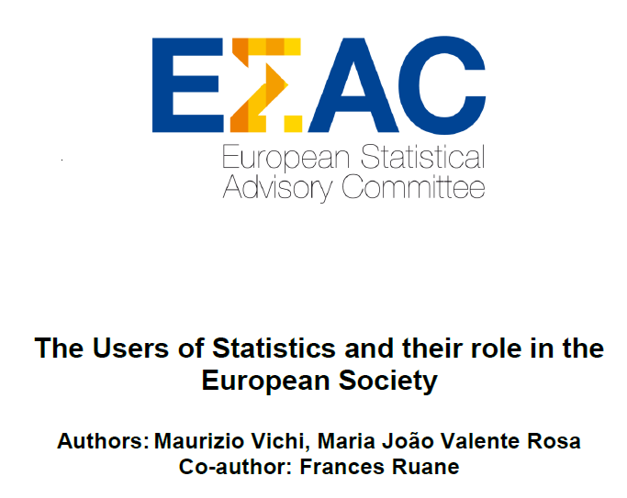
What are users?

Slide 6
Classification of users: institutional users
  European Parliament
  Council
  European Economic and Social Committee
  Committee of the Regions
  European Central Bank
  Confederation of European Business (BUSINESSEUROPE)
  European Trade Union Confederation
  European Association of Craft, Small and Medium-sized Enterprises
  European Data Protection Supervisor
  Commission DGs

Slide 7
Classification of users: non-institutional users
  Users with a general interest (e.g., economic growth)
    Journalists and media
    Citizens
    Students (by level of education, or age)
    Teachers (by level of teaching education)
  Users with a specific subject/domain interest (e.g., health)
    Other decision makers
    Policy analysts
    Marketing analysts
    Experts in a specific field
  Users with a research interest (e.g., innovation in enterprises)
    Scientific community: academics, researchers at universities and research institutions
    Consultants and researchers in Governmental Agencies and private sector

Slide 8
Type and frequency of use
 | Institutional users |  | Non-institutional users
 |  | General | Specific | Research
(very) Heavy
Light/ occasional
Not/ potential

Slide 9
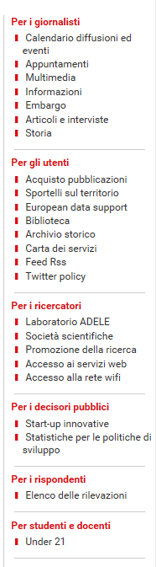

What users want

Slide 10
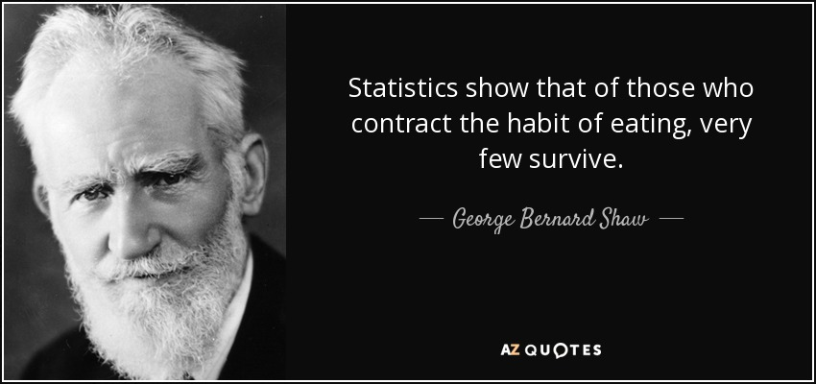
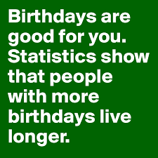
What users want: success, scandals and confirmation
  something is terribly wrong
  Italy is performing much better/worse than other countries
  an indicator shows a sharp increase/decrease
  government policies are succesful
  the quality of life of women, the elderly, people who live in the south, is much worse than of others

Slide 11
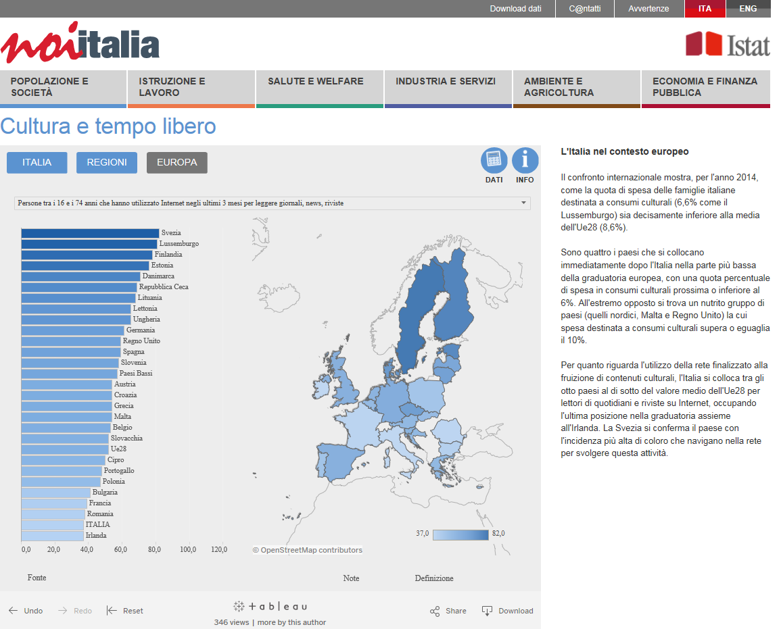

Slide 12

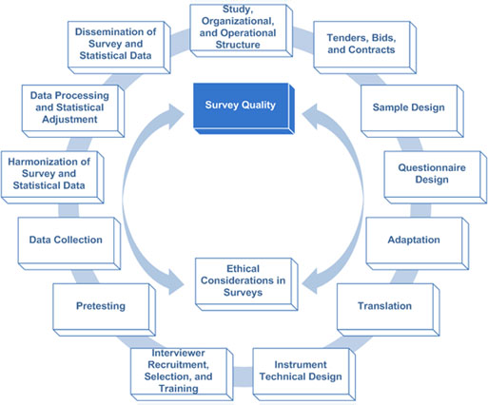
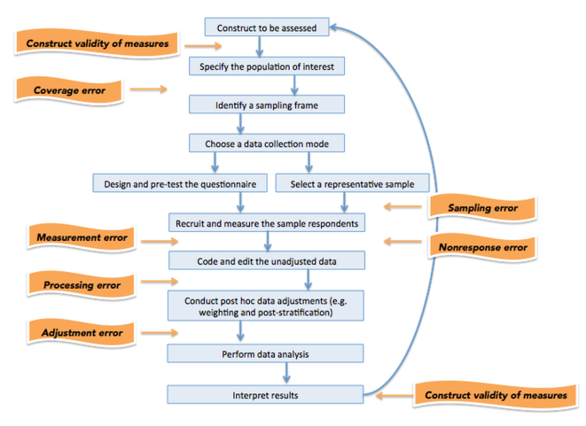
What users need: high quality statistics
  Code of Practice
  Total Survey Error
  TQM
  Fit for purpose
    Accuracy
    Quality
    Information about today?
    Regional level
    Accessibility
    Understandability
    Indicators, monitors
    Policy assessment
TQM
Plan
Do
Check
Act

Slide 13
What users want
  Open data
  Microdata
  Metadata
  Maps
  Visualisations
  Statistics
  Indicators
  Information/knowledge
  Combination of sources
  Knowledge from research

Slide 14
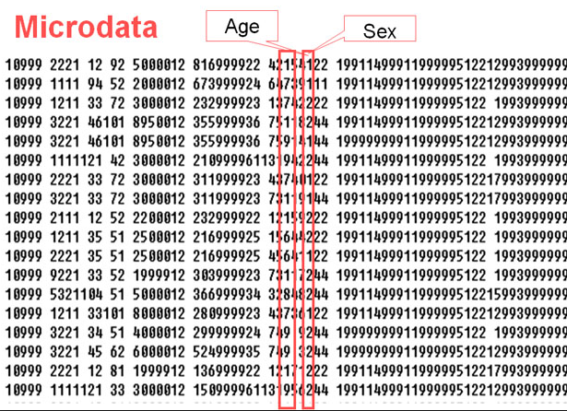
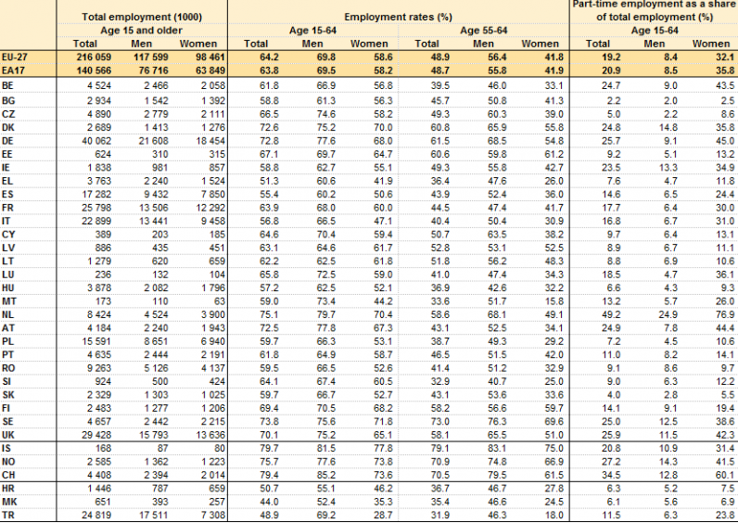
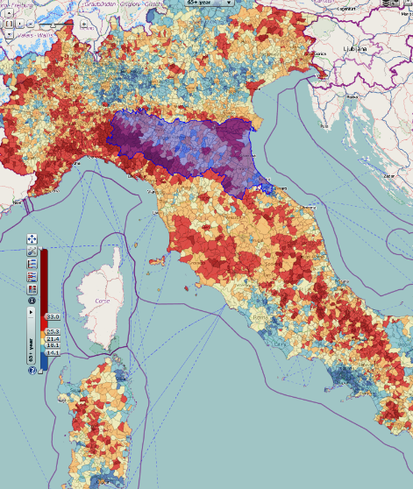
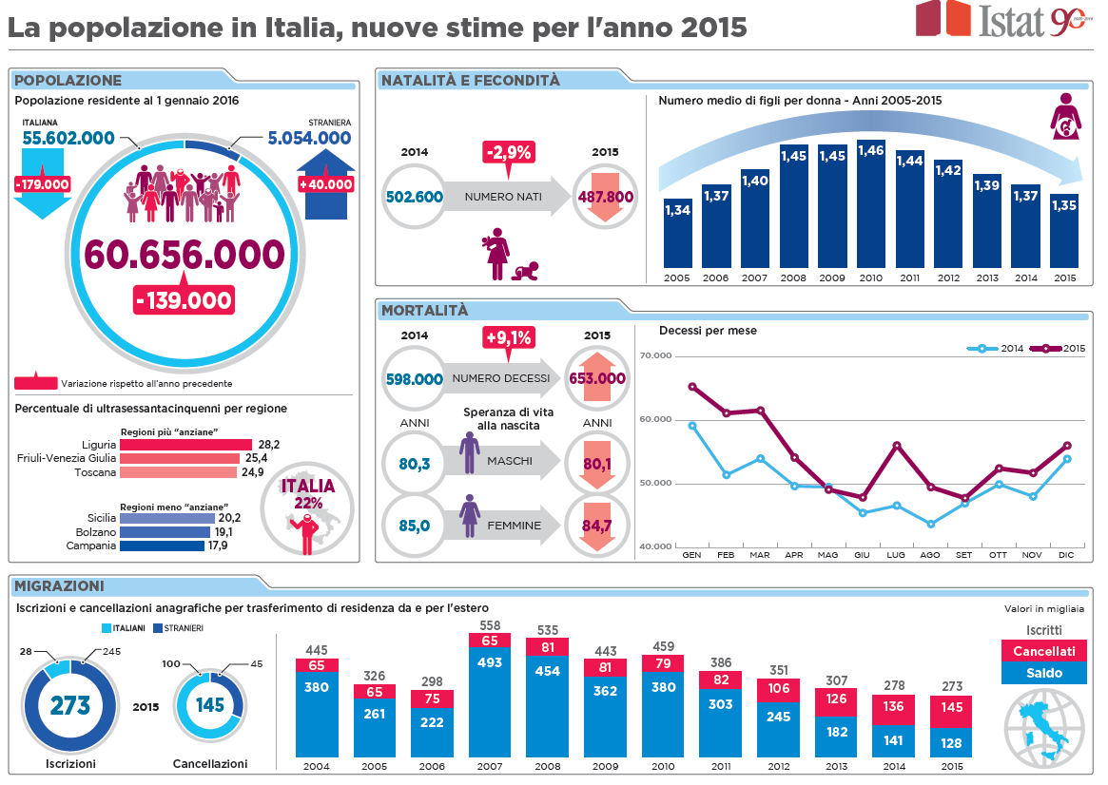
What users need

Slide 15
What users need
  Made easy?
    Nice visualisations
    Statistics is fun
    Gamification
  Information they need (content, level, form, time)
  Don’t underestimate users
  Teach them about
    Quality of statistics
    Strengths and weaknesses
    What statistics mean
    Provide background, interpretation?

Slide 16

Statistics for our civil societies
  Statistical “stamp” enough?
  Work on statistical literacy
  Able to assess fitness for purpose
  Context and interpretation
  Role of research
Policy making and evaluation
Theory Litera-ture
Data (statis-tics and other)
Analy-sis Models
Publish Dissem-inate
Institutional, environmental,national context

Slide 17
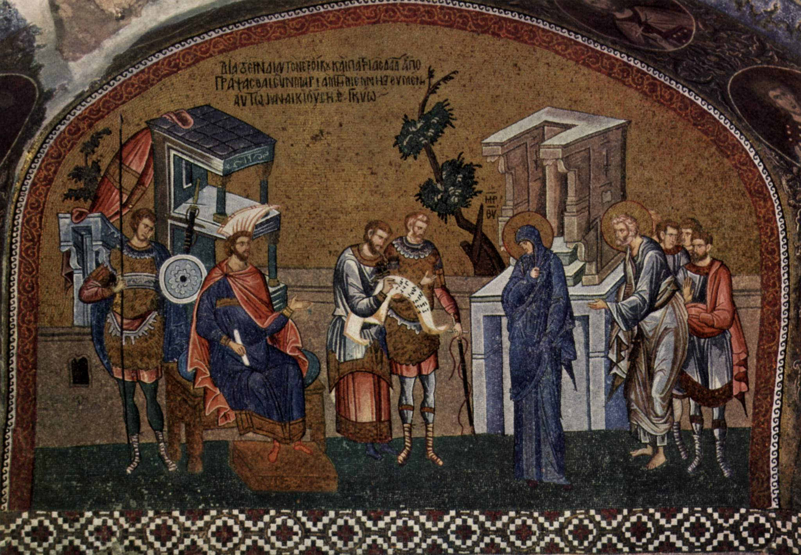
Grazie per l'attenzione
i.stoop@scp.nl

