Slide 1
COMPORTAMENTI INDIVIDUALI
E RELAZIONI SOCIALI
IN TRASFORMAZIONE
UNA SFIDA PER LA
STATISTICA UFFICIALE
LABORATORIO NUMERACY
Statistical strategies for
Big-data analysis
Agostino Di Ciaccio | Sapienza, università di Roma

Slide 2
Big Data is not just big data
It is qualitatively new kinds of data about people’s behaviours and beliefs, new kinds of tools, and new kinds of actors.
The predictive power of “social” Big Data is being used in many fields like public health, economic development
The large amount of genome sequencing data now make it possible to uncover the genetic markers of rare disorders and find associations between diseases and rare sequence variants
IoT – internet of things. Depending on which predictions you trust, there could be from 32 to 50 billion internet-connected devices by 2020. And the volume of data being generated is staggering
Poverty map in Côte d’Ivoire
estimated by mobile phone data

Slide 4

Unpleasant aspects of big data
Privacy, disclosure control
When you combine someone’s personal information with vast external data sets, you can infer new facts about that person
Coverage/selection bias
Data security
Data storage
New legislation required

Slide 5
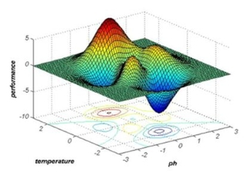
Statistical Challenges in Big Data
To handle the challenges of Big Data, we need new statistical thinking and appropriate computational methods.
If no sampling -> no sampling errors. The measure of error is largely directed to the evaluation of model bias and reliability and to analyze the quality of data.
In some cases, big data have markedly more features than observations. For example, the standard set of microarray data are typically composed of thousands of features (i.e., genes) with only a few tens of units being observed.
To predict the reaction of customers when they visit a given website. The company may have only milliseconds to decide how to respond to the click of a given user.

Slide 6
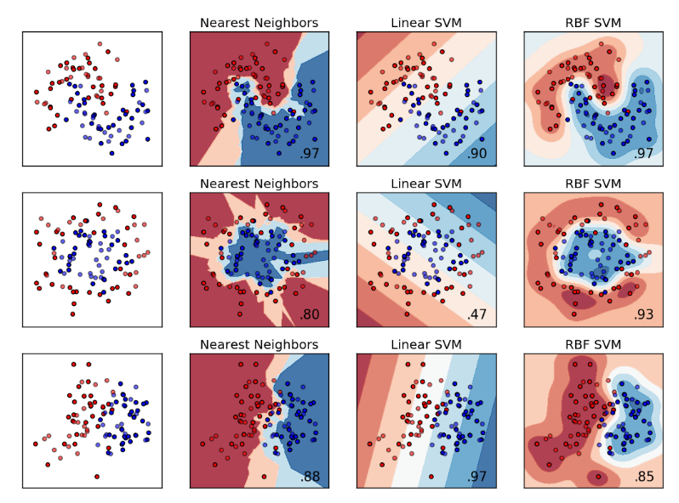
Statistical Challenges in Big Data
To handle the challenges of Big Data, we need new statistical thinking and appropriate computational methods.
When the number of variables grow, the number of fake correlations also grow. Spurious correlation may cause false scientific discoveries and wrong statistical inferences.
When testing many hypotheses, we must correct for multiple testing. Classic hypothesis tests are designed to call a set of data significant 5% of the time, even when the null is true.
If the statistical modeling assumptions are not satisfied then the model parameters are biased with inaccurate test statistics that leads to invalid statistical inferences

Slide 7

Statistical Challenges in Big Data
To handle the challenges of Big Data, we need new statistical thinking and appropriate computational methods.
Sampling from big dynamic data different from sampling finite populations, requiring new sampling algorithms; e.g., sampling from social networks.
With big data, problems such as sampling bias, missing or incomplete data and sparsity must also be addressed.
The abundance of observations allows to apply very complex statistical techniques, ensemble - multistage, impossible to apply with small data sets.
The assessment of the model reliability can be performed, often, with a good accuracy

Slide 8
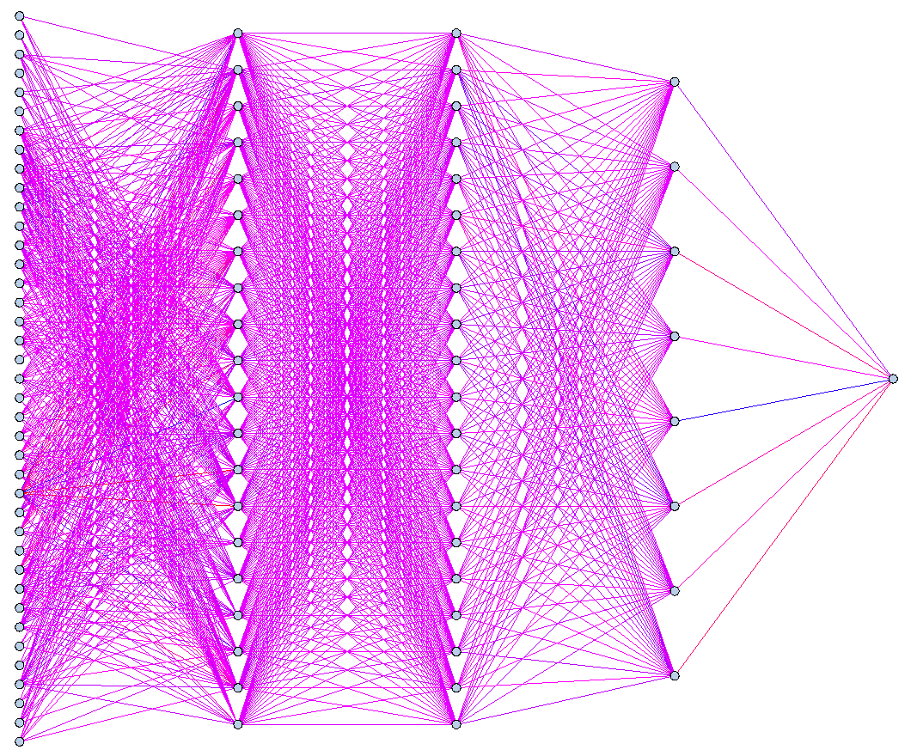
Statistical Methods for Big Data
Neural network modeling does not require any distributional assumptions between the input variables and the target variables. Most interesting NN (used by Google and Facebook) are Convolutional NN, Recurrent NN.
Ensemble learning. The idea is that by averaging (or majority voting) several prediction algorithms you can reduce variability without giving up bias: Bagging, Boosting, Random Forests, …
Multistage stacking. It is a more complex ensemble approach, with the addition of one or more stages of analysis and with a very large number of models. It is the most effective approach in the competitions.

Slide 9
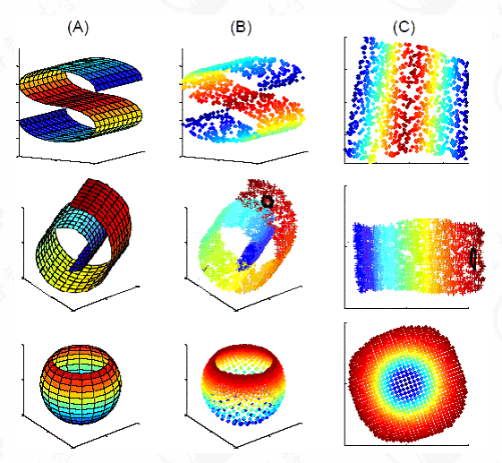
Dimensionality reduction
Analyzing a database of millions of observations is not impossible for existing statistical methods (e.g., by sampling the units).
With thousands of features, the number of input features should be reduced before a machine-learning algorithm can be successfully applied.
Automatic statistical methodologies may be required to provide fast, even real-time, analysis of big data, which would require parsimonious models.

Slide 10


Dimensionality reduction
Exploiting redundancies in the input data, creating a smaller set of new features (feature extraction).
  Visualize high-dimension data;
  Recover the intrinsic dimension of data;
  Reduce big data to manageable dimensions.
Maintaining only the most significant features from the original dataset (feature selection). (Supervised)
  Learn a target function, where certain features are irrelevant;
  Reduce big data to manageable dimensions;
  Simplify the model of the data to obtain a better interpretation;
  Improve predictor performance;
Dimensionality reduction can be performed in two different ways.
Original image: 3850x3850
rebuilt by PCA with 50 comp | rebuilt by CUR with 500 rows/columns

Slide 11
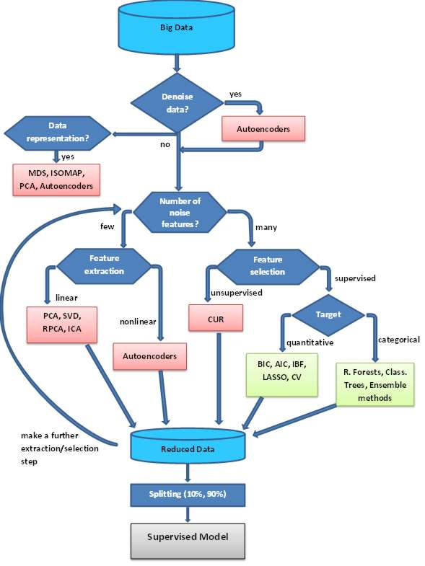
data preparation
raw data
A big-data analytics
process

Slide 12
Conclusion
Big data will be more and more big in the future.
The analysis of big data can be approached in several ways, but the underlying problem remains a statistical problem.
Learning methods for big-data are analytical methods that generalize and adapt the classical statistical methods to new large data sets.
The underlying problems, in many respects, remain the same, although with different emphasis.
Big-data analysis require the ability to assess the effectiveness of the model with a non-classical inferential approach that take advantage of the large amount of data available.
There is no need to distinguish Big Data analytics from data analytics, as data will continue growing, and it will never be small again …. (Fan & Bifet)

