Slide 1

Modernisation Lab – Focussing on Modernisation
Strategies in Europe: some NSIs’ experiences
Modernisation in focus – building an Enterprise Architecture & further standardising the integrated metadata system
Csaba Ábry | Hungarian Central Statistical Office

Slide 2
Outline
Modernisation in focus – building an Enterprise Architecture & further standardising the integrated metadata system
New structure of the Enterprise Architecture (EA) model of the HCSO as one of the key methodological development
Highlighting where relevant improvement actions take place concerning the Integrated Metainformation System (IMS) of the HCSO

Slide 3
Introduction (1)
Modernisation in focus – building an Enterprise Architecture & further standardising the integrated metadata system
Strategic goals:
  Revision of the Business, Information, Application Architectures
  Elaboration of the Enterprise Architecture
  Further standardising the IMS
Driving force behind this action:
  to support the efficient cooperation between NSIs (by using international standards: CSPA, GAMSO, GSBPM, GSIM)
  to overview the processes and objects
  to support methodological standardisation (e.g. quality guidelines, methodological handbook)

Slide 4
Introduction (2)
Modernisation in focus – building an Enterprise Architecture & further standardising the integrated metadata system
Current situation at the HCSO
Business, Information, Application Architecture have a long history due to the IMS of the HCSO
IMS of the HCSO supports the statistical and supporting activities with metadata-driven IT applications.
Elaboration of the EA in the framework of a project (27 project members, divided into 7 working subgroups)
Development projects end: 2020 Q4 (planned)

Slide 5
Definition of the EA
Modernisation in focus – building an Enterprise Architecture & further standardising the integrated metadata system
Enterprise architecture (EA) is
a discipline for proactively and holistically leading enterprise responses to disruptive forces by identifying and analyzing the execution of change toward desired business vision and outcomes.
EA delivers value by presenting business and IT leaders with signature-ready recommendations for adjusting policies and projects to achieve target business outcomes that capitalize on relevant business disruptions.
EA is used to steer decision making toward the evolution of the future state architecture.
Source: http://www.gartner.com/it-glossary/enterprise-architecture-ea/

Slide 6
Metadata driven, integrated statistical system
Modernisation in focus – building an Enterprise Architecture & further standardising the integrated metadata system
The metadata system is a sub-system of the statistical system (basically the whole EA), which aims are:
to give information on the content and quality of data or on the methods of data production to the users (both external and internal)
to support, document the work of persons engaged in data processing
to support automation and integration of statistical data production (business and supporting processes) and operation

Slide 7
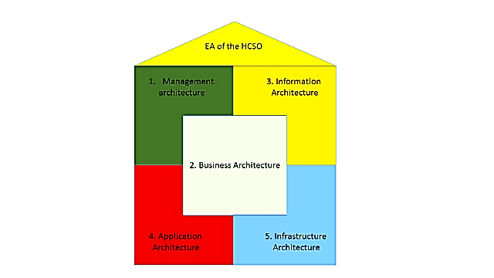
New Enterprise Architecture Model of the HCSO
Modernisation in focus – building an Enterprise Architecture & further standardising the integrated metadata system

Slide 8
Management Architecture
Modernisation in focus – building an Enterprise Architecture & further standardising the integrated metadata system
Definition:
The MA ‘describes and defines the activities that take place
within a typical statistical organization. It extends and
complements the Generic Statistical Business Process Model
(GSBPM) by adding additional activities needed to support
statistical production’ (UNECE, GAMSO ver. 1.0. description)
International standard to be used:
Generic Activity Model for Statistical Organisations (GAMSO)

Slide 9
Business Architecture
Modernisation in focus – building an Enterprise Architecture & further standardising the integrated metadata system
Definition:
‘Business Architecture covers all the activities undertaken
by a statistical organization, including those undertaken
to conceptualize, design, build and maintain information
and application assets used in the production of statistical
outputs. Business Architecture drives the Information,
Application and Technology architectures for a statistical
organization.’
(UNECE, CSPA ver. 1.1. description)
International standard to be used:
Generic Statistical Business Process Model (GSBPM ver 5.0) –
national version (ESTFM)

Slide 10
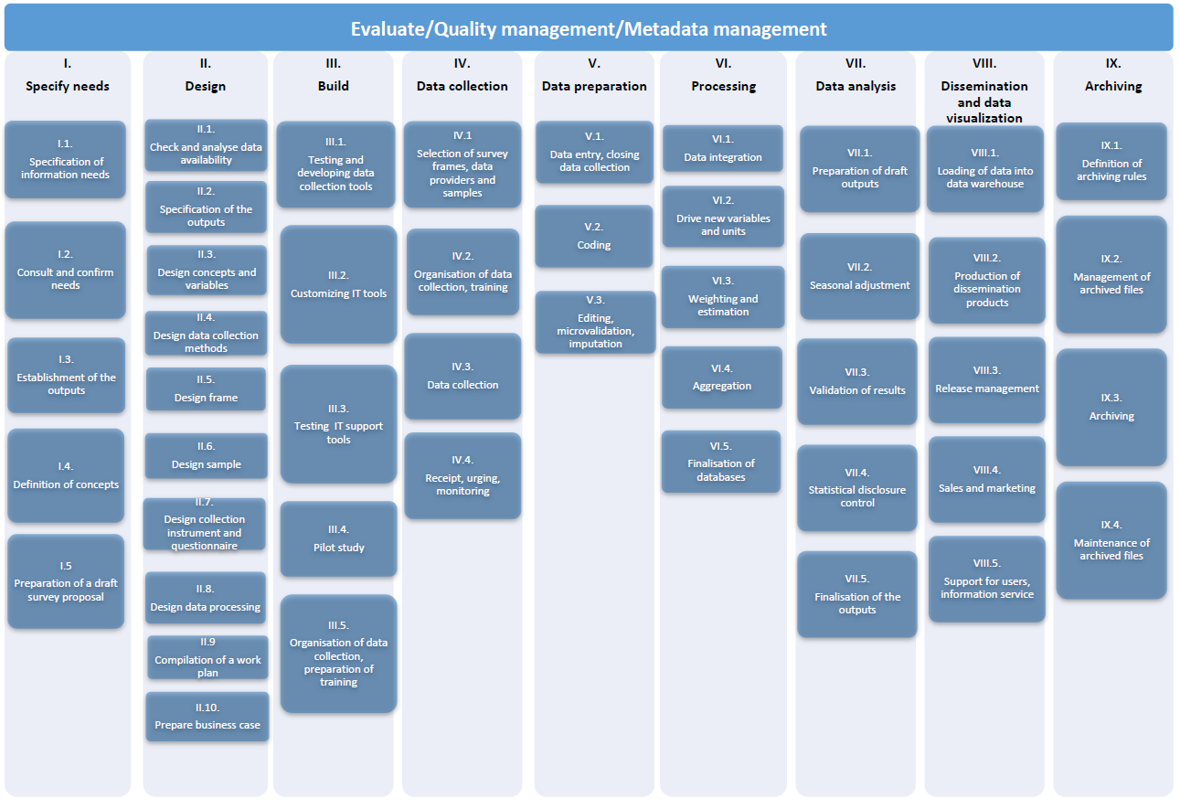
Business Architecture and metadata
Modernisation in focus – building an Enterprise Architecture & further standardising the integrated metadata system

Slide 11
Information Architecture
Modernisation in focus – building an Enterprise Architecture & further standardising the integrated metadata system
Definition:
‘Information Architecture (IA) classifies the information and
knowledge assets gathered, produced and used within the
Business Architecture. It also describes the information
standards and frameworks that underpin the statistical
information. IA facilitates discoverability and accessibility,
leading to greater reuse and sharing.’
(UNECE, CSPA ver. 1.1. description)
International standard to be used:
Generic Statistical Information Model (GSIM) – for mapping

Slide 12
Information Architecture and metadata (1)
Modernisation in focus – building an Enterprise Architecture & further standardising the integrated metadata system
Statistical domains
reconsidering the List of Statistical Domains from the point of view of the whole National Statistical System
description of the statistical domains will be upgraded according to the Single Integrated Metadata Structure (SIMS 2.0)
Data sources
the description of the data sources will be updated using the widespread international standard of the Data Documentation Initiative (DDI 2.5)
Legal base
in depth review and expansion will be carried out

Slide 13
Information Architecture and metadata (2)
Modernisation in focus – building an Enterprise Architecture & further standardising the integrated metadata system
Concepts
supervision about consistency and cross-references
to clarify key definitions and concepts for official statistics
Nomenclatures and classifications
Nomenclatures:
  setting principles for establishing new nomenclatures
  driving factors for processing systems
Classifications:
  the last improvement is connected to the revision of NACE, CPA in 2008 - new database
  changes are easy to follow up

Slide 14
Information Architecture and metadata (3)
Modernisation in focus – building an Enterprise Architecture & further standardising the integrated metadata system
Measures (indicators, variables)
further integration - operations and connections between varieties of measures
more measures should be visible on the website
Statistical registers
the description of the ‘statistical registers’ will be also updated using the widespread international standard of the Data Documentation Initiative (DDI 2.5)
national statistical law is expected to change - clarify the concept of ‘statistical register’ and will declare which metadata has to be published

Slide 15
Application Architecture (1)
Modernisation in focus – building an Enterprise Architecture & further standardising the integrated metadata system
Definition:
‘Application Architecture (AA) classifies and hosts the
individual applications describing their deployment,
interactions, and relationships with the business processes
of the organization (e.g. estimation, editing and seasonal
adjustment tools, etc.). AA facilitates discoverability and
accessibility, leading to greater reuse and sharing. ’
(UNECE, CSPA ver. 1.1. description)
As there are no international standards for describing this
architecture, therefore this architecture will be described
according to the present practices of the HCSO.

Slide 16
Application Architecture (2) - Classification of main IT applications by function
Modernisation in focus – building an Enterprise Architecture & further standardising the integrated metadata system

Slide 17
Infrastructure Architecture
Modernisation in focus – building an Enterprise Architecture & further standardising the integrated metadata system
Definition:
The Infrastructure Architecture ‘describes the infrastructure
technology underlying (supporting) the other architecture
perspectives’ (UNECE, CSPA ver. 1.1. description).
As there are no international standards for describing this
architecture, therefore this architecture will be described
according to the present practices of the HCSO.

Slide 18
Summary
Modernisation in focus – building an Enterprise Architecture & further standardising the integrated metadata system
Standard processes
Standard product list
Process-oriented operation of the statistical activity, supported by the top-management
Keeping the metainformation system integrated
Keeping everything metadata-driven
International standards are seem to be adaptable in HCSO’s environment

Slide 19
Next steps
Modernisation in focus – building an Enterprise Architecture & further standardising the integrated metadata system
Implementation of the international standards
Elaborating and implementing the EA in the HCSO
Review of the quality guidelines
Elaborating methodological handbook
On a longer term conduction of an analysis mapped against the model (discovering white spots and areas to be modified)
Launching the overview of the IMS and standard-based improvement of the sub-systems of the HCSO

Slide 20
Grazie per l'attenzione!
Modernisation in focus – building an Enterprise Architecture & further standardising the integrated metadata system
Csaba Ábry
Statistical advisor
Methodology Department
Metainformation Section
1024 Budapest, Keleti Károly u. 5-7. Hungary
 (+36-1) 345-6517
 (+36-1) 345-6681
csaba.abry@ksh.hu
www.ksh.hu

