Slide 1

Modernisation Lab – Focussing on Modernisation
Strategies in Europe: some NSIs’ experiences
Innovation at Statistics Netherlands
Barteld Braaksma| CBS (Statistics Netherlands)

Slide 2
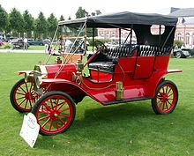
Contents
Innovation at Statistics Netherlands
Trends in society
The CBS Strategic Agenda
Some examples
Innovation Lab and Innovation Programme
Lessons learned/way forward
“I see no advantage in these new clocks. They run no faster than the ones made 100 years ago.”
Henry Ford

Slide 3
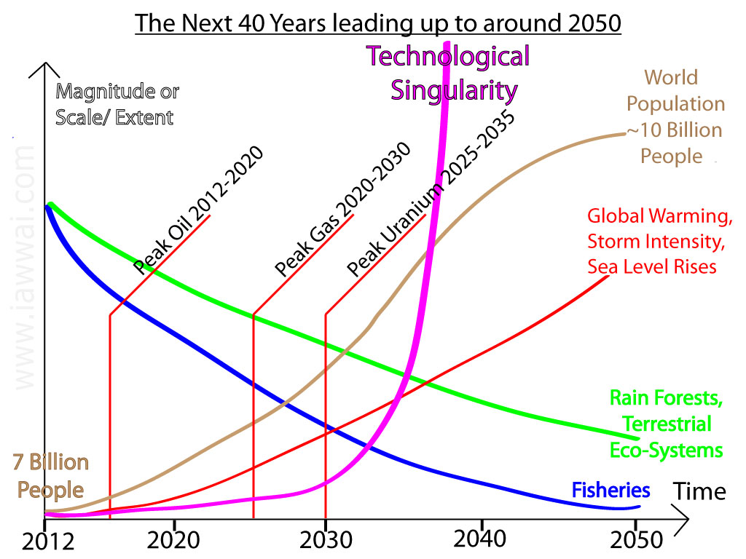

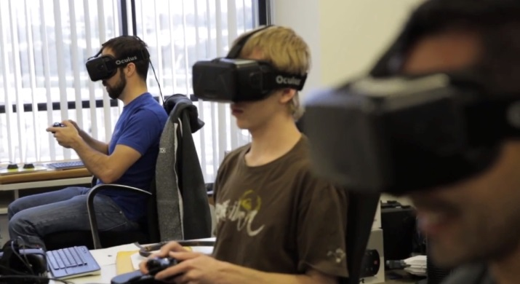

Trends in society
Innovation at Statistics Netherlands
New technologies
  Mobile devices, big data, machine-to-machine
New expectations
  Social media, interactivity, open data
New challenges
  Globalisation, sustainability, smart cities

Slide 4
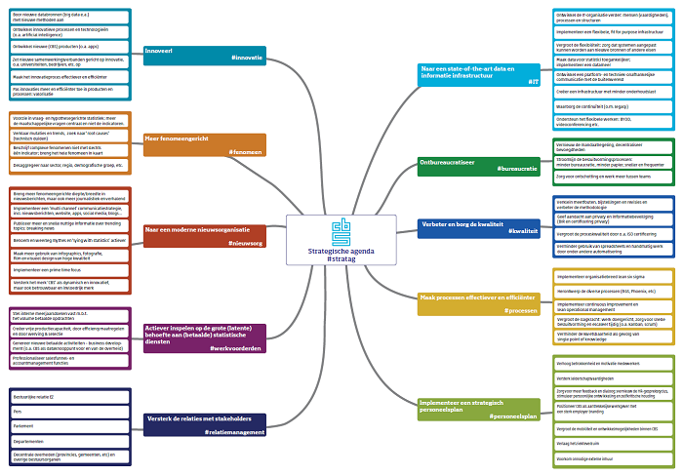
The CBS
Strategic
Agenda
Innovation at Statistics Netherlands
Be innovative!
State-of-the art data and information structure
More phenomenon-oriented
Cut the red tape!
Towards a modern news organisation
Improve and secure quality
Make processes more effective and efficient
Respond to the demand for statistical services
Strengthen relationship with stakeholders
Implement a strategic HRM plan

Slide 5

Some examples
Innovation at Statistics Netherlands
Ice Rain in January 2016
Data Camp at Twente University
Data Collection with Tablets
Blaise 5
Revamped Communication and CBS-Live
Interactive Happiness Meter
Dashboards
Infographics
All related to #stratag
Last November,
CBS was elected
best government organisation
of the year 2015

Slide 6

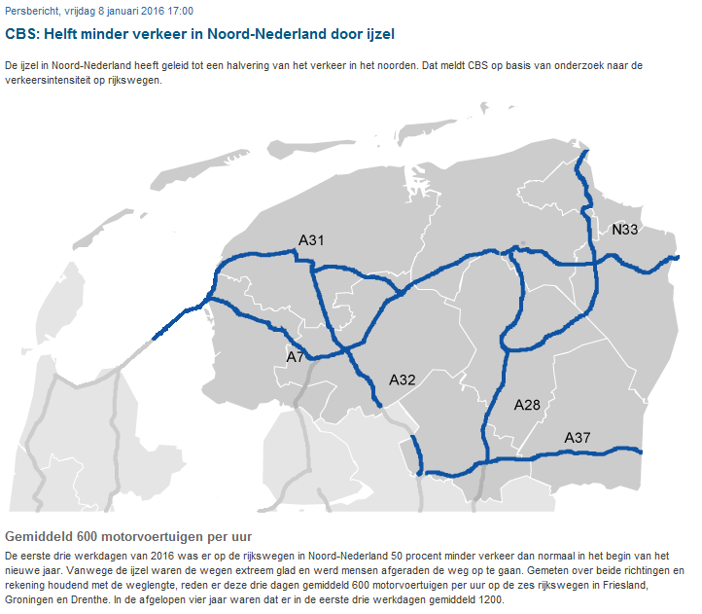
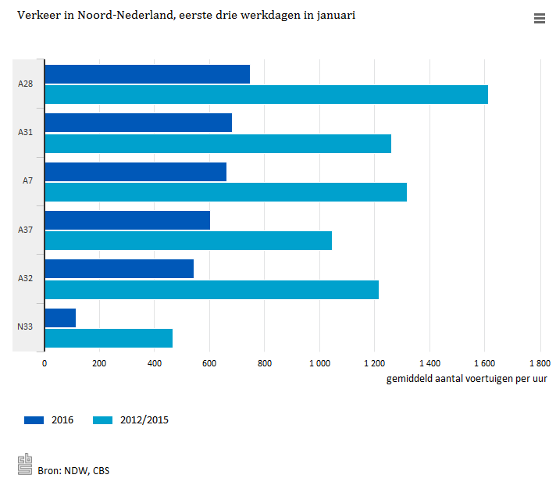
Ice Rain Effects in January 2016
Innovation at Statistics Netherlands
#innovatie #nieuwsorg #IT %processen
First three working days of 2016:
Ice rain in North of the Netherlands
Huge effect on traffic
Press release on Friday 8 January (!)
Based on big data source:
Traffic sensors in roads
(60 thousand sensors in NL, 100 TB of data)

Slide 7
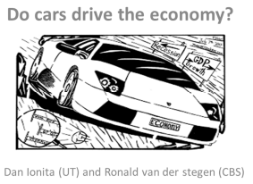
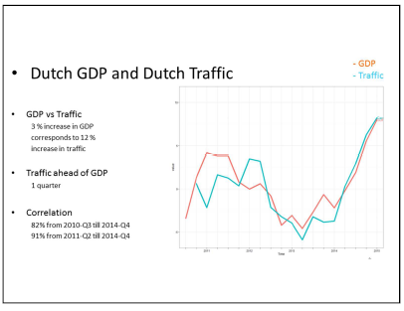
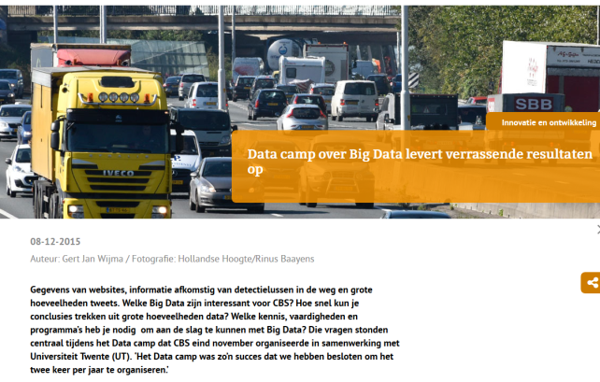
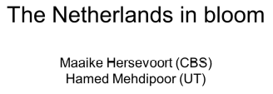
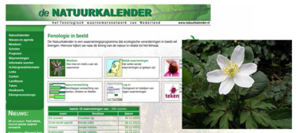
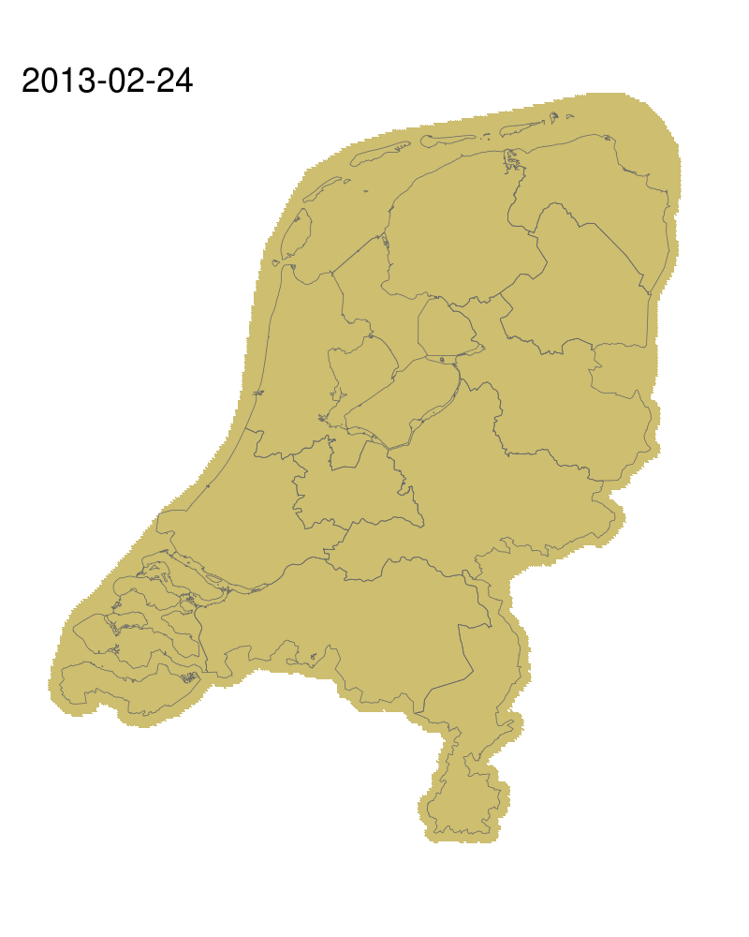

Data Camp at Twente University
Innovation at Statistics Netherlands
#innovatie #fenomeen #nieuwsorg #relatiemanagement #IT #personeelsplan
Main goal: introduce CBS staff to big data methods
Last week of November 2015
Ten CBS researchers paired to Twente PhD students
Support from experienced senior researchers
Surprising results…
We can’t do it alone!

Slide 8

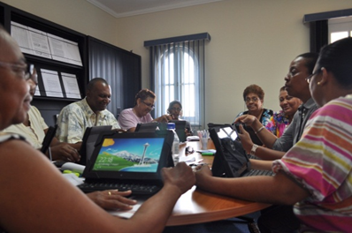
Data Collection with Tablets in Caribbean NL
Innovation at Statistics Netherlands
#innovatie #IT #processen
Lots of opposition at first (early 2014)
“We don’t know anything about tablets”
“We don’t want to use Android”
“What about data protection?”
“This is too risky, I don’t want to be part of this”
  However this did not stop us…
  Now tablets are a huge success!
With
    Limited time
    Limited resources
    Limited experience
  We
    Improved efficiency
    Promoted quality
    Generated enthusiasm
  “Yes we can”

Slide 9
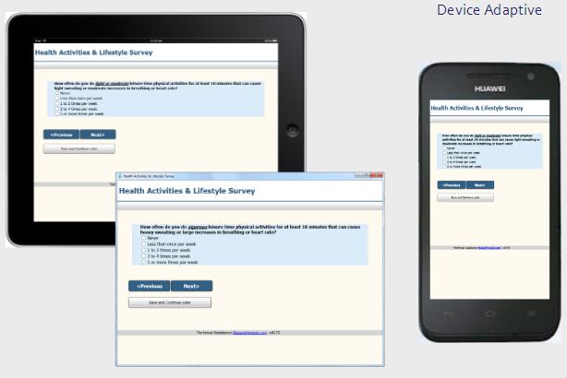
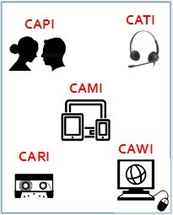


Blaise 5
Innovation at Statistics Netherlands
#innovatie #IT #processen
First version 30 years ago
Surveys still relevant…
Whilst making use of modern technologies
(multi-mode, multi-platform, multi-device)

Slide 10



Revamped Communication and CBS-Live
Innovation at Statistics Netherlands
#innovatie #fenomeen #nieuwsorg #relatiemanagement #personeelsplan
Press releases now at 7 am and 4 pm
Strengthened connections with subject matter areas
More interpretation
Increased social media presence
Corporate news app
New ‘CBS-Live’ environment
Newsroom right at the entrance
Own TV studio

Slide 11

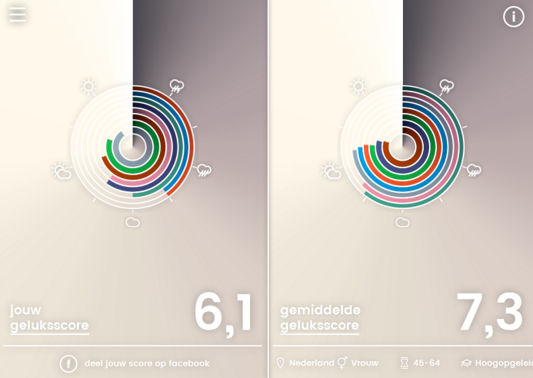

Interactive Happiness Meter
Innovation at Statistics Netherlands
#innovatie #fenomeen #nieuwsorg #IT #bureaucratie
(Re)launched on 20 March 2016
(international day of happiness)
Developed together with start-up Wayform
Approach/technique re-useable
Interest from national TV and newspapers
http://www.cbs-geluksmeter.nl/
Personal happiness score

Slide 12
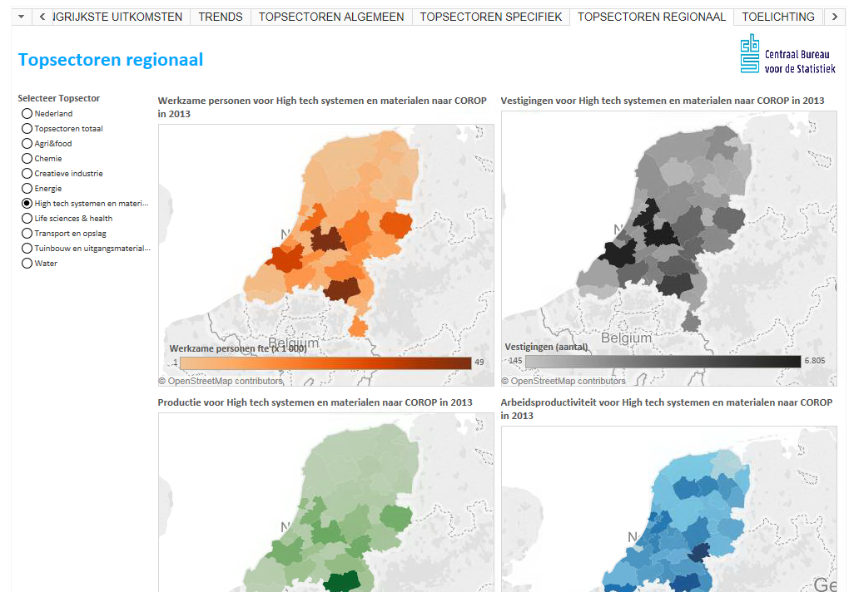
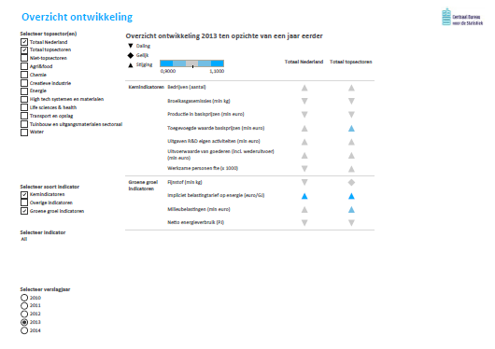
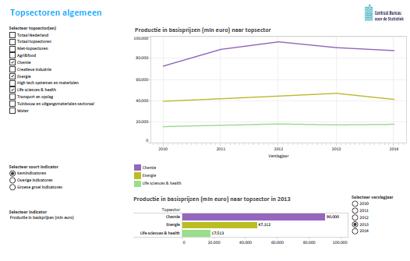
Dashboards for Economic Top Sectors
Innovation at Statistics Netherlands
#innovatie #fenomeen #werkvoorderden #relatiemanagement #IT
Commissioned by Ministry of Economic Affairs
Contains 40 indicators; replaces two reports
Support from TNO, using Tableau software
Available here (or search for: “Tableau Topsectoren”

Slide 13
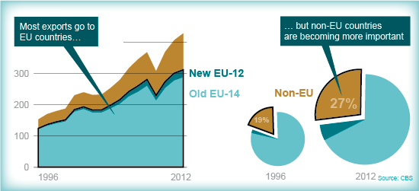
Infographics
Innovation at Statistics Netherlands
#innovatie #fenomeen #nieuwsorg #bureaucratie
… and two-thirds of Dutch exports go to the 14 countries that have been EU members the longest, many of which are located close to the Netherlands and have large economies. However, countries outside the EU are becoming increasingly important for the Netherlands ...
Innovation programme
financed external illustrator
accompanied creation process

Slide 14
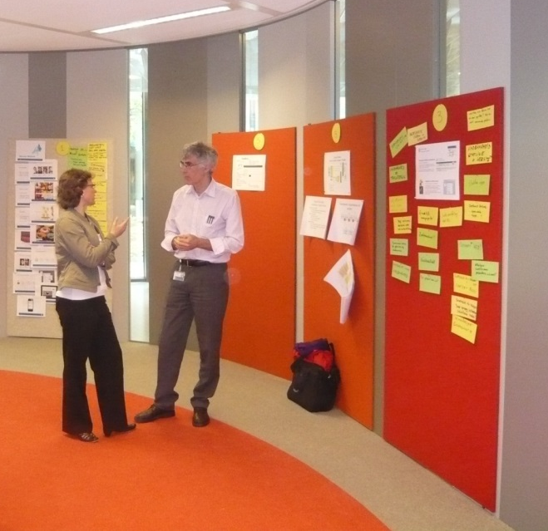
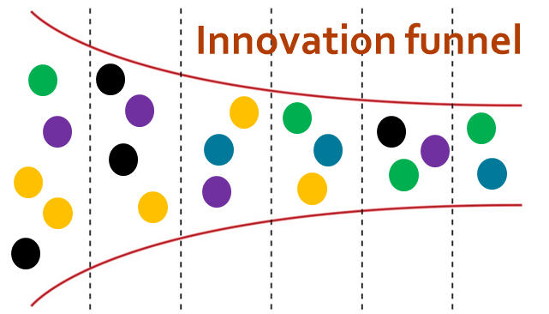
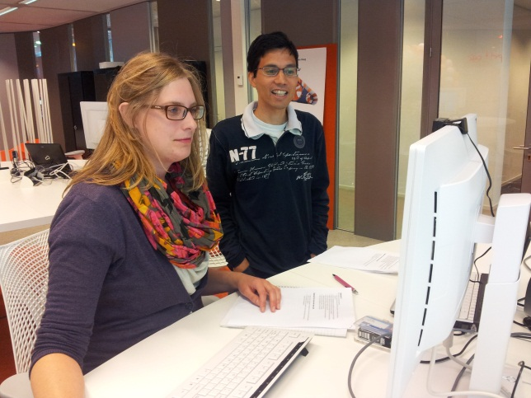
Innovation Lab and Innovation Programme
Innovation at Statistics Netherlands
The best way of having a good idea is to have a lot of ideas
Innovation Programme
Limited paperwork
Just do it!
Welcome the unexpected
Since 2012: 150 ideas, 70 PoCs, 20 implementations
Our Innovation lab is used a lot!
- State-of-the-art equipment + big data rooms
- Brainstorming and working together
Innovation Lab
Big data PCs

Slide 15

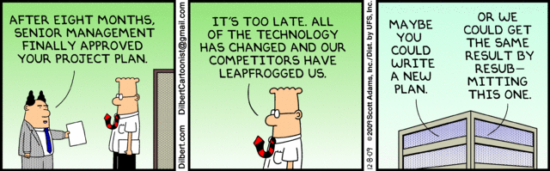

Lessons Learned/Way forward
Innovation at Statistics Netherlands
Be open and agile
Join forces
Organise innovation
Trends in society force us to speed up modernisation
This will be challenging, and we cannot do it alone
Focus on innovation is essential
(even in times of budget cuts!)
Assure strong support by top management
Make the business owners responsible
Offer a safe environment for experimentation
Maintain coherence and focus

