Slide 1

Modernisation Lab – Focussing on Modernisation
Strategies in Europe: some NSIs’ experiences
Modernisation in focus – Data collection methodologies and better use of administrative data sources for production of official statistics
Zoltán Vereczkei| Hungarian Central Statistical Office

Slide 2
Outline
Modernisation in focus – Data collection methodologies and better use of administrative data sources for production of official statistics
Modernisation activities of the HCSO focusing on:
Overview of highlighted modernisation activities of the data collection system of the HCSO
Modernisation concerning the use of administrative datasets for official statistics, with focus on the new integrated data transmission system for secondary data sources (called: KARÁT)
Modernisation of administratve dataset-related activities
Lessons learnt and value added from HCSO perspective
Following slides have been partly used from other presentations of:
Ildikó Györki
Ildikó Szűcs
Csaba Ábry

Slide 3
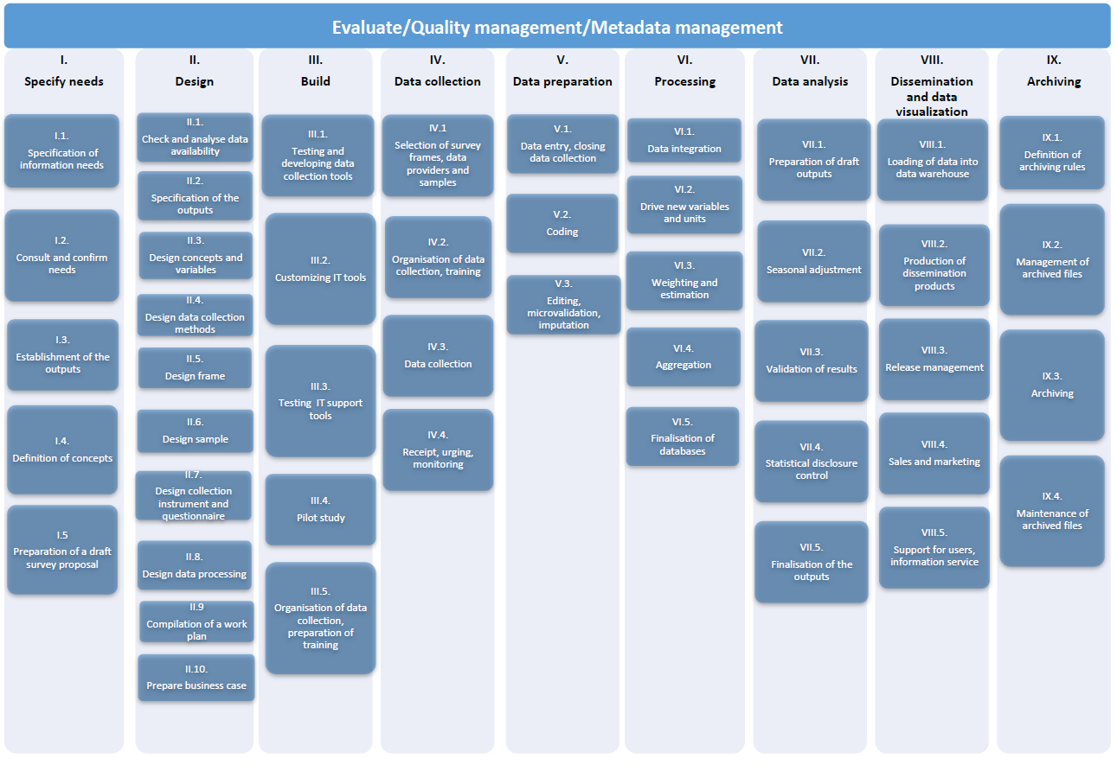
Statistical
Business
Process
Modell of the HCSO
(ESTFM)
GSBPM v4.0-based
(currently revised to
GSBPM v5.0-based modell)
Modernisation in focus – Data collection methodologies and better use of administrative data sources for production of official statistics

Slide 4


Data Collection System of the HCSO
Modernisation lines
Modernisation in focus – Data collection methodologies and better use of administrative data sources for production of official statistics
Data collection tool: ELEKTRA / GÉSA
Data preparation tool: ADÉL
Modernisation #1: methodological framework for
microvalidation and editing (DESIGN)
Modernisation #2: standardisation of data collection
methodologies for business surveys (PLAN)
Business surveys
Primary sources
Data collection tool: CAWI, CAPI / LAKOS
Data preparation tool: ADÉL
Modernisation: standardisation of data collection
methodologies for household surveys
(DESIGN & IMPLEMENTATION)
Household surveys
Data
Collection
Administrative data sources
See next slides for details!
Secondary sources
Other secondary data sources (Big Data & other secondary)
Modernisation: ongoing & planned methodological pilots
(webscraping, camera data, online cashier data,
job vacancies)

Slide 5
Modernisation in focus: use of administrative data for statistical purposes
Modernisation in focus – Data collection methodologies and better use of administrative data sources for production of official statistics
Main results, outputs
KARÁT: new integrated IT tool to receive administrative datasets from the owners of administrative data
ADAMES: new integrated IT tool for data preparation, specifically dedicated to administrative datasets (microvalidation & editing)
Development and implementation of new methodology for the assessment of already used and potential administrative datasets for the purposes of official statistics
New handbook focusing on the use of administrative datasets for statistical purposes
Ongoing and planned methodological pilots focusing on multisource statistics
Standardisation of cooperation agreements with administrative data owners (including detailed metainformation and input quality assessment)
Modernisation of the use of administrative data sources is one of the top priorities of the HCSO.
Modernisation activities of methodologies, IT tools, procedures and other tools are in most cases coordinated by the Methodology department of the HCSO.

Slide 6
KARÁT main objectives of development
& main characteristics
(implemented since 2015)
Modernisation in focus – Data collection methodologies and better use of administrative data sources for production of official statistics
Objectives
Secure channels for the transmission of the datasets;
Documentation of secondary sources;
Documentation of data transmissions;
Formal control and check of the transmitted data;
Loading data into database;
Archiving data;
Supporting data providers with proactive functions
Characteristics
General
Secure channel / standardised processes
Metadata-driven / integrated into Application architecture of the HCSO
Process-driven
Logged / Monitoring functions
Standardised documentation system

Slide 7
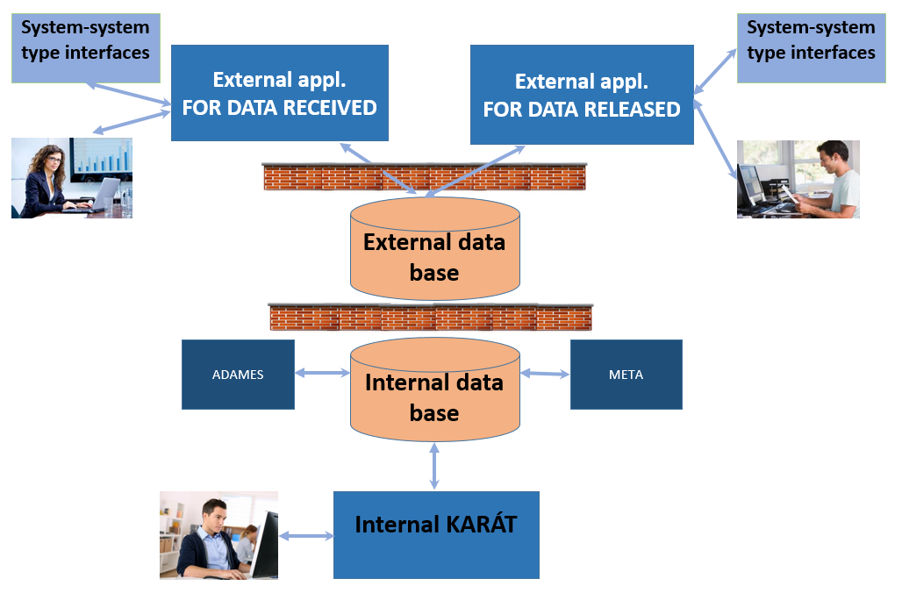
KARÁT operating environment
Modernisation in focus – Data collection methodologies and better use of administrative data sources for production of official statistics

Slide 8
KARÁT quality control of administrative datasets received
Modernisation in focus – Data collection methodologies and better use of administrative data sources for production of official statistics
Paradata
Status information;
Dates of creation and deadlines for the data transmission tasks;
Channel of transmission;
Size and type of transmitted datasets;
Urging of data providers;
Cause of missing data transmission.
Quality indicators computed by KARÁT
Quality indicators on secondary data sources;
Indicators on the quality of data transmission processes;
Indicators on the respondent burden.

Slide 9
ADAMES
Integrated data preparation system for secondary data sources
(as part of the
Application Architecture of the HCSO)
Modernisation in focus – Data collection methodologies and better use of administrative data sources for production of official statistics

Slide 10
Methodology for the assessment of already used and potential administrative datasets for the purposes of official statistics
Modernisation in focus – Data collection methodologies and better use of administrative data sources for production of official statistics
Objectives
Provide a common methodology on how to assess the administrative datasets for the purposes of official statistics;
Scope:
  (1) Administrative datasets that are already in use (extend the scope)
  (2) Administrative datasets that are not in use (determine if the data source is a real potential source for official statistics)
Provide a database that contains information on administrative datasets (both potential and already in use) that is the basis for regular assessments;
Make it integral part of the business process;
Summary overview report will be provided by 2017 Q2 (Peer Review improvement action)
Methodology is based on a previously developed methodology within the HCSO (based on Hungarian experiences). Refinement in line with the ESS.VIP ADMIN Vision 2020 project: ESSnet on quality of multisource statistics

Slide 11
Cooperation agreements standardisation of the current solutions with focus on KARÁT information, metainformation and quality
Modernisation in focus – Data collection methodologies and better use of administrative data sources for production of official statistics
Objectives
Have a standard cooperation agreement template and procedure in place for the HCSO;
Have 4 main parts:
  (1) Legal agreement text (not updated regularly)
  (2) Yearly work programme (updated yearly – also provide input for the KARÁT planning)
  (3) Metadata descriptions (data structure definitions as well)
  (4) Quality information on the input files received (standard quality report template is developed)
Planned to be available by 2016 Q3
Cooperation with all administrative data owners will be renewed based on the common template

Slide 12
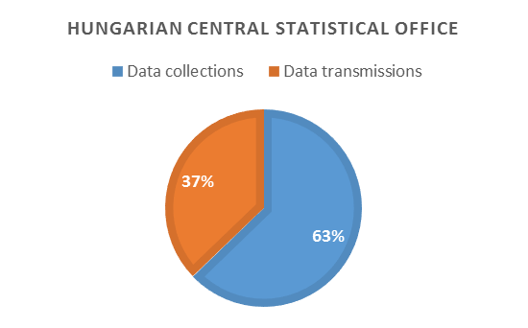
Modernisation in focus – Data collection methodologies and better use of administrative data sources for production of official statistics
Summary
Statistics on statistics
Source: Statistical Data Collection Programme (OSAP) for 2017
Use of administrative data sources for official statistics in Hungary
Proportion of secondary data sources used by the National Statistical System of Hungary is increasing year by year
Quarter of all data sources are used from secondary data sources in 2017
Hungarian Central Statistical Office
Cca 40.% of the data sources used by the HCSO are from data transmissions
Data transmissions include use of administrative data sources (most of them are already covered by the KARÁT system)
KARÁT planned to reach full coverage for all administrative data sources in 2017
Members of the National Statistical Service of Hungary | Data collections |  |  |  | Data transmissions
 | new | modified | unchanged | SUM | new | modified | unchanged | SUM
Hungarian Central Statistical Office | 5 | 11 | 114 | 130 | 1 | 5 | 71 | 77
Other members of the Hungarian NSS | 0 | 21 | 118 | 139 | 0 | 1 | 19 | 20
Sum | 5 | 32 | 232 | 269 | 1 | 6 | 90 | 97

Slide 13
Lessons learnt & current state-of-the-art of use of administratve datasets for the purposes of official statistics
Modernisation in focus – Data collection methodologies and better use of administrative data sources for production of official statistics
Summary
The HCSO invested large amount of resources into developing a standard integrated solution for the transmissions of administrative datasets to the HCSO for the purposes of official statistics.
The results are satisfying; systems are integrated into the architecture of the HCSO.
Several methodological and operational standardisation activities accompany the development of the KARÁT system.
Many additional modernisation programmes and activities are still ongoing in this area.
Lessons learnt
The modernisation has significantly increased the integrated use of administrative datasets for statistical purposes
The new solutions has been developed to be fully compatible with the integrated metadata-driven application architecture of the HCSO, which is a key value added
The modernisation has opened up other areas where further methodological standardisation is required. These activities are now ongoing.
Awareness and satisfaction of the owners of the administrative data is constantly increasing

Slide 14
Grazie per l'attenzione!
Modernisation in focus – Data collection methodologies and better use of administrative data sources for production of official statistics
Zoltán Vereczkei
Deputy Director of Methodology
Methodology Department
Sampling and Methodology Section
1024 Budapest, Keleti Károly u. 5-7. Hungary
 (+36-1) 345-6541
 (+36-1) 345-6681
zoltan.vereczkei@ksh.hu
www.ksh.hu

