Slide 1
Studying Migrations Routes:
New data and Tools
Rome, 16/06/2016
Assessment of the refugee camps extension
with optical satellite images
Alessandro Cimbelli
Istat - Italian Institute of Statistics

Slide 2
Studying Migrations Routes: New data and Tools
Goals
Automatically assess the number of tents at a certain date
Use free satellite data (Google Earth) and open source software (QGIS)
Test the tools for object recognition inside QGIS
Compare the results with information from the web
Fast and easy processing
Notes:
Geonames: eight million placenames, multilanguage, attributes, geographic coordinates, used in Inspire geoportal http://inspire-geoportal.ec.europa.eu/discovery/
GADM spatial dataset on Global Administrative Areas 556,049 low level subdivisions, countries and lower level subdivisions such as provinces, departments, counties, …, available as shapefile

Slide 3
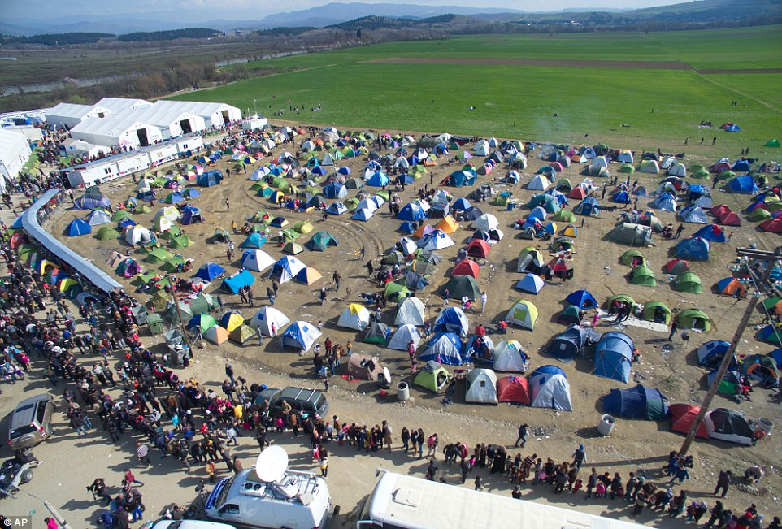
Studying Migrations Routes: New data and Tools
Notes:
Geonames: eight million placenames, multilanguage, attributes, geographic coordinates, used in Inspire geoportal http://inspire-geoportal.ec.europa.eu/discovery/
GADM spatial dataset on Global Administrative Areas 556,049 low level subdivisions, countries and lower level subdivisions such as provinces, departments, counties, …, available as shapefile

Slide 4
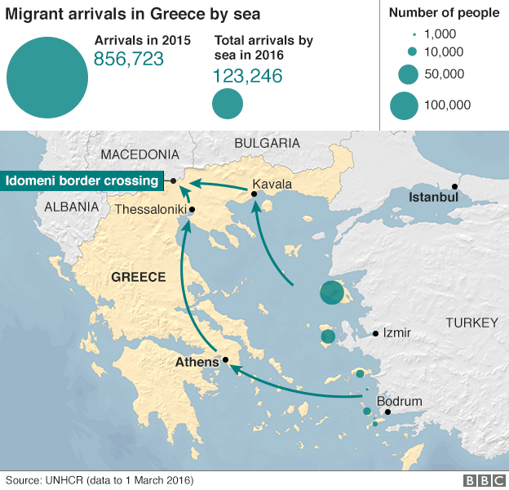
Studying Migrations Routes: New data and Tools
Notes:
Geonames: eight million placenames, multilanguage, attributes, geographic coordinates, used in Inspire geoportal http://inspire-geoportal.ec.europa.eu/discovery/
GADM spatial dataset on Global Administrative Areas 556,049 low level subdivisions, countries and lower level subdivisions such as provinces, departments, counties, …, available as shapefile

Slide 5
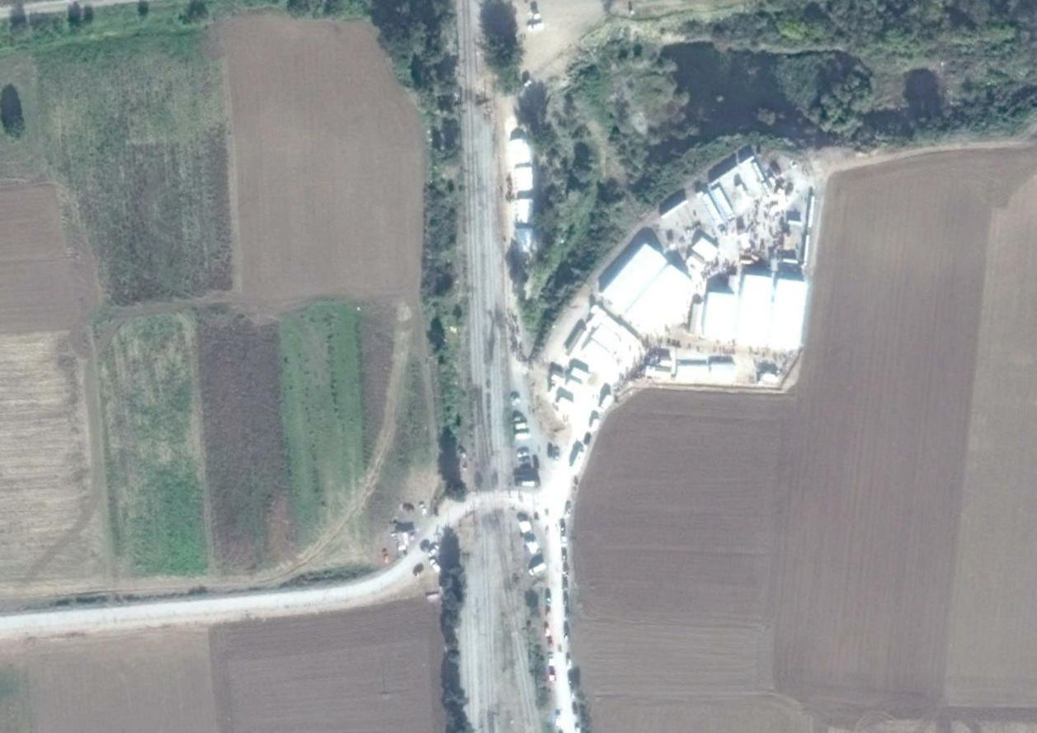
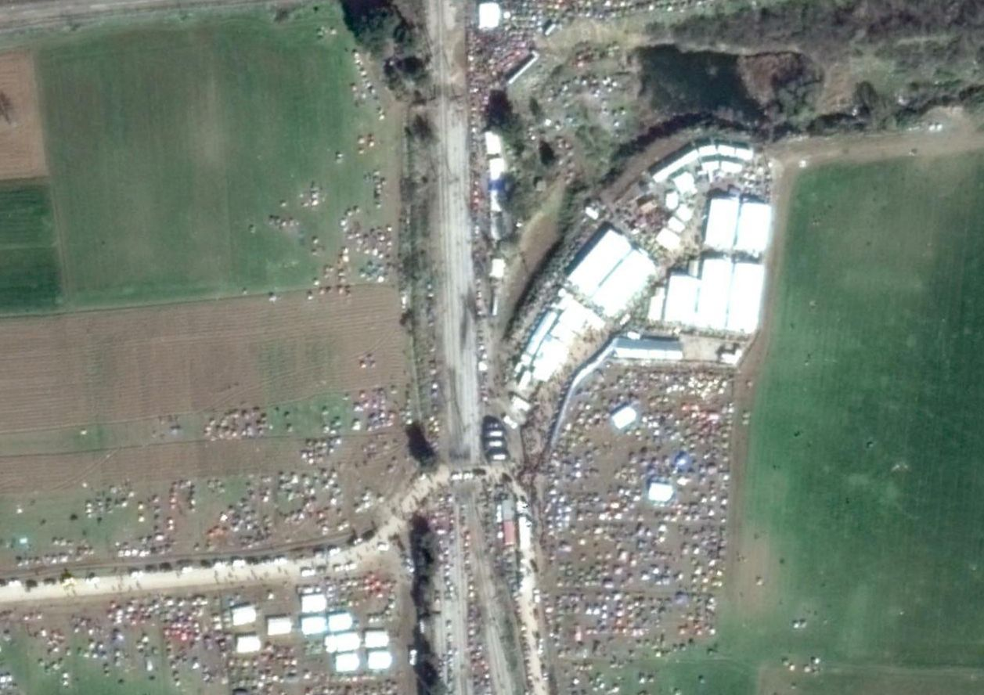
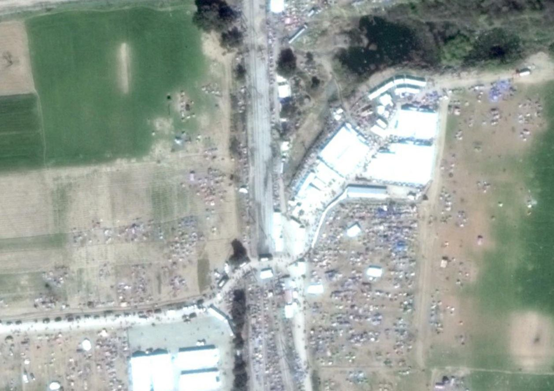
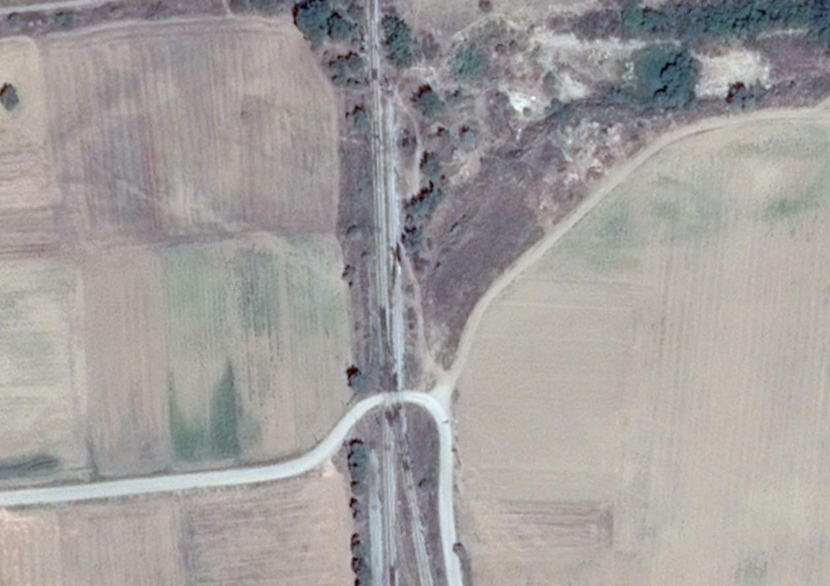
Studying Migrations Routes: New data and Tools
Idomeni
21/10/2014
07/11/2015
05/03/2016
30/03/2016
Notes:
Geonames: eight million placenames, multilanguage, attributes, geographic coordinates, used in Inspire geoportal http://inspire-geoportal.ec.europa.eu/discovery/
GADM spatial dataset on Global Administrative Areas 556,049 low level subdivisions, countries and lower level subdivisions such as provinces, departments, counties, …, available as shapefile

Slide 6
Studying Migrations Routes: New data and Tools
Process
Image georeferencing
Segmentation “meanshift”
Zonal statistics
Geometric information
Notes:
Geonames: eight million placenames, multilanguage, attributes, geographic coordinates, used in Inspire geoportal http://inspire-geoportal.ec.europa.eu/discovery/
GADM spatial dataset on Global Administrative Areas 556,049 low level subdivisions, countries and lower level subdivisions such as provinces, departments, counties, …, available as shapefile

Slide 7
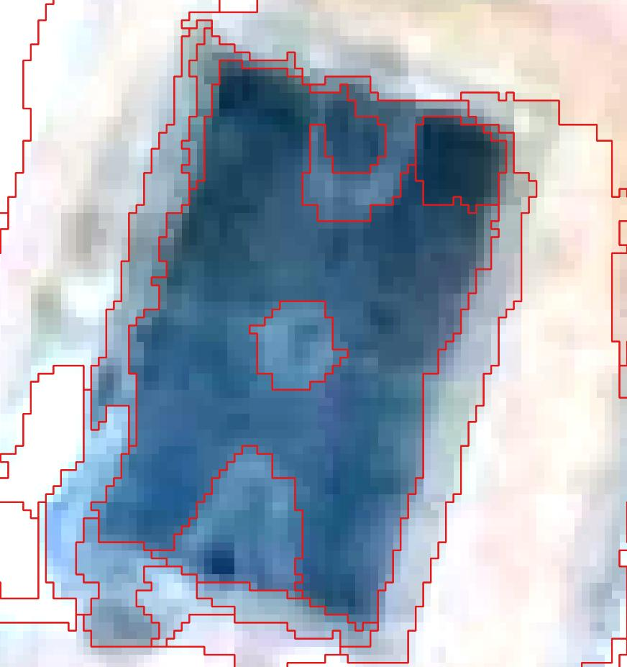
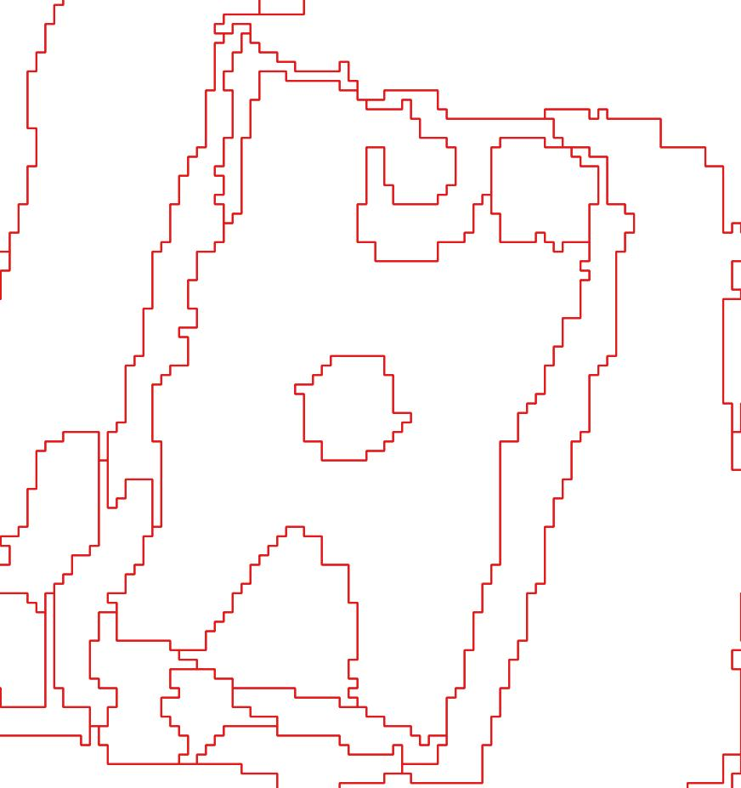
Studying Migrations Routes: New data and Tools
Segmentation
raster
vector
Notes:
Geonames: eight million placenames, multilanguage, attributes, geographic coordinates, used in Inspire geoportal http://inspire-geoportal.ec.europa.eu/discovery/
GADM spatial dataset on Global Administrative Areas 556,049 low level subdivisions, countries and lower level subdivisions such as provinces, departments, counties, …, available as shapefile

Slide 8
Studying Migrations Routes: New data and Tools
Criteria for tent recognition
Each tent area is between 2 – 6 m²
"AREA" <6
Compact shape (square)
and "AREA"/("PERIMETER"^2) < 0,03
Light colour
and "_mean" > 155
Notes:
Geonames: eight million placenames, multilanguage, attributes, geographic coordinates, used in Inspire geoportal http://inspire-geoportal.ec.europa.eu/discovery/
GADM spatial dataset on Global Administrative Areas 556,049 low level subdivisions, countries and lower level subdivisions such as provinces, departments, counties, …, available as shapefile

Slide 9
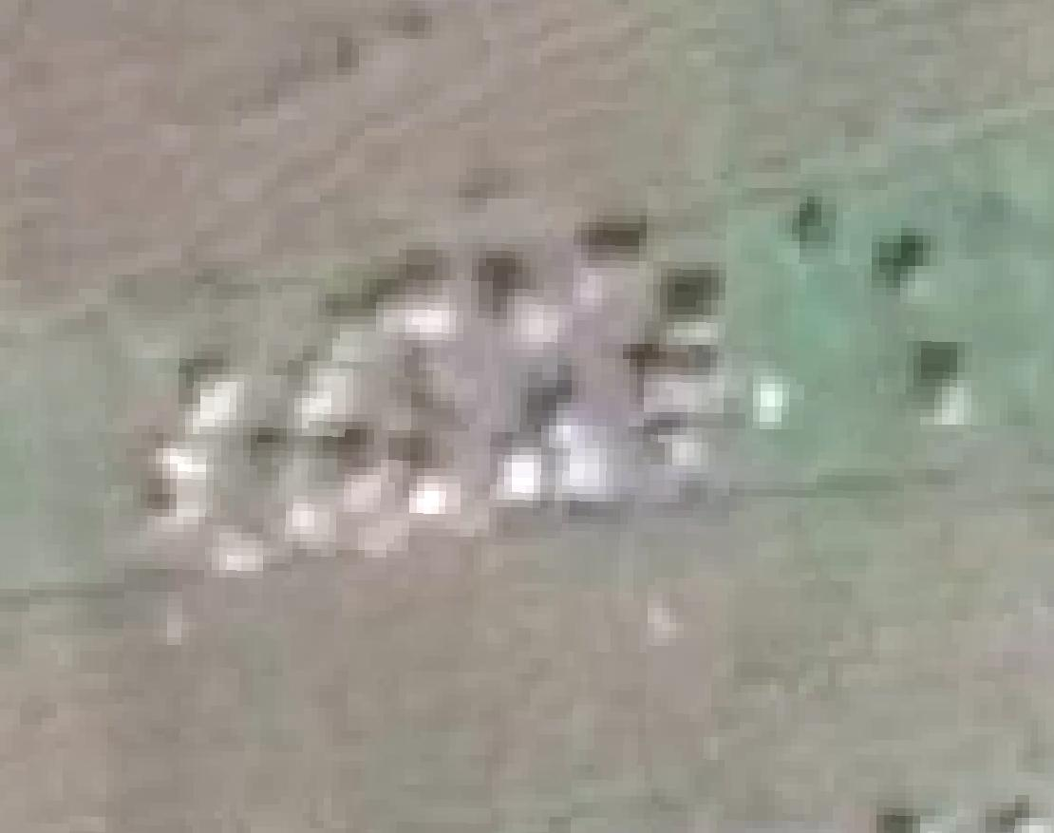
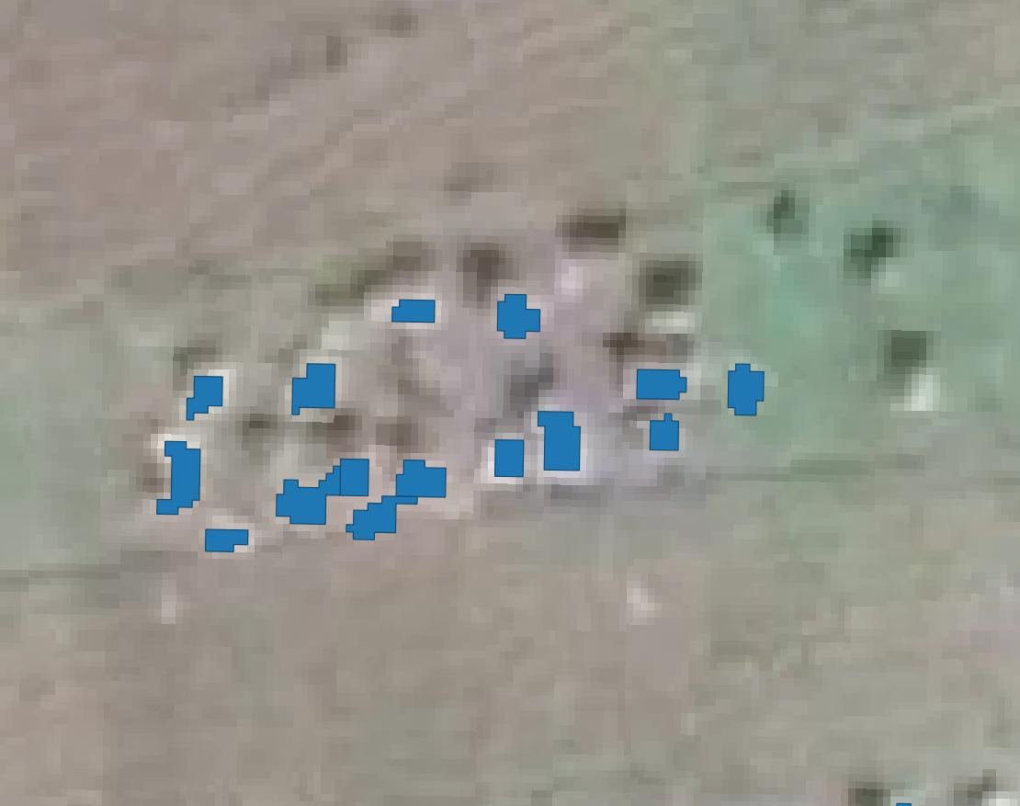
Studying Migrations Routes: New data and Tools
Notes:
Geonames: eight million placenames, multilanguage, attributes, geographic coordinates, used in Inspire geoportal http://inspire-geoportal.ec.europa.eu/discovery/
GADM spatial dataset on Global Administrative Areas 556,049 low level subdivisions, countries and lower level subdivisions such as provinces, departments, counties, …, available as shapefile

Slide 10
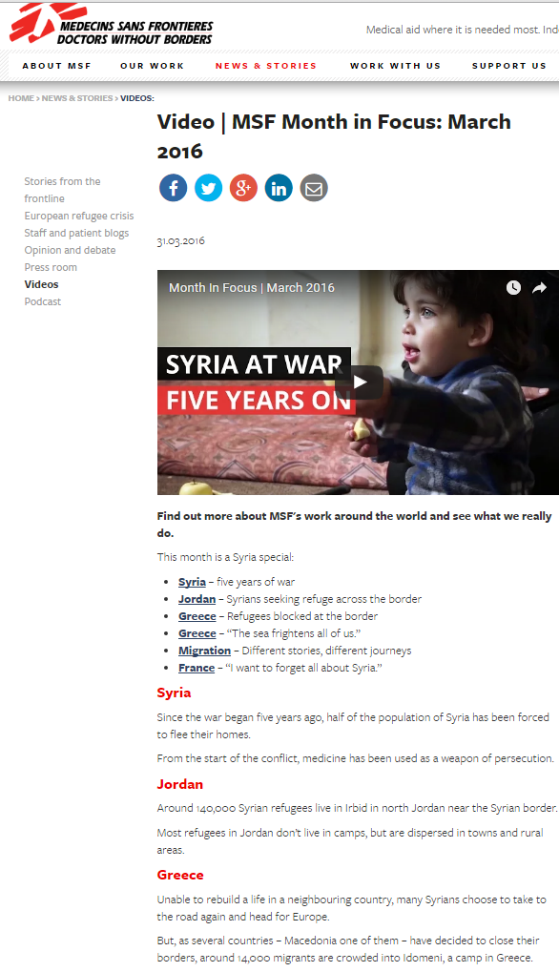
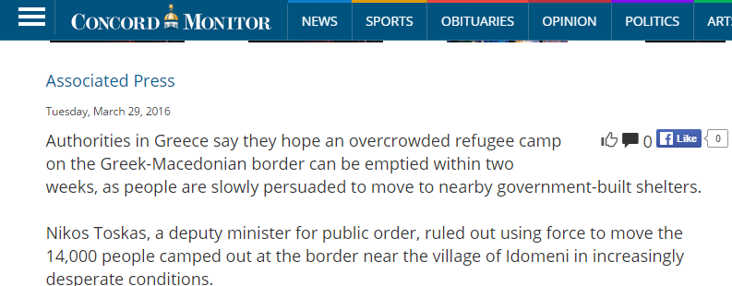
Studying Migrations Routes: New data and Tools
Notes:
Geonames: eight million placenames, multilanguage, attributes, geographic coordinates, used in Inspire geoportal http://inspire-geoportal.ec.europa.eu/discovery/
GADM spatial dataset on Global Administrative Areas 556,049 low level subdivisions, countries and lower level subdivisions such as provinces, departments, counties, …, available as shapefile

Slide 11
Studying Migrations Routes: New data and Tools
Results
Date | # Records | Total area (m²) | # Migrants
05/03/2016 | 2124 | 5734 | 12000
30/03/2016 | 2509 | 6991 | 14000
Migrants / Area
2.09
2.00
Around 2 migrants / m² in the tent camp
Notes:
Geonames: eight million placenames, multilanguage, attributes, geographic coordinates, used in Inspire geoportal http://inspire-geoportal.ec.europa.eu/discovery/
GADM spatial dataset on Global Administrative Areas 556,049 low level subdivisions, countries and lower level subdivisions such as provinces, departments, counties, …, available as shapefile

Slide 12
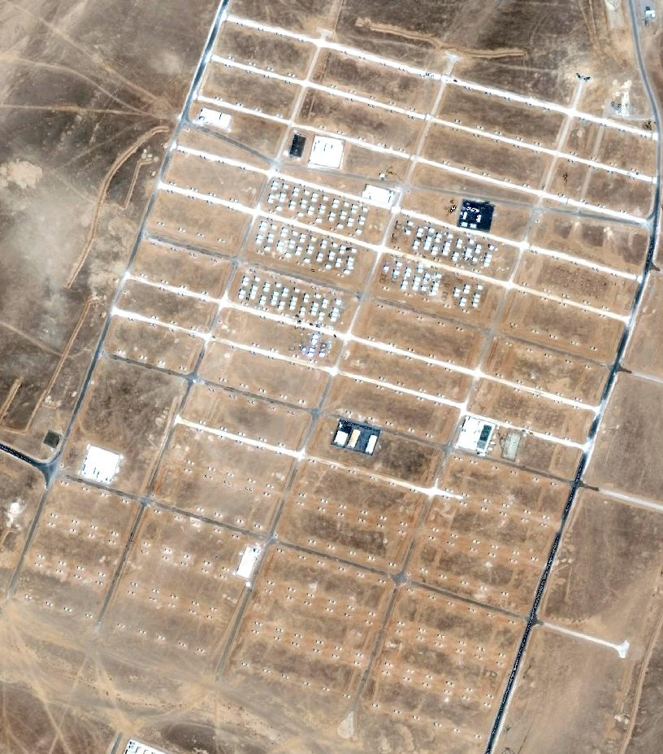
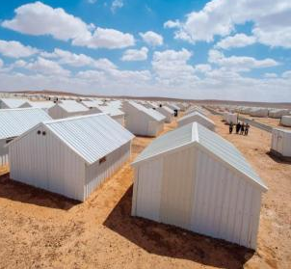
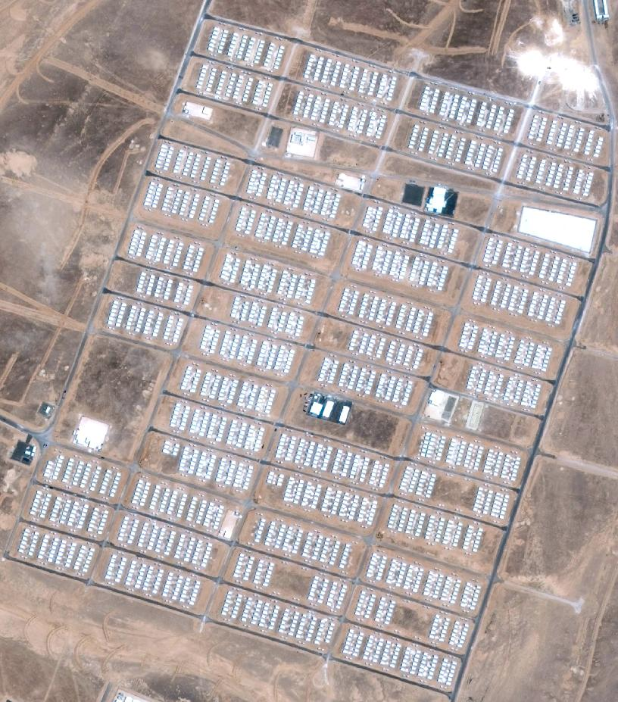
Studying Migrations Routes: New data and Tools
Azraq (Jordan)
Built in 2013
Opened in 2014
Planned for 130 k
On march 2016 only 32 k refugees
(Wikipedia)
Notes:
Geonames: eight million placenames, multilanguage, attributes, geographic coordinates, used in Inspire geoportal http://inspire-geoportal.ec.europa.eu/discovery/
GADM spatial dataset on Global Administrative Areas 556,049 low level subdivisions, countries and lower level subdivisions such as provinces, departments, counties, …, available as shapefile

Slide 13
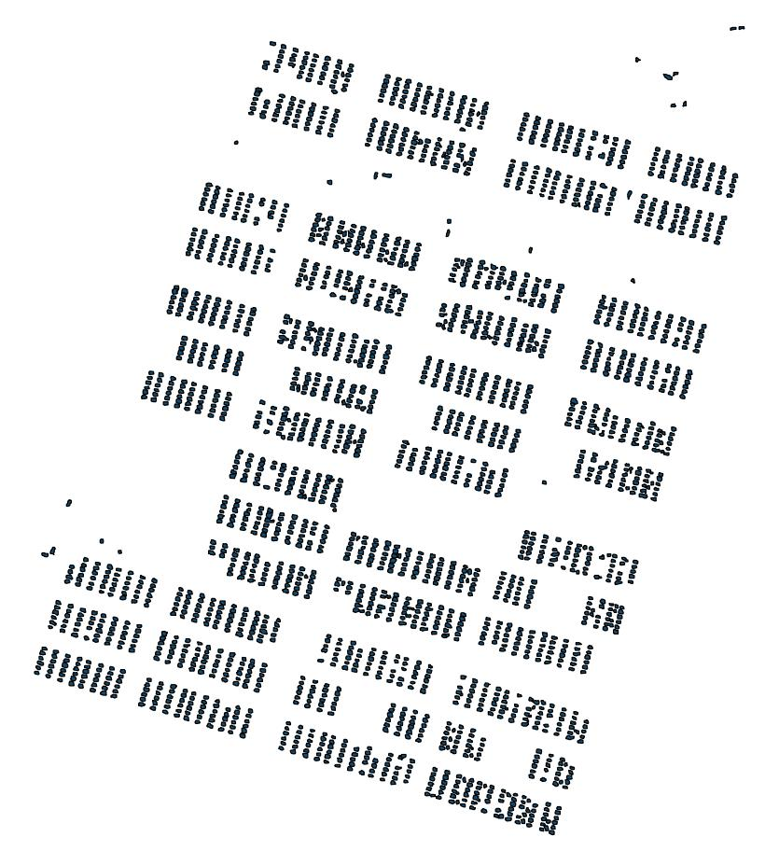
Studying Migrations Routes: New data and Tools
Azraq (Jordan)
7/10/2013 – 200 shelters
4/5/2014 – 2763 shelters
Notes:
Geonames: eight million placenames, multilanguage, attributes, geographic coordinates, used in Inspire geoportal http://inspire-geoportal.ec.europa.eu/discovery/
GADM spatial dataset on Global Administrative Areas 556,049 low level subdivisions, countries and lower level subdivisions such as provinces, departments, counties, …, available as shapefile

Slide 14
Studying Migrations Routes: New data and Tools
Conclusions
Free satellite images could help in the assessment of the extension of the refugee camps over time
Open source software easily allows the objects (tents, shelters) extraction and count
Issues in the use of precise information from the web at a specific date
Notes:
Geonames: eight million placenames, multilanguage, attributes, geographic coordinates, used in Inspire geoportal http://inspire-geoportal.ec.europa.eu/discovery/
GADM spatial dataset on Global Administrative Areas 556,049 low level subdivisions, countries and lower level subdivisions such as provinces, departments, counties, …, available as shapefile

Slide 15
Studying Migrations Routes: New data and Tools
Thanks for your attention
cimbelli@istat.it
Notes:
Geonames: eight million placenames, multilanguage, attributes, geographic coordinates, used in Inspire geoportal http://inspire-geoportal.ec.europa.eu/discovery/
GADM spatial dataset on Global Administrative Areas 556,049 low level subdivisions, countries and lower level subdivisions such as provinces, departments, counties, …, available as shapefile

