Slide 1
Mobility of Italian citizens in EU and Efta countries
Opportunities and challenges from admnistrative data
Studying Migrations Routes: New data and Tools
Workshop - 16 June 2016
Rome, Italy
Domenico Gabrielli, University of Rome “La Sapienza”, Istat

Slide 2
National Security data (INPS)
Data from «changes of residence» survey, Istat

Slide 3
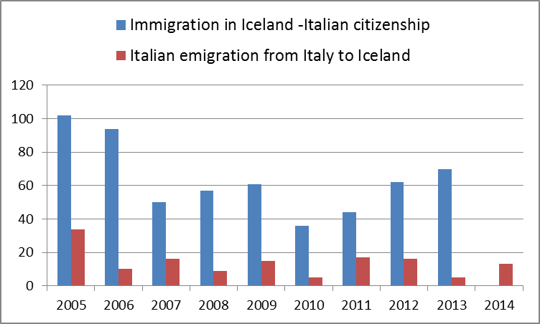

Slide 4
Iceland – Migration Metadata (by Statistics Iceland)
History and sources
Founding of the Register of Migration Data in 1986:
figures on migration were processed monthly, based on individuals having to be resident for at least one month in the same place before being considered as having moved.
Accuracy and reliability
Late registration of change of residence:
main cause of errors in migration figures (this is true for all statistics on migrations).
When considering all moves over the past five years (from 1996-2000) only around 55% of registrations were received within a month of moving. After two months 96% of all registrations had been received by Statistics Iceland and within six months 98% had been received.

Slide 5
Statistics Iceland - Access to data
Basic data; storage and usability
Data stored in digital format by the Population Statistics Department of Statistics Iceland.
No access is provided to data relating to individuals, though it is possible to have it especially processed.

Slide 6
Norway

Slide 7
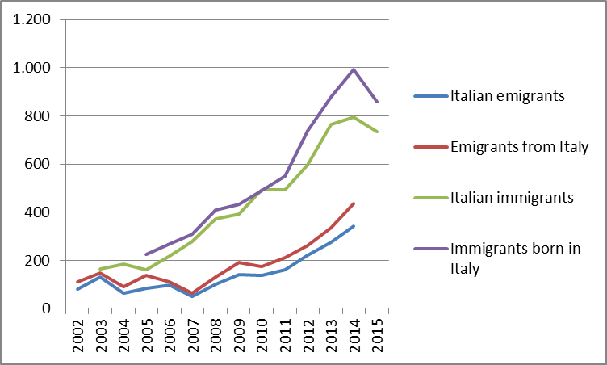

Slide 8
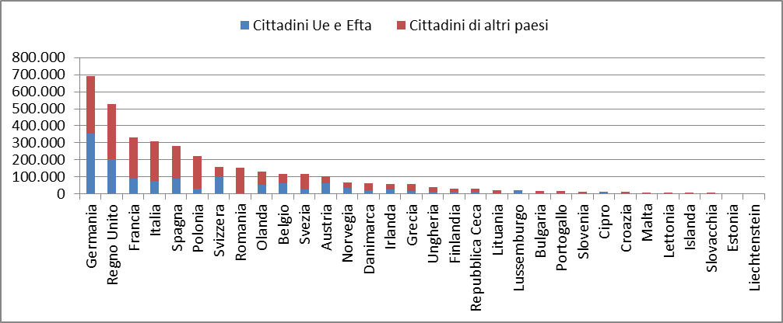
Germany
Immigration of EU and Efta citizens in Germany. Year 2013

Slide 9
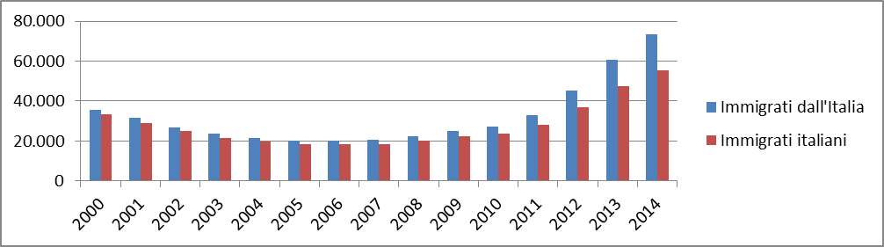
Immigration flows from Italy/of Italian citizens in Germany

Slide 10
DATA FROM CHANGE OF RESIDENCE SURVEY- ITALY. Year 2014
Country Origin/Destination | Immigration | Emigration | Net balance
Germany | 3.771 | 14.440 | -10.669
United Kingdom | 2.398 | 13.491 | -11.093
Switzerland | 2.530 | 10.376 | -7.846
France | 1.920 | 8.426 | -6.506
United States of America | 2.109 | 5.181 | -3.072
Spain | 1.367 | 4.090 | -2.723
Brasil | 1.969 | 3.462 | -1.493
Belgium | 636 | 2.491 | -1.855
Other countries | 12.571 | 26.902 | 14.331
Total | 29.271 | 88.859 | -59.588

Slide 11
A particular flow of immigration in the United Kingdom

Slide 12
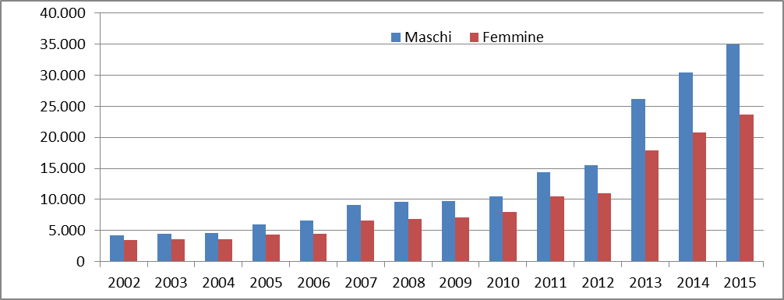
Nino granted to Italian citizens, by sex. Years 2002-2015

Slide 13
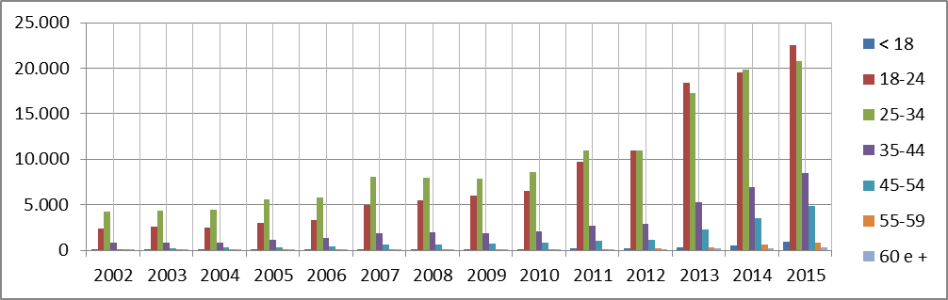
Nino granted to Italian citizens , by age group . years 2002-2015

Slide 14
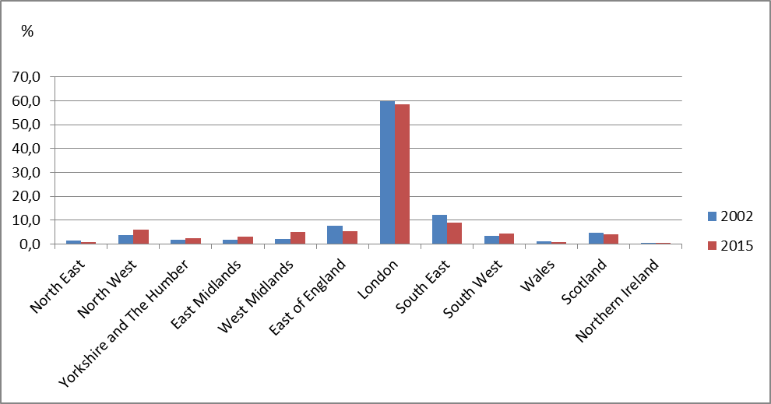
Nino granted to Italian citizens, Regional Administration . Years 2002 and 2015.

Slide 15
Qualified migrations
Emigrated Italian citizens aged 25 and over, by level of education . Years 2002-2011. Absolute values ​​, percentages and rates per 1,000

Slide 16
Conclusions and perspectives
Since the early ’90 Prof. Willekens envisaged a multi-source approach to migrations observation and analysis: Willekens, F. 1994. Monitoring international migration flows in Europe: towards a statistical database combining data from different sources. European Journal of Population, 10:1-42
In Italy we followed such an approach to the survey of immigrations and characteristics of immigrants from the early 90s onwards.

Slide 17
Moreover several projects on migration statistics have been funded by the European Commission (Lanzieri 2014 a)),
as for example:
COMPSTAT (2001-2002): Comparing National Data Sources in the Field of Migration and Integration took initial steps to overcome the lack of comparable data in 10 European countries (Austria, Belgium, the Czech Republic, Germany, Hungary, Italy, the Netherlands, Norway, Poland and Switzerland)
THESIM (2004-2005) Towards Harmonised European Statistics on International Migration (THESIM) aimed at supporting implementation of the EU regulation on migration statistics
PROMINSTAT (2007-2009) Promoting comparative quantitative research in the field of migration and integration in Europe produced an online database containing essential technical information on migration and integration for 29 European countries (EU-27 plus Norway and Switzerland)

Slide 18
MIMOSA (2007-2009) Migration Modelling for Statistical Analysis aimed to develop methods for reconciling differences in European countries’ international migration statistics. The project produced estimates of migration flows and population stocks for the 31 EU and EFTA countries for 2002-07.
Estimation of O/D matrixes and/or implementation of new sources and methods such as integration of administrative records in destination countries?

Slide 19
New migrations patterns: temporary and circular migrations. Opportunities from BIG DATA
In “You are where you E-mail: Using E-mail Data to Estimate International Migration Rates”, Zagheni and Weber take an innovative approach to evaluate age and gender-specific global migration rates.
Migration flows are estimated trough changes of geo-referenced IP addresses and through a comparison with administrative data.

Slide 20
References
Conti C., Gabrielli D., Quattrociocchi L., Rottino F.M. (2012): Definitions, sources and measures for internal mobility and secondary migrations: a focus on non-EU citizens, Note by ISTAT, Italy for Conference of European Statisticians Group of Experts on Migration Statistics Work Session on Migration Statistics Geneva, 17-19 October 2012
Lanzieri, G. (2014), a): “Filling the ‘migration gaps’ — can research outcomes help us improve migration statistics?”. Note by the Statistical Office of the European Union
Lanzieri, G. (2014), b): Emerging issues and methodologies for the measurement of migration. “Test of an estimation method for annual migration flows between EU-EFTA countries”. Note by the Statistical Office of the European Union (Eurostat)
INE-Spain (2013): “Exchange of information between EU Member States to improve population statistics. A proposal from INE-Spain”. Paper for the meeting of the Eurostat Working Group on Population Statistics, Luxembourg, 16 - 17 December 2013
Willekens, F. (1994): Monitoring international migration flows in Europe: towards a statistical database combining data from different sources. European Journal of Population, 10:1-42
Emilio Zagheni, Ingmar Weber, ”You are where you E-mail: Using E-mail Data to Estimate International Migration Rates”

