Slide 1
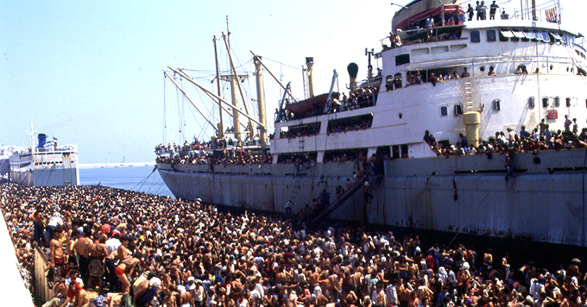
Indagine sulle seconde generazioni 2015
Migration routes to Italy and internal movements
Cinzia Conti
Fabio Massimo Rottino
Istat
16 giugno 2016

Slide 2
Migration and territory
Geographical position: the case of Italy
Transformation of territory
Migration flows as consequence of territory transformations
Network between territories (globalization)
Studies on integration have demonstrated that the citizenship (origin) of migrants and the territory of settlement give a strong contribute in shaping the integration model (Istat and Ministry of Interior, 2013)

Slide 3
Origin destination studies……in another age of migrations
Castels and Miller 1993
Relevant international projects on origin-destination matrix at national level
Push-pull factors
Collecting data (coherence)
Measures
Visualization instruments: http://www.global-migration.info/

Slide 4
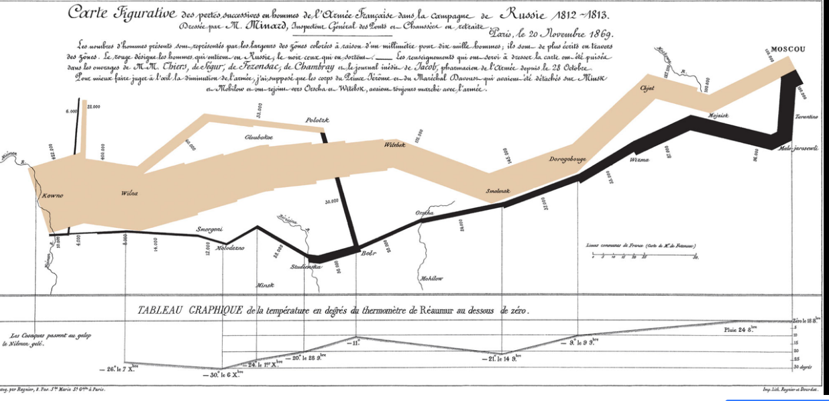
Charles Minard's map of Napoleon's disastrous Russian campaign of 1812. The graphic is notable for its representation in two dimensions of six types of data: the number of Napoleon's troops; distance; temperature; the latitude and longitude; direction of travel; and location relative to specific dates

Slide 5
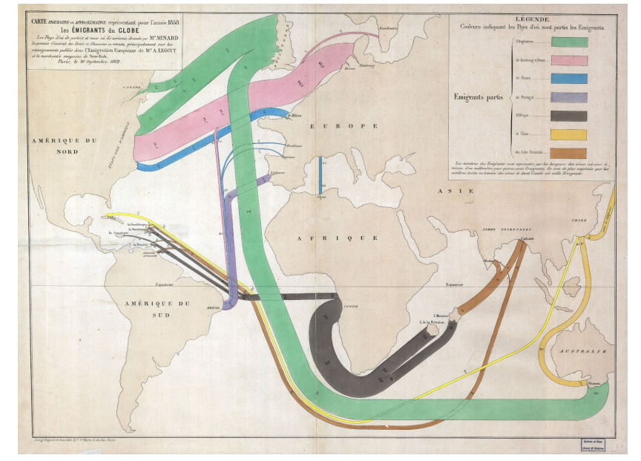
The Emigrants of the World, 1858. By Charles Joseph Minard (in Sander, 2014)

Slide 7
Net inter-Regional migration flows of those aged 60 or more, 1961-66. Source: Law & Warnes (1976, p. 464) The challenge in the development ……..in Sander, 2014

Slide 9
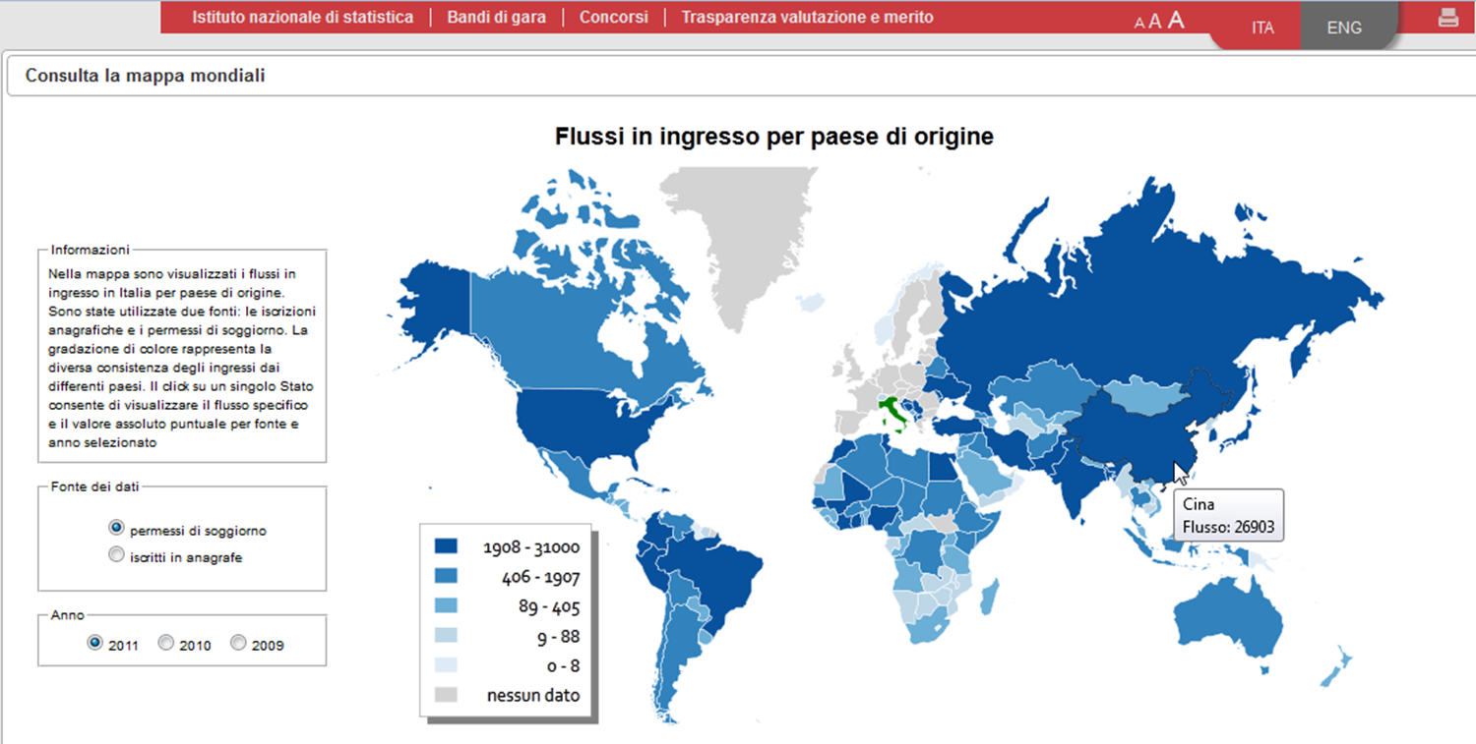
The information system of thematic "immigrants and new citizens” | ISTAT | Rome 17 - 18 June 2013

Slide 10
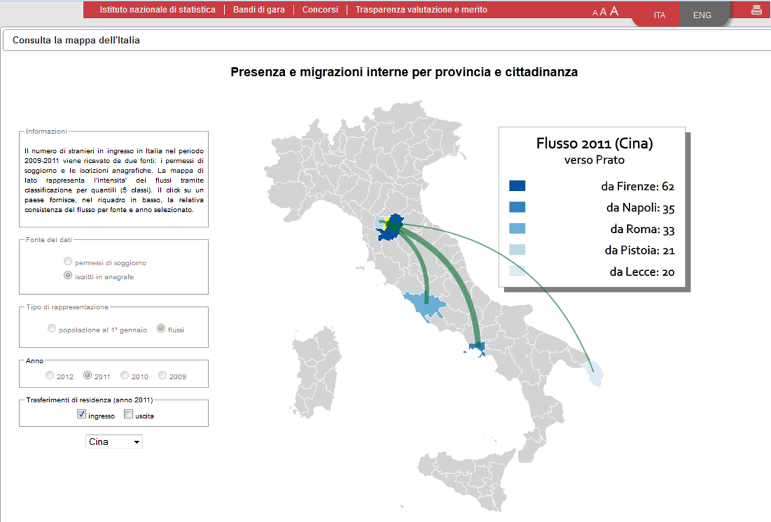
http://www.istat.it/it/immigrati/mappe-dinamiche
The information system of thematic "immigrants and new citizens”| ISTAT | Rome 17 - 18 June 2013

Slide 11
The new age of migrations
Ban Ki-moon, Secretary-General of the United Nations (UN), called this century the “new migration age”, a second stage of globalisation
New reasons for migration are arising
Still push-pull factors?
Rising push factors (wars, geopolitical crisis, environmental reasons)
Rising networks links
New routes
Closing distances/Growing distances
Different means of transport
Longer time/ more steps
Organizations
New kind of migrations: circular migrations, temporary migrations

Slide 12
Origin Destination

Slide 13
Origin- Destination- Destination….

Slide 14
Glo(bal) and (lo)cal
The “country of origin and country destination” analysis is not sufficient to study migrations nowdays
The networks work at local level
Not always a whole country is involved in international migrations and particularly in migration towards a specific country
Often the flows of asylum seekers are originated in specific areas of a country
Often migration routes are complex, made of different steps. Migrants cross different countries and travel across different territories of a country before arriving in the settlement area
International and Internal migrations are often part of the same phenomena
Having more information about origin areas (at local level) let us planning more efficiently policies.

Slide 15
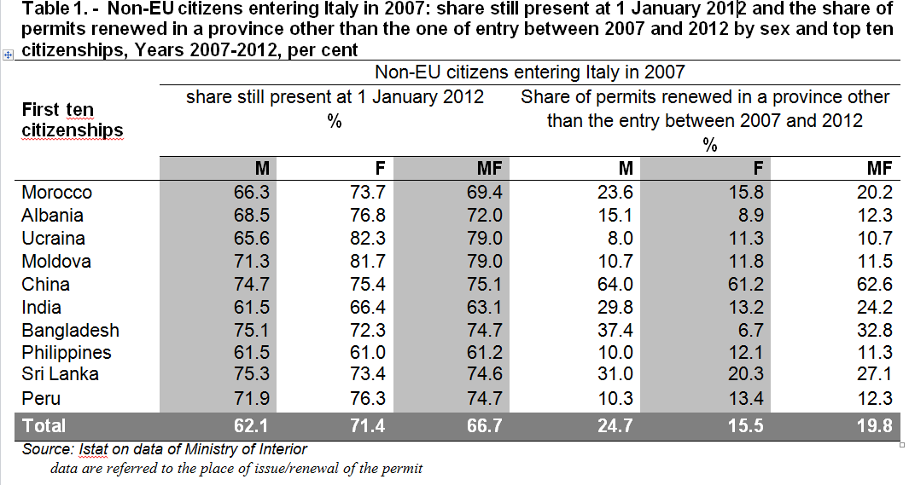
Step by step migrations

Slide 16
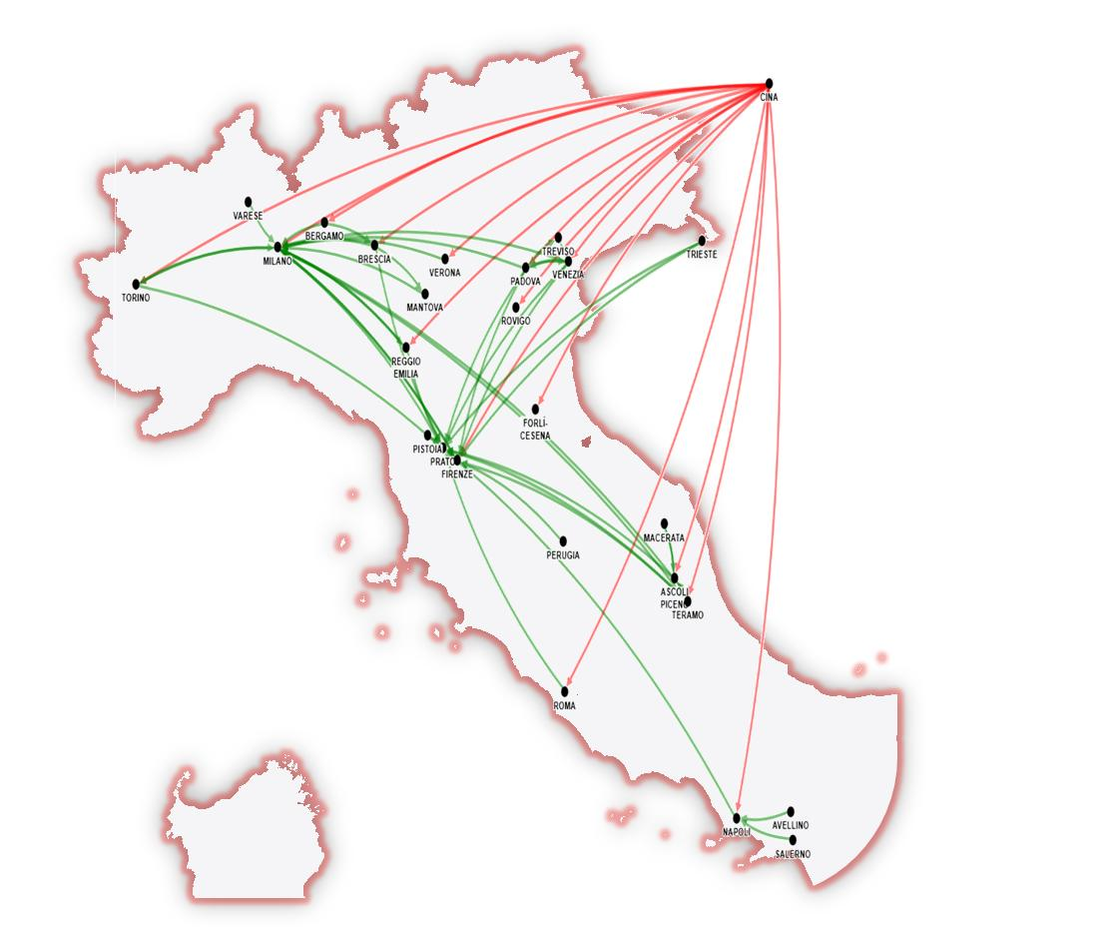
The 15% of Chinese immigrants have moved twice or more between 2007 and 2012

Slide 17
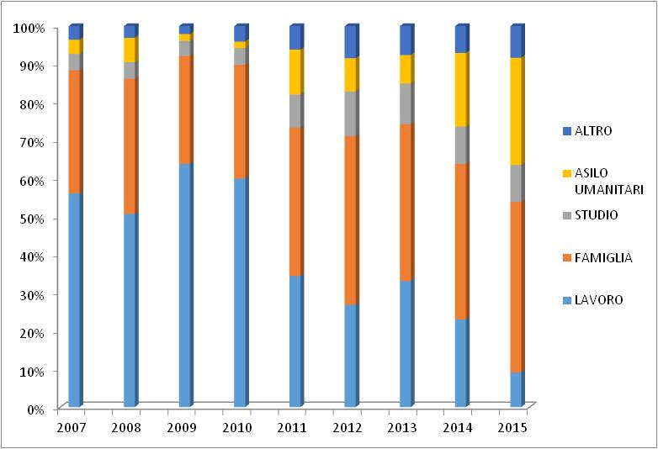
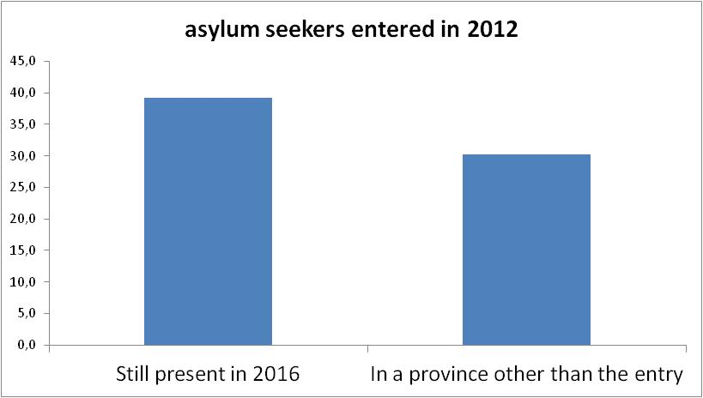
Italy new flows and settlement
New residence permits issued for reasons, 2007-2015
Source: Istat on data of Ministry of Interior
Note: data for 2015 are provisional

Slide 18
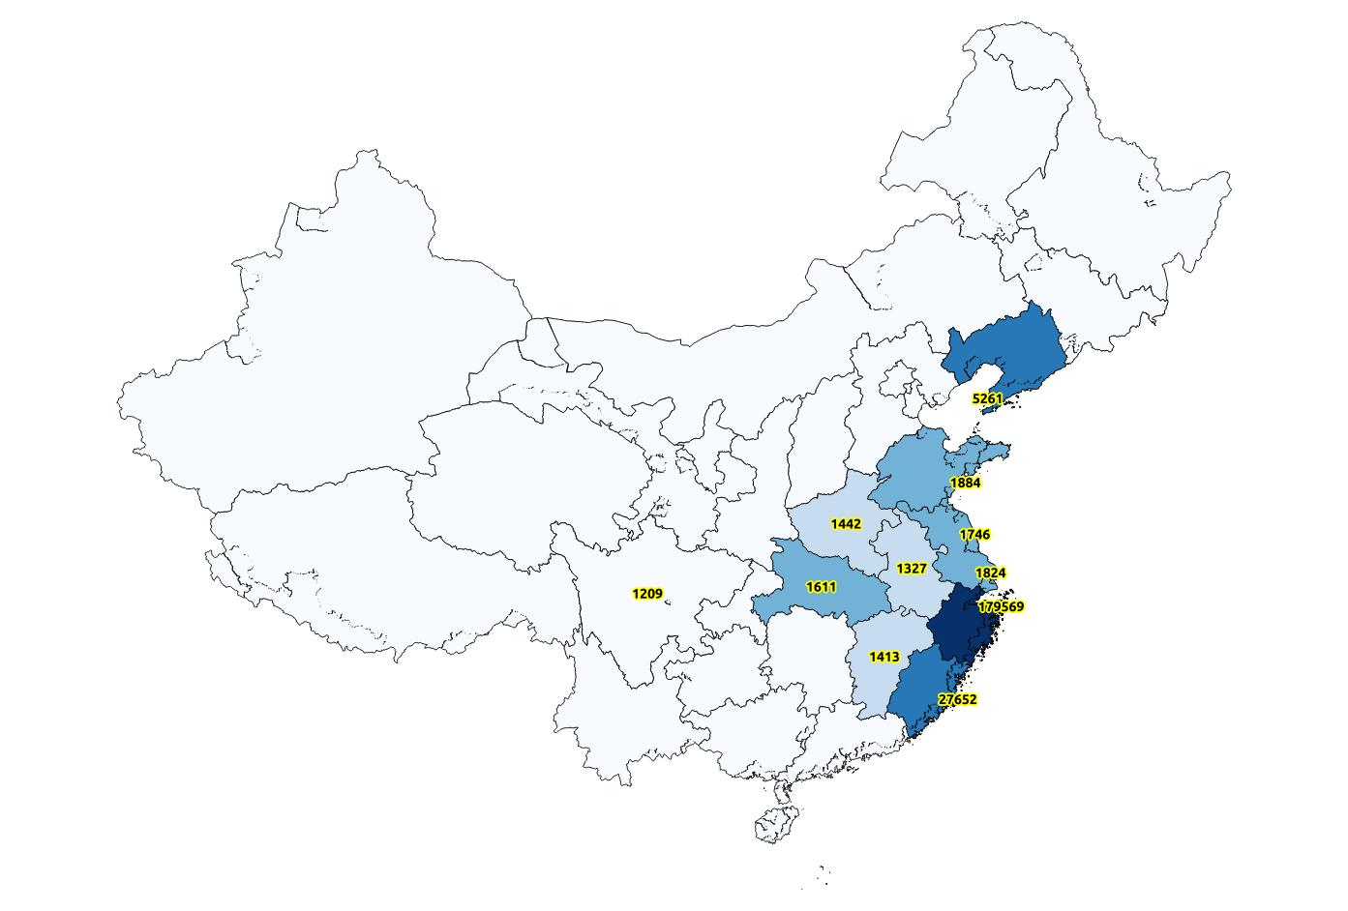
Chinese?
79,5% from ZHEJIANG

Slide 19
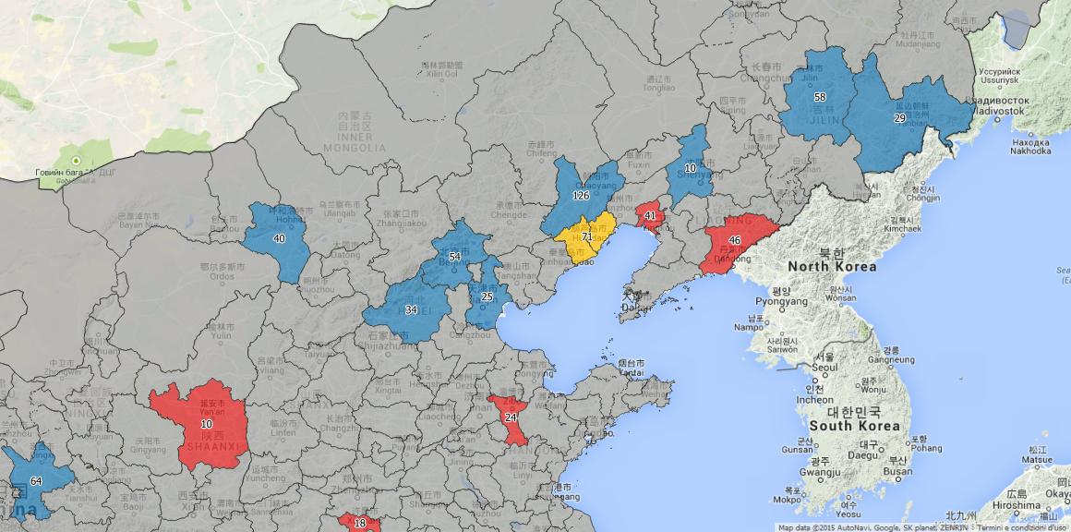
Grant agreements for merging statistics and geospatial information
China - 2012

Slide 20
Origin destination: territorial details

Slide 21
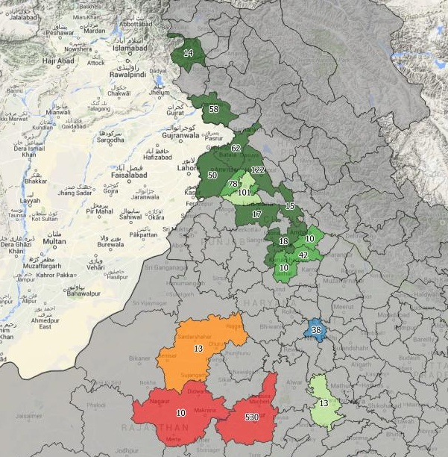
India
The map confirm some evidence about migrations from India to Italy.
Infact is well known that Many indian migrants are sikhs. If we campare the map of migrations and the map of distribuition of Sikhs we can observe that the most relevant flows are originated in the areas of concentration of this ethnic group.
The involvement of Punjab and other northern regions (border with Pakistan) and the relevance for migrations of the areas near the border with Balngadesh in the migration flows suggest the possibility of transnational migration network. In future we intend to analyse also the origin of migrations flows from Pakistan and Bangladesh

Slide 22
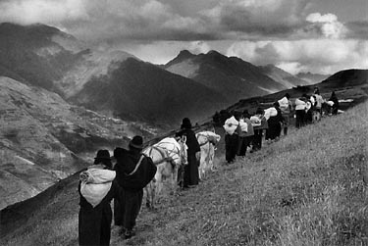
Migration is a process
Humanity in Transition (S. Salgado)

Slide 23
Migration routes
In order to support the governance of migrations at national and international level it is important overcoming the origin- destination approach in favour of a migration routes approach
Disaggregated information about origin of flows can support more efficient migration policies and integration policies
Migration is a process…..

