Slide 1


MIXED MIGRATION HUB

Slide 2


The “Mixed Migration Hub” (MHub) is an autonomous entity that works on behalf of the North Africa Mixed Migration Task Force consisting of
Mhub’s objectives are to:
  Share and pool expertise
  Disseminate good practices and lessons learned
  Support collaboration and joint initiatives
  Support collective advocacy efforts
MHub has a twofold purpose:
  Regional knowledge hub
  Secretariat for the North Africa Mixed Migration Task Force

Slide 3

Research Initiatives
Monthly Trend Bulletin
Research Meetings
Research Reports
Migrant Footprints Database
Field Research - Surveys

Slide 4
Migrant Footprints Database
www.migrantfootprints.info

Slide 5
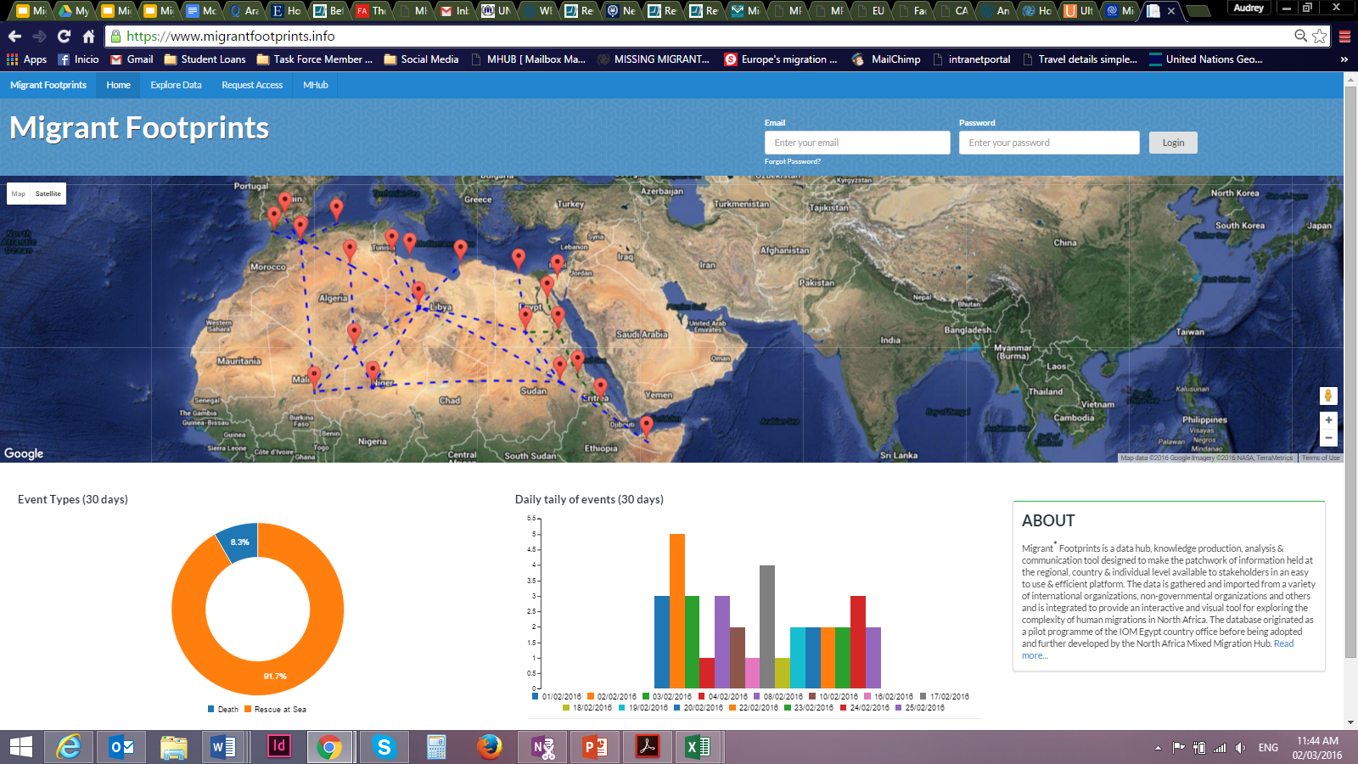
www.migrantfootprints.info

Slide 6
HOW IT WORKS
Collates existing data from
  National Governments
  International Organizations
  NGOs
  Researchers
  Media
Data presented through
  Dynamic visualizations
  Comparison tools
  Custom mapping
Export public data and visualizations

Slide 7
Why is Migrant Footprints important?
Pooling information from various data sources and types into one platform
Allows more comprehensive look into mixed migration
Data collection and sharing tools available allow for analysis of past, current and emerging trends
Allows inclusion of narrative entries, incident entries, and connecting of events

Slide 8
How is data Inputted?
Manually
  Narrative Entry
  Incident Entry
  Excel Data Import
    Government Agencies
    Intl. Organizations
    NGO
    Research findings
    Public datasets (UN, UNHCR..)
Automatically
  Survey Submission – Data Focal Points
  Direct Feed (API) (Migrant Files, World Bank)

Slide 9
Data Confidentiality
Various levels of access and data classification
Open access to data classified as public
5 confidentiality levels
  Private
  Organization Internal
  Organization Wide
  Authorization
  Public

Slide 10
UTILITY OF DATA
Close to real-time data
Data compiled over time
Accessible & manipulate-able platform
Dynamic visualization and comparison tools
Export for further analysis
Diversity of data
Demographics
Routes, segments, costs, intentions, experiences..
Custom mapping

Slide 11
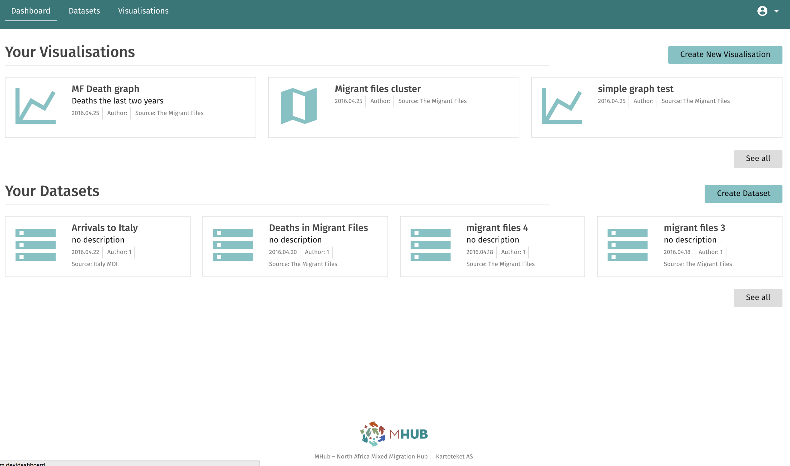
Personal Viz-tool Dashboard - Example

Slide 12
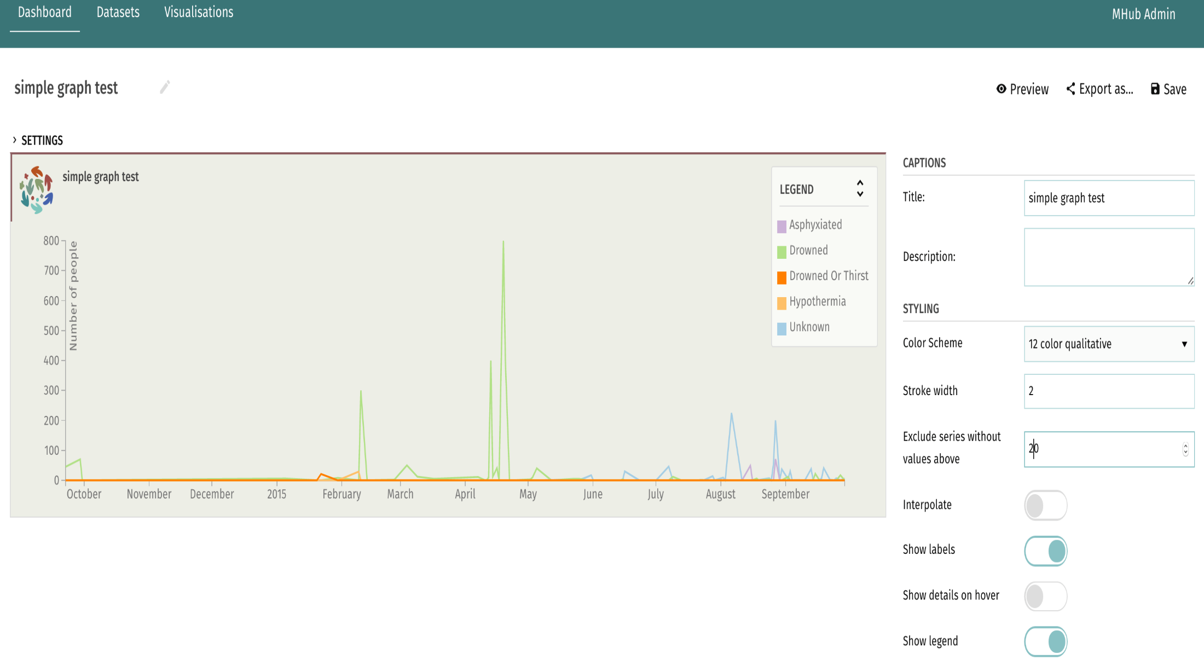
Example

Slide 13
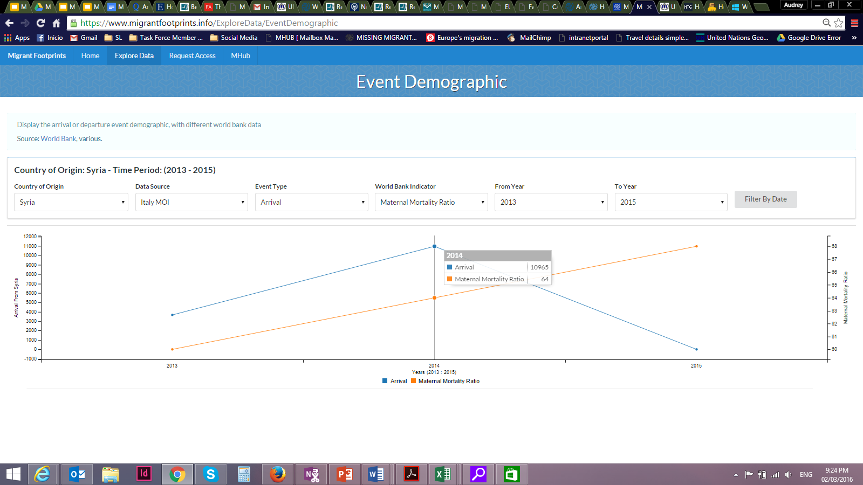
Analysis/Comparison Tool

Slide 14
Current Developments
Field Application / Digital Surveys
Data Focal Points
  Database
  Monthly trend bulletin
  Knowledge gaps
  Evolving trends
  Composition and journey
Feedback on new features

Slide 15
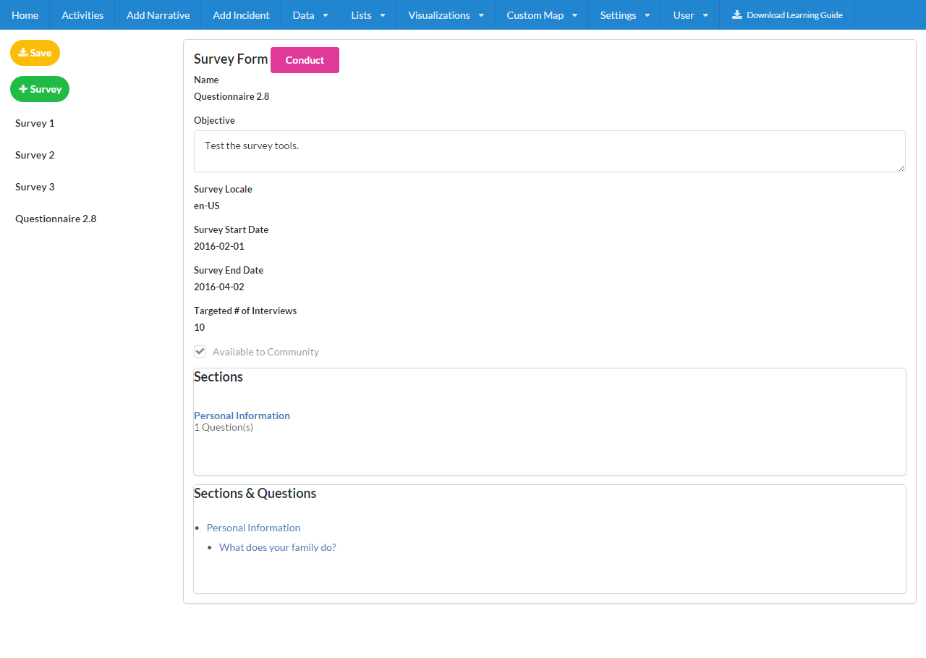
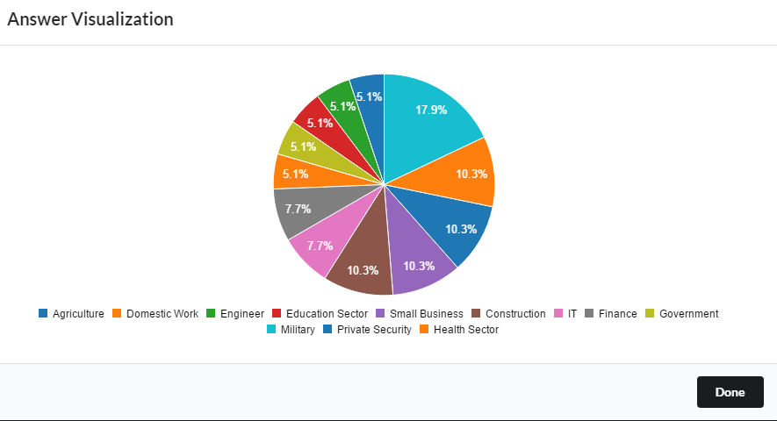
Digital Survey – input to output

Slide 16
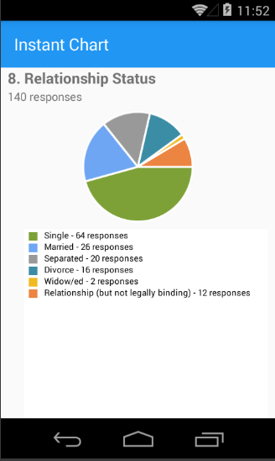
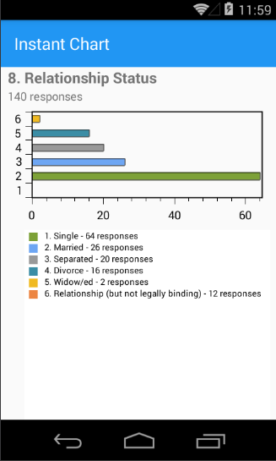
Field Application

Slide 17
Data Focal Points (DFPs)

Slide 18
MHub Platforms
www.mixedmigrationhub.org
  MHub research
  Bulletins
  Snapshots (English, Arabic, coming soon – French
  Mailing list
www.migrantfootprints.info
Facebook – MHub – North Africa Mixed Migration Hub
Twitter - @MIXMIGHUB
Email – info@mixedmigrationhub.org

