Slide 1

Italian data collection on asylum
Workshop on Studying migration Routes
Rome – 16 June 2016

Slide 2


Overview on asylum procedure
Arrivals – pre registration and identification
First reception
Eurodac (cat1 or cat2)
Application for international protection
Second reception
In case of positive hit
In case of Italian responsability
Dublin procedure
Interview
Positive decision
Negative decision
Integration
Appeal
Closure
Return

Slide 3
Italian data collection on asylum
Institutional stakeholders in Italian administrations

Slide 4
Italian data collection on asylum
Data repositories
VESTANET database co-shared between the Police Dep. and the Commissions for asylum.
The DPS collects and manages all the information on identity, residence permits, applications for international protection, and withdrawals, forced return of asylum seekers.
The Commissions manage information on decisions in legal proceedings.
VESTANET is interconnected with DUBLINET (managed by the Dublin unit for the implementation of DUB III EU Reg.)
VESTANET is also interconnected with the Revenue Agency: a temporary tax code is automatically generated for each applicant (the code will be permanent in case of positive decision or cancelled in case of refusal)
A new database on RECEPTION system, connected with the other 2 will be operate since October 2017.

Slide 5
Italian data collection on asylum
Arrivals
Collection of personal data and fingerprints (Eurodac cat 2)
Identification of asylum seekers (AFIS and SDI), UNAMS, vulnerable individuals…
PRE-REGISTRATION
EURODAC
AFIS
SGA reception
Personal data
navy code+individual code
Date and place of arrival
Eurodac link
Fingerprint
Personal data
Personal data
Status
Reception facility data
Fingerprint
Photo
Personal data

Slide 6
Italian data collection on asylum
Reception 1
First assistance
First reception
Data and place of arrival
Family group
Data on vulnerability
Type of recep. facility
Avalaible places
Services
First assistance
Reception Centres for Immigrants (Centri prima accoglienza and Hotspots): first assistance and identification or urgent medical assistance (12.985 presences at 6 June 2016);
First reception
CAS: Strutture temporanee: short term large centres for the formal registration of asylum application (89.967 presences at 6 June 2016);

Slide 7
Italian data collection on asylum
Reception 2
Second reception
SPRAR System: coordinated by the Central Service, entrusted in agreement with ANCI, involves 382 local authorities, covering 30 provinces and 352 municipalities with 434 local projects, of which 19.720 for ordinary categories, 729 for unaccompanied minors and 295 for persons with mental distress.
(20.086 presences at 6 June 2016)
CIE (Centres for Identification and Expulsion):
Facilities for the detention of irregular immigrants for the time necessary to exercise the expulsion order.
Second reception
Project code
Facility code
Individual code
Integration steps

Slide 8
Italian data collection on asylum
Application
fingerprinting (eurodac – cat 1) and photo
formal registration and issue of a temporary permit of stay
RESIDENCE PERMIT
VESTANET
REVENUE AGENCY
DUBLIN
Type of permit
Number and validity
Individual code (CUI)
Individual code (CUI)
Localisation
Resident permit
Eurodac code
Family tracing
Vat code
Vat code
Individual code (CUI)
Dublin code
Localisation
Residence permit
Eurodac code
DUBLINET database linked to VESTANET and permit of stay by CUI individual code
Dublin cases
Procedure to determine the MS responsible for the asylum procedure.

Slide 9
Italian data collection on asylum
Appeal
The applicant can appeal to the Ordinary Court with territorial jurisdiction within 30 days from the date of communication of the decision of the Territorial Commission
RESIDENCE PERMIT
VESTANET
JUDICIARY DATABASE
Type of permit
Number and validity
Individual code (CUI)
Individual code (CUI)
Date of appeal
Court

Slide 10
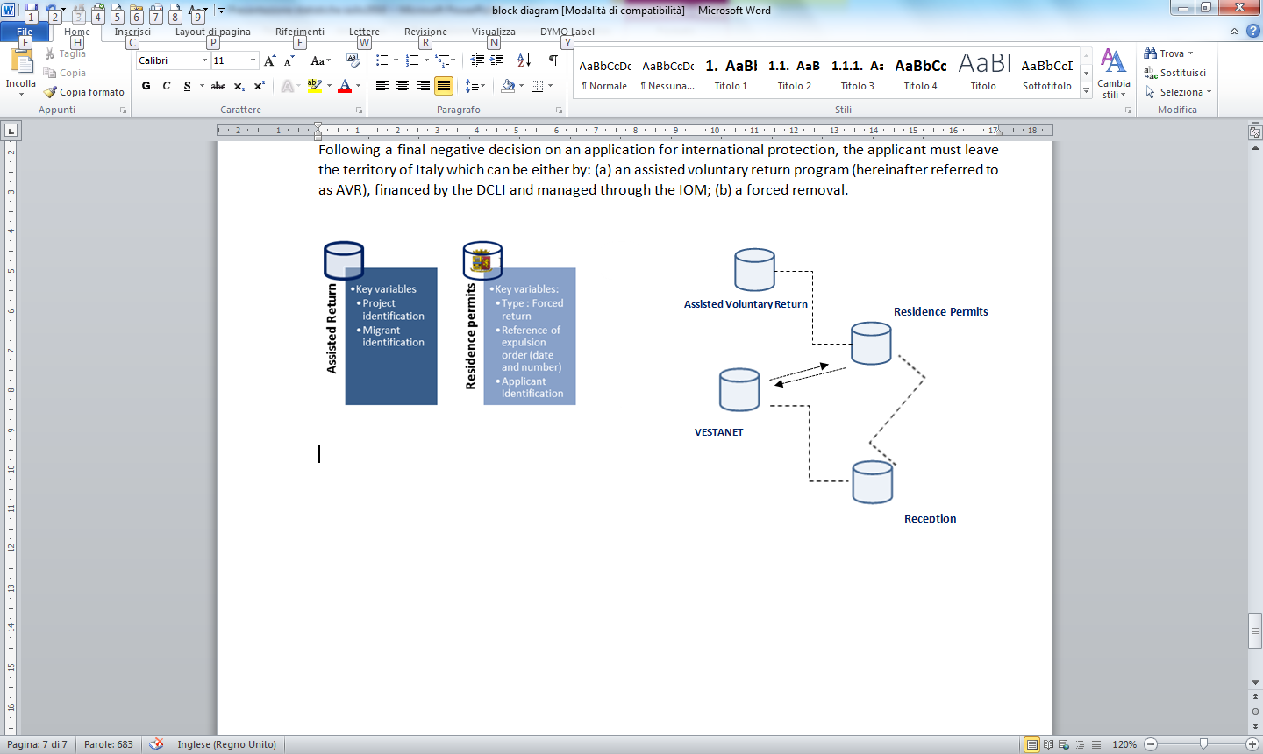
Italian data collection on asylum
Return
Following a final negative decision on an application for international protection, the applicant must leave the territory of Italy which can be either by:
an assisted voluntary return program (hereinafter referred to as AVR), financed by the DCLI
a forced removal
RESIDENCE PERMIT
VOLUNTARY ASSISTED RETURN
Expulsion order
Forced return
Individual code (CUI)
Individual code (CUI)
Project identification

Slide 11
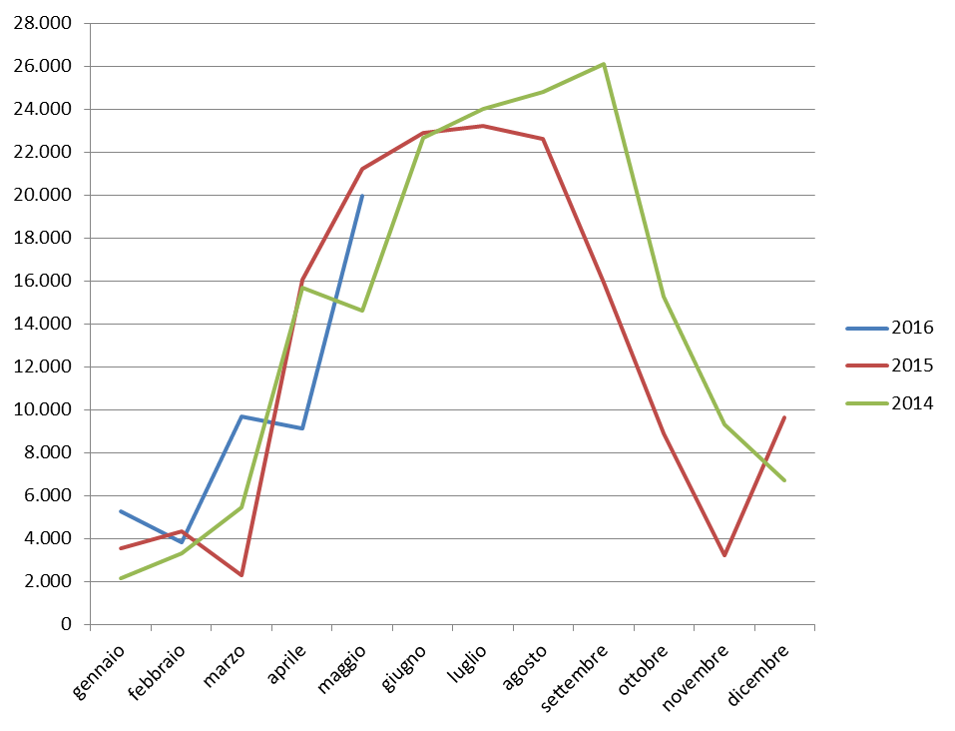
Italian data collection on asylum
Landings in Italy
Source of data: DIPPS

Slide 12
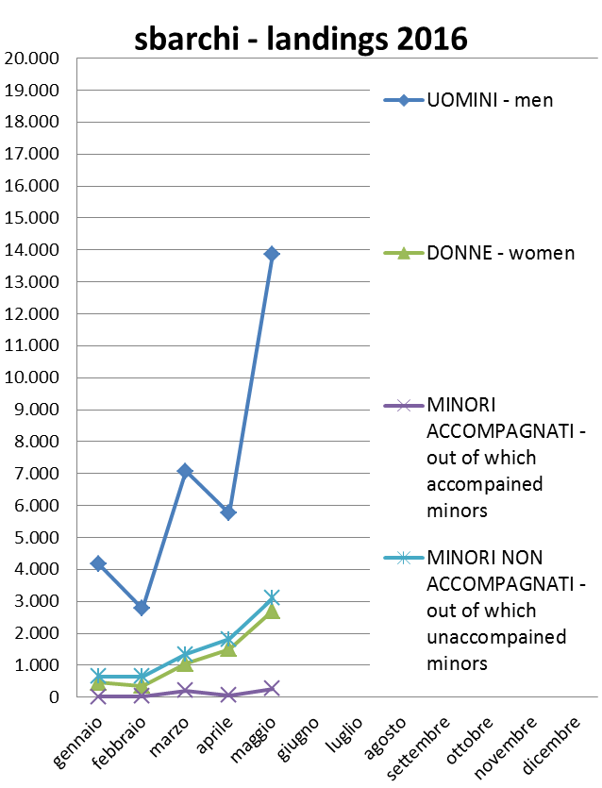
Italian data collection on asylum
Landings in Italy

Slide 13
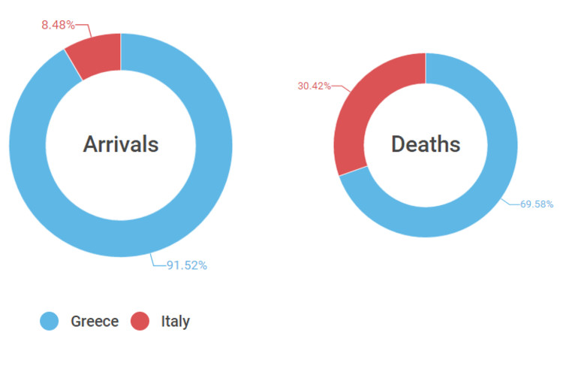
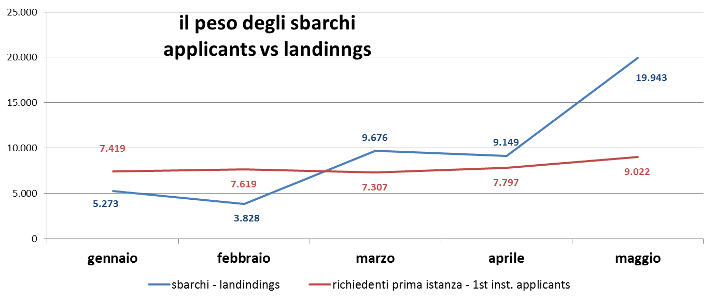
Italian data collection on asylum
Landings
Deaths and arrivals by route in 2016, to March 24. Data: IOM; Elaboration: www.medmig.info, Author provided
Source of data: DIPPS and VESTANET

Slide 14
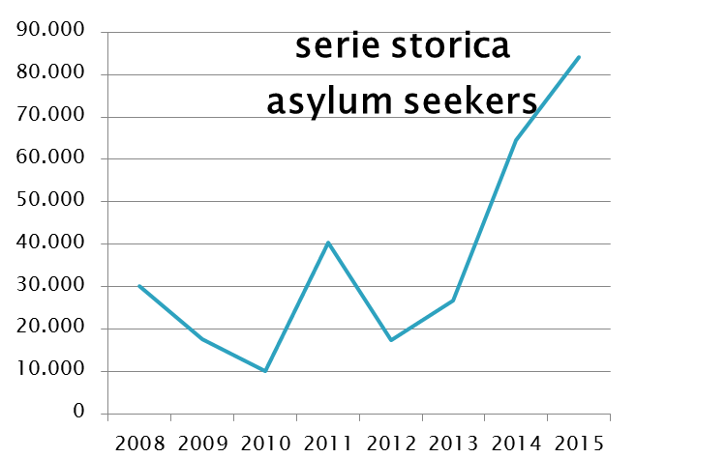
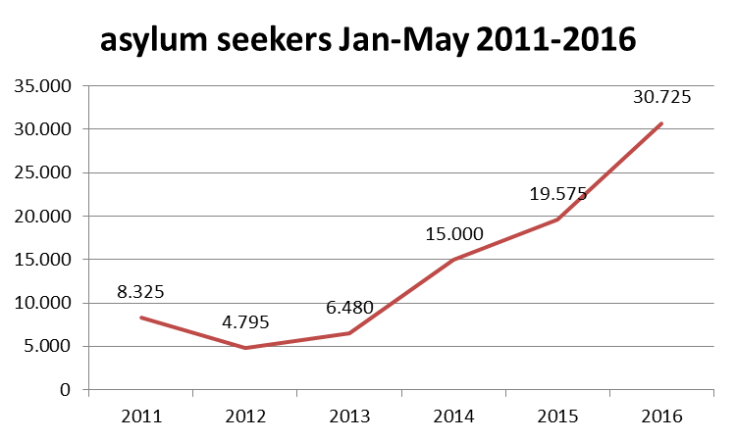
Italian data collection on asylum
Asylum in Italy
Source of data: VESTANET and EUROSTAT

Slide 15
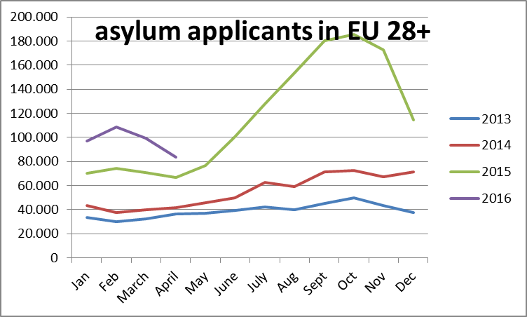
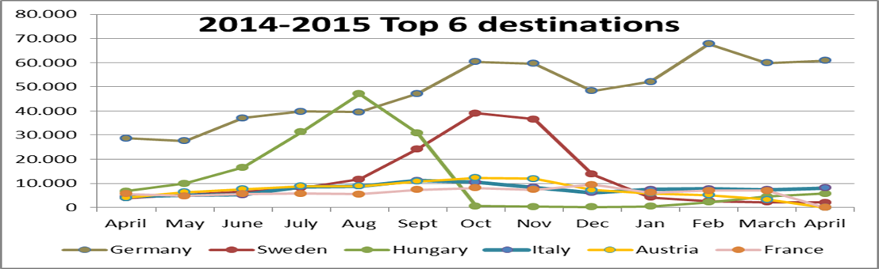
Italian data collection on asylum
Asylum in Europe
Source of data: Eurostat

Slide 16
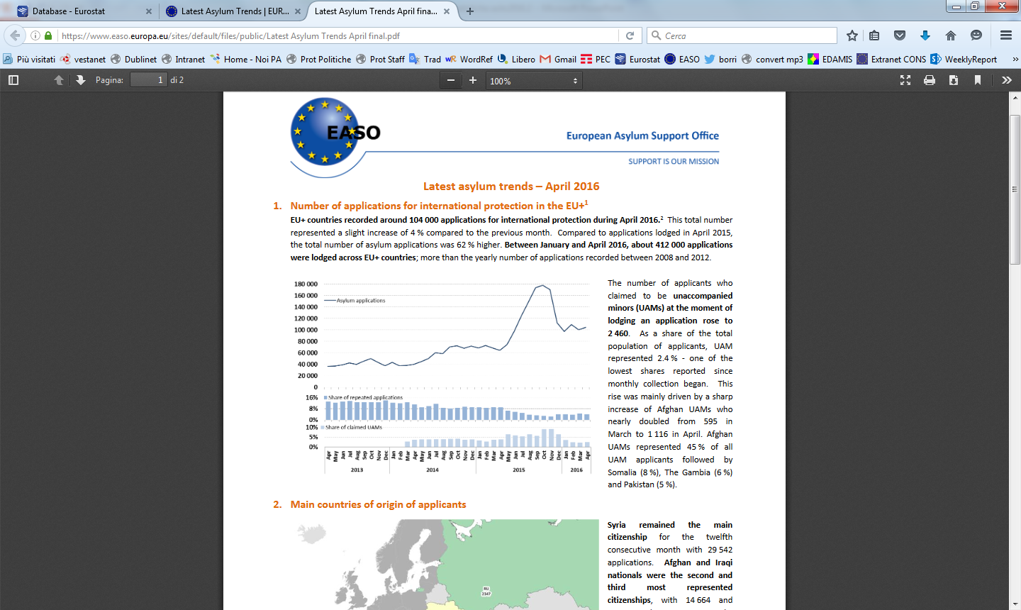
Italian data collection on asylum
April 2016: Asylum in EU
Source of data of data: EASO

Slide 17
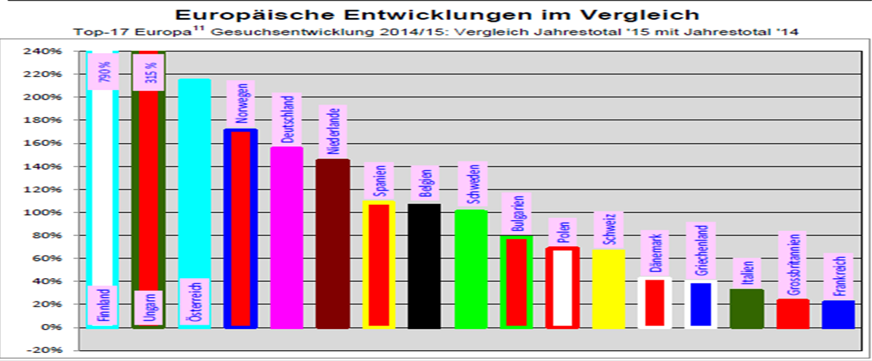
Italian data collection on asylum
Asylum in Europe 2014-2015

Slide 18
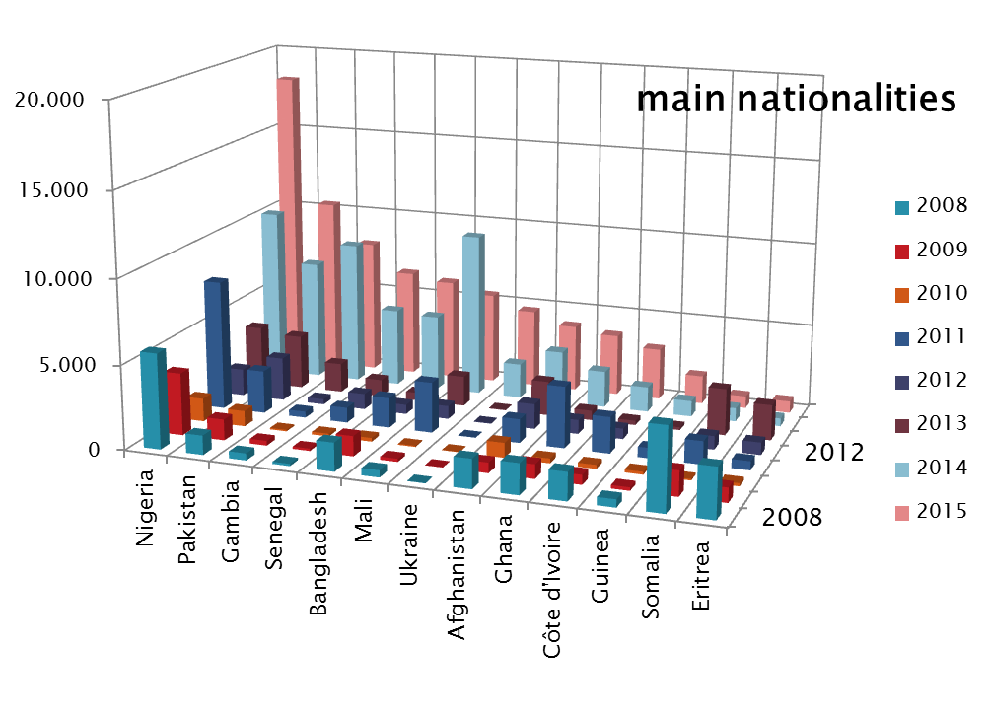
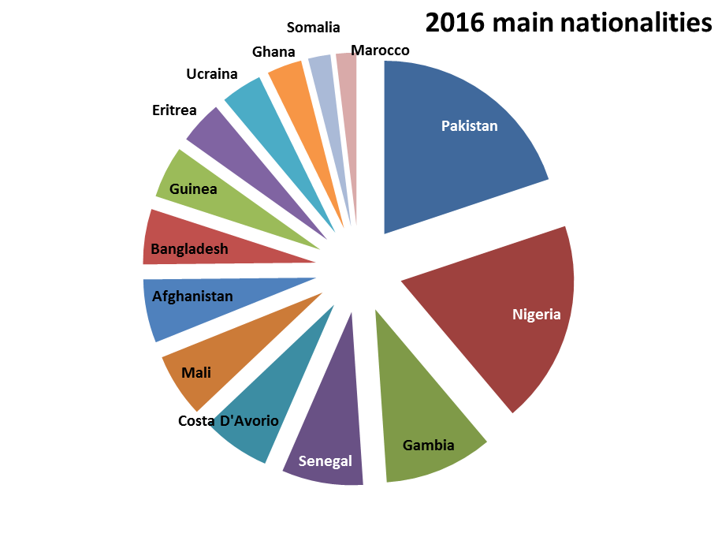
Italian data collection on asylum
Asylum in Italy
Source of data: VESTANET

Slide 19
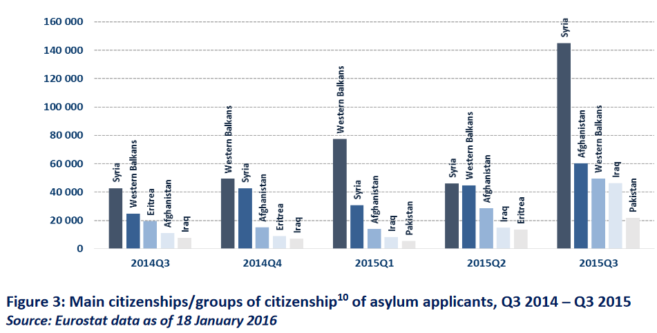
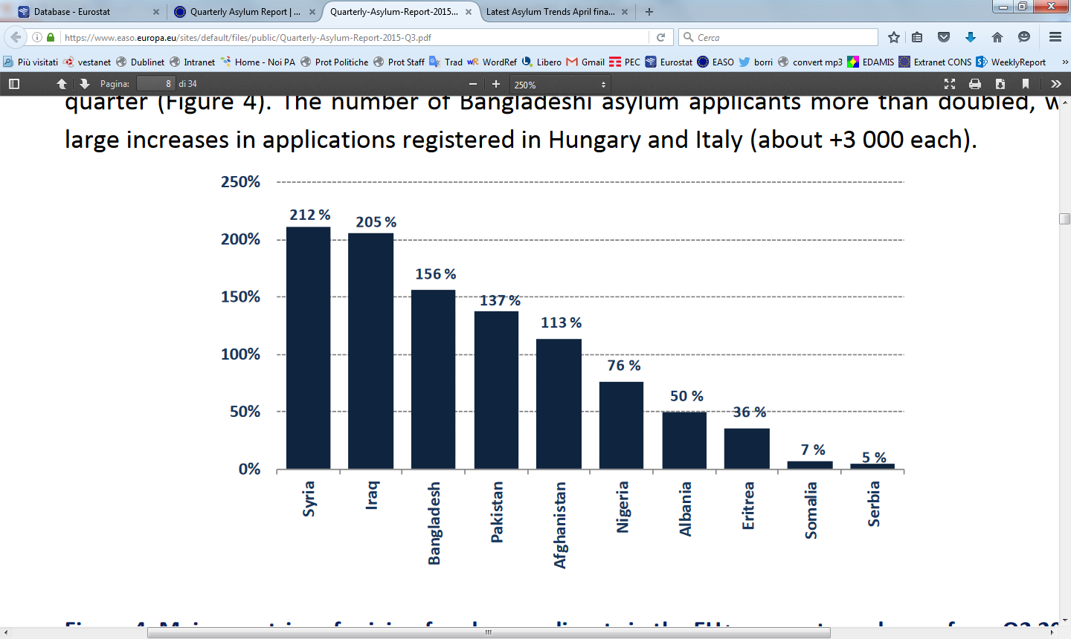
Italian data collection on asylum
April 2016: Asylum in EU
Main nationalities

Slide 20
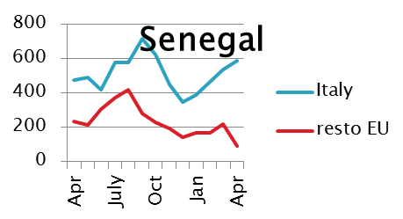
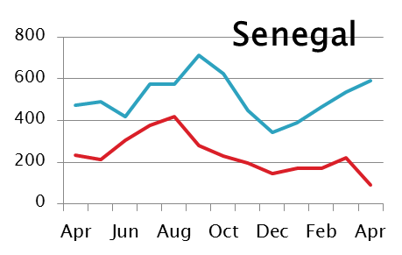
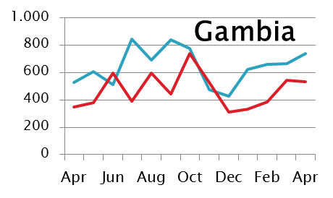
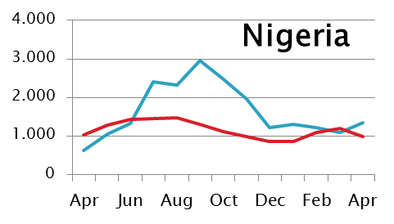
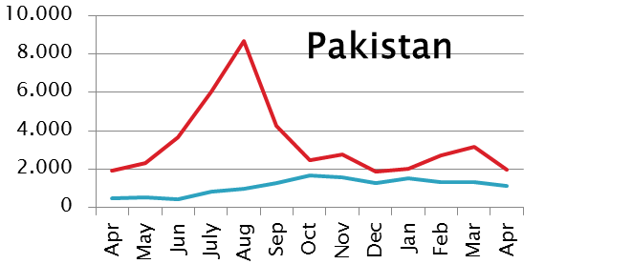
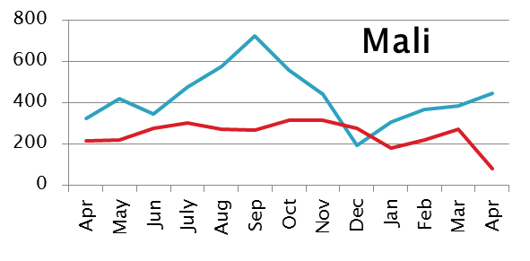
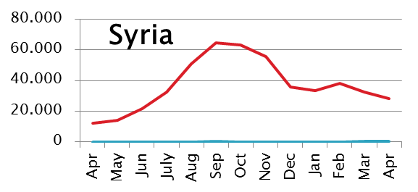
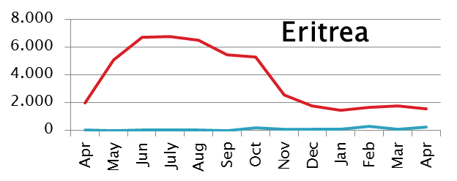
Italian data collection on asylum
Asylum In IT and EU
Source of data of data: EUROSTAT

Slide 21
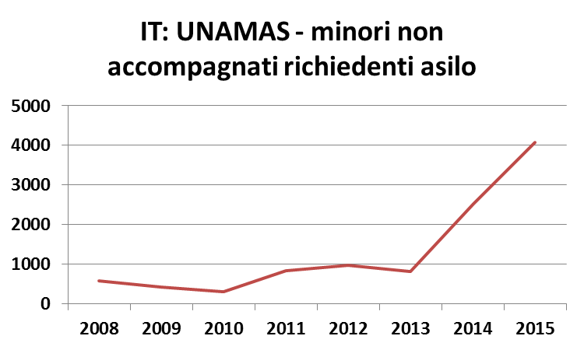
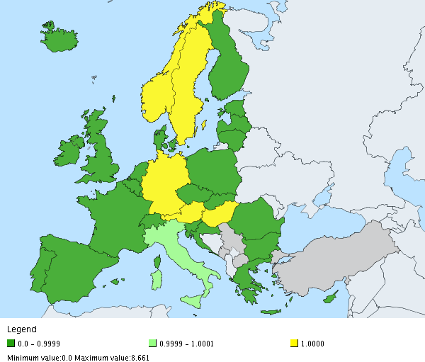
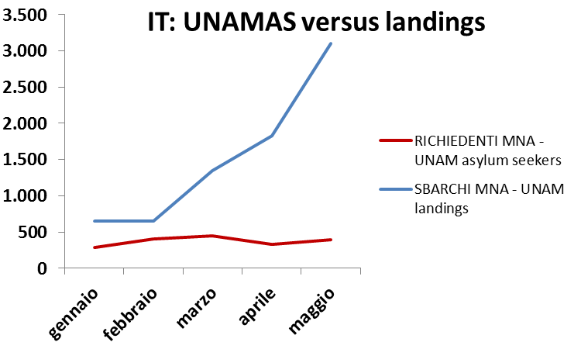
Italian data collection on asylum
Asylum seekers – focus minors
Source of data: EUROSTAT
UNAMAS 2015 compared with Italy
Source of data: VESTANET

Slide 22
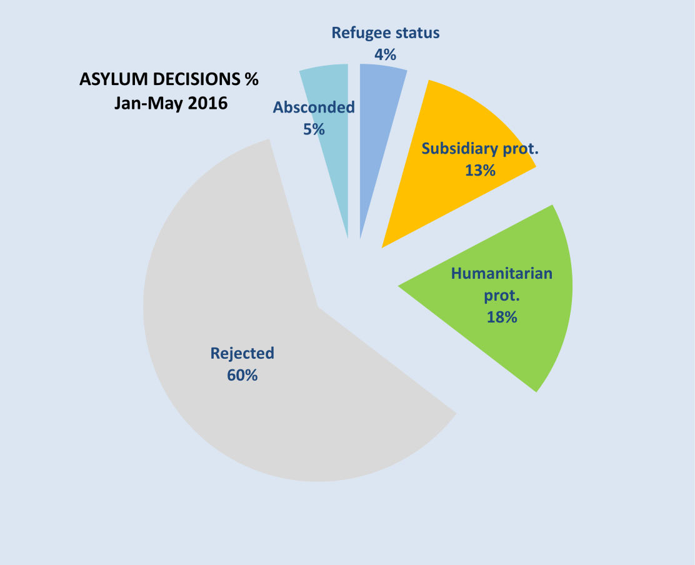
Italian data collection on asylum
Jan-May 2016: Asylum decisions
Main positive CoO | Refugee status | % | Subsidiary prot. | % | Human. prot. | % | Rejected | % | Total | International Protection (Refugees+ Subsidiary) %
Siria | 371 | 90% | 36 | 9% | 0 | 0% | 0 | 0% | 412 | 99%
Afghanistan | 147 | 9% | 1.462 | 88% | 17 | 1% | 19 | 1% | 1.667 | 97%
Somalia | 117 | 19% | 451 | 74% | 19 | 3% | 10 | 2% | 607 | 94%
Iraq | 58 | 21% | 188 | 70% | 12 | 4% | 4 | 1% | 270 | 91%
Libia | 17 | 15% | 82 | 71% | 9 | 8% | 1 | 1% | 115 | 86%
Eritrea | 85 | 42% | 77 | 38% | 8 | 4% | 9 | 4% | 203 | 80%
Turchia | 26 | 18% | 41 | 29% | 54 | 38% | 21 | 15% | 143 | 47%
Total | 1.768 | 4% | 5.265 | 13% | 7.374 | 18% | 24.432 | 60% | 40.699 | 100%
Source of data: VESTANET

Slide 23
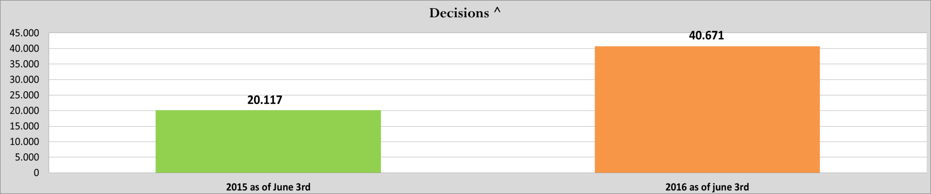

Italian data collection on asylum

Slide 24
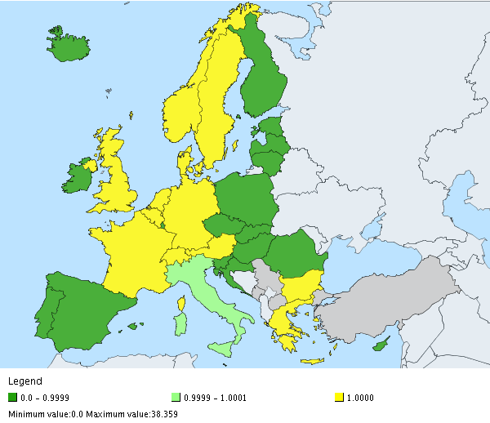
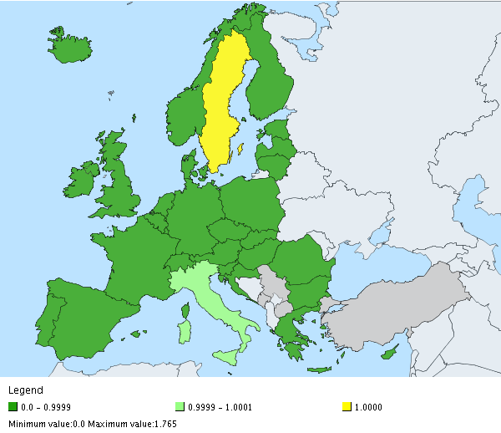
Italian data collection on asylum
Asylum decisions IT vs EU
Refugee status 2015 compared with Italy
Subsidiary prot. 2015 compared with Italy
Source of data: EUROSTAT

Slide 25
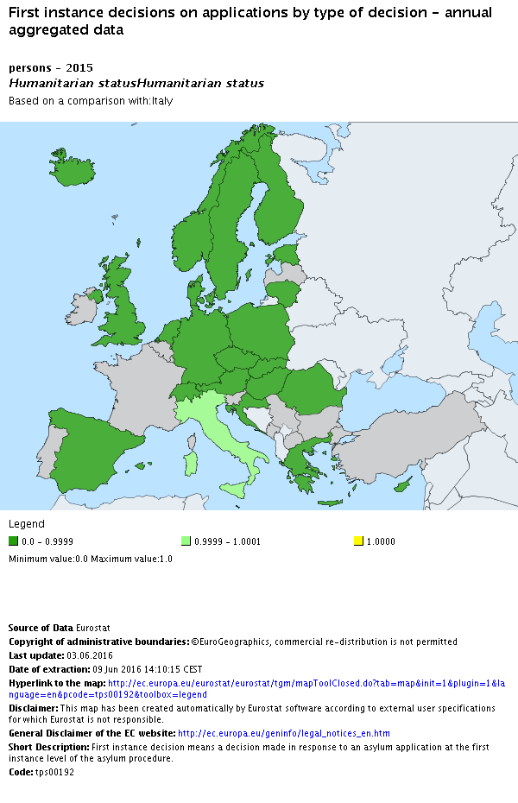
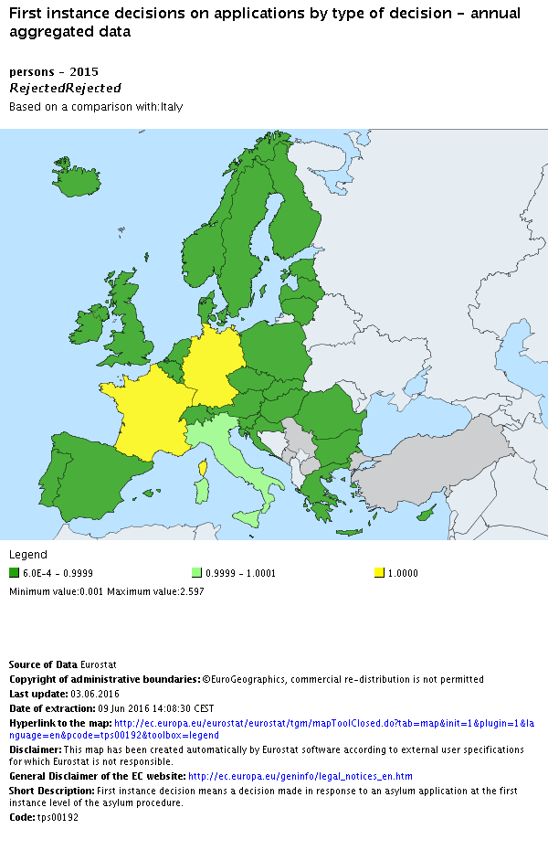
Italian data collection on asylum
Asylum decisions IT vs EU
Humanitarian 2015 compared with Italy
Rejection 2015 compared with Italy
Source of data: EUROSTAT

Slide 26
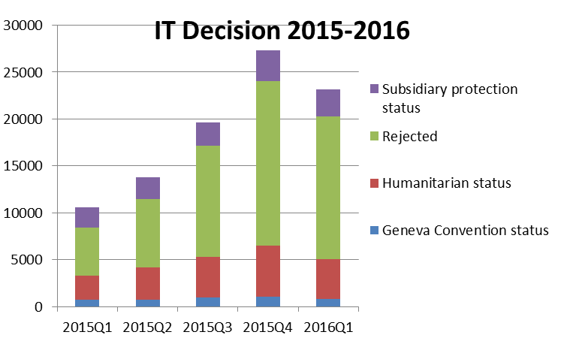
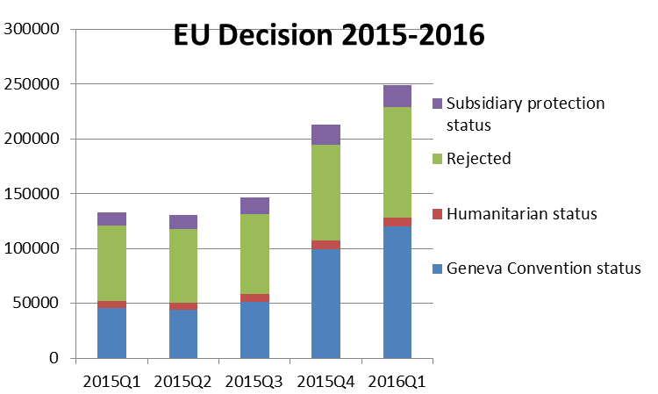
Italian data collection on asylum
2015- 2016: Asylum decisions IT vs EU
Source of data: EUROSTAT

Slide 27
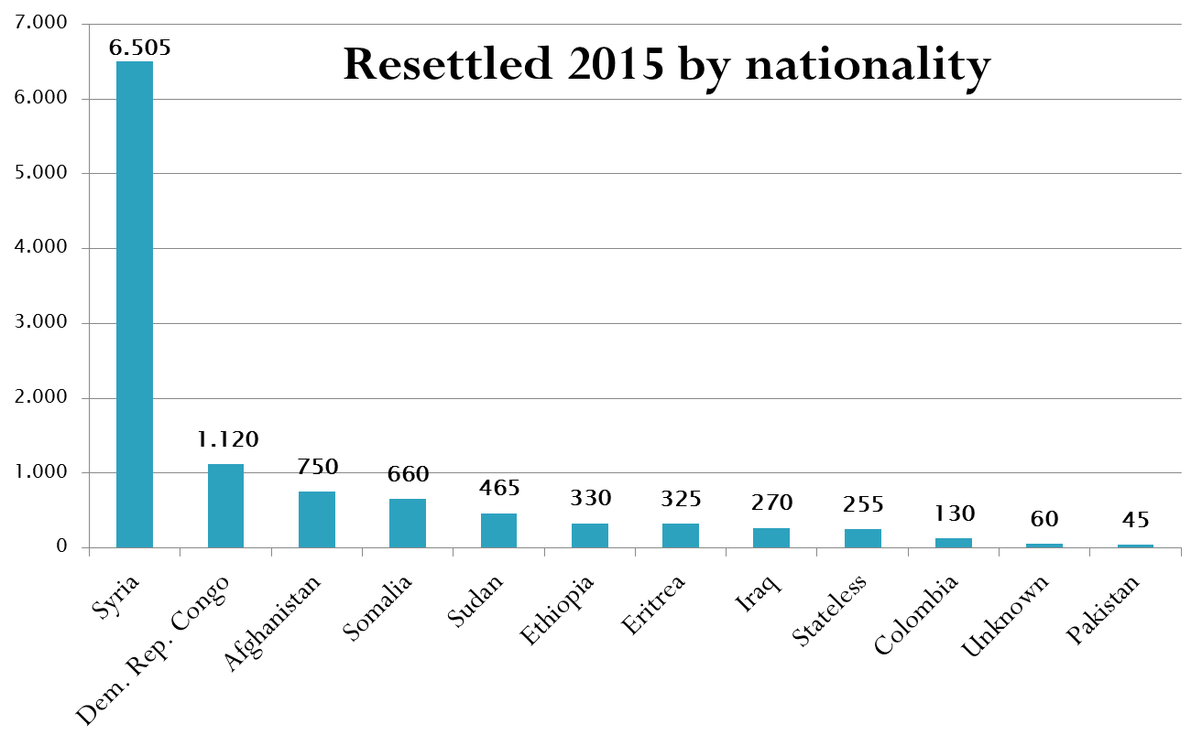
Italian data collection on asylum

Slide 28
Italian data collection on asylum
Relocated from IT and EL to other MS
Fonte: EASO

