Slide 1
WP5: Discussion
Laura Sauli
MIMOD Final workshop 12 April 2019

Slide 2
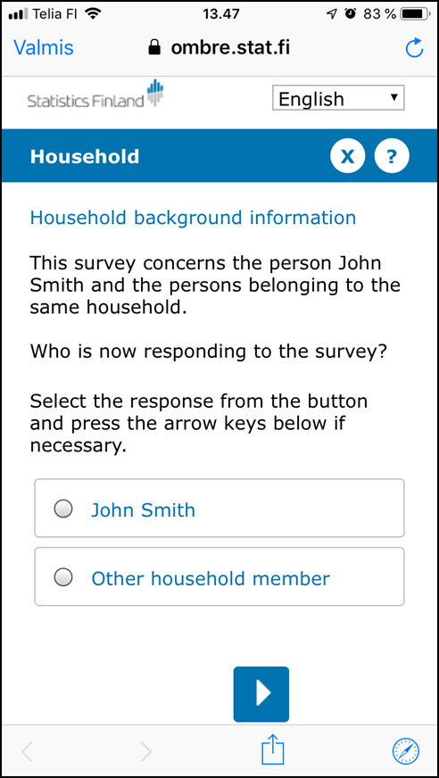
Mobile first as a strategy: should we do it?
Short answer: YES!
  We cannot choose the device for the respondent
  We cannot afford to lose the respondents whose only device is mobile
  Allows effective contact strategies
Mobile first = respondent first
  Developing mobile friendly questionnaires benefits questionnaires in general

Slide 3
Assessing fitness for mobile devices
Criteria presented are relevant
  But are they too difficult to implement?
Is it dangerous to talk about ”assessing the fitness”?
  What happens if a questionnaire gets a low score? Is the conclusion to stop all development work on the questionnaire?
  The current mode can also cause response burden and measurement error → doing nothing is not a good option
Identifying some surveys as more challenging (SILC)
  Can be misleading, as the surveys are conducted in country-specific ways
  Maybe the evaluation should start from a clean page?

Slide 4
Mobile friendly questionnaires: how to do it?
Transformation of the questionnaire (not translation from CATI but also redesigning CATI and web-questionnaire)
Shorter surveys:
  Removing questions is often possible even if at first seems impossible
  Eurostat: reconsider the number of variables and mandatory questions?
Questionnaire layout:
  Invest in developing and testing a common mobile friendly layout for all questionnaires
Shorter and simpler questions:
  Possible, but requires a lot of iterations and testing
  Eurostat: Re-evaluate the model questionnaires and variables from this perspective?

Slide 5

Conclusions
Brakes in time series will happen → this is the place to make bold improvements and simplifications into the questionnaire and improve the questionnaire
Everything has to be redesigned to make to questionnaire/survey to fit for smartphones
Design boldly – tailored design gives better respondent experience and makes the questions easier to understand.
merja.kallio-peltoniemi@stat.fi
Make long questionnaire shorter with questionnaire changes and design solutions (fewer clicks, checkbox questions, dynamic answering buttons).
Make respondent friendly questionnaire: pretest – redesign – pretest – redesign. Iterative approach is recommended.
DEMO (SILC):
https://youtu.be/t5i6Gt0R2bw

Slide 6
Sensor data: early days
We know what is or should be possible to do, but do not (yet) have the means to do it → frustrating!
Criteria presented and assessment of ESS surveys gives interesting insight and food for thought
  Does it help in practice?
  Do we need to start from what is doable / available?
Further concerns:
  Can we invest enough in the development work? Common apps are not enough, they need to be integrated in the IT-infrastructure
  What happens to harmonization and comparability?
  Fast development: how do we know what solutions work in 5 years?

