Slide 1





ROME
April 11^{th |} 12th 2019
MIMOD
Mixed-Mode Designs for Social Surveys
FINAL WORKSHOP
WP5 Deliverable 4 - Summary results from testing of responsive designs for ICT and LFS
Vivian Meertens & Dag F. Gravem
Statistics Netherlands (CBS), Statistics Norway (SSB)

Slide 2
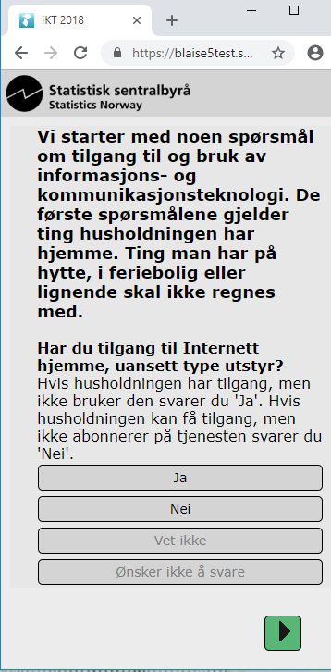

Work package 5 – ICT survey tests
Current ICT is CATI only, embedded in omnibus survey. Discussions to make it a standalone CAWI/CATI survey
Test questionnaire based on existing CATI questionnaire: practically all introductions and clarifications were kept
Responsive design: implementation of work-in-progress style sheets optimized for a smartphone while retaining consistency with Stats Norway’s website design principles
developed at SSB and built in Blaise 5 for cross-platform (Android, iOS) application development.
One single question per screen.
  Grid questions split into sequences of yes/no
Rare examples of vertical scrolling necessary.
MIMOD project - Mixed-Mode Designs in Social Surveys
Rome, 11-12 April 2019

Slide 3
Work package 5 – ICT survey tests
8 test persons with similar age characteristic: 25-35
Comfortable using smartphones for a variety of purposes
Avoid variation due to differences in familiarity with technology – results not representative of general population
Bring your own device for more realistic test situation
Eyetracking – less successful
ID | Age (approx.) | Gender | Device features/ Type of smart phone
1 | 30 | Man | Large iPhone
2 | 25 | Woman | Large iPhone
3 | 27 | Woman | Medium Samsung, broken screen
4 |  | Woman | Small iPhone (SE)
5 | 26 | Man | Medium Samsung
6 | 30 | Man | Small iPhone (SE), broken screen
7 | 25 | Man | Medium iPhone
8 | 25-30 years | Woman | Large iPhone
MIMOD project - Mixed-Mode Designs in Social Surveys
Rome, 11-12 April 2019

Slide 4
Work package 5 – Results ICT: Usability
Owners of small iPhones had to scroll to see all response options.
One case of a test subject not understanding that (s)he had to scroll down to see the next button
Confusion regarding auto-forwarding:
  Initially, many test subjects expected having to use buttons to navigate
  Soon, they got used to the functionality
  Auto-forwarding often happened so fast that test subjects were unsure whether they had answered correctly
    Solution: Add a short delay before auto-forwarding
  But on questions where multiple options can be selected there is no auto forwarding – leading to renewed confusion
    Solution: Discard auto-forwarding??
MIMOD project - Mixed-Mode Designs in Social Surveys
Rome, 11-12 April 2019

Slide 5
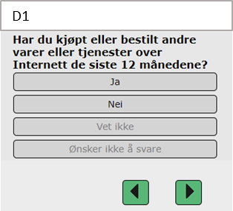
Work package 5 – Results ICT: Usability
Don’t know and Refusal buttons
  Always visible and available, but presented as greyed-out to distinguish from substantial response options
  Test subjects noticed them, in the words of one of them: “I got the impression you didn’t want me to use them”
  Still, five of eight did select Don’t know on questions with difficult terms and difficult recall tasks, e.g. D1
  Substantial, not casual Don’t know
MIMOD project - Mixed-Mode Designs in Social Surveys
Rome, 11-12 April 2019

Slide 6
Work package 5 – Recommendations for ICT mobile questionnaire
General recommendations valid also for other modes and screen sizes
Reduce long texts in introductions, questions, instructions and response categories
Reduce the number of response categories
Limit the number of sub-questions in batteries (e.g. converted grids)
  Difficult to get overview with screen-by-screen design
  CBS had a more fruitful approach
Avoid repeating text from screen to screen in such batteries
  But do repeat every 4th of 5th screen
Use design and navigation to avoid confusion regarding which answer(s) has/have been selected
MIMOD project - Mixed-Mode Designs in Social Surveys
Rome, 11-12 April 2019

Slide 7
Work package 5 – Results LFS
Responsive design: implementation of style sheets optimized for a smartphone developed at CBS and built in Blaise 5 for cross-platform (Android, iOS) application development.
Individual sample approach. This LFS questionnaire is under redesign due to a new (not final) regulation of input harmonisation for measuring employment and unemployment.
One single question on a screen. Maximum of two (interrelated) questions at one screen if necessary. The formulation of the question and answer question text is shortened as much as possible.
In general minimum level of scrolling is allowed, meaning no horizontal scrolling and sometimes vertically scrolling as with the grid questions.
Instructions texts are limited and included on the same screen. No buttons with instruction texts or help function are used in the visual design.
The questionnaire is shortened as some questions are left out in this version for the first wave. This LFS questionnaire was fielded in a sample of the general population aged 15-74 years as a pilot at CBS in November 2018.
MIMOD project - Mixed-Mode Designs in Social Surveys
Rome, 11-12 April 2019

Slide 8
Work package 5 – Results LFS
Resnr | Age | Gender | Main status: employed, unemployed, student, pensioner or other | Educational level | Device used for testing LFS
1 | 21 | Male | Student, currently working full-time paid internship and has side job | High | laptop (CBS)
2 | 41 | Female | works as employee | Medium | smartphone Samsung Galaxy 6 edge
3 | 49 | Female | working from an employment agency, lookig for work | High | Iphone 6S+
4 | 55 | Male | works 9hrs a week as employee, has income from social security (incapacitated) | Low | laptop (CBS)
5 | 40 | Male | Incapacitated | Low | Samsung galaxy S7
6 | 62 | Male | Incapacitated | High | laptop (CBS)
7 | 54 | Male | works as employee | Medium | Samsung A5
8 | 56 | Female | Unemployed | High | laptop (CBS)
9 | 16 | Female | student, with small side job | Low | Iphone X
10 | 46 | Female | self-employed | Medium | Iphone 6 (CBS)
11 | 50 | Male | works as employee | High | Ipone XS
12 | 53 | Female | Works as employee (a larger job and a small side job) and is looking for work | Medium | iPad
13 | 52 | Male | Houseman | Medium | iPad
14 | 24 | Female | student with side job | High | Smartphone Sony X2
15 | 39 | Female | housewife, looking for job, does volunteer work | Low | tablet Galaxy S2
16 | 54 | Female | Unemployed | Medium | iPhone)
17 | 23 | Male | just finished school, looking for work | High | laptop (CBS)
18 | 24 | Male | works as employee | Low | smartphone Samsung Galaxy
19 | 36 | Male | works as employee | Low | iPad (CBS)
20 | 58 | Male | incapacitated, self-employed | High | iPhone
MIMOD project - Mixed-Mode Designs in Social Surveys
Rome, 11-12 April 2019

Slide 9
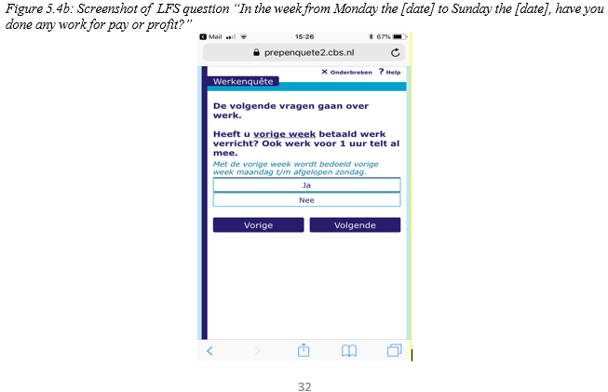
Work package 5 – Screen size and style sheets
MIMOD project - Mixed-Mode Designs in Social Surveys
Rome, 11-12 April 2019

Slide 10
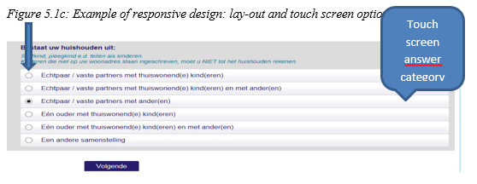
Work package 5 – Touch navigation
MIMOD project - Mixed-Mode Designs in Social Surveys
Rome, 11-12 April 2019

Slide 11
Work package 5 – General usability findings CBS (1)
Less is more: it takes more effort to read information from a small screen. The required effort to find relevant information is higher if this information is outside the viewable space.
The colouring and font for questions was generally appreciated. However, several respondents indicated that slightly larger letters and more contrast would be better. The legibility of the text in the answer buttons was considered somewhat less. The italic, blue letters for the introduction text were often not read and considered more difficult to read.
For the touchscreen devices, and especially smartphones, we saw that selecting the correct answer options required more effort from respondents. This was partly caused by the fact that the touch targets in our questionnaires seemed too small and too close together. Respondents had to be very careful to select the right option. In literature on usability also called ‘fat finger problem’.
Possibly, the buttons for the answer options on the touch screen devices are also too broad. In some cases that posed problems in case of scrolling, as respondents then accidentally selected an answer.
The ‘no answer’ button is too close to the substantial answer buttons. This increases the chance of erroneous answers. A visual distinction is needed here, more space.
MIMOD project - Mixed-Mode Designs in Social Surveys
Rome, 11-12 April 2019

Slide 12
Work package 5 – General usability findings CBS (2)
Number of questions on a screen: some respondents expressed appreciation for the fact that there is mostly only one question per screen.
Scrolling: vertical scrolling is no problem for any respondent, even the ones with less experience using touchscreen devices, and all scroll spontaneously. Sometimes however, an answer is erroneously selected by scrolling.
On the current CBS smartphone stylesheets there is no visual difference between “select all that apply” questions and single choice questions. This sometimes confused respondents.
MIMOD project - Mixed-Mode Designs in Social Surveys
Rome, 11-12 April 2019

Slide 13
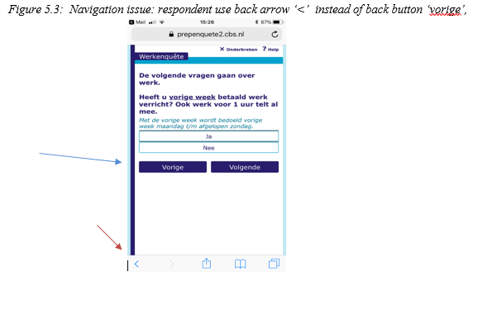
Work package 5 – General usability findings CBS (3)
From observations: a few times respondents on smartphones accidentally navigated in the questionnaire using the back button from the phone itself (the symbol ‘<’see red arrow ) instead of the back-button of the survey ‘vorige’ (blue arrow). This causes them to leave the questionnaire and having to login again.
MIMOD project - Mixed-Mode Designs in Social Surveys
Rome, 11-12 April 2019

Slide 14
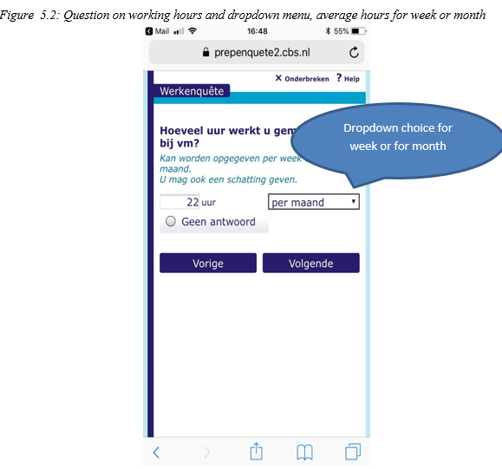
Work package 5 – General usability findings CBS (4)
Although most respondents did not have problems with the dropdown choice for week / month in the LFS question on number of contract hours, it did not work as intended for all respondents. The chance of faulty answers is real. It might be better to offer the two answers as multiple choice.
MIMOD project - Mixed-Mode Designs in Social Surveys
Rome, 11-12 April 2019

Slide 15
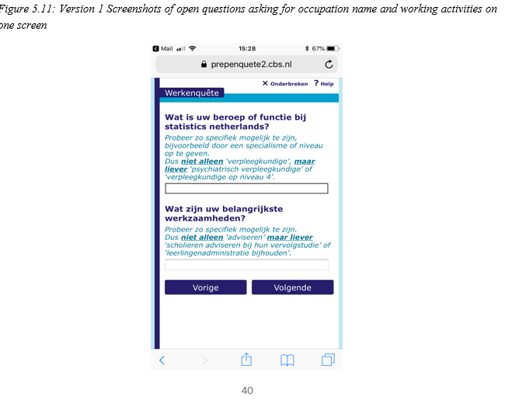
Work package 5 – Touch navigation: open issues
Open questions: it was not always clear for respondents that an open text field was active, they expected some visual; indication as for example a blinking cursor to indicate that they could start typing.
MIMOD project - Mixed-Mode Designs in Social Surveys
Rome, 11-12 April 2019

Slide 16
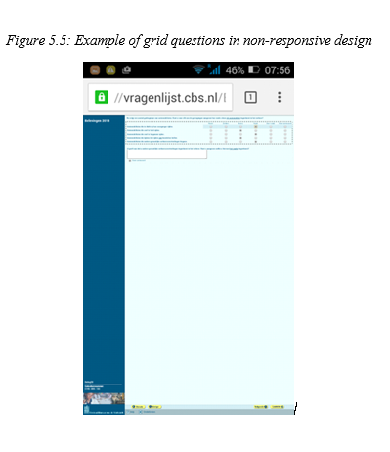
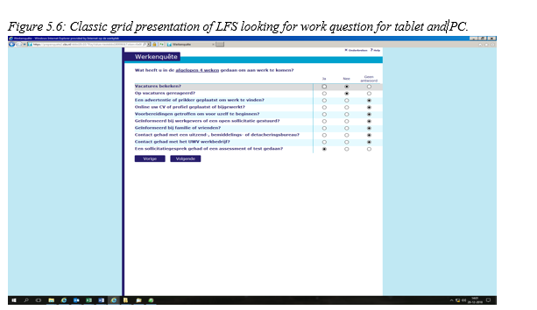
Work package 5 – Screen size: grid questions (1)
MIMOD project - Mixed-Mode Designs in Social Surveys
Rome, 11-12 April 2019

Slide 17
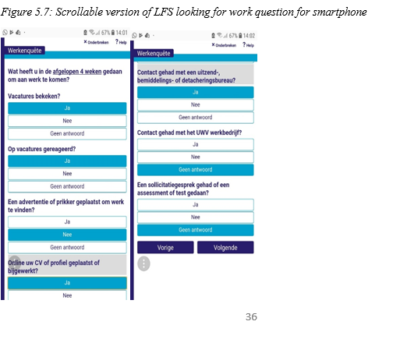
Work package 5 – Screen size: grid questions (2)
MIMOD project - Mixed-Mode Designs in Social Surveys
Rome, 11-12 April 2019

Slide 18
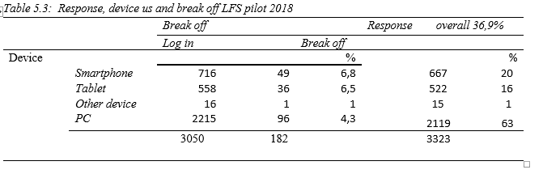
Work package 5 – Enjoyment relevance & burden
MIMOD project - Mixed-Mode Designs in Social Surveys
Rome, 11-12 April 2019

Slide 19
Work package 5 – Recommendations screen size
Dimension | Criterion | Design options
Screen size | Introductions | Limit amount of and text length of instruction and introduction text Position introductions on separate pages with separate back-forward buttons Include shortened instruction that is crucial in the question text Make introductory information that is not essential for all respondents available behind expandable links that indicate which information may be found behind it.
 | Grid questions | Fix the stem of the questions and either allow for swiping between items on multiple pages horizontally or collapsing items vertically Allow for scrolling vertically (but avoiding horizontal scrolling) Use numbers, letters or visual features to distinguish between the different items More research testing and developments are needed for choices of most device friendly design
 | Question text | Shorten question texts Make clarifying information that is not essential for all respondents available behind expandable links that indicate which information may be found behind it (further testing needed)
 | # answer cat’s | Reduce number of categories Split into multiple questions, possibly hierarchically
 | Answer text | Shorten answer texts and avoid repetition from question text Make clarifying information that is not essential for all respondents available behind expandable links that indicate which information may be found behind it (further testing needed)
MIMOD project - Mixed-Mode Designs in Social Surveys
Rome, 11-12 April 2019

Slide 20
Work package 5 – Recommendations touch navigation
Touch navigation | Open question | Attempt to replace open questions by closed questions Position open questions on separate pages Choose a visual design with an open text field with enough space where respondents see all the words or the last complete lines what they are typing in Introduce visualization to indicate completeness/richness of answer data with for instance colours, red, orange, green or indicate a maximum number of words
 | Many answers | Use auto-search or auto-fill Split into multiple questions, possibly hierarchically Remove response categories that are very rarely used, and add an “Other” option. Use numbers or letters to distinguish between the different items
MIMOD project - Mixed-Mode Designs in Social Surveys
Rome, 11-12 April 2019

Slide 21
Work package 5 – Recommendations duration
Duration | # of items | Reduce length of the survey Split into multiple waves in a panel design Consider to use a split questionnaire design with randomization
 | Household | Move from household to person survey
 | Database | Rely more heavily on processing and analysis afterwards Perform checks at data collection web server Further developments and testing is needed to evaluate the use and fill in of retro-data on usability and data quality.
 | Complexity | Reduce number of complex questions Inform respondents that using larger screens and quiet surroundings when filling in the questionnaire is advisable in the survey invitation/information materials Use contact modes that are compliant with access to appropriate response mode Research possibilities to make the survey more enjoyable (to some extent)
 | Enjoyment Relevance Burden | Make the survey attractive and appealing on a smartphone Utilize proven design of existing apps and websites Add value to the survey by afterwards feeding back information to the respondent
MIMOD project - Mixed-Mode Designs in Social Surveys
Rome, 11-12 April 2019

Slide 22


Work package 5 – Discussion
Is a mobile device a separate mode when applied to ESS surveys?
Shall/must we consider the Smartphone in the close future as the “first mode” and thus the ultimate focus, leading perspective?
Should MQs be shortened in the future?
…..
MIMOD project - Mixed-Mode Designs in Social Surveys
Rome, 11-12 April 2019

