Slide 1





ROME
April 11^{th |} 12th 2019
MIMOD
Mixed-Mode Designs for Social Surveys
FINAL WORKSHOP
Overview of objectives
WP5 Deliverable 1- Assessment of fitness of ESS surveys for smartphone
Vivian Meertens
Statistics Netherlands (CBS)

Slide 2

Work package 5 – Mobile device surveys in ESS
Deliverable contains:
Exploration for the mobile device option in ESS surveys
Elaboration of fitness criteria for mobile device use
Assessments of fitness criteria to ESS surveys model questionnaires and country specific implementations of the EHIS, EU-SILC, ICT and LFS
Results of these assessment of the four ESS surveys
Recommendations for these four surveys
MIMOD project - Mixed-Mode Designs in Social Surveys
Rome, 11-12 April 2019

Slide 3
Work package 5 – Objective 1 mobile device surveys
Disparity of modes:
Presence of an interviewer:
    Sensitivity of survey topics
    Assistance for complex terminology and wording
    Motivation for longer surveys
Pace/speed of the interview;
Presentation (oral, visual)
Timing of the interview
MIMOD project - Mixed-Mode Designs in Social Surveys
Rome, 11-12 April 2019

Slide 4




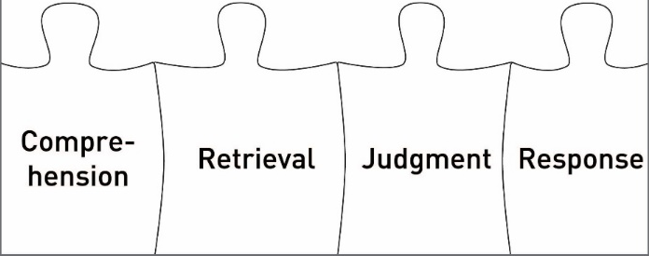


Question & Answer process & Modes
Stimulus
Visual or oral
Question
Response
Visual or Oral
Answer
Respondent
Tourangeau (1984, 2013)
Notes:
In this WP, the focus is on the last two features, i.e. assuming that the surveys can be done without an interviewer.

Slide 5
Work package 5 – Objective 1 mobile device surveys
Fitness of ESS surveys for smartphones
Three dimensions are considered in the assessment:
Screen size: Smartphones have a wide variety of screen sizes, but are typically much smaller than traditional devices
Touch Navigation: Screens are used for presentation as well as for navigation
Duration: Since smartphones can be used for multiple purposes simultaneously, can be used anywhere and anytime, and have smaller screen sizes, it is conjectured that length is an issue
MIMOD project - Mixed-Mode Designs in Social Surveys
Rome, 11-12 April 2019

Slide 6
Operationalization of Fitness criteria
Dimension | Criterion | Operationalization
Screen size | Introductions | Number of items with introductions Number of items with instructions included
 | Grid questions | Number of grid questions Average number of items per grid
 | Question text | Number of items with > 20 words (excluding introduction text)
 | # answer cat’s | Number of items with > 5 answer categories
 | Answer text | Number of items with > 10 words in at least one category
Touch Navigation | Open question | Number of open questions
 | Many answers | Number of items with > 25 answer categories
Duration | # of items | Total number of items Average duration of survey per respondent
 | Household | Is survey a household survey? Yes/no
 | Database | Does survey require interaction with a database? Yes/no
 | Complexity | Number of (anticipated) items that require calculations by a average respondent Number of (anticipated) items that require consultation of personal documentation by a average respondent
 | Enjoyment Relevance & Burden | Response rate to traditional online devices

Slide 7
Work package 5 – Objective 1 mobile device surveys
Assessment of the ESS surveys:
Both the Eurostat Model Questionnaire and the country-specific implementations.
For the EU-SILC no model questionnaires exist, but, instead, Eurostat has disseminated a set of guidelines.
Each NSI (Norway Netherlands Germany) coded in Excell the MQ (except EU-SILC) and county specific questionnaire.
Assessments were done by at least two colleagues individual and discussed differences (if any).
MIMOD project - Mixed-Mode Designs in Social Surveys
Rome, 11-12 April 2019

Slide 8
Results of assessments for EHIS
Dimension | Criterion | Scores
 |  | Model | SSB
Screen size | Introductions | 19 | 15
 | Instructions | 23 | 40
 | Grids | 0 | 0
 | #item per grid | NA | NA
 | Question text | 1 | 14
 | # answer cat’s | 5 | 4
 | Answer text | 0 | 0
Touch navigation | Open question | 0 | 0
 | Many answers | 0 | 0
Duration | # of items | 118 | 153 + 150
 | Av duration | NA | 34 min
 | Household | No | No
 | Database | Yes | No
 | Cogntv burden | 29 | 21
 | Consultation | 2 | 6
 | Enj-Rel-Bur | 35,9% (web) 54,5% (total) | 59% (CATI)

Slide 9
Results of assessments for EU-SILC
Dimension | Criterion | Scores
 |  | DESTATIS | CBS
Screen size | Introductions | 0 | 34
 | Instructions | 43 | 42
 | Grids | 17 | 7
 | #item per grid | 7 | 5.7
 | Question text | 5 | 20
 | # answer cat’s | 33 | 37
 | Answer text | 37 | 2
Touch navigation | Open question | 5 | 16
 | Many answers | 5 | 0
Duration | # of items | 329 | 262 (140 proxy)
 | Av duration | 55 min | 32 min
 | Household | Mix | No
 | Database | No | No
 | Cogntv burden | 1 | 9
 | Consultation | 87 | 16
 | Enj-Rel-Bur | NA | 33%

Slide 10
Results of assessments for ICT
Dimension | Criterion | Scores
 |  | Model | CBS | DESTATIS
Screen size | Introductions | 5 | 26 | 17
 | Instructions | 4 | 4 | 16
 | Grids | 1 | 23 | 0
 | #Items per grid | 6 | 2 | NA
 | Question text | 13 | 39 | 26
 | # answer cat’s | 7 | 13 | 10
 | Answer text | 3 | 16 | 5
Touch navigation | Open question | 0 | 5 | 9
 | Many answers | 0 | 0 | 0
Duration | # of items | 39 | 140 | 61
 | Av duration | NA | 23 min | NA
 | Household | No | No | No
 | Database | No | No | 2
 | Cogntv burden | 7 | 7 | 1
 | Consultation | 3 | 4 | 2
 | Enj-Rel-Bur | NA | 33.1% (web) 36.9% (CATI) | NA

Slide 11
Results of assessments for LFS
Dimension | Criterion | Scores
 |  | Model | SSB |  |  | CBS
 |  |  | Employee | Unemployed | Student
Screen size | Introductions | 0 | 3 | 0 | 1 | 13
 | Instructions | 7 | 14 | 5 | 18 | 42
 | Grids | 0 | 0 | 0 | 0 | 4
 | #Items per grid | NA | NA | NA | NA | NA
 | Question text | 1 | 2 | 1 | 2 | 76
 | # answer cat’s | 18 | 1 | 4 | 3 | 41
 | Answer text | 14 | 1 | 0 | 0 | 4
Touch navigation | Open question | 4 | 5 | 0 | 4 | 70
 | Many answers | 0 | 0 | 0 | 0 | 16
Duration | # of items | 85 | 33 | 21 | 48 | 346
 | Av duration | NA | NA | NA | NA | 27 min
 | Household | Yes | Yes | Yes | Yes | Yes
 | Database | NA | No | No | No | Yes
 | Cogntv burden | 5 | 0 | 0 | 0 | 21
 | Consultation | 2 | 0 | 0 | 0 | 0
 | Enj-Rel-Bur | NA | NA | NA | NA | 22% (web) 54% (overall)

Slide 12
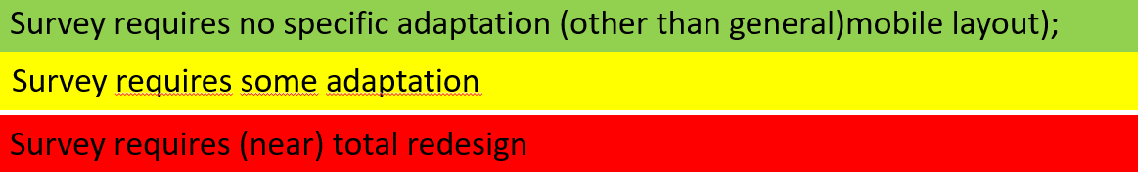
Work package 5 – Objective 1 mobile device surveys
MIMOD project - Mixed-Mode Designs in Social Surveys
Rome, 11-12 April 2019

Slide 13


Work package 5 – Objective 1 mobile device surveys
Is a mobile device a separate mode when applied to ESS surveys?
Does accepting mobile device response imply shortening of MQs and survey questionnaires or the use of advanced techniques such as split questionnaire/modular survey designs?
Shall/must we consider the Smartphone in the close future as the “first mode” and thus the ultimate focus, leading perspective?
MIMOD project - Mixed-Mode Designs in Social Surveys
Rome, 11-12 April 2019

