Slide 1





ROME
April 11^{th |} 12th 2019
MIMOD
Mixed-Mode Designs for Social Surveys
FINAL WORKSHOP
Mixed-mode questionnaire designs: Recommendations for Eurostat and NSIs
WP4
Dag F. Gravem
Statistics Norway

Slide 2

Mixed-mode questionnaire designs: Recommendations for Eurostat and NSIs
Agenda
Overview of WP4
Presentation of deliverables
Recommendations for discussion
Discussant Anette Björnram, Statistics Sweden
Open discussion
MIMOD project - Mixed-Mode Designs in Social Surveys
Rome, 11-12 April 2019

Slide 3
Overview of WP4
Mixed-mode questionnaire designs: Recommendations for Eurostat and NSIs
Main contributors
  Statistics Norway (WP leader)
  CBS
  Istat
Supporting contributor
  Destatis
MIMOD project - Mixed-Mode Designs in Social Surveys
Rome, 11-12 April 2019

Slide 4
Overview of WP4
Mixed-mode questionnaire designs: Recommendations for Eurostat and NSIs
Recommendations on approaches for developing web questionnaires for mixed-mode surveys
  Questionnaire level
  Question level
  Questionnaire elements
“Unimode vs. mode-specific questionnaires”
MIMOD project - Mixed-Mode Designs in Social Surveys
Rome, 11-12 April 2019

Slide 5
Overview of WP4
Mixed-mode questionnaire designs: Recommendations for Eurostat and NSIs
Feasibility of mixed-mode questionnaires and usefulness of MIMOD recommendations dependent on several factors
  Survey practices and infrastructure
  Survey communication options
  Survey content and requirements (from Eurostat)
MIMOD project - Mixed-Mode Designs in Social Surveys
Rome, 11-12 April 2019

Slide 6
WP4 Deliverables
Mixed-mode questionnaire designs: Recommendations for Eurostat and NSIs
A paper on mixed mode combinations and experiences at participating NSIs
A paper on survey communication in mixed-mode ESS surveys
A paper with recommendations for key questionnaire elements, questions and question types in mixed mode settings
Methodological report
MIMOD project - Mixed-Mode Designs in Social Surveys
Rome, 11-12 April 2019

Slide 7
WP4 Deliverable 1
Mixed-mode questionnaire designs: Recommendations for Eurostat and NSIs
Mixed mode experiences at European NSIs
  Data from MIMOD survey
    Mixed mode combinations in use
    Questionnaire differences
    Opinions on surveys not fit for CAWI
    Good and bad practices
  National case studies
    Stats Norway: Mixed mode in a historical perspective
    Istat: Recent experiences from census and aspects of life survey
    CBS: The “Omnimode” questionnaire design system
MIMOD project - Mixed-Mode Designs in Social Surveys
Rome, 11-12 April 2019

Slide 8
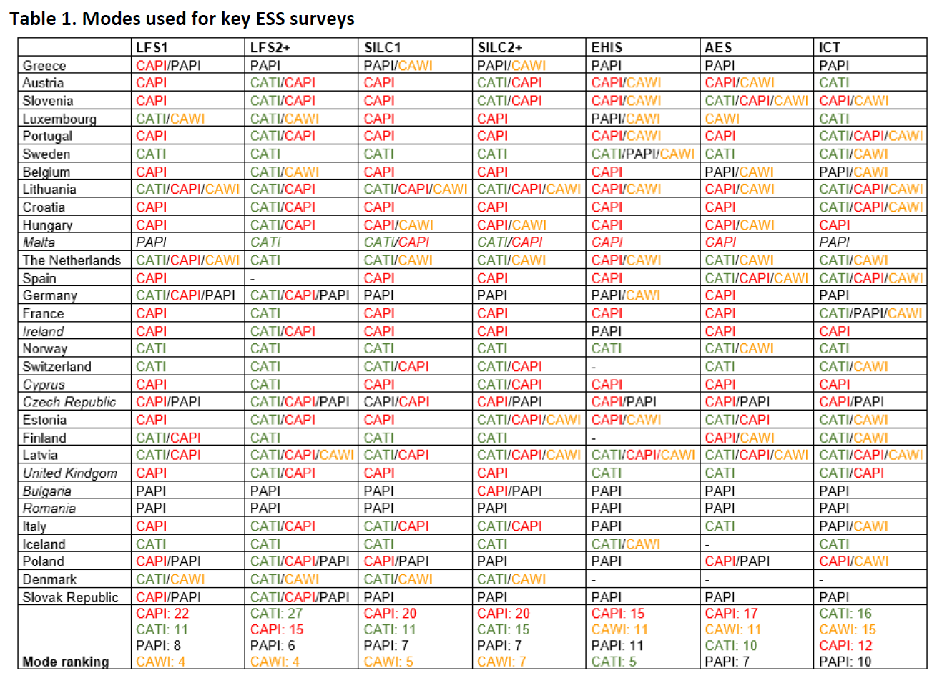
Deliverable 1: Mixed mode combinations in use

Slide 9
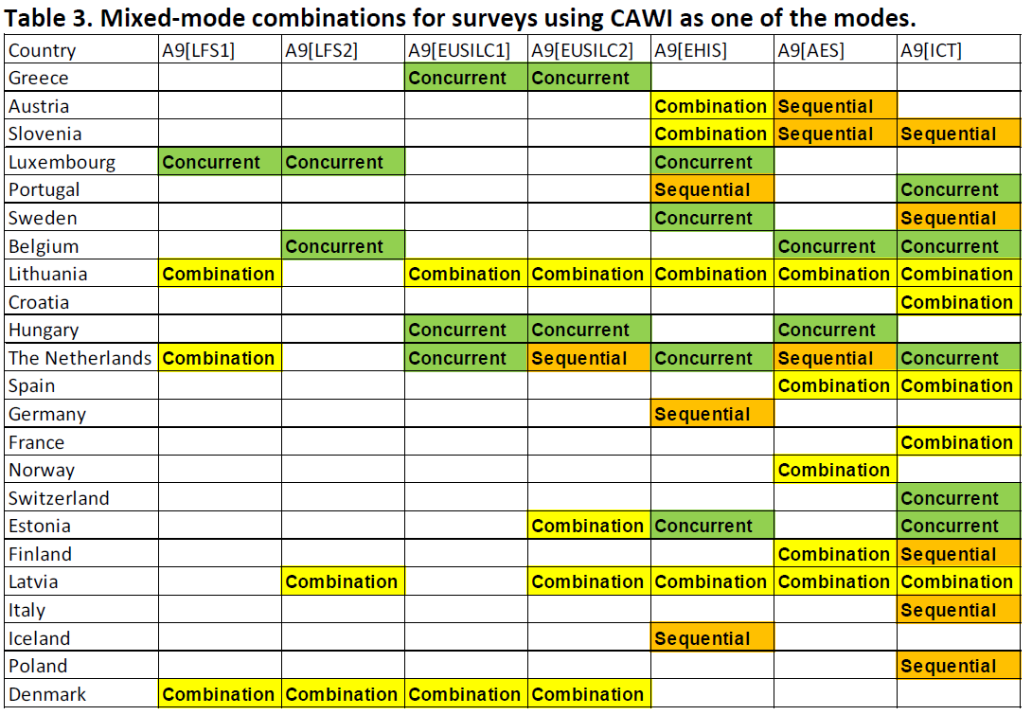
Deliverable 1: Concurrent, sequential & combined mixed mode data collection

Slide 10
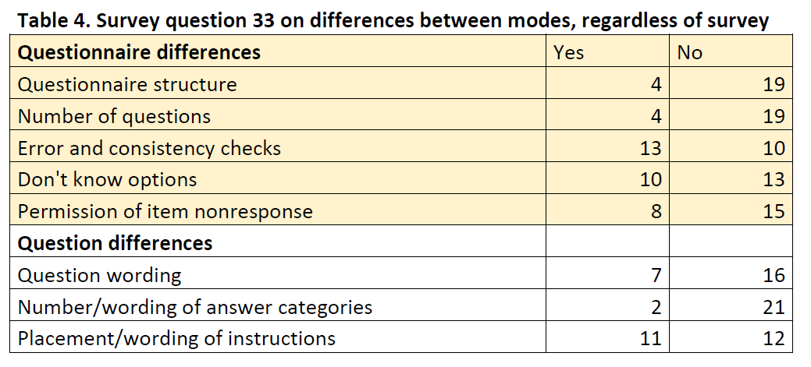
Mixed-mode questionnaire designs: Recommendations for Eurostat and NSIs
Deliverable 1: Questionnaire differences
  Error and consistency checks: many, but small
  Don’t know and Item nonresponse: many, and some large

Slide 11
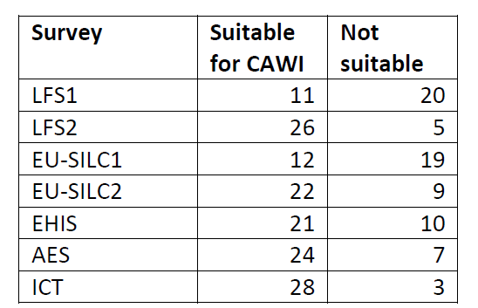
Mixed-mode questionnaire designs: Recommendations for Eurostat and NSIs
Deliverable 1: Fitness of key ESS surveys for CAWI
  LFS: Lack of interviewer support
  EU-SILC: Length of survey
MIMOD project - Mixed-Mode Designs in Social Surveys
Rome, 11-12 April 2019

Slide 12
Deliverable 1: Good practices
Mixed-mode questionnaire designs: Recommendations for Eurostat and NSIs
General advice
  When introducing mixed-mode at your NSI, start with a simple survey
  Gradually introduce web sample to go mixed-mode
  Pretest, pilot, measure effects
Login and completion assistance
  Make login as easy as possible
  Establish and man a helpdesk at the times respondents are active

Slide 13
Deliverable 1: Good practices
Mixed-mode questionnaire designs: Recommendations for Eurostat and NSIs
Questionnaire development
  Adapt questionnaires strongly
  Ensure smartphone compliance
  Use a respondent-centric web design approach
  Modularize questionnaires
  Add open questions to surveys asking for suggestions for improvement

Slide 14
Deliverable 1: Good practices
Mixed-mode questionnaire designs: Recommendations for Eurostat and NSIs
Communication strategies
  Find the right communication strategy for each survey
  Use ONE web address for all surveys
    Use login info for routing respondent to the correct one
  Add a brochure with web completion instructions to your cover letter
  Use recurrent reminders
  Shorten e-mail notifications
  Use lotteries for boosting CAWI response

Slide 15
Deliverable 1: Good practices
Mixed-mode questionnaire designs: Recommendations for Eurostat and NSIs
Data collection organization
  Find the right data collection strategy for each survey
  Use an online first approach
  Do CAWI reclaim directly in CATI
  Customize breakoff strategies
  In CAPI/CATI designs, use the same interviewer for the same respondent
  Keep CAWI option open after introducing other modes
Technical aspects
  Monitor servers constantly
  Enable restart at breakoff points

Slide 16
Deliverable 1: Bad practices (don’ts)
Mixed-mode questionnaire designs: Recommendations for Eurostat and NSIs
Don’t send too many reminders
Don’t send reminders indiscriminately
Don’t introduce differences that can lead to bias and time series breaks
Don’t underestimate case management and IT infrastructure costs
Don’t make questionnaires too long

Slide 17
National case studies: Statistics Norway
Mixed-mode questionnaire designs: Recommendations for Eurostat and NSIs
Ongoing transition from interviewer-administered to CAWI single mode or mixed mode with CAWI
  Starting with smaller, non-ESS surveys
Survey specific data collection strategies
Adult Education Survey the first ESS survey with mixed mode data collection

Slide 18
National case studies: Istat
Mixed-mode questionnaire designs: Recommendations for Eurostat and NSIs
Eliminating paper questionnaires for the next census (CAWI/CATI/CAPI design)
Development of household CAWI questionnaire for the Aspects of daily life survey
  Privacy

Slide 19
National case studies: CBS
Mixed-mode questionnaire designs: Recommendations for Eurostat and NSIs
Factors leading to questionnaire differences in conversions to mixed mode:
  Not being able to start afresh
  Fear of time series breaks
  Specific client demands
  Technical restrictions and limitations.
  Consequences for the rest of the organization.
  Time and money restrictions.

Slide 20
National case studies: CBS
Mixed-mode questionnaire designs: Recommendations for Eurostat and NSIs
CBS guidelines for omnimode design
  Keep the stimulus – question and answer categories – the same across modes
  Redesign using unimode principles if possible. Don’t use one mode as the primary one.
  Use a screen-by-screen design to keep the respondent focussed on one question at a time …
    Unless they are filter or follow-up questions
  Repeat question texts on next page/screen to give the complete stimulus again
  Always include all answer options in questions to be read out loud, including No opinion, Refused or Don’t know.
  Avoid grids if possible, and ask series of questions in all modes instead
  Minimize instructions and explanations, and present them similarly across modes, preferably in the form of questions

Slide 21
WP4 deliverable 2
Mixed-mode questionnaire designs: Recommendations for Eurostat and NSIs
A paper on survey communication in mixed-mode ESS surveys
  The concept of contact modes in survey literature
  NSI experiences
    Communication strategies
    Use of digital communication
    Push-to-web strategies
  National case studies
    ISTAT’s communication strategy
    Statistics Norway’s use of digital concact communication
    CBS: Push-to-web communication and use of incentives

Slide 22
Deliverable 2: Contact modes
Mixed-mode questionnaire designs: Recommendations for Eurostat and NSIs
Contact phase mode change
Follow-up phase mode change
Push-to-web and communication mode variation

Slide 23
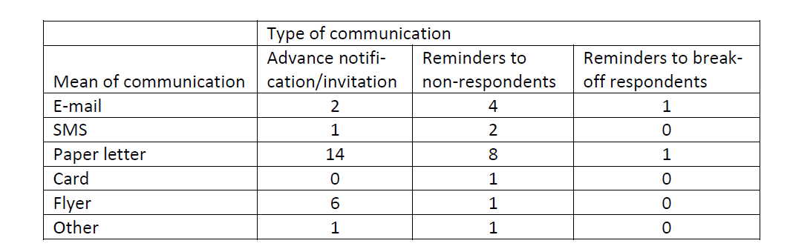
Deliverable 2: NSI experiences
Mixed-mode questionnaire designs: Recommendations for Eurostat and NSIs
Uniform communication strategies

Slide 24
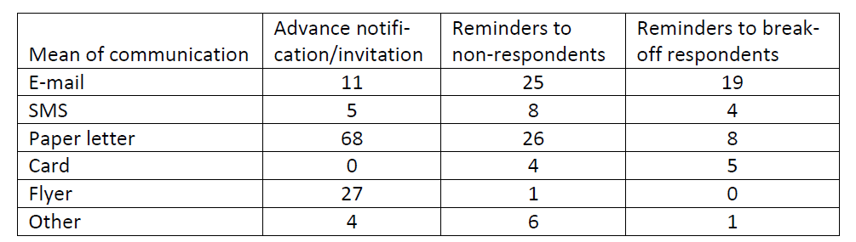
Deliverable 2: NSI experiences
Mixed-mode questionnaire designs: Recommendations for Eurostat and NSIs
Tailored communication strategies

Slide 25
Deliverable 2: NSI experiences
Mixed-mode questionnaire designs: Recommendations for Eurostat and NSIs
Reasons why digital communication is little used
  Lack of e-mail addresses
  Lach of mobile phone numbers
  Questionnaire not adapted to smartphone
  Data protection
  Household survey design
  Lack of web data collection experience
  Negative experiences with use of SMS notifications before CATI callbacks

Slide 26
Deliverable 2: NSI experiences
Mixed-mode questionnaire designs: Recommendations for Eurostat and NSIs
Push-to-web
  Many different combinations and protocols, but
  Practically all sequential mixed-mode survey with CAWI are CAWI first,
    Followed by interviewer-administered modes
  Reduction of field costs the main motivator

Slide 27
Deliverable 2: More on push-to-web
Mixed-mode questionnaire designs: Recommendations for Eurostat and NSIs
Nicolaas and Smith (2017): motivational aspects paper-> web.
Motivation to open the mailing
  Personalisation, type of mailing – enveloped, postcard etc., Appearance before opening.
Motivation to read the mailing
  Personalisation, Easy to read – length, font, vocabulary, appearance – e.g. important, professional
Motivation to take part in the survey
  Clarity about purpose of mailing and survey request, use of persuasive reasons for taking part – including incentives

Slide 28
Deliverable 2: More on push-to-web
Mixed-mode questionnaire designs: Recommendations for Eurostat and NSIs
Motivation to go online
  Clear instructions for logging into the questionnaire
  Minimal effort needed to enter login details
  Multiple access methods; e.g. any internet-enabled device
Motivation to complete questionnaire
  Authentic looking landing page with clear instructions
  Designed for mobile: short, reduction of clutter and text
  Avoid question types prone to breakoff: complex question formats and cognitively difficult questions

Slide 29
Deliverable 2: National case studies
Mixed-mode questionnaire designs: Recommendations for Eurostat and NSIs
Istat
  Respondent-oriented letters
    Emphasizes the importance of the respondent, not the survey
    Balances legal requirements, practical information and
    Focus on readability
  Respondents’ pages on Istat
    Standardized survey descriptions
    Survey materials: advance letter, questionnaire, instructions, templates

Slide 30
Deliverable 2: National case studies
Mixed-mode questionnaire designs: Recommendations for Eurostat and NSIs
Stats Norway
  Use of digital contact communication – no paper letters anymore
    Register with verified e-mail and mobile phone numbers
  CAWI questionnaires: direct links and two-factor login
  Data on contact mode use needs to be better integrated in survey management system (see also WP3)

Slide 31
Deliverable 2: National case studies
Mixed-mode questionnaire designs: Recommendations for Eurostat and NSIs
CBS
  Push-to-web communication with persons and households: inventory of experiments
    Advance letters, reminders, flyers, envelopes, QR codes, and incentives.
    Lower linguistic complexity always good
    Otherwise, different approaches work better for different subgroups: tailoring!
  Incentive experiments in LFS with positive results
    Increased response
    Better representativeness
    Better data quality
    Cost savings

Slide 32
Deliverable 3: recommendations for key questionnaire elements, questions and question types in mixed mode settings
Mixed-mode questionnaire designs: Recommendations for Eurostat and NSIs
Theoretical frameworks for mixed mode analysis
Assessment of questionnaires
  Eurostat model questionnaires and documentation
  National implementations
  Results from prestesting performed for MIMOD
ICT, EHIS, EU-SILC, AES, LFS
Appendix: Test report from Statistics Norway
MIMOD project - Mixed-Mode Designs in Social Surveys
Rome, 11-12 April 2019

Slide 33
Deliverable 3: Theoretical frameworks
Mixed-mode questionnaire designs: Recommendations for Eurostat and NSIs
Unimode, mode-specific, generalized mode, mode enhanced design
De Leeuw & Hox: Different design conventions – question format effects
  Often mode specific designs by survey practicioners
  Experimental designs often try to minimize question differences
MIMOD project - Mixed-Mode Designs in Social Surveys
Rome, 11-12 April 2019

Slide 34
Deliverable 3: Theoretical frameworks
Mixed-mode questionnaire designs: Recommendations for Eurostat and NSIs
MIMOD predecessor DCSS (Körner et al. 2013)
  Key factors for differential measurement
    Type of social interaction – interviewer involvement, respondent control
    Type of communication – verbal, non-verbal, para-verbal, computer mediated
    Questionnaire design options – visual vs. aural stimulus
    Computer assistance
  High risk question types
    Sensitive, difficult, long, many response options, complex skip instructions
MIMOD project - Mixed-Mode Designs in Social Surveys
Rome, 11-12 April 2019

Slide 35
Deliverable 3: Theoretical frameworks
Mixed-mode questionnaire designs: Recommendations for Eurostat and NSIs
Campanelli et al. (2013): Question Characteristics Relevant to Measurement Error
  Mode recommendations for 29 different characteristics of individual questions grouped by
    Question content – topic, sensitivity, inherent difficulty
    Question format – open, closed, ratio, ordinal, nominal
  One question may have several and conflicting characteristics
MIMOD project - Mixed-Mode Designs in Social Surveys
Rome, 11-12 April 2019

Slide 36
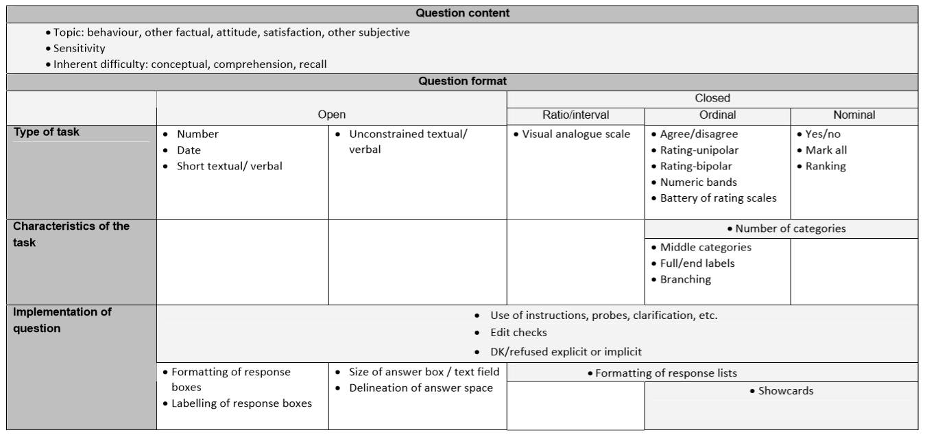
Mixed-mode questionnaire designs: Recommendations for Eurostat and NSIs

Slide 37
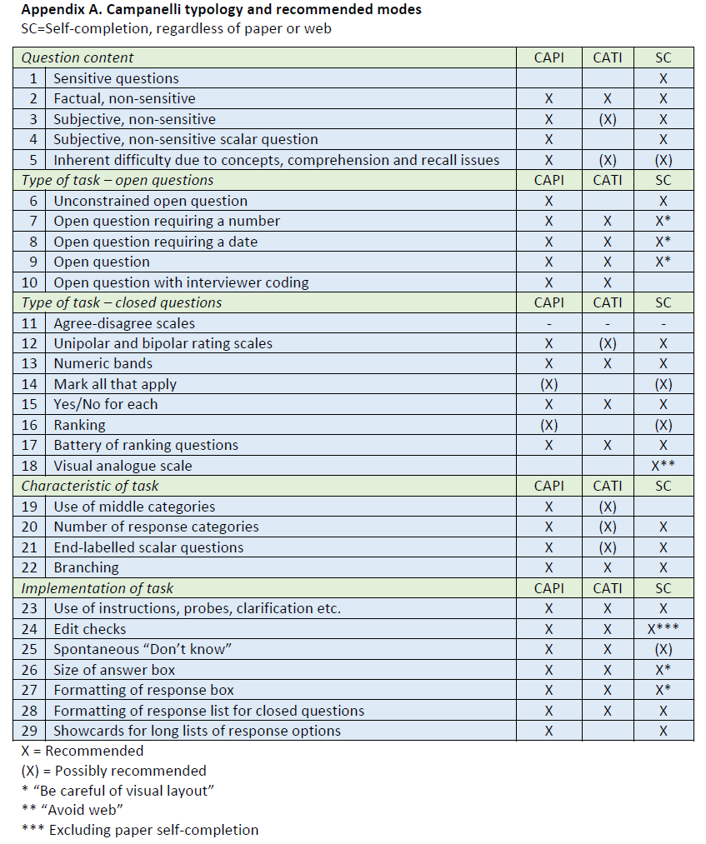
Table of mode recommendations

Slide 38
Deliverable 3: Campanelli continued
Mixed-mode questionnaire designs: Recommendations for Eurostat and NSIs
  Question types not recommended for all modes
    1) Sensitive questions
    4) Subjective, non-sensitive scalar questions
    6) Unconstrained textual/verbal open questions
    10) Open questions with interviewer coding
    14) Mark all that apply response format
    16) Ranking questions
    18) Visual analogue questions
    20) Questions with a high number of response categories
    24) Questions with edit checks
    29) Questions with show cards
MIMOD project - Mixed-Mode Designs in Social Surveys
Rome, 11-12 April 2019

Slide 39
Deliverable 3: Mixed mode pretesting by Statistics Norway
Mixed-mode questionnaire designs: Recommendations for Eurostat and NSIs
Test-retest design
  Test subjects were first interviewed in CATI mode
  Then responded to the same questions in CAWI mode about a week later
Retrospective probing
Eyetracking
Test of unimode design: Entire ICT questionnaire
Test of mode specific design for problematic questions according to Campanelli criteria:
  Selected questions from ICT, EHIS, EU-SILC, AES and LFS surveys
MIMOD project - Mixed-Mode Designs in Social Surveys
Rome, 11-12 April 2019

Slide 40
Assessment of questionnaires:
ICT questionnaire
Mixed-mode questionnaire designs: Recommendations for Eurostat and NSIs
ICT survey regulation contains no recommendations or limitations regarding which mode to use
But: Model questionnaire presupposes a visual format
  But CATI most used (16 NSIs)
  Followed by CAWI (15 NSIs)
MIMOD project - Mixed-Mode Designs in Social Surveys
Rome, 11-12 April 2019

Slide 41
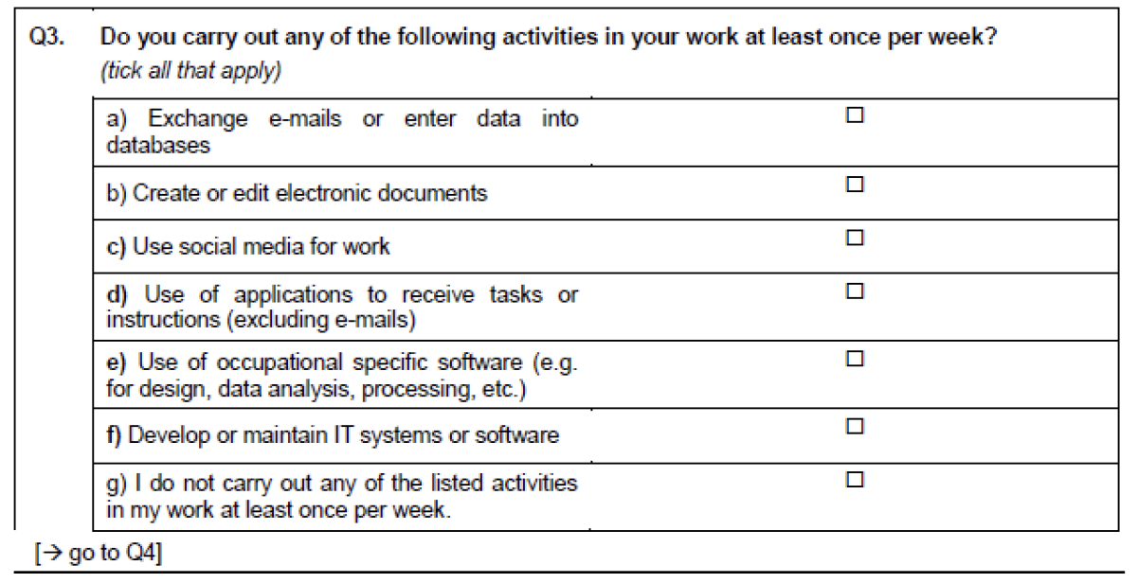
ICT model questionnaire example
Mixed-mode questionnaire designs: Recommendations for Eurostat and NSIs

Slide 42
Assessment of questionnaires:
ICT questionnaire
Mixed-mode questionnaire designs: Recommendations for Eurostat and NSIs
Application of Campanelli typology on model questionnaire indicates possible issues
  A. Mark all that apply format (14)
  B. Inherent difficulty due to concepts (6)
  C. Use of instructions and clarification (23)
  D. Use of Don’t know (25)
  E. Question length (Dillman)
MIMOD project - Mixed-Mode Designs in Social Surveys
Rome, 11-12 April 2019

Slide 43
ICT: National implementations
Mixed-mode questionnaire designs: Recommendations for Eurostat and NSIs
Netherlands
  CATI/CAPI/CAWI design
  Omnimode approach: everything visible on a screen will be read out loud
Norway
  CATI only
  Embedded in 35-minute omnibus
  «Check all that apply» grids converted to yes/no sequences
MIMOD project - Mixed-Mode Designs in Social Surveys
Rome, 11-12 April 2019

Slide 44
ICT questionnaire Pretesting
Mixed-mode questionnaire designs: Recommendations for Eurostat and NSIs
Stats Norway: Both unimode (omnimode) and mode specific approach tested
  Unimode: entire questionnaire
  Mode specific: selections with «mark all that apply» and inherently difficult questions
Mobile unimode based on existing CATI questionnaire
PC mode specific version based on model questionnaire
MIMOD project - Mixed-Mode Designs in Social Surveys
Rome, 11-12 April 2019

Slide 45
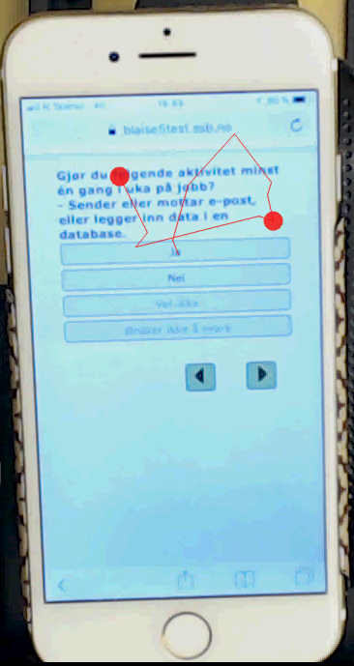
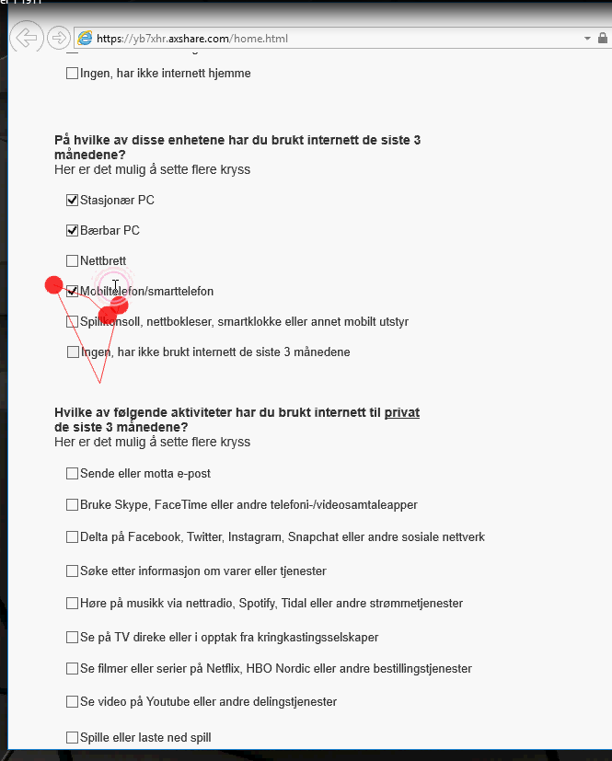

Slide 46
ICT pretesting: main findings
Mixed-mode questionnaire designs: Recommendations for Eurostat and NSIs
Unimode: General problems more important than mode-related problems
  Overall verbosity – redundant phrases
  Insufficient operationalization – too theoretical language
  Transformation to yes/no increases questionnaire length and makes it difficult for respondents to have an overview
Mode specific PC:
  Indicate that «check all that apply» on PC can be combined with yes/no sequence in CATI for the questions that were tested
    Should be tested quantitatively
MIMOD project - Mixed-Mode Designs in Social Surveys
Rome, 11-12 April 2019

Slide 47
Assessment of questionnaires: EHIS
Mixed-mode questionnaire designs: Recommendations for Eurostat and NSIs
EHIS: face-to-face modes described as «preferred modes» in methodological manual
  Show cards suggestions
  Separate document on CATI implementation of questions on alcohol consumption
CAPI used by 15 NSIs, CAWI by 11
Note: literature does not recommend face-to-face for personal interviews
MIMOD project - Mixed-Mode Designs in Social Surveys
Rome, 11-12 April 2019

Slide 48
Assessment of questionnaires: EHIS
Mixed-mode questionnaire designs: Recommendations for Eurostat and NSIs
Application of Campanelli typology on model questionnaire indicates possible issues
  A. Sensitive questions (1)
  B. Long “yes/no for each” question batteries (15)
  C. Show cards (29)
  D. Inherent difficulty due to difficult terms and calculations (5)
MIMOD project - Mixed-Mode Designs in Social Surveys
Rome, 11-12 April 2019

Slide 49
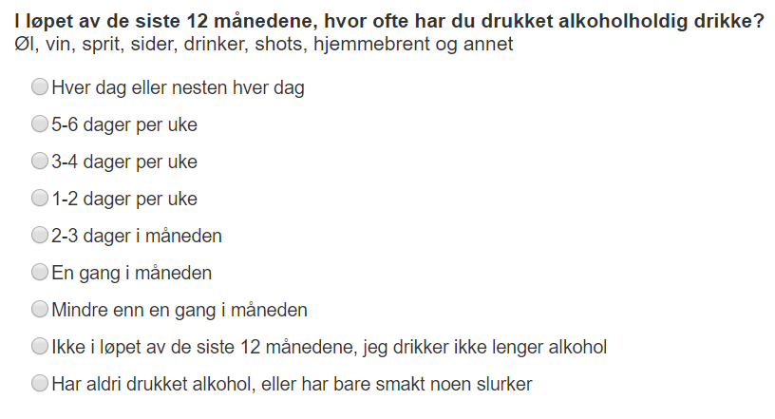
EHIS question pretesting
Mixed-mode questionnaire designs: Recommendations for Eurostat and NSIs
Question on alcohol comsumption
Mode-specific test-restest
  CATI: sequence of questions
  CAWI: Single questions with nine options
  Indication of equivalence
    But 9 options too much for mobile ..?
MIMOD project - Mixed-Mode Designs in Social Surveys
Rome, 11-12 April 2019

Slide 50
Assessment of questionnaires: EU-SILC
Mixed-mode questionnaire designs: Recommendations for Eurostat and NSIs
Methodological guidelines state that five modes of data collection are possible, PAPI, CAPI, PASI and CAWI
  «Priority to be given to personal interviews»
  CATI not covered in legal basis, but allowed on «gentleman’s aggreement» in case of person rather than household samples
  Recommendations presuppose interviewer-administered modes: No discussion on how to implement for self-administered
CATI and CAPI most widely used
MIMOD project - Mixed-Mode Designs in Social Surveys
Rome, 11-12 April 2019

Slide 51
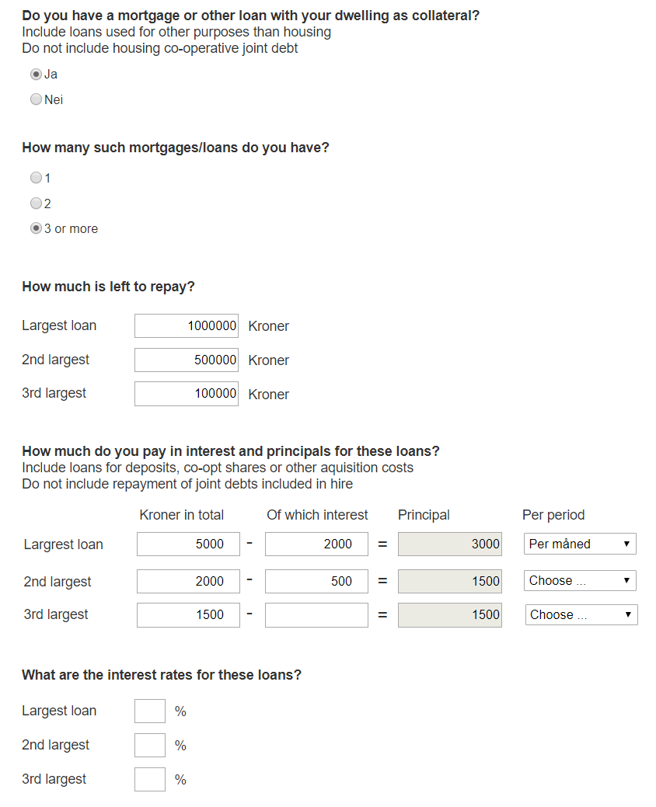
EU-SILC pretesting
Mode-specific test-retest of questions on mortgages
  Interviewer for motivating and assisting in CATI
  Visual presentation and automatic calculations in CAWI
  Inspired by business survey questionnaire design
MIMOD project - Mixed-Mode Designs in Social Surveys
Rome, 11-12 April 2019

Slide 52
EU-SILC questionnaire prestesting
Mixed-mode questionnaire designs: Recommendations for Eurostat and NSIs
Visual presentation: increased perceived response burden
  Satisficing
Calculations with subtractions not intuitive
  Measurement error
Layout not suited for mobile screens
  Device effects in addition to possible mode effects?
MIMOD project - Mixed-Mode Designs in Social Surveys
Rome, 11-12 April 2019

Slide 53
Assessment of questionnaires:
Adult Education Survey (AES)
Mixed-mode questionnaire designs: Recommendations for Eurostat and NSIs
Reference questionnaire and survey guidelines are available
Variable INTMETHOD has nine values
  Pros and cons of different data collection methods are discussed
  CAPI and other interviewer-administered modes recommended in guidelines
  But reference questionnaire often presupposes a visual mode
CAPI most used mode (17), followed by CAWI (11) and CATI (10)
MIMOD project - Mixed-Mode Designs in Social Surveys
Rome, 11-12 April 2019

Slide 54
Assessment of questionnaires:
AES questionnaire
Mixed-mode questionnaire designs: Recommendations for Eurostat and NSIs
Application of Campanelli typology on model questionnaire indicates possible issues
  A. Mark all that apply format (14)
  B. Inherent difficulty due to long and complex questions (5)
  C. Inherent difficulty due to long recall period (5)
MIMOD project - Mixed-Mode Designs in Social Surveys
Rome, 11-12 April 2019

Slide 55
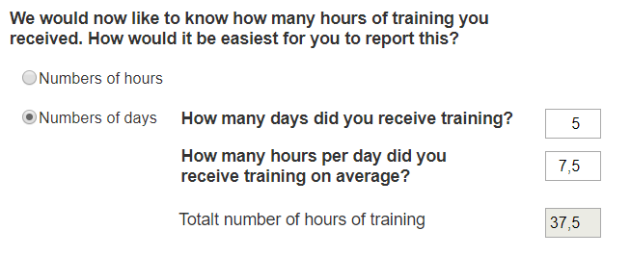
AES pretesting
Mixed-mode questionnaire designs: Recommendations for Eurostat and NSIs
Mode-specific CAWI test of questions on hours of training
Visual presentation and automatic calculations
MIMOD project - Mixed-Mode Designs in Social Surveys
Rome, 11-12 April 2019

Slide 56
AES questionnaire pretesting
Mixed-mode questionnaire designs: Recommendations for Eurostat and NSIs
Non-mode specific issues persist
  What should be considered one learning activity?
  Should breaks be included or excluded?
  Difficulties calculating average length of days
Calculator does not solve these problems
  Can even enhance them with an extra task of evaluation
MIMOD project - Mixed-Mode Designs in Social Surveys
Rome, 11-12 April 2019

Slide 57
Assessment of questionnaires: LFS
Mixed-mode questionnaire designs: Recommendations for Eurostat and NSIs
No model questionnaire, but minimum reqirements in terms of variables found in explanatory notes
  No mention of CAWI
  Show cards mentioned as the «essential difference» between CAPI and CATI …
CAPI most common data collection method in LFS W1 (22)
CATI most common in W2+ (15)
CAWI considered unsuitable for LFS W1 by 20 NSIs
  Recruitment and identification
  Need for interviewer clarification
MIMOD project - Mixed-Mode Designs in Social Surveys
Rome, 11-12 April 2019

Slide 58
Mixed-mode questionnaire designs: Recommendations for Eurostat and NSIs
Assessment of questionnaires: LFS
Application of Campanelli typology on model questionnaire indicates possible issues
  A. Inherently difficult questions – including recall (5)
  B. Open questions with interviewer coding (10)
  C. Use of instructions (23)
  D. Show cards (29)
MIMOD project - Mixed-Mode Designs in Social Surveys
Rome, 11-12 April 2019

Slide 59
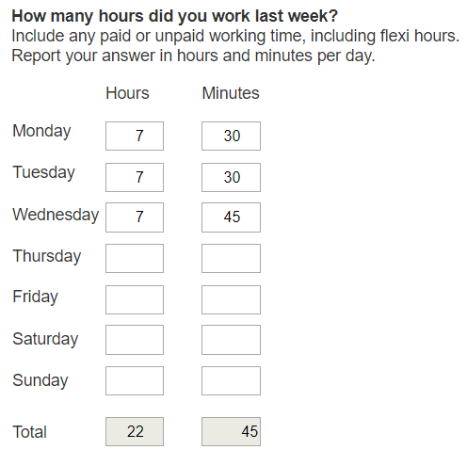
LFS pretesting
Mixed-mode questionnaire designs: Recommendations for Eurostat and NSIs
Mode-specific test-retest of question on actual working hours
  Interviewer for motivating and assisting in CATI
  Visual presentation and automatic calculations in CAWI
MIMOD project - Mixed-Mode Designs in Social Surveys
Rome, 11-12 April 2019

Slide 60
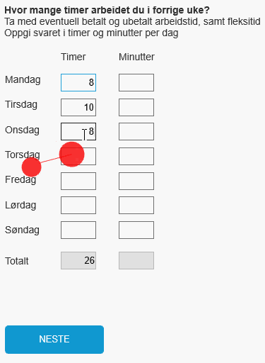
LFS prestesting
Mixed-mode questionnaire designs: Recommendations for Eurostat and NSIs
Similar setup tested previously
  Statistics Finland in the DCSS project – positive pilot results
    Equivalent results with CATI
  ONS – negative results from cognitive and usability tests
    Annoys respondents
    Satisficing
Stats Norway’s results very similar to UK experience
  E.g. rounding off to full hours every day (see figure)
MIMOD project - Mixed-Mode Designs in Social Surveys
Rome, 11-12 April 2019

Slide 61
Recommendations and conclusions for discussion
Mixed-mode questionnaire designs: Recommendations for Eurostat and NSIs
Difficult to offer recommendations that contradict existing Eurostat requirements and recommendations
  Rebuild all model and national questionnaires and documentation with mixed mode in mind – modes will be mixed!
  Start from scratch instead of continuing on an existing patchwork
  Shorten, modularize, simplify
  Take unimode as a starting point
    But continue exploring mode specific solutions using cognitive and usability testing, plus piloting
MIMOD project - Mixed-Mode Designs in Social Surveys
Rome, 11-12 April 2019

Slide 62
Recommendations and conclusions for discussion
Mixed-mode questionnaire designs: Recommendations for Eurostat and NSIs
The Campanelli typology: useful, but needs updating
  Little in terms of CAWI specific recommendations
  Other tools for identifying and analyzing problematic questions?
Better facilitation of rapid exchange of experiences and recommendations
  Including mixed mode pretesting protocols
  Risk of being outdated before publication
  Documentation of surveys and questionnaire fragmented
  A better tool than Cros-portal and Circabc?
  Wiki-based web page?
MIMOD project - Mixed-Mode Designs in Social Surveys
Rome, 11-12 April 2019

