Slide 1





ROME
April 11^{th |} 12th 2019
MIMOD
Mixed-Mode Designs for Social Surveys
FINAL WORKSHOP
WP3 – Current and Future Data Collection Systems in the ESS
Marc Plate
Statistics Austria

Slide 2
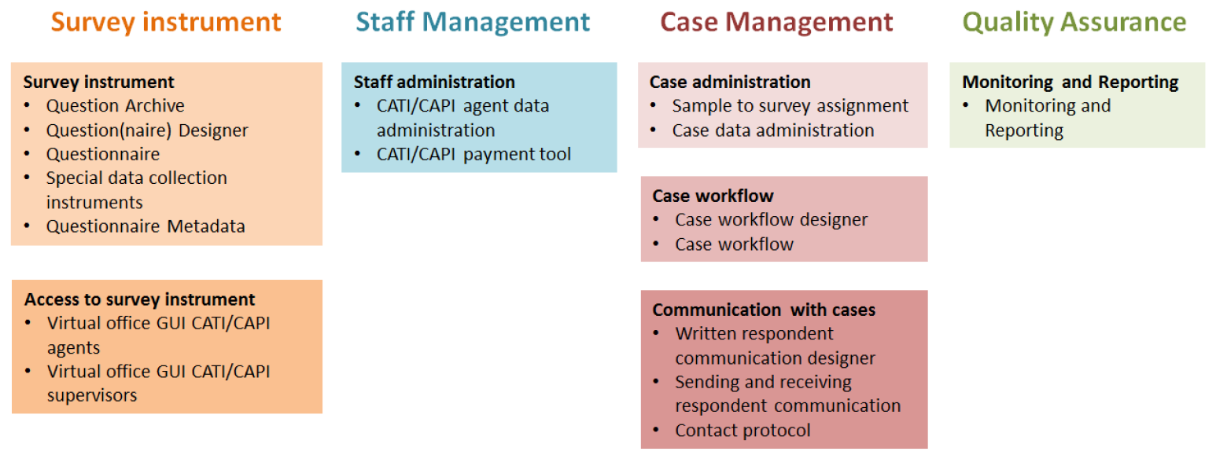

Data Collection System’s Domains
MIMOD project - Mixed-Mode Designs in Social Surveys
Rome, 11-12 April 2019

Slide 3
Background Info
Goal of WP3
Overview of Data Collection Systems (DCS) in use in the ESS
Identify Organisational Needs and Best Practice Solutions
Identify most important components of a modern Data Collection System
Mixed-Methods Approach! Combine data from:
Standardized MIMOD Survey (n=31)
Open Interviews with data collection experts via phone (n=9), via personal (n=1)
Open Q&A via email (n=3)
Study Visit (n=1)
MIMOD project - Mixed-Mode Designs in Social Surveys
Rome, 11-12 April 2019

Slide 4
Relation of Organisation and Technical System (1)
Data Collection Systems grew with the Organisation,
«Old» Systems very different between countries!
Differences because of:
Mode tradition
Seperation of business and social surveys
Usage of omnibus surveys
MIMOD project - Mixed-Mode Designs in Social Surveys
Rome, 11-12 April 2019

Slide 5
Trend towards one single system
System type | Old systems |  | New Systems
One single system for all social surveys | 1 | BE | 7 | EE, LV, LT, PT, AT, CZ, PO
In transition towards one single system |  |  | 6 | FI, FR, IT, NO, S2, NL
Multiple systems running parallel…
…an own system for certain modes | 5 | SI, HU, MT, DE, CY | 1 | LU
…some systems for certain modes and some for certain surveys | 2 | GR, HR | 1 | IE
…some systems for internal and some for outsourced surveys | 2 | SE, CH
…an own system for each survey | 2 | BG, RO
New Systems
MIMOD project - Mixed-Mode Designs in Social Surveys
Rome, 11-12 April 2019

Slide 6
Relation of Organisation and Technical System (2): Fieldwork
Data Collection Field Unit | Centralized | Decentralized | Outsourced |  | Mix
CATI Studio | Centralized | Decentralized | Outsourced | None, each Interviewer independent
CAPI and CATI separate | Separate Interviewers | Same Interviewers
Inbound Contacts | with Backoffice | with CATI Studio | with outsourced Institute | with Interviewer | Mix
Outbound Contact | from Backoffice | from CATI Studio | from outsourced Institute | from Interviewer | Mix
MIMOD project - Mixed-Mode Designs in Social Surveys
Rome, 11-12 April 2019

Slide 7
Trend towards more domain coverage but not often complete
System type | Old systems |  | New Systems
System offers components for all of the four domains | 2 | SE, BE | 6 | IE, PT, AT, FI, IT, NL
System misses components for one or two of the domains | 5 | SI, HU, MT, DE, HR | 7 | LV, LT, LU, CZ, FR, NO, PO
System misses components for three or four of the domains | 4 | BG, RO, CH, CY
New Systems
Domains:
Survey Instrument, Interviewer Management, Case Management and Monitoring/Reporting.
MIMOD project - Mixed-Mode Designs in Social Surveys
Rome, 11-12 April 2019

Slide 8
Relation of Organisation and Technical System (3)
Differences because of IT-Strategy:
External / open-source
tool integration
In-house tool
development
MIMOD project - Mixed-Mode Designs in Social Surveys
Rome, 11-12 April 2019

Slide 9
Trend towards in-house development
System type | Old systems |  | New Systems
All components are fully developed in-house. | 2 | MT, GR | 7 | EE, LV, PT, FR, IT, PO, ES
Most components are developed in-house, some external tools are in use. | 1 | SE | 2 | LT, AT
BLAISE questionnaire supplemented by in house developed components. | 6 | HU, SK, BG, RO, IS, HR | 4 | CZ, FI, NO, (NL)
BLAISE questionnaire supplemented by in house programmed external products. | 4 | SI, BE, DE, CY | 1 | IE
New Systems
MIMOD project - Mixed-Mode Designs in Social Surveys
Rome, 11-12 April 2019

Slide 10
Mixed-Mode challenges Questionnaire Production
MIMOD project - Mixed-Mode Designs in Social Surveys
Rome, 11-12 April 2019

Slide 11
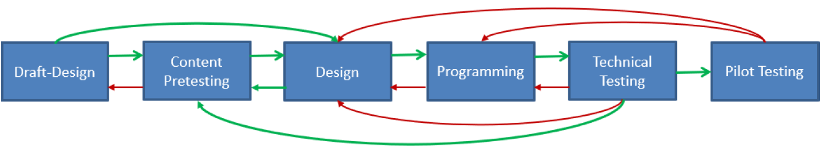
Mixed-Mode challenges Questionnaire Production
MIMOD project - Mixed-Mode Designs in Social Surveys
Rome, 11-12 April 2019

Slide 12
Questionnaire Production: Best Practice Solutions
Organisational solution:
Central Questionnaire Design and Testing Unit
Technical solutions:
Questionnaire Design+Programming+Testing in one component
Question banks
Questionnaire metadata
At least 5 NSIs: AT, CZ, FR, HU, NL
At least 2 NSIs: FR, HU (DDI)
MIMOD project - Mixed-Mode Designs in Social Surveys
Rome, 11-12 April 2019

Slide 13
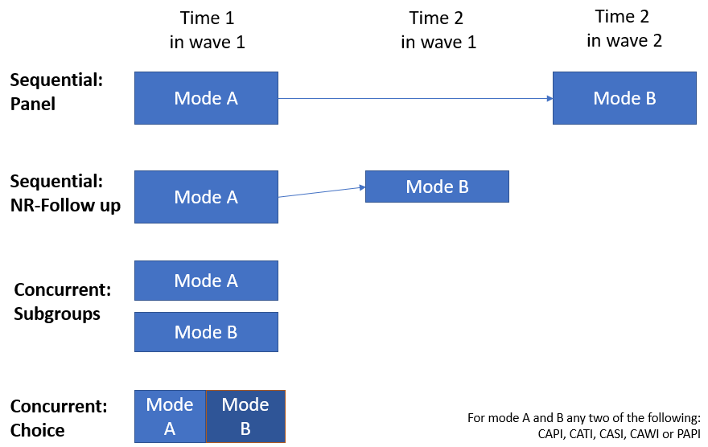
Mixed-Mode challenges Case Management
MIMOD project - Mixed-Mode Designs in Social Surveys
Rome, 11-12 April 2019

Slide 14
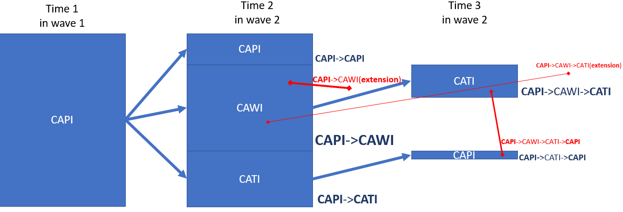
Mixed-Mode challenges Case Management
MIMOD project - Mixed-Mode Designs in Social Surveys
Rome, 11-12 April 2019

Slide 15
Case Management: Best Practice Solutions
Organisational solution:
Central Data Collection Unit
Technical solutions:
Central Case Management
Metadata:
Masterdata
Statusdata (final disposition codes, temporary contact codes)
Event Diary Data
Automated Survey Plans
All NSIs with new systems! But no standards.
At least 7 NSIs: AT, FI, HU, IT, LT, NL, SE
MIMOD project - Mixed-Mode Designs in Social Surveys
Rome, 11-12 April 2019

Slide 16





Mixed-Mode challenges Communication with Respondent
Invitation
Reminder
Completion
MIMOD project - Mixed-Mode Designs in Social Surveys
Rome, 11-12 April 2019

Slide 17
Communication with Respondent: Best Practice Solutions
Organisational solution:
Central communications units
Central contact centers
Technical solutions:
Template Design
Generating and Sending in different channels
Access to Case Event Diary
At least 8 NSIs: AT, FI, IT, LA, LT, LU, NO, NL
Automated Workflow in NL
At least 5 NSIs: AT, FR, IT, LV, NL
MIMOD project - Mixed-Mode Designs in Social Surveys
Rome, 11-12 April 2019

Slide 18
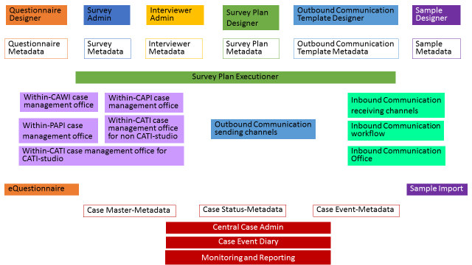
Components and Metadata of a modern Data Collection System
MIMOD project - Mixed-Mode Designs in Social Surveys
Rome, 11-12 April 2019

Slide 19
Developing a new system: Everyone is or will be doing it!
6 Countries that have finished a new data collection system:
EE, IE, LV, LT, LU, PT
10 Countries that are in the midst or end of developing a new data collection system: AT, CZ, FI, FR, IT, NO, PO, ES, NL, GB
5 Countries that have just started or will soon start developing a new system for data collection: SI, SE, HU, MT, SK
6 Countries that plan to start developing a new system for data collection in the next two years: GR, BE, DE, BG, RO, IS
3 Countries that do not plan to develop a new system for data collection: HR, CH, CY
MIMOD project - Mixed-Mode Designs in Social Surveys
Rome, 11-12 April 2019

Slide 20
Final Remarks
Data Collection Systems greatly differed in the past
With the challenges of Mixed-Mode Design almost all NSIs have started or plan to start developing a new system
Organisation and technical solutions become more similar
  Organisational Centralization
  Needs for certain components are alike
  The newly developed components function similar
Most inefficient, if every country develops their own system in-house
Let‘s join forces!
Let‘s not think and design the system as one big monolith system. Rather make it a loosely coupled, modular system!
Joint collaboration and development may be possible on the level of components and metadata.
MIMOD project - Mixed-Mode Designs in Social Surveys
Rome, 11-12 April 2019

