Slide 1





ROME
April 11^{th |} 12th 2019
MIMOD
Mixed-Mode Designs for Social Surveys
FINAL WORKSHOP
Mode effects in mixed-mode data collection
WP2
Paweł Szymankiewicz
Statistics Poland

Slide 2


Mode effects in mixed-mode data collection
Mode effect
The term "mode effect" usually refers to effects that are due to the use of one mode compared to another, or a combination of modes to a single mode, or to a different combination of the same or other modes.
MIMOD project - Mixed-Mode Designs in Social Surveys
Rome, 11-12 April 2019

Slide 3
Mode effects in mixed-mode data collection
Mode effects
Mixed mode simultaneously generates:
nonresponse error (selection effects),
measurement error (measurement effects).
MIMOD project - Mixed-Mode Designs in Social Surveys
Rome, 11-12 April 2019

Slide 4
Mode effects in mixed-mode data collection
Mode effects:
selection effects – caused by the selection mechanism of a mixed-mode survey design, resulting in partitioning the sample into respondents and nonrespondents.
Selection effects appear when different types of respondents choose different modes to complete the survey.
MIMOD project - Mixed-Mode Designs in Social Surveys
Rome, 11-12 April 2019

Slide 5
Mode effects in mixed-mode data collection
Mode effects (cont.):
measurement effects (measurement bias, pure mode effects) – caused by specifics of the modes in the survey and affect the recorded responses to the surveys questions.
In other words, measurement effects refer to the influence of a survey mode on the answers (the same respondent gives different answers to the same questions in different modes).
MIMOD project - Mixed-Mode Designs in Social Surveys
Rome, 11-12 April 2019

Slide 6
Mode effects in mixed-mode data collection
Problems described in documents prepared by WP2 within the framework of the MIMOD Project:
detection and estimation of mode effects (including separation of selection effects from measurement effects),
adjustment for mode effects.
MIMOD project - Mixed-Mode Designs in Social Surveys
Rome, 11-12 April 2019

Slide 7
Mode effects in mixed-mode data collection
Some measures reported by countries participating in the MIMOD Project:
to assess mode effects:
pre-tests, experiments on questionnaire design,
pilot surveys,
differences in distributions of socio-demographic or target variables,
pre-tests, experiments on sensitive or core questions etc.,
to adjust for mode effects:
weight adjustments,
calibration to fixed mode distributions,
estimate measurement errors and correct responses to a benchmark mode etc.
Source: WP 2 Methodological Report
MIMOD project - Mixed-Mode Designs in Social Surveys
Rome, 11-12 April 2019

Slide 8
Mixed-mode data collection
MIXED-MODE DESIGNS
IN POLISH SOCIAL SAMPLE SURVEYS
MIMOD project - Mixed-Mode Designs in Social Surveys
Rome, 11-12 April 2019

Slide 9
Mixed-mode designs in Polish social sample surveys
LEGAL BASIS:
Law of 29 June 1995 on Official Statistics,
Regulation of the Council of Ministers concerning the programme of statistical surveys of official statistics
MIMOD project - Mixed-Mode Designs in Social Surveys
Rome, 11-12 April 2019

Slide 10
Mixed-mode designs in Polish social sample surveys in 2019
Survey | No. of the survey in the programme of surveys | Questionnaires in use | Sample size | Methods in use
EU-LFS (BAEL), including module Work organisation and working time arrangements | 1.23.01, 1.23.18 | ZD, ZG ZD-C | ≈ 55,000 | CAPI, CATI, PAPI
Household Budget Survey | 1.25.01 | BR-01, BR-01a, BR-01b, BR-04 | 3,132 | CAPI, CAWI, PAPI
EU-SILC | 1.25.08 | EU-SILC-G EU-SILC-I | 18,000 41,800 | CAPI, PAPI
Household Condition (consumers’ attitudes) | 1.25.02 | KGD | 2,700 | CAPI, CATI
Participation of Polish Residents in Travels | 1.30.18 | PKZ | 18,750 | CAPI, PAPI
ICT (Information Society Indicators) | 1.43.14 | SSI-10G SSI-10I | 8,100 12,000 | CAPI, CAWI
MIMOD project - Mixed-Mode Designs in Social Surveys
Rome, 11-12 April 2019

Slide 11
Mixed-mode designs in Polish social sample surveys in 2019
Concurrent
EU-LFS (BAEL)
Household Budgets
Sequential
ICT (Information Society Indicators):
CAWI: 18.03.2019 – 07.04.2019,
CAPI: 08.04.2019 – 31.05.2019
EU-SILC
Household Condition
Participation of Polish Residents in Travels
MIMOD project - Mixed-Mode Designs in Social Surveys
Rome, 11-12 April 2019

Slide 12
Mixed-mode designs in Polish social sample surveys
MIMOD project - Mixed-Mode Designs in Social Surveys
Rome, 11-12 April 2019

Slide 13
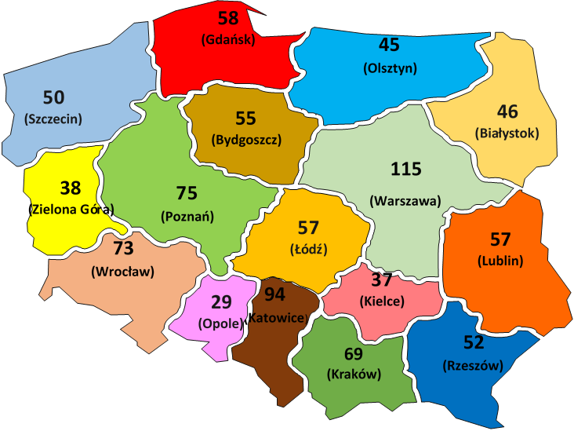
Mixed-mode designs in Polish social sample surveys
Number of "permanent” interviewers in statistical offices (Dec. 31th, 2018)
MIMOD project - Mixed-Mode Designs in Social Surveys
Rome, 11-12 April 2019

Slide 14

Mixed-mode designs in Polish social sample surveys
MIMOD project - Mixed-Mode Designs in Social Surveys
Rome, 11-12 April 2019

