Slide 1





ROME
April 11^{th |} 12th 2019
MIMOD
Mixed-Mode Designs for Social Surveys
FINAL WORKSHOP
Experimenting methods to assess and adjust mode effect when a single mode control survey is available as a benchmark: a case study on the Italian “Aspects of daily life” survey
WP2 – DEL.3
Claudia De Vitiis (A. Guandalini, F. Inglese, M.D. Terribili, R. Varriale)
Istat

Slide 2

Methods to assess and adjust mode effect: a case study
Outline
The Mixed Mode in ISTAT social surveys
The setting of the “Multipurpose survey on households - Aspects of daily life” and the analysis framework
The assessment of the introduction of the mixed mode
The estimate of mode effect (selection and measurement)
The adjustment of mode effect with different methods
Final considerations
MIMOD project - Mixed-Mode Designs in Social Surveys
Rome, 11-12 April 2019

Slide 3
Methods to assess and adjust mode effect: a case study
1. Mixed mode in ISTAT social surveys
In ISTAT several situations have occurred so far
Mixed mode used primarily to address coverage issues of previously mono mode CATI surveys
  “University and High school graduates' vocational integration” surveys, sequential CAWI/CATI
  “Victimization survey”, concurrent CATI/CAPI
Mixed mode in longitudinal household surveys to reduce cost and burden
  “Labour Force” Survey and “Eusilc” CAPI/CATI
Mixed mode used primarily to reduce survey cost whereas expanding population coverage, through the introduction of CAWI technique in traditionally PAPI surveys
  “Multipurpose survey on households: Citizens and leisure time” - 2015”, CAWI/PAPI
  “Multipurpose survey on households: Aspects of daily life - 2017” : sequential CAWI/PAPI with a control mono mode sample PAPI
MIMOD project - Mixed-Mode Designs in Social Surveys
Rome, 11-12 April 2019

Slide 4
Methods to assess and adjust mode effect: a case study
2. Survey settings and analysis framework
  The sample survey “Multipurpose survey on households: Aspects of daily life”
Collects information about recreational and cultural activities in free time, such as sports, reading, cinema, music, the Internet, social relations, issues for the quality of life of people
Based on a sample of about 24.000 households, selected through a two stage sample design (municipalities/households) from the centralized municipal register (LAC)
Mixed technique: sequential web-PAPI
A self-compiled questionnaire (web) proposed in the inviting letter sent by ISTAT and after, on non respondent households, direct interview with a questionnaire on paper with an interviewer (PAPI)
In 2017: experimental set up: sequential web/PAPI (MM) with a control single mode sample PAPI (SM)
  The selected sample of individuals was linked to an administrative data base (Archimede Project) through the individual code available from the selection frame to obtain external auxiliary variables
MIMOD project - Mixed-Mode Designs in Social Surveys
Rome, 11-12 April 2019

Slide 5
Methods to assess and adjust mode effect: a case study
2. Survey settings and analysis framework
Summary scheme of the experimental context
Parallel independent samples (single mode SM, mixed mode MM) | Mixed-mode: Sequential web-PAPI; Single mode: PAPI
Main goal of the analyses | Evaluation of the switching from single to mixed mode Evaluation of total non-sampling error components (measurement)
Theoretical context | Counterfactua/Instrumentall approaches
Available auxiliary information | Register demo-social covariates
Phases of the analyses | Comparison between the SM and MM samples Assessment of the mode effect in the MM design Adjusting for mode effect in the MM design
MIMOD project - Mixed-Mode Designs in Social Surveys
Rome, 11-12 April 2019

Slide 6
Methods to assess and adjust mode effect: a case study
2. Survey settings and analysis framework
Theoretical framework
From an inferential point of view the selection and measurement effects need to be investigated separately, to obtain a correct formulation of the total non-sampling error and to apply methods to adjust the estimates of the parameters of interest for the bias effects
The problem of the confounding between the two effects is the central theme of the theory of causal inference
The measurement error is conceptualized as a causal effect of the mode on the survey variable, while the selection effect is seen as a spurious correlation between the target variable and the mode
For the estimation of the two effects causal inference is used according to a counterfactual perspective: the existence of a potential result not really observed (the value that the respondent would have provided with the other mode) is hypothesized
An alternative approach is based on the use of instrumental variables, when a benchmark survey is available
MIMOD project - Mixed-Mode Designs in Social Surveys
Rome, 11-12 April 2019

Slide 7
Methods to assess and adjust mode effect: a case study
2. Survey settings and analysis framework
Analysis framework
In this experimental setting, the study is developed on two main levels of analysis, which can be considered an analysis check list for similar situations
    the first level is based on the comparison between the two samples SM and MM, to evaluate the impact on the estimates due to the introduction of mixed mode
      tests were performed on the differences in the estimates from the two sample, SM and MM
      analyses were conducted to study the bias caused by the total nonresponse in the two samples
        Total response rates and indicators of response representativeness were evaluated in order to identify differences (especially in terms of magnitude of the bias) that could explain the differences in the estimates of the survey produced with the SM and MM samples
MIMOD project - Mixed-Mode Designs in Social Surveys
Rome, 11-12 April 2019

Slide 8
Methods to assess and adjust mode effect: a case study
2. Survey settings and analysis framework
    Analysis framework
    the second level investigates the mode effect (selection and measurement) of the samples of respondents web and PAPI in the MM design, to analyze the reasons that determine significant differences in the estimates
        propensity score (Rosenbaum and Rubin, 1983) to estimate the selection effect and the measurement effect in MM sample, making the samples of respondents web and PAPI comparable
        instrumental variable approach proposed by Vannieuwenhuyze et al. (2010) has been applied to SM and MM samples, using SM are benchmark mode
        analysis of the equivalence of the measurements in MM surveys, using Multi-group confirmatory factor analysis, to identify the latent structure of the phenomenon
  Finally the estimates deriving from the application of different adjustment methods are compared
      Calibration on fixed mode proportions (Buelens et al 2015)
      Calibration using selection effect correction factors (PS)
      Standard calibration
MIMOD project - Mixed-Mode Designs in Social Surveys
Rome, 11-12 April 2019

Slide 9
Methods to assess and adjust mode effect: a case study
Operational steps of the analysis
 | Method | Objective | Assumptions/Conditions
First Step | 1) Tests on the differences in the estimates calculated on the two sample for a set of relevant survey variables | Highlighting the variables for which a suspect of mode effect was significant | Independence between the two samples
 | 2) Tests on the response rates in the SM and MM sample 3) Indicators of representativeness 4) Tests on the differences on estimates of benchmark variables known for selected sample units | Analysis of the response processes and evaluation of the bias caused by the total nonresponse | Independence between the two samples; MAR assumption for the response models
 | 5) Instrumental variable approach | Disentangling measurement and selection effects | Representativity assumption
Second Step | 6) Propensity score | Disentangling measurement and selection effects | MAR assumption for the response models; Balancing assumption
 | 7) Multi-group confirmatory factor analysis | Analysis of the equivalence of the measurements in surveys | Identification of the latent structure of the phenomenon
Third Step | 8) Weighting methods as propensity score, calibration | To adjust selection effect | Ignorability of selection mechanism; Measurement error negligible
 | 9) Mode calibration | To stabilize the total measurement error | Invariance over time of measurement error
 | 10) Multiple imputation (standard) | To adjust measurement effect | MAR assumption
MIMOD project - Mixed-Mode Designs in Social Surveys
Rome, 11-12 April 2019

Slide 10
Methods to assess and adjust mode effect: a case study
3. The assessment of the introduction of the mixed mode
Test of differences between SM and MM estimates
To evaluate the differences between the estimates of the some parameters of interest of the survey, obtained with the mixed and the single mode samples, hypothesis tests were carried out (Martin and Lynn, 2011).
Test of the differences in proportions through t-test, while the independence between the distributions were evaluated as a whole through the Chi-square test
The hypothesis tests concerned the following estimates:
  Satisfaction for life (Satisfaction)
  Health conditions (Health)
  Valuation of the economic situation compared to the previous year (EcoSit)
  Reading books in the last 12 months (Books)
  Frequency of seeing friends (Friends)
  Habit to smoke (Smoke)
    The difference for Satisfaction for life, Reading books and Frequency of seeing friends resulted significant
MIMOD project - Mixed-Mode Designs in Social Surveys
Rome, 11-12 April 2019

Slide 11
Methods to assess and adjust mode effect: a case study
3. The assessment of the introduction of the mixed mode
The auxiliary variables available for the following analyses and models
Auxiliary mode-insensitive variables in ADL survey at household level:
Household type: one-component under 55, one-component over 54, couple with children at least one under 25, couple with children without under 25, couple without children, one parent at least one under 25, one parent without under 25, other types
Higher education level: below/equal/above high school diploma
Occupation type: Prevalence of: employed, self employed, not in labor age, mixed types
Municipal type: Metropolitan cities, metropolitan area, other municipalities <2000, 2000-10000, 10000-50000, >50000
Geographical area (North, Center, South and Islands)
Income class: 5 quintiles (€ 11.955, 20.892, 30.028, 46.119)
Citizenship (nationality): Italian/Foreign household
MIMOD project - Mixed-Mode Designs in Social Surveys
Rome, 11-12 April 2019

Slide 12
Methods to assess and adjust mode effect: a case study
3. The assessment of the introduction of the mixed mode
Analysis of total nonresponse bias – R-indicators
R-indicators are based on a measure of the variability of the response propensity and describe how the sample of respondents to a survey reflects the population of interest with respect to certain characteristics
At national level MM sample deviates less from the representative response with respect to the SM sample – MM sample is more representative
R-indicators in SM and MM samples
R_Indicator | SM sample | MM sample
Italy | 0.812 | 0.852
North | 0.847 | 0.840
Center | 0.752 | 0.842
South and Islands | 0.840 | 0.907
response models defined at national level
response models defined for each geographical area
MIMOD project - Mixed-Mode Designs in Social Surveys
Rome, 11-12 April 2019

Slide 13
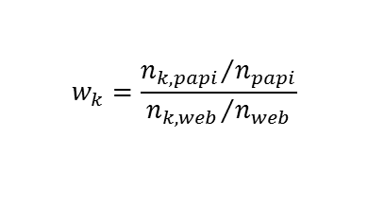
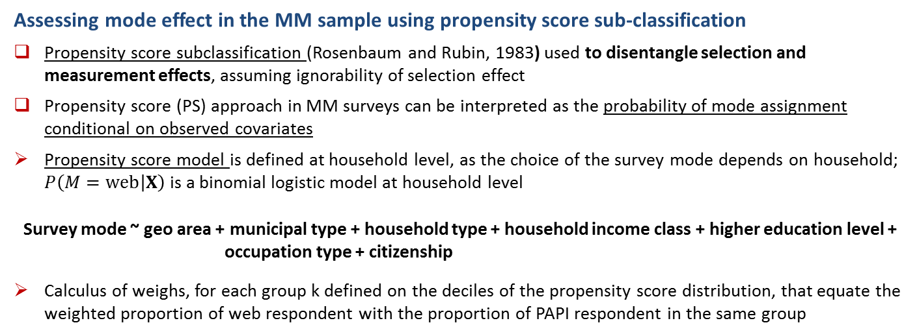
Methods to assess and adjust mode effect: a case study
4. Estimating mode effects (selection and measurement)
Assessing mode effect in the MM sample using propensity score sub-classification
Propensity score subclassification (Rosenbaum and Rubin, 1983) used to disentangle selection and measurement effects, assuming ignorability of selection effect
Propensity score (PS) approach in MM surveys can be interpreted as the probability of mode assignment conditional on observed covariates
Propensity score model is defined at household level, as the choice of the survey mode depends on household; $P\left(M=web | X\right)$is a binomial logistic model at household level
Survey mode ~ geo area + municipal type + household type + household income class + higher education level + occupation type + citizenship
Calculus of weighs, for each group k defined on the deciles of the propensity score distribution, that equate the weighted proportion of web respondent with the proportion of PAPI respondent in the same group
$$w_{k}=\frac{{n_{k,papi}}/{n_{papi}}}{{n_{k,web}}/{n_{web}}}$$
MIMOD project - Mixed-Mode Designs in Social Surveys
Rome, 11-12 April 2019

Slide 14
Methods to assess and adjust mode effect: a case study
4. The estimate of mode effects (selection and measurement)
Estimating selection and measurement effects through a instrumental variable
To evaluate both selection and measurement effects, has been adopted the instrumental variable approach proposed by Vannieuwenhuyze et al. (2010), in which SM sample (PAPI) is taken as a benchmark, assuming the representativity of the response processes
In order to make the SM and MM samples comparable, a calibration procedure is adopted, separately for the two samples, starting from the sampling weights
Selection and measurement effect are evaluated on the basis of the probability distributions of the survey categorical variables, estimated from the two comparable respondents’ samples (SM and MM)
MIMOD project - Mixed-Mode Designs in Social Surveys
Rome, 11-12 April 2019

Slide 15
Methods to assess and adjust mode effect: a case study
4. The estimate of mode effects (selection and measurement)
Selection and measurement effects estimated through different approaches
Selection and measurement effects for “reading books in the last 12 months” through instrumental variable approach
Variable | Category | Selection effect | Measurement effect
Reading books in the last 12 months | No | 0,1478 | -0,0727
 | Yes | -0,1767 | 0,0416
 | NR | 0,0288 | 0,0311
Selection and measurement effects for “reading books in the last 12 months” in MM respondent’s sample using Propensity Score
Variable | Category | Weighted Web mean | Web mean | PAPI mean | Selection effect | Measurement effect
Reading books (last 12 months) | No | 0.485 | 0.451 | 0.618 | 0.034 | -0.132
 | Yes | 0.432 | 0.508 | 0.347 | -0.075 | 0.085
 | NR | 0.043 | 0.041 | 0.035 | 0.002 | 0.007
MIMOD project - Mixed-Mode Designs in Social Surveys
Rome, 11-12 April 2019

Slide 16
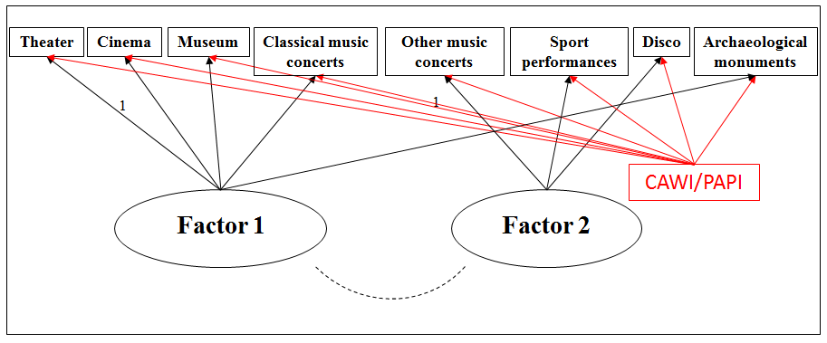
Methods to assess and adjust mode effect: a case study
4. The estimate of mode effects
Multi-group confirmatory factor analysis (frequency of going to the cinema, theatre, etc)
        Aim: analyze the equivalence of the measurements in MM survey, in order to identify the latent structure of the phenomenon
The MCFA has been applied in order to identify which are the latent constructs related with the behavioral model regarding the frequency of going to the cinema, theatre, etc.
The measurement invariance has been tested
MIMOD project - Mixed-Mode Designs in Social Surveys
Rome, 11-12 April 2019

Slide 17
Methods to assess and adjust mode effect: a case study
5. The adjustment of mode effect with different methods
  Methods for adjusting selection effect - Weighting methods
    Propensity score, calibration of weights modified through the correction factors
    Standard calibration on demographic totals
    Calibration on fixed levels of mode proportions (method proposed by Buelens and Van den Brakel, 2015), to stabilize the selection effect in repeated surveys, assuming the invariance of measurement effect, with the aim to obtain reliable changes over time
    Assuming the hypothesis of ignorability of the selection effect
MIMOD project - Mixed-Mode Designs in Social Surveys
Rome, 11-12 April 2019

Slide 18
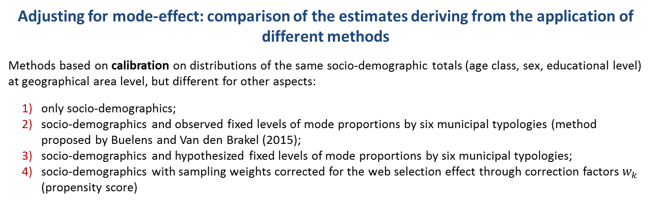
Methods to assess and adjust mode effect: a case study
5. The adjustment of mode effect with different methods
Adjusting for mode-effect: comparison of the estimates deriving from the application of different methods
Methods based on calibration on distributions of the same socio-demographic totals (age class, sex, educational level) at geographical area level, but different for other aspects:
only socio-demographics;
socio-demographics and observed fixed levels of mode proportions by six municipal typologies (method proposed by Buelens and Van den Brakel (2015);
socio-demographics and hypothesized fixed levels of mode proportions by six municipal typologies;
socio-demographics with sampling weights corrected for the web selection effect through correction factors $w_{k}$ (propensity score)
Estimates of “reading books in the last 12 months” variable with different methods
Variable | Category | Estimate (%)
 |  | Meth. 1 | Meth. 2 | Meth. 3 | Meth. 4
Reading books (last 12 months) | No | 59,82 | 58,88 | 58,54 | 59,81
 | Yes | 36,51 | 37,47 | 37,76 | 36,46
 | NR | 3,67 | 3,65 | 3,70 | 3,73
MIMOD project - Mixed-Mode Designs in Social Surveys
Rome, 11-12 April 2019

Slide 19
Methods to assess and adjust mode effect: a case study
6. Final considerations
From the experience of the case study we can highlight that the introduction of mixed mode has an important impact for the Aspect of Daily Life survey, both on the composition of the sample (and its better representativeness) and on several indicators, which seem to be affected by measurement effect, not easily assessed.
the application of all the presented methods is subject to the validity of the hypotheses underlying all these methods and that need to be verified by the researcher as far as possible
from a strictly methodological point of view, the analyses need to taken into account the sampling variability, by means of a simulation to assess significance of the evaluated mode effects
Generally speaking, what can be underlined is that the underlying effort is hardly compatible with the usual resources and the timing of a statistical process: only in some cases such a deepening is feasible; in general situations an accurate planning of the data collection phase is more advisable, in order to limit as far as possible ex-ante the measurement effect, which is the main drawback of the mixed mode.
MIMOD project - Mixed-Mode Designs in Social Surveys
Rome, 11-12 April 2019

Slide 20
Methods to assess and adjust mode effect: a case study
6. Final considerations
The set of the analyses presented and applied in a specific survey context has been an occasion for ISTAT for experimenting methods, but can be considered as a possible checklist, a sequence of steps usable by researchers of other NSIs to carry out an assessment of mode effect in similar situations.
The applied methods try to cover all the different approaches applicable in this specific survey context, even if without claiming to be exhaustive, being the literature really very wide.
MIMOD project - Mixed-Mode Designs in Social Surveys
Rome, 11-12 April 2019

