Slide 1





ROME
April 11^{th |} 12th 2019
MIMOD
Mixed-Mode Designs for Social Surveys
FINAL WORKSHOP
MIMOD – Project overview
Marina Signore
Istat

Slide 2

MIMOD project
The MIMOD – Mixed Mode Designs in Social Surveys is a multi-beneficiary grant awarded by Eurostat
Consortium:
  Leader: Istat (Italy)
  Partners: CBS (Netherlands), SSB (Norway), STAT (Austria) and Destatis (Germany)
Supporting Network:
  INSEE (France), Czech Statistical Office (Czech Republic), Central Statistical Office of Poland (Poland), Statistic Finland (Finland) and Statistics Sweden (Sweden)
Start: 1st December 2017 - Final Workshop: 11-12 April 2019
MIMOD project - Mixed-Mode Designs in Social Surveys
Rome, 11-12 April 2019

Slide 3

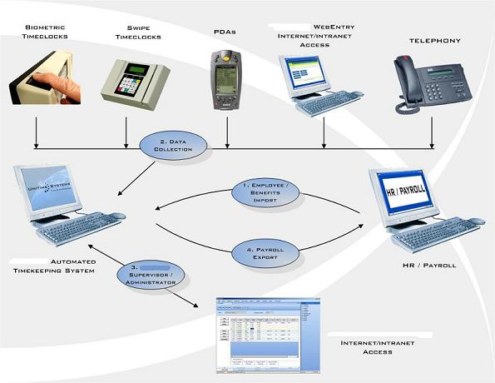
MIMOD aims and activities
State of the art in the European Statistical System
  use of mixed-mode designs, with a focus on the web
Review of recent literature
Tests and case studies
Support EU NSIs in implementing mixed-mode in social surveys
  Recommendations and practical guidelines
  Selection of relevant papers
  Work to be undertaken at a European level
  Suggestions for future work
3
MIMOD project - Mixed-Mode Designs in Social Surveys
Rome, 11-12 April 2019

Slide 4

MIMOD aims and activities
WP1: mode organisation (concurrent/sequential and adaptive/responsive) with the objective of providing guidelines on data collection strategies combining quality, cost, respondents’ characteristics and modes. (WP leader: M. Murgia, Istat)
WP2: mode bias/mode effect assessment and adjustment with the aim of providing general guidelines on methodologies to deal with (WP leader: O. Luzi, Istat)
WP3: case management with the purpose of investigating the different data collection systems in use and their characteristics (WP leader: M. Plate, Statistics Austria)
WP4: mixed-mode questionnaire designs in order to give best practice recommendations for mixed-mode questionnaires for key ESS surveys, with an emphasis on web, and for the contact and follow-up phases (WP leader: D. Gravem, Statistics Norway)
WP5: challenges for mobile phones and tablets respondents in CAWI with the aim of investigating the use of new devices in ESS surveys and of mobile device sensors (such as GPS, camera, microphone, accelerometers) to enrich ESS surveys (WP leader: B. Schouten, CBS)
4
MIMOD project - Mixed-Mode Designs in Social Surveys
Rome, 11-12 April 2019

Slide 5

MIMOD results
A summary of MIMOD results:
Final methodological report summarizing the results of WP 1-5
WP1
Del. 1: Report on MIMOD survey on the state of the art of mixed-mode for EU social surveys
Del. 2: Methodological report - Mixed-mode strategies for social surveys: how to best combine data collection modes
WP2
Del. 1: Current methodologies to deal with mode effects and mode bias in mixed-mode designs
Del. 2: Report containing the results of the analyses performed on re-interview designs -A cost-benefit analysis of re-interview designs for mode-specific measurement bias
Del. 3: Report containing the results of the applications of selected methods on mixed-mode social surveys. - Experimenting methods to assess and adjust mode effect when a single mode control survey is available as a benchmark: a case study on the Italian “Aspects of daily life” survey
Del. 4: Methodological report
5
MIMOD project - Mixed-Mode Designs in Social Surveys
Rome, 11-12 April 2019

Slide 6
MIMOD results (continued)
WP3
Del. 1: Desktop review exercise and draft typology
Del. 2: Exploratory interviews and questionnaire - Exploratory standardized questions in MIMOD survey
Del. 3: Standardized survey on CMS - In-depth telephone interviews on data collection systems in practice
Del. 4: In-depth expert interviews on data collection systems in practice - Technical solutions to the challenges of running mixed-mode surveys
Del. 5: Methodological report - Final Report on Data Collection Systems within the ESS
WP4
Del. 1: Mixed-mode experiences of European NSIs
Del. 2: Survey communication in mixed-mode surveys
Del. 3: Recommandations for key questionnaire elements, questions and question types in mixed mode settings. Related to the European Statistical System’s person and household surveys
Del. 4: Methodological report
6
MIMOD project - Mixed-Mode Designs in Social Surveys
Rome, 11-12 April 2019

Slide 7
MIMOD results (continued)
WP5
Del. 1: Assessment of fitness of ESS surveys for smartphones
Del. 2: Responsive questionnaire designs for the LFS and ICT
Del. 3: Final methodological report discussing the use of mobile device sensors in ESS surveys - Sensor data for ESS surveys: a first inventory
Del. 4: Final methodological report presenting results of usability tests on selected ESS surveys and Census - Smartphone fitness of ESS surveys – case studies on the ICT survey and the LFS
7
MIMOD project - Mixed-Mode Designs in Social Surveys
Rome, 11-12 April 2019

Slide 8
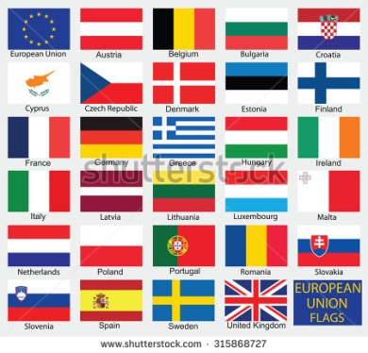

MIMOD survey- State of the art of mixed-mode in the ESS
Istat coordination and supervision
Major activity of WP1
Key inputs to the activities in all WPs
Questionnaire in cooperation by all WPs and with support from Network countries
Web questionnaire was developed by Istat with
to provide comments and descriptions
to upload screenshot of questions and questionnaire layouts
to upload documentation
The survey run from March 26 to May 5, 2018
All the European NSIs replied
MIMOD project - Mixed-Mode Designs in Social Surveys
Rome, 11-12 April 2019

Slide 9

MIMOD survey contents
The questionnaire reflects the structure of the MIMOD project
Section A - Data collection strategies: -> WP1
Section B - Questionnaire design: -> WP4
Section C - Use of smartphones and tablets: -> WP5
Section D - Methodologies to deal with mode effect: -> WP2
Section E - Case Management Systems: -> WP3
MIMOD project - Mixed-Mode Designs in Social Surveys
Rome, 11-12 April 2019

Slide 10
MIMOD survey contents
Social surveys
Labour Force Survey waves 1 and 2 (LFS)
Survey on Income and Living Conditions waves 1 and 2 (EU-SILC)
European Health Interview Survey (EHIS)
Adult Education Survey (AES)
Survey on Information and Communication Technology (ICT)
Household Budget Survey (HBS)
Harmonised European Time Use Survey (HETUS/TUS)
Up to three additional country-specific surveys
Data collection modes and sources
CATI; CAPI; PAP/PAPI; CAWI
Registers; Other sources (big data, web scraping, gps, etc.)
MIMOD project - Mixed-Mode Designs in Social Surveys
Rome, 11-12 April 2019

Slide 11




MIMOD survey- Section A
M
A
I
N
R
E
S
U
L
T
S
Mixed-mode strategies in EU NSIs
Data collection strategies used by EU NSIs | NSIs
NSIs using mixed-mode strategies | 30
NSI not using mixed-mode strategies | 1
Mixed-mode strategies with the web mode | 23
Mixed-mode strategies without web mode | 7
NSIs using web mode | 25
NSIs not using web mode | 6
MIMOD project - Mixed-Mode Designs in Social Surveys
Rome, 11-12 April 2019

Slide 12
MIMOD survey- Section A
M
A
I
N
R
E
S
U
L
T
S
Mixed-mode versus single mode in social surveys
 | %
Mixed-mode | 50.2
Mix of modes and sources | 10.0
Mix of only data collection techniques | 40.2
Single mode | 40.5
Multi-mode | 7.9
Surveys not done** | 1.4
Total surveys | 100
mixed-mode: the combined use of different data collection modes to administer the same survey questionnaire to all sample units
multi-mode surveys: different data collection modes are used to administer different sections of the survey questionnaire to the same sample unit.
**Not all NSIs run the investigated social surveys.
MIMOD project - Mixed-Mode Designs in Social Surveys
Rome, 11-12 April 2019

Slide 13
MIMOD survey- Section A
M
A
I
N
R
E
S
U
L
T
S
Mixed-mode versus single mode by survey
MIMOD project - Mixed-Mode Designs in Social Surveys
Rome, 11-12 April 2019

Slide 14
MIMOD survey- Section A
M
A
I
N
R
E
S
U
L
T
S
Modes and combinations in mixed-mode social surveys
Mixed-mode surveys | %
Mixed-mode surveys including CAWI | 43.6
CATI-CAWI | 18.1
CAPI-CAWI | 18.1
CATI-CAPI-CAWI-Registers | 16.3
PAPI-CAWI | 11.5
CATI-CAWI-Registers | 11.5
Other combinations with CAWI | 24.5
Mixed-mode surveys without CAWI | 56.4
CAPI-PAPI | 24.1
CATI-Registers | 24.1
CATI-CAPI-Registers | 19.0
CAPI- Registers | 10.1
Other combinations without CAWI | 22.7
Total | 100
See WP1
MIMOD project - Mixed-Mode Designs in Social Surveys
Rome, 11-12 April 2019

Slide 15
MIMOD survey- Section A
M
A
I
N
R
E
S
U
L
T
S
Single mode social surveys
Single mode | %
PAP/PAPI | 45.1
CAPI | 42.5
CATI | 10.6
CAWI | 1.8
Total | 100
MIMOD project - Mixed-Mode Designs in Social Surveys
Rome, 11-12 April 2019

Slide 16
MIMOD survey- Section A
M
A
I
N
R
E
S
U
L
T
S
Communication strategies
Communication strategies | Absolute values | % values
Uniform communication strategy | 15 | 50.0
Different communication strategies | 15 | 50.0
Total | 30 | 100
See WP4
MIMOD project - Mixed-Mode Designs in Social Surveys
Rome, 11-12 April 2019

Slide 17
MIMOD survey- Section B: Questionnaire design
M
A
I
N
R
E
S
U
L
T
S
The impact of mixed-mode strategies on questionnaire design
See WP4
MIMOD project - Mixed-Mode Designs in Social Surveys
Rome, 11-12 April 2019

Slide 18
MIMOD survey- Section C: Use of smartphones and tablets
M
A
I
N
R
E
S
U
L
T
S
Adaptation of web questionnaires to smartphones
Adaptation of web questionnaire to smartphones | %
Profoundly adapted | 0
Slightly adapted | 7.4
Not adapted, but smartphone are usable | 74.1
Smartphones are blocked | 18.5
Total | 100
See WP5
The use of ‘apps’ for social surveys is not a topic of immediate interest for NSIs.
However pre-testing for multiple devices and multiple browsers is performed for almost the majority of social surveys using the web mode
MIMOD project - Mixed-Mode Designs in Social Surveys
Rome, 11-12 April 2019

Slide 19
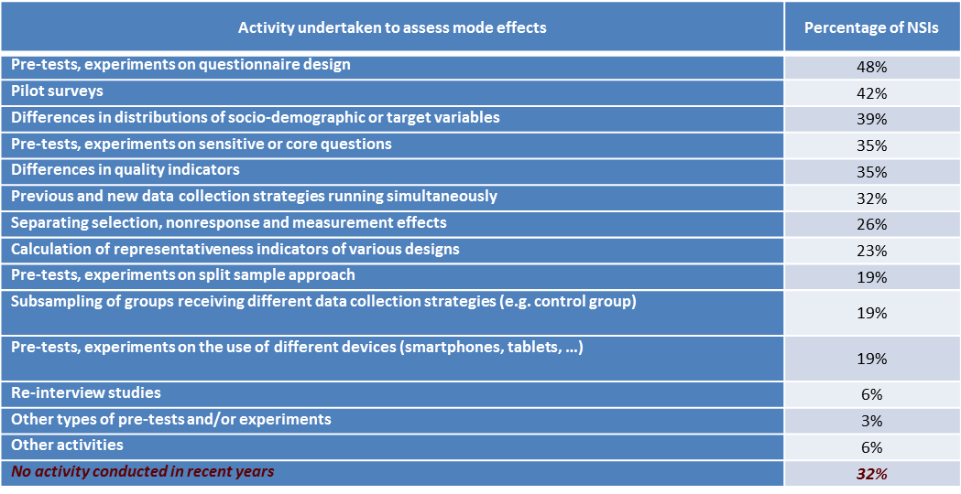
MIMOD survey- Section D: Methodologies to deal with mode effect
M
A
I
N
R
E
S
U
L
T
S
Activities undertaken by 31 ESS NSIs to assess mode effects in mixed-mode designs. Each NSI could report multiple activities.
See WP2
Almost all NSIs reported multiple activities.
MIMOD project - Mixed-Mode Designs in Social Surveys
Rome, 11-12 April 2019

Slide 20
MIMOD survey- Section D: Methodologies to deal with mode effect
M
A
I
N
R
E
S
U
L
T
S
Measures to adjust for mode effects in mixed-mode designs.
Each NSI could report multiple measures.
Measure taken | Percentage of NSIs
Weight adjustments | 26%
Calibration to fixed mode distributions | 13%
Estimate measurement errors and correct responses to a benchmark mode | 10%
Other | 13%
No measure taken | 61%
See WP2
Future Plans: 17 out of the 31 NSIs report to have future research plans on mode effects assessment and/or adjustment methods
MIMOD project - Mixed-Mode Designs in Social Surveys
Rome, 11-12 April 2019

Slide 21
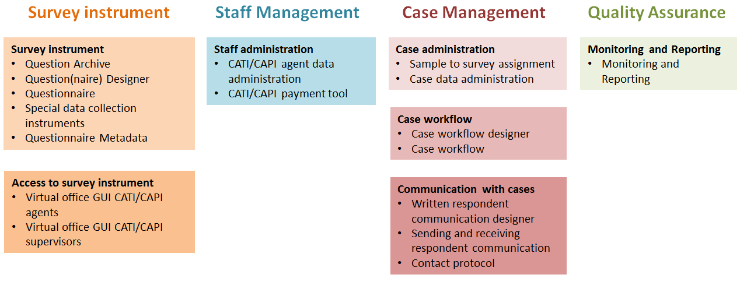
MIMOD survey- Section E: Case Management System
The domains of a Data Collection System
MIMOD project - Mixed-Mode Designs in Social Surveys
Rome, 11-12 April 2019

Slide 22
MIMOD survey- Section E: Case Management System
M
A
I
N
R
E
S
U
L
T
S
Presently NSIs are… | Absolute values | %
.. in the practical phase of changing our IT-System(s) | 10 | 33.3
… planning to start projects on changing the IT-system(s) within the next two years | 6 | 20.0
… in the concept phase of defining how to change their IT-System(s) | 5 | 16.7
… not working on adaptation of IT-systems because they have just finished major changes on their IT-system(s) | 4 | 13.3
…not working on adaptation of IT-systems for other reasons | 5 | 16.7
Total | 30 | 100
See WP3
MIMOD project - Mixed-Mode Designs in Social Surveys
Rome, 11-12 April 2019

Slide 23

MIMOD survey: in general
Trend over the past 5 years
The adoption of mixed-mode strategies in social surveys increased in 71% of NSIs
The use of the web mode increased as well, (64.5%) especially as a component of the ‘mix’ (80%)
MIMOD project - Mixed-Mode Designs in Social Surveys
Rome, 11-12 April 2019

Slide 24
MIMOD survey: in general
Major advantages and disadvantages of mixed-mode strategies over the past 5 years
Advantages
Number of NSIs
MIMOD project - Mixed-Mode Designs in Social Surveys
Rome, 11-12 April 2019

Slide 25
Some conclusions
The MIMOD survey provides a comprehensive view on the state of the art in the ESS
The picture shows how heterogeneous the situation is in the NSIs across EU
CAWI and particularly mixed-mode (including CAWI) are the future for Social Surveys
The MIMOD results support the implementation of mixed-mode designs
This calls for a re-thinking of tools (questionnaires, data collection systems) and methodological support
Mixed-mode data collection calls for a greater collaboration in the ESS. We do hope the MIMOD can be the beginning of continued future joint work in the ESS
MIMOD project - Mixed-Mode Designs in Social Surveys
Rome, 11-12 April 2019

