Slide 1




“Strengthening the statistical system of Lebanon through reinforcement of the Central Administration of Statistics”
A joint partnership Lebanon – Italy
Beirut, 26 February – 1 March 2018

Slide 2
Project kick-off mission, 26 Feb – 1 Mar 2018
Contents
1. Istat and the National Statistical System (Sistan)
2. Project overview
3. Main objectives and activities
4. Organisation and management
5. Coordination with other activities

Slide 3
(1) Istat profile
By Law, the National Institute of Statistics (ISTAT) is a public institution with scientific, organisational, financial and accounting independence
91 years of official statistics production
Works with other organisations and public administration to improve the level of awarness as regards statistics and quality of statistics
Pivotal role within the Italian National Statistical System (Sistan)
Involved in a modernisation process aimed at increasing register based production, further enhance quality and reduce burden on respondents
Long-standing experience in the design and implementation of EU best practices for the production of statistics; involved in many fields as leader in the definition of methodological standards to be adopted internationally
Valuable experience in technical cooperation projects in many regions of the world and in a large number of transition and development countries
In depth experience in the provision of know how and training in order to ensure sustainability, ownership, replicability and knowledge sharing.

Slide 4

(1) National Statistical System: Sistan
Structure
National Institute of Statistics– Istat
Statistical offices of central and local government administrations
Other public bodies and organisations dealing with statistical information
Main
actors
Provide Italian and international bodies with official statistics information
Ensure uniform policy, homogeneous
organisation and rationalised information flows at central and local levels (National Statistical Law)
Mission

Slide 5

(1) Istat role within Sistan
Istat drafts the National Statistical Programme and carries out the main surveys as envisaged in the Programme
Istat directs, coordinates, promotes, provides technical assistance and training to bodies and offices belonging to Sistan
Istat sets nomenclatures, standards and methodologies binding for Sistan bodies
Istat publishes and disseminates data, analyses and studies produced by itself or by other Sistan bodies that are not able to do that directly.

Slide 6
(1) Modernization Programme - 1
2010
Launch of the first innovation projects (Stat2015 Framework)
October 18th, 2012
Permanent Census of population and housing introduced by law
Second half of 2014
Start of Istat’s Modernisation Programme, in accordance with:
UNECE – HLG on Modernisation of Official Statistics
ESS Vision 2020
January 28th, 2016
Official approval of the Modernisation Programme by the Governing Board

Slide 7
(1) Modernization Programme - 2
Weaknesses
Local or vertical know-hows which do not promote reuse
Duplication and lack of consistency of solutions
Limited interoperability
Limited capacity to exploit methodological and technological opportunities
Research and innovation at departmental rather than corporate level

Slide 8
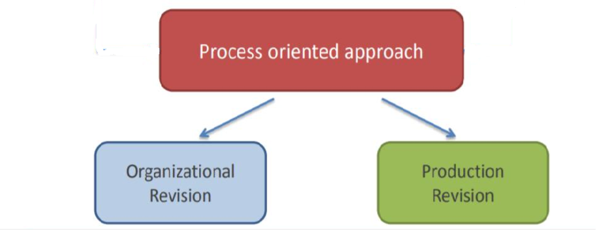
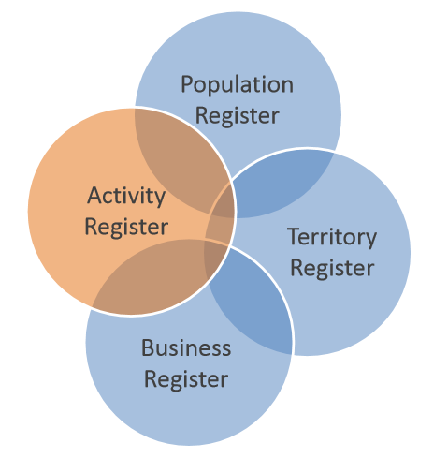
(1) Modernization Programme - 3
Integrated Business Statistics Framework
Standardization of methods and tools for some phases of the statistical production process
Standardization of the workflow
New Organizational Structure
From Divisional structure
silos ‘tied’ to people
To Centralized Organizational Structures
enterprise approach
Integrated System of Statistical Registers
A system of base registers interconnected at the level of elementary units by linking codes
Continuously updated from administrative sources and integrated statistical surveys
Check of quality
PERMANENT CENSUSES

Slide 9
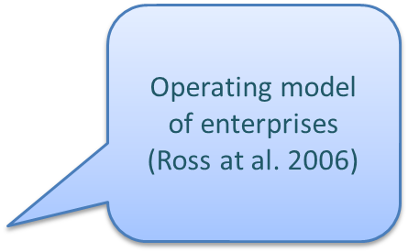
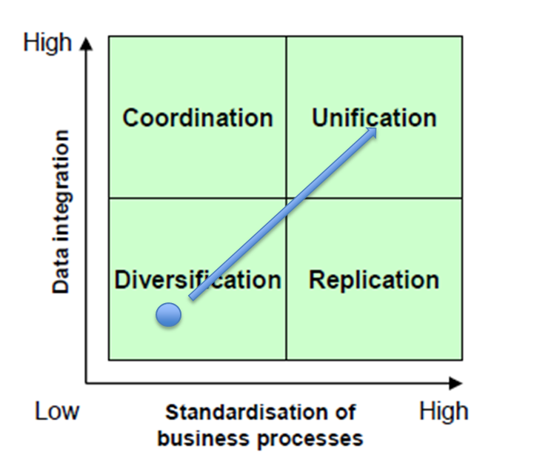
(1) Modernization Programme - 4
Enterprise architecture – main characteristics
Holistic view of the Enterprise
Support to the establishment of a common language
Change management
Standardisation and integration.
Integrated System of Statistical Registers
Standardised
production process

Slide 10
(1) New Organizational Structure
Presidency
Comstat
CUIS
DCPS
Strategic Directorate
DGEN
Directorate General
DIRM
DIPS
Statistical Production
Human Resources
Data Collection
Social Statistics and Population Census
Division for strategic planning
Methodology and Statisctical process design
Economic Statistics
Administrative Affairs
Division for institutional relations
ICT
Territorial Statistics
Division for international affairs
Statistical output and information value
National Accounts
Communication of statistical information

Slide 11

(2) Project overview
Duration: February 2018 –February 2021 (36 months)
Resources:
107 weeks/person for TA and training/training-on-the-job
10 weeks/person for coordination and management.
1. Institutional Building - dr. Maral Tutelian, Marlene Bakhos, Michelle Jouvenal
2. Improvement of IT division performance - Ziad Abdallah, …., Carlo Vaccari
3. SDMX standards - Ziad Abdallah, …., Francesco Rizzo
4. Support to GIS implementation - Ziad Abdallah, …., Pina Ticca
5. Administrative procedures and processes - Marlene Bakhos, Silvia Losco
6. Social statistics - Najwa Yaacoub, Lara Badre, Maria Pia Sorvillo
Project management and coordination – CAS, AICS, Tiziana Pellicciotti

Slide 12

(2) Project overview
Overall objective:
To contribute to the enhancement of the statistical system in Lebanon by supporting CAS in its official statistics production and dissemination processes.
Specific objectives:
To provide CAS with IT equipment, the introduction and training on new tools, support in specific production processes, modernisation of its administrative infrastructure, with a view to further promoting its role within the Lebanese society.

Slide 13
(2) Project overview
On the basis of consultations during the mission, it is proposed to build the project around three main pillars interlinked with each other in a consistent way:
introduction and training on new tools and methodologies (IT, SDMX, GIS, selected statistical processes, website, digitalisation of processes and corporate planning)
activities complementary to existing and ongoing production processes (e.g. support in the field of social statistics and, in particular to the current LF-Living conditions survey)
specific actions aimed at designing a framework for
cooperation among administrations producing
statistics with a view to enhance CAS role
at national level.

Slide 14

(3) Objectives, activities and results
Institutional Development.
  1.a Analysis of CAS current situation and structure and its role within the Lebanese PA in order to increase the quality of the elaborated data, also for elaboration of SDGs indicators.
  1.b Promotion of CAS strategies at the national level, including the exchange of data and information with other public administrations.
 | Activity | Year 1 |  |  |  | Year 2 |  |  |  | Year 3
 |  | 1Q | 2Q | 3Q | 4Q | 1Q | 2Q | 3Q | 4Q | 1Q | 2Q | 3Q | 4Q
1 | Support to Institutional building
1.1 | Assess the current CAS role
1.2 | Establish a framework of agreements for improved coordination of the statistical function
1.3 | Support CAS in fostering its strategies at national level

Slide 15
(3) Objectives, activities and results
2. Improvement of IT division performance
2.a Training on the job and technical assistance on website redesign, web architecture, network security and implementation, operating systems and databases.
 | Activity | Year 1 |  |  |  | Year 2 |  |  |  | Year 3
 |  | 1Q | 2Q | 3Q | 4Q | 1Q | 2Q | 3Q | 4Q | 1Q | 2Q | 3Q | 4Q
2 | Support the IT department in CAS
2.1 | Website redesign and intranet
2.2 | Web applications and web services
2.3 | Network (security, wifi and email server)
2.4 | Operating systems (Win server, VM ware, Linux)
2.5 | Databases management (performance, security, migration to O11g)

Slide 16

(3) Objectives, activities and results
3. SDMX standards and tools for data exchange.
3.a Support CAS in the introduction of SDMX standards and tools for exchange of data with relevant administrations.
 | Activity | Year 1 |  |  |  | Year 2 |  |  |  | Year 3
 |  | 1Q | 2Q | 3Q | 4Q | 1Q | 2Q | 3Q | 4Q | 1Q | 2Q | 3Q | 4Q
3 | SDMX
3.1 | Introduction to SDMX: use cases
3.2 | Training on SDMX for statisticians and IT staff
3.2 | Pilot exercise on CAS data

Slide 17
(3) Objectives, activities and results
4. New methodologies of GIS for statistics.
4.a Training on the use of GIS for statistics: data collection, data manangement and dissemination.
4.b Support to the design of a geospatial framework for statistics (address register)
 | Activity | Year 1 |  |  |  | Year 2 |  |  |  | Year 3
 |  | 1Q | 2Q | 3Q | 4Q | 1Q | 2Q | 3Q | 4Q | 1Q | 2Q | 3Q | 4Q
4 | Support to the GIS system in CAS
4.1 | Training - GIS for statistics (Basic, Intermediate, Advanced)
4.2 | Training on Web Mapping and new GIS technology
4.3 | Training on the job for developing GIS Web Application for the survey fieldwork
4.4 | Training on the job - Geodatabases for statistics
4.5 | Address Register (best practice and requirements evaluation)

Slide 18
(3) Objectives, activities and results
5. Digitalisation processes and corporate planning for the administrative work in CAS.
5.a Support on introduction of staff accounting system and staff folders recording
5.b Support on digitalisation of administrative processes
5.c. Reinforce of skills on corporate planning and management
 | Activity | Year 1 |  |  |  | Year 2 |  |  |  | Year 3
 |  | 1Q | 2Q | 3Q | 4Q | 1Q | 2Q | 3Q | 4Q | 1Q | 2Q | 3Q | 4Q
5 | Support to the administrative work in CAS
5.1 | Corporate planning: define demand management process and medium term activities planning framework
5.2 | Staff accounting system and folders recording
5.3 | Electronic administrative procedures (correspondance, procurement)
5.4 | Training on management and digitalisation of administrative processes

Slide 19
(3) Objectives, activities and results
6. Improved social statistics.
6.a Reinforcement of methodological skills on household surveys
6.b Improved quality and availability of results (analysis and dissemination)
6.c Improved skills on the use of statistical packages such as R
6.d Improved inter-institutional cooperation for the use of administrative data (tbc).
 | Activity | Year 1 |  |  |  | Year 2 |  |  |  | Year 3
 |  | 1Q | 2Q | 3Q | 4Q | 1Q | 2Q | 3Q | 4Q | 1Q | 2Q | 3Q | 4Q
6 | Support to Social Statistics Department
6.1 | Training on methodologies and techniques to Improve household surveys
6.2 | Support to improve availability and quality of analysis and dissemination of household surveys data (online and paper publications)
6.3 | Training on statistical packages (R)
6.4 | Inter-institutional cooperation for the use of administrative data (TBC)

Slide 20

(3) Objectives, activities and results
Short-term missions;
Training, on the job and/or traditional;
Study visits, 3 foreseen during the project;
Workshop and seminars, if the case, to involve other institutions or when visibility (results, innovations introduced…) is important.
ACTIVITIES
What is more effective for which kind of activities and for which result
?

Slide 21

(3) POG –General Operational Plan
Official framework for project implementation, based on the principles of:
    Relevance
    Effectiveness
    Efficiency
    Impact
    Sustainability.
Contains jointly agreed
    Workplan and resources allocation
    Expected results
    Activities breakdown
    Project deliverables
    Indicators (LogFrame).
To be transmitted to funding agency.

Slide 22
(4) Project management and organisation
Component Coordinators
Technical level:
Istat
CAS
Component technical teams
Management and organisational level:
Project management team
(Project managers and CC?)
AICS
Beirut
Istat
CAS

Slide 23
(4) Project management and organisation
Project management team
AICS
Beirut
Istat
CAS
- Composition: PMs, Component Coordinators, sector experts when relevant, IADC (AICS).
- Regular meetings , every 6 months.
- Produce and approve regular 6-month reports on project implementation.
- Role and functions: to evaluate previous periods and to agree
on future activities, to assess and approve possible changes
(newly arisen needs, adjustments….), to monitor project
implementation.

Slide 24
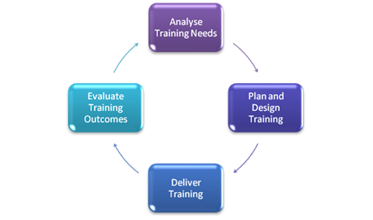

(4) Design and organisation of activities
1) Preparation (Tor, agendas, staff involved)
2) Implementation (staff, logistics, equipment, debriefing)
3) Reporting (mission reports and other supporting documentation)
Short-term missions
(inputs and outputs)
Trainings

Slide 25





(5) Coordination with other activities and donors
Possible impact on:
internal resources
processes and activities.

Slide 26

Looking forward to starting this new cooperation.
Thank you.

