Slide 1

Using Twitter Data for the
Social Mood on Economy Index
Diego Zardetto
Istat

Slide 2
Introduction: Motivation and Goals
Nowadays more and more people are using Social Media platforms to find out news, to express their feelings and to share or debate opinions about virtually every possible topic
  The interest towards Social Media as a means for “measuring” public’s mood is still growing
We are investigating whether social media messages may be successfully exploited to develop domain-specific sentiment indices. The aim is to assess the Italian mood about specific topics or aspects of life, e.g.
  the economic situation, the European Union, the migrants’ phenomenon, the terrorist threat, and so on
These new indices would enable high-frequency (e.g. daily) measures of the Italian sentiment about phenomena which are of interest in Official Statistics
The hope is that such indices could either improve the performance of Istat’s forecasting models, or enrich existing statistical products (e.g. the BES), or even be disseminated as new statistical outputs in their own right
Notes:
Sentiment Analysis (Opinion Mining) through Social Media sources isn’t a novel/fresh endeavor, yet it is still interesting in Official Statistics
Domain-specific sentiment indices have to be contrasted to ‘generic’/‘general purpose’ indices of the ‘Mood of the Nation’ kind, which inevitably mix up all the topics into a poorly defined measure
If successful, these new indices can be natural candidates to the forthcoming ‘Experimental Statistics’ section of Istat website

Slide 3
The Quest for Relevance: Filters (1/2)
We developed procedures to collect and process only social media messages containing at least one keyword belonging to a specific ‘filter’, namely a definite set of relevant Italian words
  Ideally, filters should be able to capture relevant messages and eliminate off-topic ones since the beginning
  Domain-specific filters have been designed by subject-matter experts (possibly supported by data-driven techniques)
At the moment we are using Twitter as a source, but further Social Media might be taken into consideration in the future
Two filters have been up and running since late February 2016:
  ‘Social Mood on Economy’ filter. Designed to measure the Italian sentiment on the state of the economy. It collects ~40’000 tweets/day
  ‘Istat’ filter. Designed to enable custom downstream analyses via further filtering, and for diagnostic/validation purposes. It collects ~170’000 tweets/day
Notes:
Filter’s major aims are the following:
increase relevance
decrease storage and computational complexity
increase accuracy of downstream analyses (by enhancing signal-to-noise ratio)
Current (end June 2018) stocks of tweets:
‘Social Mood on Economy’ filter: ~38 million
‘Istat’ filter: ~150 million

Slide 4
The Quest for Relevance: Filters (2/2)
The ‘Social Mood on Economy’ filter encompasses 60 keywords (actual words or phrases). Most of these keywords have been borrowed from questionnaire items of the Italian Consumer Confidence Survey
  However, the phenomenon tracked by the Social Mood on Economy index and consumer confidence only partially overlap
    Still, the new index can detect events that influence consumer confidence but are missed by the official survey, e.g. the Central Italy earthquake of 24th Aug. 2016
The ‘Istat’ filter involves 278 keywords. These have been derived from the Themes which can be used to browse Istat’s online data warehouse (I.stat)
  Messages sampled through the ‘Istat’ filter are meant to represent a small-scale model of the overall population of messages which are potentially relevant in the Official Statistics perspective
    Allows to assess the performance of the ‘Social Mood on Economy’ filter by providing access to “unseen” messages, i.e. those that have been filtered out
The rest of this presentation will focus on the Social Mood on Economy index
Notes:
Still, the Social Mood on Economy index can detect and promptly point out events that influence consumer confidence but happen to occur after the interview period of the Consumer Confidence Survey: the Central Italy earthquake of 24th August 2016 is a striking example
The ‘Istat’ filter can help understand how well the ‘Social Mood on Economy’ filter performed in:
Blocking off-topic tweets/topics, even though they are highly popular/widespread (e.g. Italy failing to qualify to FIFA World cup 2018) → high TN score
Avoid filtering out relevant tweets → low FN score
NOTE that to assess TN and FN one need information from the UNSEEN sector: here’s where the complement ‘Istat’ filter comes to rescue!

Slide 5





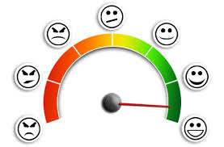
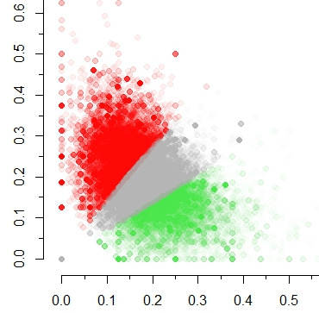
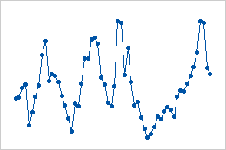
Processing Pipeline at a Glance
Twitter
Public
Stream
‘Social Mood
on Economy’
Filter
Filtering
Italian
Sentiment
Lexicon
Surveillance System
Outlier Detection
and Imputation
Sentiment Scoring
Clustering
Daily Index
Computation

Slide 6
Data Collection and Storage
Data Collection Technique
  We exploit Twitter’s Streaming API to get low latency access to Twitter’s firehose and collect samples of public tweets
Target Population
  Public tweets whose text matches at least one keyword belonging to the filter
Sampling Design
  The sampling algorithm is a black box, as it is entirely controlled by Twitter’s Streaming API. At most a 1% of all the tweets produced on Twitter at a given time can be sampled
Data Format
  Twitter’s Streaming API returns data in JSON format
Data Staging and Storage
  We temporarily store gathered JSON data as text files inside a staging area residing on a server. Then we periodically load bunches of tweets into an Oracle DB (and remove the corresponding files from the staging area)
Notes:
Public Tweets are immediately visible to anyone, whether or not they have a Twitter account (note that this is the default setting of the Twitter platform)
On the contrary, Protected Tweets may only be visible the followers of the author of the Tweet.

Slide 7
Text Processing and Sentiment Analysis
Process Granularity
  To compute daily index values, we process all the tweets collected in a single day as a single block
Input Data
  We only analyze the textual content of the tweets. (No information about users is ever accessed: the index only uses unlinked anonymized data)
Text Cleaning and Normalization
  We perform standard NLP pre-processing steps: (i) convert to lowercase,
  (ii) tokenize running text into words, (iii) apply basic orthographic repairs,
  (iv) remove URLs, (v) remove non-alphabetic characters (e.g. ‘#’ or ‘@’),
  (vi) remove stop words, (vi) if needed, stem words to get rid of inflected forms
Sentiment Analysis Approach
  To classify tweets as Positive, Negative or Neutral we chose to adopt an unsupervised, lexicon-based approach
  We discarded supervised, Machine Learning approaches because we were unable to find large, high quality training sets of human-labeled tweets in Italian

Slide 8
Sentiment Scores: The Lexicon
Our Sentiment Analysis application involves two sequential steps
  Calculate sentiment scores for each tweet
  Use these sentiment scores to cluster tweets into three mutually exclusive classes: Positive (P), Negative (N) and Neutral (U)
To attach sentiment scores to a tweet we leverage an Italian Sentiment Lexicon, namely a vocabulary whose lemmas are associated to pre-computed positive and negative sentiment scores
Currently we are using the Sentix lexicon [Basile and Nissim 2013]
Since it aligns several existing, independent lexical resources (WordNet, MultiWordNet, BabelNet, SentiWordNet) Sentix contains many duplicated lemmas
  ~75’000 lemmas overall, only ~42’000 unique
    To ensure unambiguous and reproducible results we de-duplicated Sentix by averaging atomic sentiment scores of duplicated lemmas

Slide 9
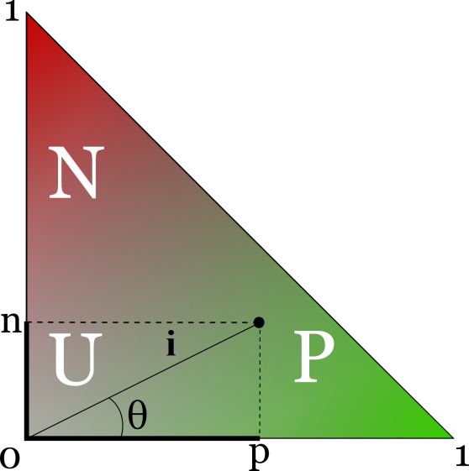
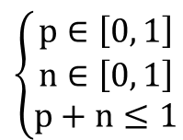
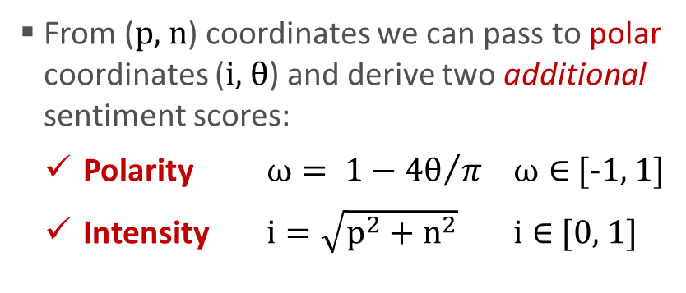
The Sentiment Space
$$\left\{\begin{matrix}p∈\left[0, 1\right] \\ n∈\left[0, 1\right] \\ p+n≤1\end{matrix}\right.$$
In Sentix, positive (p) and negative (n) sentiment
scores of lemmas are constrained as follows:
Therefore Sentix maps lemmas to points
belonging to the sentiment triangle:
From (p, n) coordinates we can pass to polar coordinates (i, θ) and derive two additional sentiment scores:
  Polarity $ω= 1−{4θ}/π$ $ω∈$ [-1, 1]
  Intensity $i=\sqrt{p^{2}+n^{2}}$ $i∈$ [0, 1]
lemma | pos | neg | polarity | intensity
caldo | 0.25 | 0.125 | 0.41 | 0.28
freddo | 0.047 | 0.297 | -0.8 | 0.3
This way Sentix lemmas are
mapped to a 4D sentiment space
To enable clustering, tweets too must be mapped to this 4D space

Slide 10
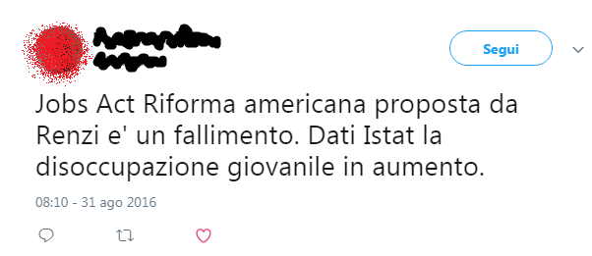
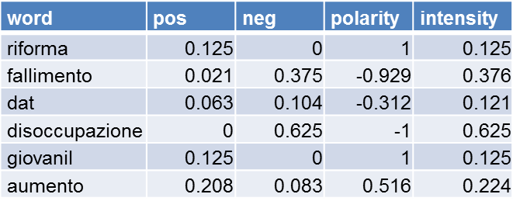

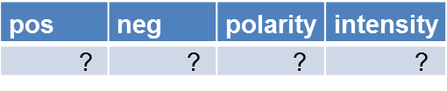
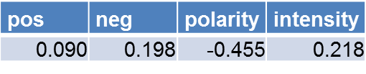
From Word-level to Tweet-level Sentiment Scores
1
disoccupazione
negative score
fallimento
dat
aumento
giovanil
0
riforma
1
positive score

Slide 11
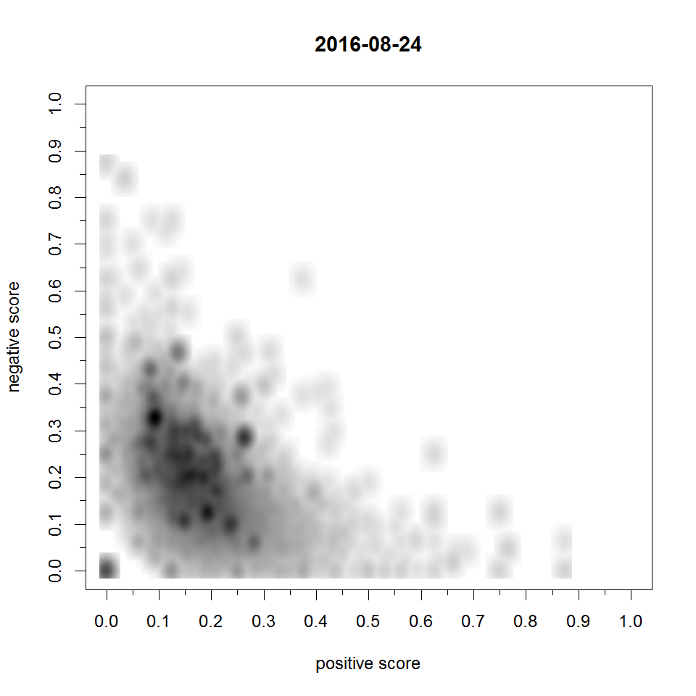
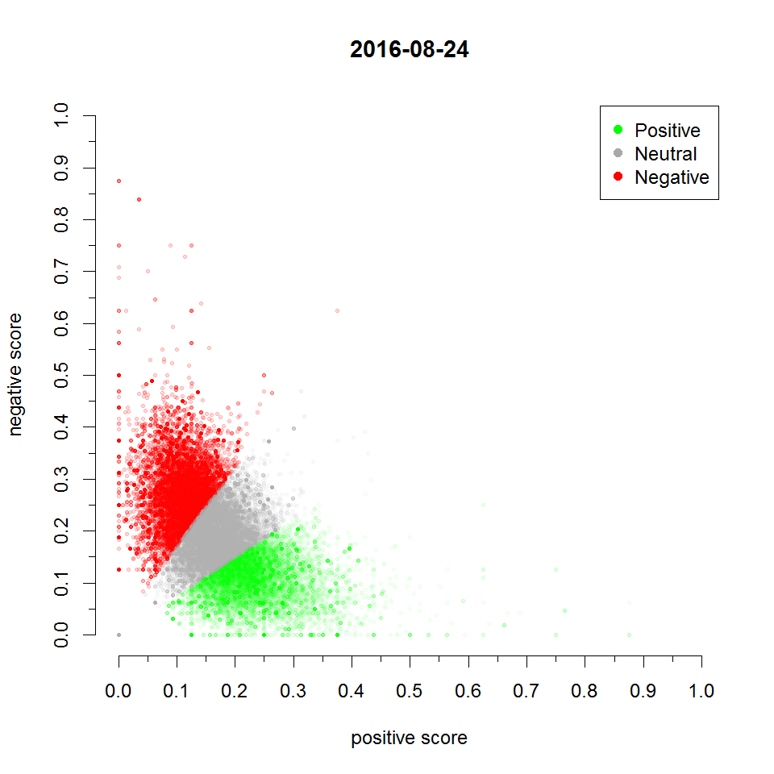

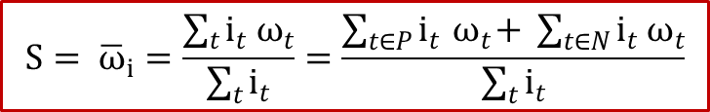
Clustering and Calculation of the Index
Once sentiment scores (p, n, ω, i) are available for all the tweets of a daily block…
…we use K-means to cluster them into Positive, Negative and Neutral tweets
  to lower the risk of finding a local optimum, we run it 100 times with random starts and pick the best solution
Lastly we compute the daily index value (S), which depends on the distribution of tweets within the Positive, Neutral and Negative classes
$$S= {\overline{ω}}_{i}=\frac{\sum_{t}{i_{t}{ ω}_{t}}}{\sum_{t}{i_{t}}}=\frac{\sum_{t∈P}{i_{t}{ ω}_{t}+ }\sum_{t∈N}{i_{t}{ ω}_{t}}}{\sum_{t}{i_{t}}}$$
where ${ ω}_{t}≝0 ∀t∈Neutral$
This index can be seen as the average of polarity (ω) weighted by intensity (i), provided we treat Neutral tweets as if their polarity were zero. Compared to traditional alternatives:
  It is more resilient to tweets’ misclassification
  It reduces day-to-day volatility
Notes:
Popular sentiment indices typically involve counts or proportions of positive and negative Tweets:
S= card(P) ⁄ ( card(P)+card(N) )
S=( card(P) - card(N) ) ⁄ ( card(P) + card(N) + card(U) )
S= card(P) ⁄ card(N)

Slide 12
Monitoring and Validation
No filter is perfect! Thus we devoted special care to make the index robust against possible contaminations by off-topic tweets that might pass the filter
We developed a surveillance system, which periodically searches for anomalous values in the daily time series by means of two independent and complementary outlier detection routines
  Daily values detected as potential outliers cause the system to generate a set of automated diagnostic reports
  These are then sent to human reviewers in charge of deciding whether the detected values are actually proper data points, or instead truly anomalous
Truly anomalous data typically arise when an off-topic tweet that happened to pass the filter becomes “viral” on Twitter
  Being re-twitted and quoted thousands of times in a day, viral tweets may have an unduly impact on the daily index and introduce bias
All the daily index values classified as truly anomalous are eventually imputed via nearest-neighbor interpolation

Slide 13
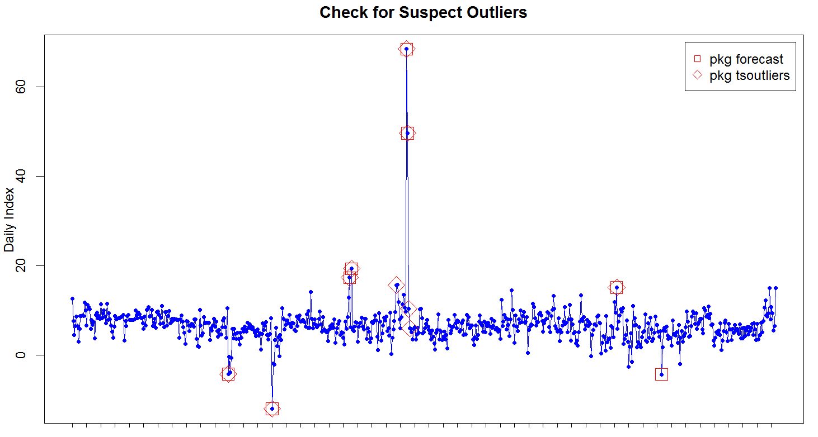
Anomalous Values: One Example
Day: 3 Jan 2017
Value: 69
Event: ???
Day: 24 Aug 2016
Value: -12
Event: Earthquake

Slide 14


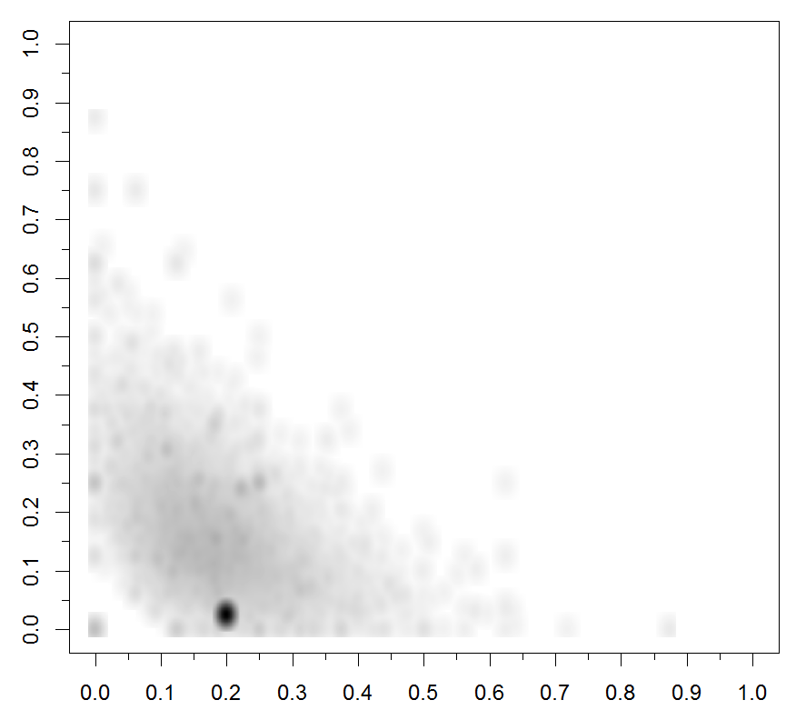
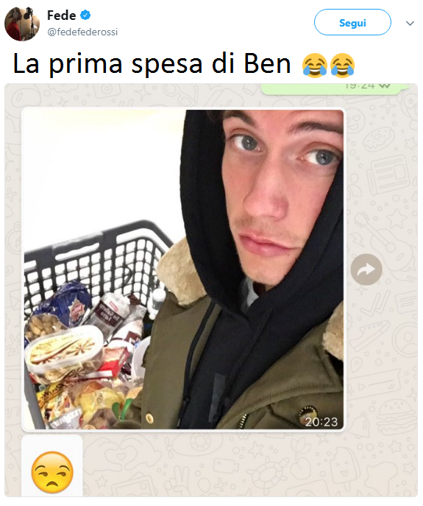
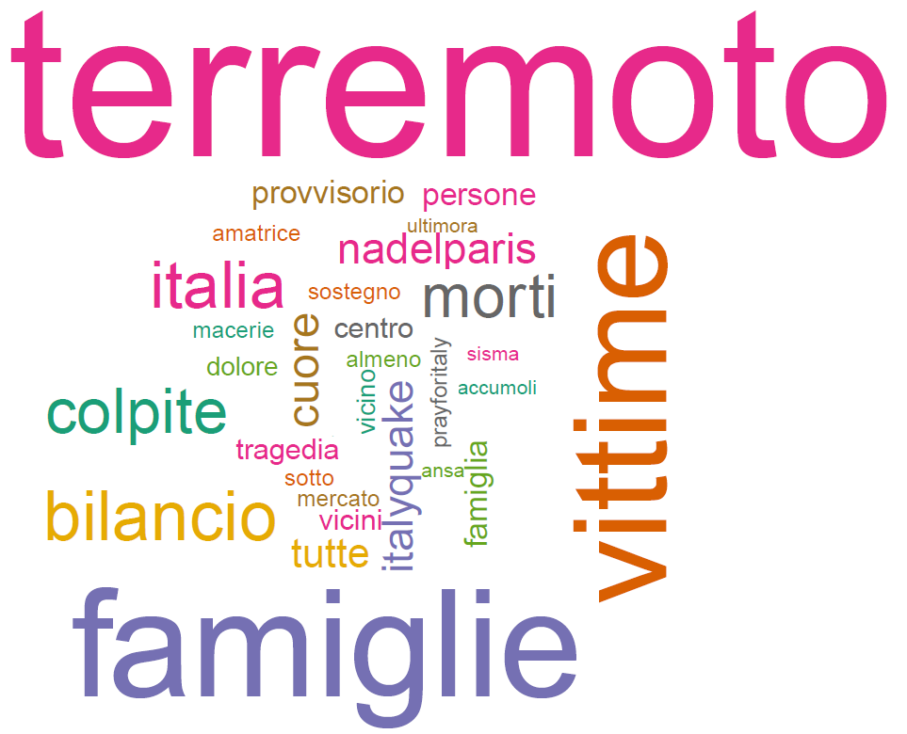
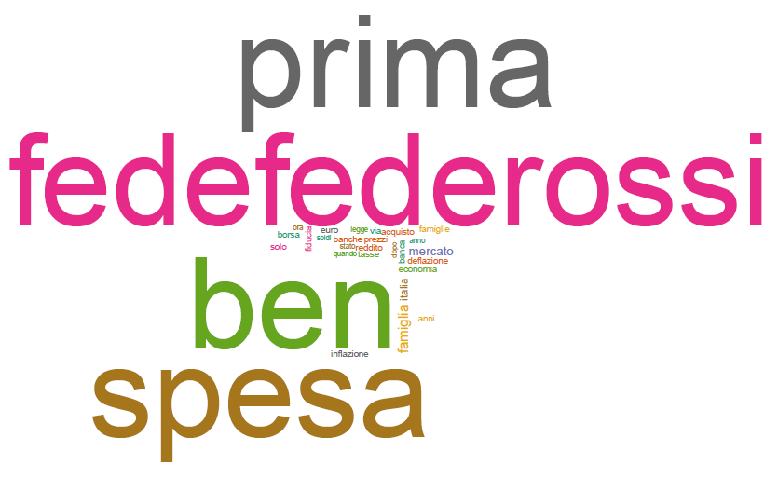
24 Aug 2016
3 Jan 2017
Notes:
Viral tweets with a significant impact on the daily sentiment index will likely show up in 2D density plots as:
well isolated, extremely high density spots emerging from an underlying lower density, almost uniform background
Not all viral tweets are off-topics (e.g. Pope Francis words at Ilva about income and jobs became viral but are definitely in-scope):
After detecting the fingerprint of a viral tweet, reviewers must understand if it is actually out-of-scope
Here’s where word-cloud plots come to rescue
NOTE: Benji & Fede viral tweet was retweeted ~250’000 times on Jan 3 2017

Slide 15
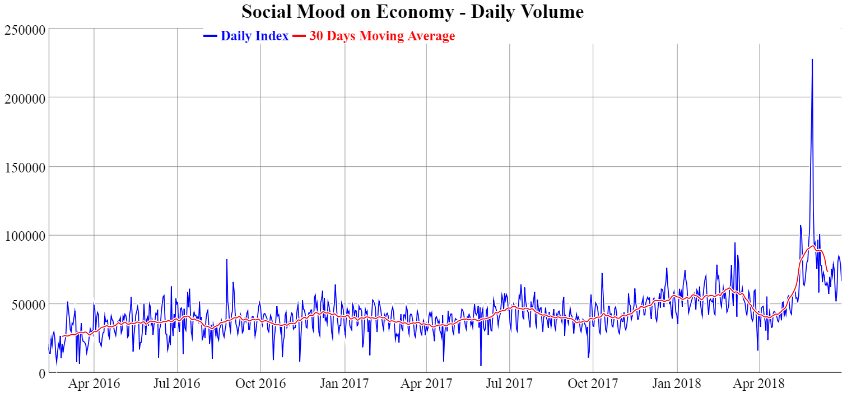
Volume Burst in 2018 Post-Election Crisis
29 May 2018
Spread Peaks Above 300 bps
230,000 tweets
16 May 2018
“Italy will ask the ECB a debt write-off of 250 billion €”
110,000 tweets
5 March 2018
Political Election Results
95,000 tweets
Notes:
Timeline
4 March 2018
Italian general elections
5 March 2018
Elections results become clear (M5S and Lega won)
16 May 2018
A leaked draft of M5S-Lega Government Contract reports that “Italy will ask the ECB a debt write-off of 250 billion €” bought during ECB’s QE
27 May 2018
President Sergio Mattarella rejects Paolo Savona as Minister of Finance
Giuseppe Conte resigns its designation to Mattarella
President Mattarella’s speaks to the nation
28 May 2018
President Mattarella designates Carlo Cottarelli to form a government
29 May 2018
Carlo Cottarelli runs into difficulties and cannot manage to form a government
European Commissioner Gunther Oettinger says: <<the markets will teach Italians how to vote right>>
Btp-Bund Spread peaks and goes above 300 bps
30 May 2018
The M5S-Lega government sees the light

Slide 16
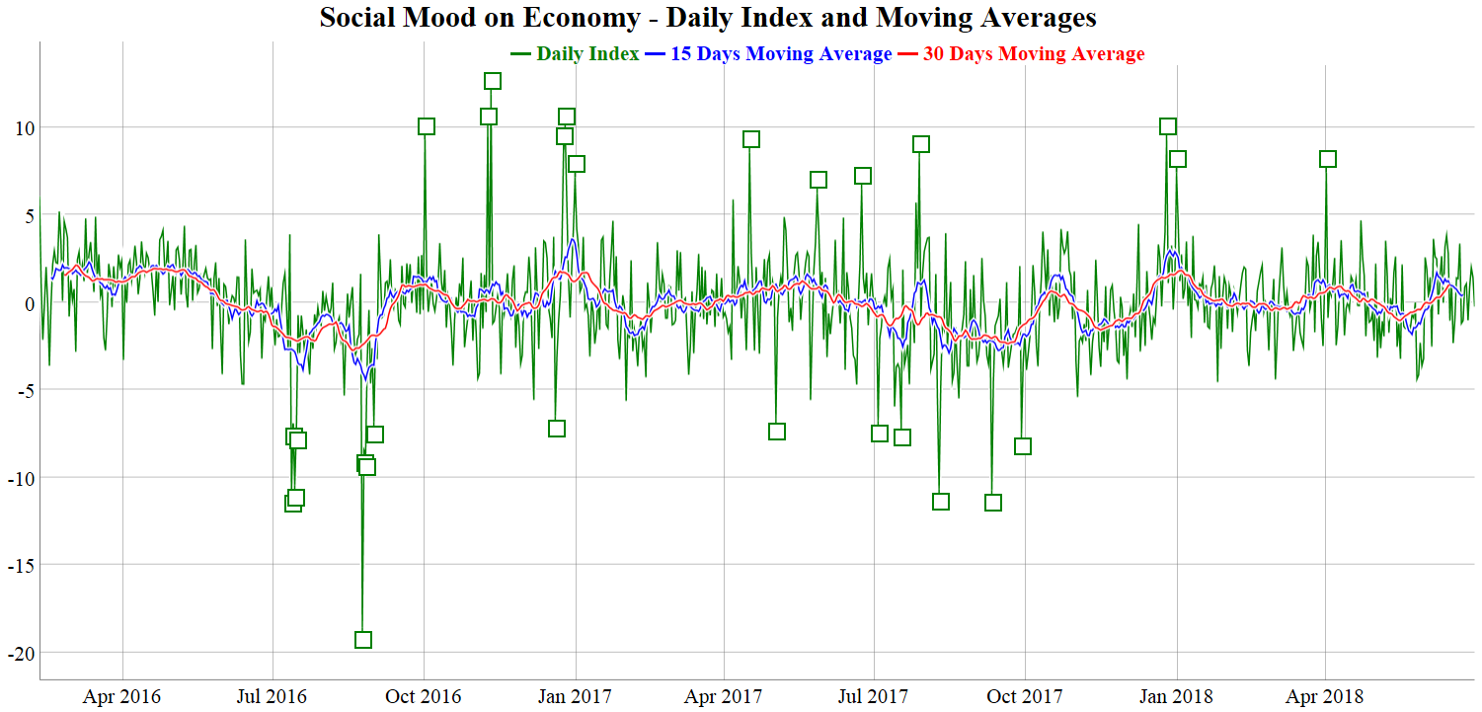
A Highly Volatile Time Series
Notes:
Some qualitative features of the daily time series:
High volatility
MEANINGFUL PEAKS AND VALLEYS
DEFINITELY NON WHITE NOISE
Short memory: values three or more lags away seem almost independent (HINT: average life-span of the News is 2-3 days)
Perhaps stationary: no clearly recognizable trend or drift of the mean
Possible monthly seasonality (but only 26 months so far…)

Slide 17
Valleys: Disasters and Terrorism
Disasters

Slide 18
Valleys: Disasters and Terrorism
Disasters
    Central Italy Earthquake

Slide 19
Valleys: Disasters and Terrorism
Disasters
    Central Italy Earthquake
    Livorno Flood

Slide 20
Valleys: Disasters and Terrorism
Disasters
    Central Italy Earthquake
    Livorno Flood
    Andria-Corato Train Collision

Slide 21
Valleys: Disasters and Terrorism
Disasters
    Central Italy Earthquake
    Livorno Flood
    Andria-Corato Train Collision
Terrorism

Slide 22
Valleys: Disasters and Terrorism
Disasters
    Central Italy Earthquake
    Livorno Flood
    Andria-Corato Train Collision
Terrorism
    Truck Attack in Nice

Slide 23
Valleys: Disasters and Terrorism
Disasters
    Central Italy Earthquake
    Livorno Flood
    Andria-Corato Train Collision
Terrorism
    Truck Attack in Nice
    Christmas Market Attack in Berlin

Slide 24
Valleys: Welfare and Economy
Welfare and Economy

Slide 25
Valleys: Welfare and Economy
Welfare and Economy
    Poverty

Slide 26
Valleys: Welfare and Economy
Welfare and Economy
    Poverty
    Pension System (women’s)

Slide 27
Valleys: Welfare and Economy
Welfare and Economy
    Poverty
    Pension System (women’s)
    Unemployment (youth’s!)

Slide 28
Valleys: Welfare and Economy
Welfare and Economy
    Poverty
    Pension System (women’s)
    Unemployment (youth’s!)
    Income (youth’s)

Slide 29
Peaks: Welfare and Economy
Welfare and Economy

Slide 30
Peaks: Welfare and Economy
Welfare and Economy
    School Teachers Mobility

Slide 31
Peaks: Welfare and Economy
Welfare and Economy
    School Teachers Mobility
    Pension System (women’s)

Slide 32
Peaks: Welfare and Economy
Welfare and Economy
    School Teachers Mobility
    Pension System (women’s)
    Universal Employment vs Universal Income (Pope Francis)

Slide 33
Peaks: Finance and Politics
Finance and Politics

Slide 34
Peaks: Finance and Politics
Finance and Politics
    Financial Markets Rally after Donald Trump Election

Slide 35
Peaks: Finance and Politics
Finance and Politics
    Financial Markets Rally after Donald Trump Election
    Solidarity to Former Rome Mayor for his Criminal Trial

Slide 36
Peaks: Holidays
Holidays

Slide 37
Peaks: Holidays
Holidays
    Christmas and Christmas Eve

Slide 38
Peaks: Holidays
Holidays
    Christmas and Christmas Eve
    New Years’ Eve

Slide 39
Peaks: Holidays
Holidays
    Christmas and Christmas Eve
    New Years’ Eve
    Easter

Slide 40
An Interesting Dynamic
Renewal of ‘Women's Option’ Retirement Opportunity
    Rejected in 2018 Budget Law

Slide 41
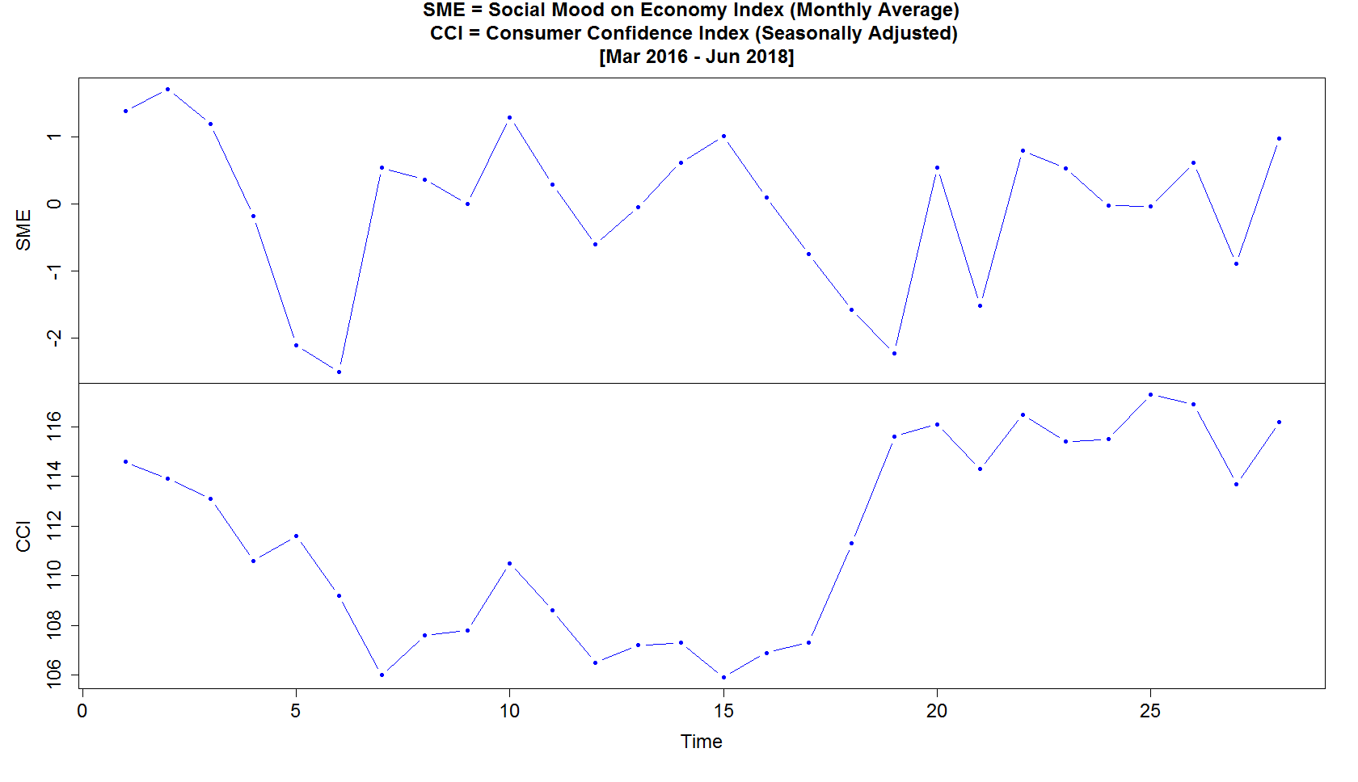
Social Mood on Economy vs Consumer Confidence
Mar 2016
Mar 2017
Sep 2017
Jun 2018

Slide 42

Conclusion
A detailed analysis of the daily time series of the Social Mood on Economy index is currently being finalized
The new index has been accepted for publication as Experimental Statistics…
…and will be disseminated soon through a dedicated page of Istat’s website
  Stay tuned!
  Please let us know your opinion!
Thanks!

