Slide 1
Standardizzazione dei processi produttivi @ Istat
Mauro Bruno
Istituto Nazionale di Statistica - Istat

Slide 2
Outline
Il contesto
L’Enterprise Architecture (EA) come strumento di supporto alla standardizzazione
Verso la standardizzazione dei processi
Modellazione AS-IS (silos based)
Modellazione TO-BE (horizontal integration)
Gap analysis
Use Case: la modellazione delle rilevazioni statistiche sulle imprese

Slide 3
Il contesto
Il contesto esterno:
incremento della domanda statistica (livello territoriale, tipologia di canali di diffusione, etc.)
presenza di competitor sul mercato (sviluppo e diffusione delle tecnologie ICT ha abbattuto la spesa per la produzione dei dati statistici)
necessità di aggiornare le competenze del personale (rapida evoluzione delle tecnologie ICT)
Il contesto interno:
processi & metodologie non standard (assenza di visione olistica)
modello organizzativo ‘decentralizzato’ (ha favorito la proliferazione dei silos nelle diverse rilevazioni statistiche)
Notes:
Reasons for Modernization
In recent years, Istat has been carrying out an in-depth analysis of the cultural, organizational, and technological context in which it works, like other National Statistical Institutes (NSIs) of the most advanced countries which are experiencing a period of profound transformation and facing relevant challenges due the extremely difficult economic and financial situation, especially in Europe.
Further the way in which our society is developing has a direct impact on the supply and demand of official statistical information:
statistical demand is characterized by an unprecedented variety as regards the issues (economic, social, environmental, etc.), the level of territorial detail (from global events to micro-territorial trends) and the type of information (microdata, frames, macrodata, etc.);
the availability of microdata opens new opportunities, but also new challenges for official statistics as for data disclosure control and confidentiality;
information timeliness is crucial also for social, environmental and demographic events that are characterized by long-term evolutions;
current technology allows new data producers to compete with NSIs, at least in some domains, hence the heterogeneity of users should necessarily lead to an heterogeneity of products and channels for dissemination and communication of statistical information;
the private sector is investing a growing quantity of resources in information processing;
the NSIs’ human capital is required a great capacity for regenerating, so as to handle available technologies, deal with new issues and orientate suppliers’ market and relationships with users.
Traditional production chain
In such evolving scenario the traditional production chain, based on the vertical integration of different survey-specific tasks carried out to collect, process, analyse and disseminate statistical data, has become outdated
Image description (top right)
The image on the right schematizes “Silos-based” production. Each arrow represents an organisational silos:
local or vertical know-hows which do not promote reuse
duplication and lack of consistency of solutions
limited interoperability
limited capacity to exploit methodological and technological opportunities
research and innovation at departmental rather than corporate level
Process oriented approach
The whole problem can be stated quite simply by asking “How to overcome this model?”
My answer would be: “we need to adopt a Process oriented approach!”
Image description (bottom right)
The second image on the right schematizes “Process-oriented” approach. Simply speaking the horizontal arrow schematizes the integration needed to overcome the “Silos-based” production.
Obviously in order to introduce this integration dimension in a complex organization such as ISTAT a lot of work has to be done. In the rest of my talk I will describe the organizational and production changes needed to move towards a process oriented organization

Slide 4
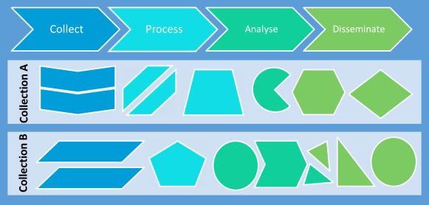
Il contesto
Assenza di una visione olistica
Soluzioni tecniche e metodologie specifiche per ogni indagine:
proliferazione di metodologie e tecnologie
rilevanti rischi di coerenza, integrità e difficoltà di accesso ai dati (aggravio in termini di gestione e sui rispondenti)
Accidental architecture
Processes and solutions are not designed from a holistic view.
Fonte: Common Statistical Production Architecture (CSPA)

Slide 5
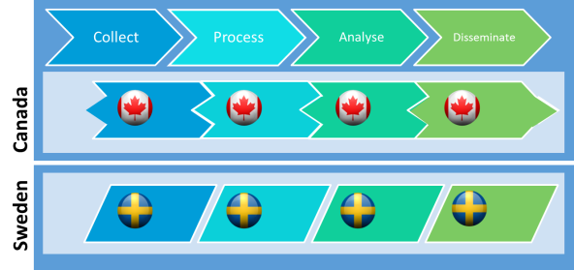
Il contesto
Standardized
architecture
EA helps to remove silos and improves collaboration
Come si possono fronteggiare questi problemi?
Molte organizzazioni statistiche hanno avviato un processo di modernizzazione per rispondere alle esigenze di cambiamento
In questo contesto l’impianto di una Enterprise Architecture permette di :
supportare la standardizzazione
migliorare l’efficienza e la qualità dei processi di produzione
dare impulso allo sviluppo dell’innovazione metodologica, tecnologica e organizzativa
Fonte: Common Statistical Production Architecture (CSPA)

Slide 6
Enterprise Architecture:
Definizioni e
caratteristiche principali

Slide 7
EA: definizioni
Enterprise architecture: a coherent whole of principles, methods, and models that are used in the design and realisation of an enterprise’s organisational structure, business processes, information systems, and infrastructure.
[The Open Group]
Principles
Methods
Information systems
Organizational structure
Business processes

Slide 8
EA: definizioni
Enterprise architecture: a coherent whole of principles, methods, and models that are used in the design and realisation of an enterprise’s organisational structure, business processes, information systems, and infrastructure.
[The Open Group]
Business processes
Business processes
Information systems
Information systems
Enterprise
Architecture
Principles
Organizational structure
Methods
Methods

Slide 9
EA: principali caratteristiche
Visione olistica dell’impresa
rappresentazione di un’impresa nella sua interezza
strumento che permette di coordinare aspetti di business, organizzativi e IT
Supporto alla comunicazione
necessità di definizione di un linguaggio comune, che sia trasversale ai singoli domini
Gestione del cambiamento
creazione di una visione condivisa del presente e del futuro che guidi l’allineamento continuo tra business e IT

Slide 10
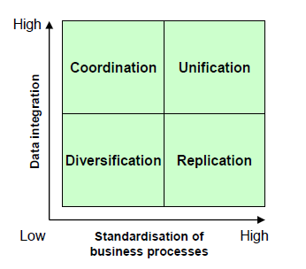
EA: principali caratteristiche
Integrazione e standardizzazione
Sistema integrato dei registri (SIR)
Operating model of enterprises (Ross at al. 2006)
Processo Unico
Notes:
As Ross et al. (2006) show with numerous case studies, successful enterprises employ an ‘operating model’ with clear choices on the levels of integration and standardisation of business processes across the enterprise. In the STATISTICAL domain both components are of utmost importance. On the one side we NEED data integration (one day we will have all data stored in registers) on the other we NEED process standardisation to overcome stovepipes

Slide 11
Verso la standardizzazione dei processi:
Architecture Development Method

Slide 12
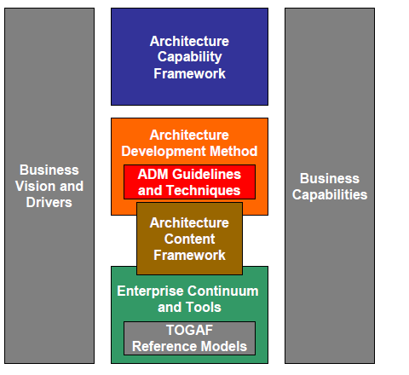
TOGAF
Framework sviluppato dal Consorzio The Open Group
Costituisce un quadro di riferimento (framework + metodi) per la progettazione e la realizzazione di una EA, tenendo conto della specifica realtà di business
Principali componenti utilizzati:
Architecture Development Method (ADM)
Architecture Content Framework
EARF – Enterprise Architecture Reference Framework
Notes:
The Open Group è un consorzio internazionale che ha come obiettivo facilitare il raggiungimento degli obiettivi di business grazie all’adozione di standard nell’Information Technology. Più di 400 aziende partecipano a The Open Group (ci siamo anche noi di E-quality Italia), in rappresentanza di tutti i settori; aziende clienti, fornitori di sistemi e soluzioni, fornitori di tool per l’Enterprise Architecture, System Integrator, consulenti, studiosi e ricercatori.

Slide 13
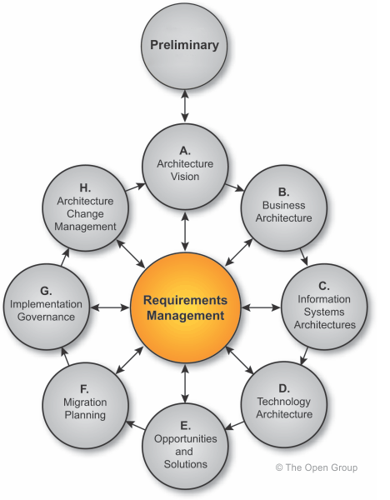
TOGAF - ADM
Architecture Development Method
L’ADM rappresenta il nucleo del TOGAF
L’ADM dettaglia (fase per fase) come realizzare l’EA all’interno di una organizzazione
Costituisce un riferimento per l’architetto per permettergli di soddisfare i requisiti, comunicare il concept, orientarsi su tool di sviluppo, etc.
Ogni fase produce degli artifact che devono essere definiti, classificati e presentati
(ADM)

Slide 14
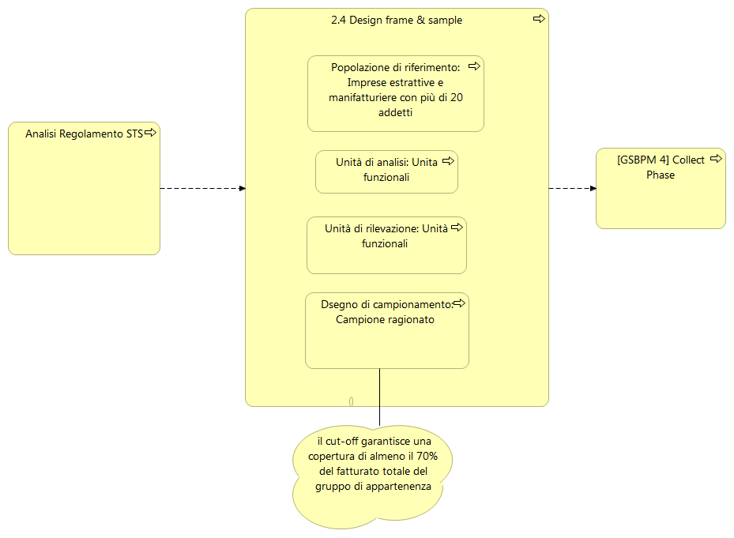
TOGAF - ADM
ADM – Business Architecture
Documentare l’architettura corrente di business (AS-IS), analizzando in particolare:
i processi
le strutture organizzative
le relazioni tra gli attori coinvolti
gli strumenti utilizzati
Definire l’architettura target (TO-BE)
Analizzare il gap tra AS-IS e TO-BE, in termini di: competenze, inefficienze di processo, etc.
B.
Business
Architecture
Artifact: modellazione architetturale AS-IS e TO-BE
Notes:
Scope of phase Business Architecture:
To describe the Baseline Business Architecture
To develop a Target Business Architecture, describing the product and/or service strategy, and the organizational, functional, process, information, and geographic aspects of the business environment, based on the business principles, business goals, and strategic drivers
To analyze the gaps between the Baseline and Target Business Architectures
To select the relevant architecture viewpoints that will enable the architect to demonstrate how the stakeholder concerns are addressed in the Business Architecture
To select the relevant tools and techniques to be used in association with the selected viewpoints
Gap Analysis
A key step in validating an architecture is to consider what may have been forgotten. The architecture must support all of the essential information processing needs of the organization. The most critical source of gaps that should be considered is stakeholder concerns that have not been addressed in prior architectural work.
Other potential sources of gaps:
People gaps (e.g., cross-training requirements)
Process gaps (e.g., process inefficiencies)
Tools gaps (e.g., duplicate or missing tool functionality)
Information gaps
Measurement gaps
Financial gaps
Facilities gaps (buildings, office space, etc.)
Gap analysis highlights services and/or functions that have been accidentally left out, deliberately eliminated, or are yet to be developed or procured. Gap Analysis Matrix in Phase D illustrates an example of a gap analysis matrix.
L’output di questa fase è la modellazione di processo a livello di Business (nello specifico in Istat la modellazione dei processi produttivi è prodotta usando archimate)

Slide 15
TOGAF - ADM
ADM – Information System Architecture
Viene analizzata in dettagli l’architettura dei sistemi informativi (AS-IS), in particolar modo:
flussi di dati
architetture applicative
È necessario documentare la situazione attuale e ipotizzare le informazioni e le applicazioni che possano essere di supporto agli obiettivi di business (TO-BE), suddividendo il sistema informativo in blocchi (siano essi esistenti o meno)
Analizzare il gap tra AS-IS e TO-BE
C.
Information
Systems
Architecture
Artifact: modellazione dati e definizione building blocks
Notes:
Information Systems Architectures - Data Architecture
The objective here is to define the major types and sources of data necessary to support the business, in a way that is:
Understandable by stakeholders
Complete and consistent
Stable
It is important to note that this effort is not concerned with database design. The goal is to define the data entities relevant to the enterprise, not to design logical or physical storage systems. (However, linkages to existing files and databases may be developed, and may demonstrate significant areas for improvement.)
Information Systems Architectures - Applications Architecture
The objective here is to define the major kinds of application system necessary to process the data and support the business.
It is important to note that this effort is not concerned with applications systems design. The goal is to define what kinds of application systems are relevant to the enterprise, and what those applications need to do in order to manage data and to present information to the human and computer actors in the enterprise.
The applications are not described as computer systems, but as logical groups of capabilities that manage the data objects in the Data Architecture and support the business functions in the Business Architecture. The applications and their capabilities are defined without reference to particular technologies. The applications are stable and relatively unchanging over time, whereas the technology used to implement them will change over time, based on the technologies currently available and changing business needs.

Slide 16
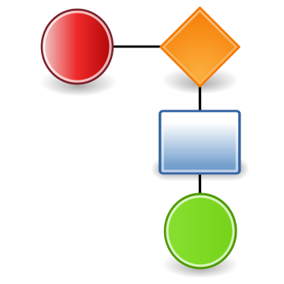
TOGAF - ADM
ADM – Technology Architecture
Sviluppare l’architettura tecnologica che implementa il business e l’architettura informativa definite in precedenza
Creare un riferimento all’esistente (AS-IS), suddividere il sistema IT in blocchi e descriverli singolarmente
Creare un modello (TO-BE), combinando più blocchi insieme (siano essi esistenti o da sviluppare)
Analizzare il gap tra AS-IS e TO-BE
DB RELAZIONALE
D.
Technology
Architecture
WORKFLOW
Artifact: realizzazione building blocks

Slide 17
TOGAF - ADM
ADM – Opportunities and Solutions
Nelle fasi precedenti sono state fotografate la situazione attuale e il target di riferimento e si è divisa l’architettura in parti (building blocks)
In questa fase si considerano tutti i blocchi presenti, quali riutilizzare, quali sostituire, quali acquistare o costruire in funzione delle priorità e delle dipendenze
Concentrarsi su progetti a breve termine che garantiscono risultati immediati, in grado di favorire successivi progetti di grandi dimensioni
E.
Opportun.
and
Solutions

Slide 18
Use case:
La modellazione delle rilevazioni statistiche sulle imprese

Slide 19
Obiettivo del progetto
«Definizione e realizzazione prototipale di un sistema integrato generalizzato per la produzione delle statistiche sulle imprese»
Standardizzazione di metodi e strumenti IT per alcune fasi dei processi di produzione delle statistiche sulle imprese
[AS-IS] Rilevazioni sulle imprese modello tradizionale (stove-pipe)
[TO-BE] Processo Integrato
Notes:
Sistema generalizzato per la conduzione delle rilevazioni statistiche sulle imprese che, nel rispetto degli standard per la modellazione dei processi definiti a livello internazionale, è supportato da “servizi” progettati a partire dai software generalizzati disponibili in Istituto

Slide 20
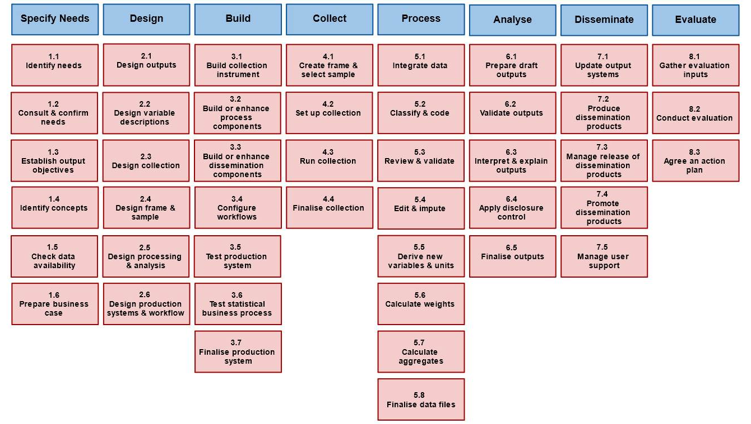
Standard di riferimento
Generic Statistical Business Process Model (GSBPM v. 5.0)
GSBPM (v 5.0)

Slide 21
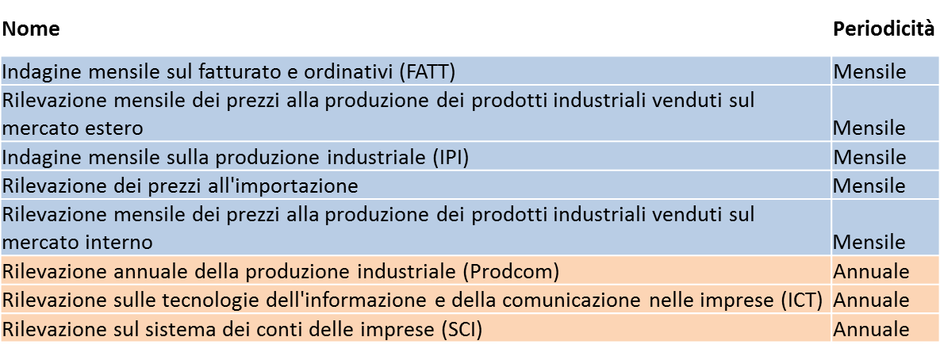
Ambito di azione
Individuazione delle indagini candidate (set iniziale di 8 indagini):
Congiunturali (5 mensili)
Strutturali (3 annuali)
Ricognizione e acquisizione documenti procedura di audit per la valutazione della qualità (scheda processo, scheda qualità di prodotto, report di valutazione) (5 indagini)
Esecuzione interviste indagini congiunturali

Slide 22
Indagini congiunturali: primi risultati
AS-IS (silos based)
TO-BE (horizontal integration)
Survey 1
Survey
Survey 2
Survey
Collect
Process
Analyse
Survey
Centralized assets
Survey 3
Notes:
Production process revision
So far I have detailed the organizational revision. Now I will move to the major production revision choices that we put in place.
Our AS-IS situation was characterized by business lines with different methods and tools that had a very limited sharing among each other.
The TO-BE situation that we designed was articulated in two lines:
Defined processes, in terms of (i) same methods and tools and (ii) workflow of activities.
Centralized assets, especially in terms of data and metadata. The major effort in this sense is our project of an Integrated System of Statistical Registers that I am going to describe in the next slide.
Image description
Left side: we have designed three boxes. Each box represents a survey and within each survey there are two shapes (triangle, rhombus, etc.). Each shape represents a phase in the statistical process and the method/tool used within the phase. Therefore we are modeling the AS-IS situation, where each survey has its own methods and tools, with very limited ability to share among each other.
Right side: concerning the surveys we have made two changes:
the boxes are now arrows
within each box the shapes are now rectangles. T
This means that within each survey a process has been defined. And that processes are defined in terms of i) same methods and tools and (ii) workflow of activities.
Further we introduced an image that represents the Centralized assets.

Slide 23
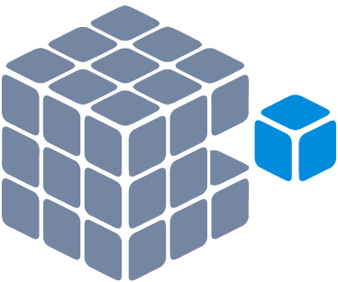
Indagini congiunturali AS-IS
Survey 1
Survey 2
Collect
DB – Micro
DB – Micro
Metadata
Process
Disseminate
DB – Macro
DB – Macro

Slide 24
Indagini congiunturali TO-BE
Survey 1
Survey 2
Collect
Raw data
Metadata
Process
Disseminate
Business register

Slide 25
What’s next
Standardizzazione dei processi, due dimensioni strettamente connesse
Dimensione organizzativa
Dimensione di processo
Cambiamenti massivi -> grandi rischi
Dobbiamo ottenere risultati nel breve/medio periodo
Utilizzo di standard internazionali a supporto del processo di cambiamento
Notes:
Wrap up and final remarks
In synthesis, Istat adopted a process-oriented approach for its modernization programme.
This approach was articulated along two dimensions, an organizational one and a production one.
The impact on the organization is huge with related high risk of failure. However, we were actually at a turning point: no change at all was actually the highest risk. The challenge is to harness this risk.
In this respect, it is important to: (i) have quick wins to show that «it is possible» and reduce the skepticism and (ii) to produce results in a «continous delivery» fashion, thus not having to wait for reaching the final target.
We do believe that the international vision from which we started and to which we are aligned is very much important not only to orient the national investements but also to support them in terms of (i) recognition of shared strategies and (ii) adoption of common solutions.

Slide 26
Grazie per la vostra attenzione!

