Slide 1

COMPORTAMENTI INDIVIDUALI
E RELAZIONI SOCIALI
IN TRASFORMAZIONE
UNA SFIDA PER LA
STATISTICA UFFICIALE
TEMI EMERGENTI
New challenges for official statistics:
Climate change, SDGs and
disaster risk reduction
23 GIUGNO 2016
11.15 | 12.45
Anu | Peltola

Slide 2



Regional data needs in Europe are arising from global policies
Sustainable Development Goals - UNSD
With 17 Goals and 169 targets
Climate Change, COP21 - UNFCCC
The Paris Climate Conference led to
a legally binding and universal agreement
Sendai Framework - UNISDR
For Disaster Risk Reduction 2015-2030

Slide 3
Statistics for Sustainable Development Goals (SDGs) – global work
UN Statistical Commission
  Agreed on initial SDG indicators
  Submits the indicators to ECOSOC for review in June 2016
Inter-agency and Expert Group on Sustainable Development Goal Indicators (IAEG-SDG)
  Discusses how to organize global data flows
  Refines indicator methodologies & plans capacity building
High-level Group for Partnership, Coordination and Capacity-building
  Global Action Plan for the modernization of statistical systems for sustainable development data

Slide 4

Statistics for SDGs – regional work
Regional coordination at the Conference of European Statisticians
  Declaration on the role of statistical offices in SDG monitoring
  Annual high-level SDG discussion
UNECE Task Force
  Adjusts the CES Recommendations on
  Measuring Sustainable Development (2013) for SDGs
  Mapped the 17 SDGs and 169 targets
  with the CES framework
UNECE Steering Group
  Prepares a Road Map for SDG monitoring
  Guides countries in providing statistics for SDGs

Slide 5

Paris Climate Agreement from COP21
– global data requirements
All Parties of the Paris Agreement will report data on:
  National inventories of greenhouse gas emissions and removals
  Progress in the nationally determined contributions
  Mitigation actions and their impact
  Financial, technological and capacity
  building support to developing countries
  Impacts of climate change and adaptation to them
The reporting requires
socio-economic and
environmental statistics!

Slide 6
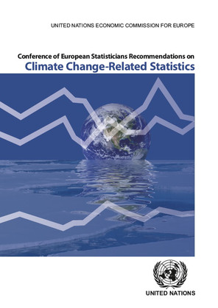
CES Recommendations on climate change related statistics (2015) – regional work
Practical steps to:
inform emission inventories – COP21
inform analysis of climate change
improve the readiness to produce data

Slide 7

Current regional work on climate change
UNECE Steering Group
  Supports countries in developing these statistics: narrative, roadmap, web portal
  Promotes harmonization of official statistics and inventories in close collaboration with UNFCCC, Eurostat, EEA, IEA, FAO…
  Organizes Expert Forums for statisticians, inventory compilers, environment agencies and international organizations
UNECE Task Force, chaired by Italy
  Develops an internationally comparable set of key climate change-related indicators, links with SDGs
  Drafts definitions and suggested data
  sources for the indicator set
  Final report with the indicators by end-2016

Slide 8
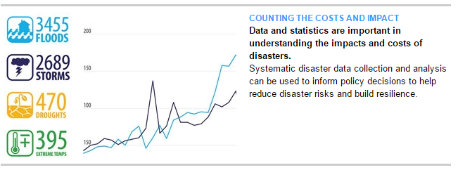
The Sendai Framework for Disaster Risk Reduction – global work
Open-ended Intergovernmental Expert Working Group on Indicators and Terminology
  Established by the UN General Assembly to develop a set of indicators to measure global progress in disaster risk reduction
Needs data and statistics disaggregated e.g. by sex, age and disability & linked to the types, costs and impacts of disasters
Source: The United Nations Office for Disaster Risk Reduction (UNISDR)

Slide 9

Measuring extreme events and disasters – regional work
UNECE Task Force, chaired by Italy
  Defines the role of official statistics in disaster management and risk reduction
  Works closely with UNISDR, ESCAP Expert Group, UNFPA…
  Provides input to the global process on defining indicators to measure the Sendai Framework
  Linked with SDGs
Draft recommendations available in 2017

