Slide 1
Users of statistics
Who are they and what do they need?
Ineke Stoop
Chair ESAC

Slide 2
The ESAC (European Statistical Advisory Committee) shall assist the European Parliament, the Council and the Commission in ensuring that user requirements and the costs borne by information providers and producers are taken into account in coordinating the strategic objectives and priorities of the Union's statistical information policy.
That assistance shall cover all statistical domains relevant to the Union's statistical information policy.
The Committee should contribute to a close cooperation in the programme planning process in order to improve the governance of the European Statistical System and enhance the quality of Community statistics.

Slide 3
The ESAC (European Statistical Advisory Committee) shall assist the European Parliament, the Council and the Commission in ensuring that user requirements and the costs borne by information providers and producers are taken into account in coordinating the strategic objectives and priorities of the Union's statistical information policy.
That assistance shall cover all statistical domains relevant to the Union's statistical information policy.
The Committee should contribute to a close cooperation in the programme planning process in order to improve the governance of the European Statistical System and enhance the quality of Community statistics.

Slide 4
Users
Who are they?
What do they want?
What do they need?
What should they know?

Slide 5
What are users?

Slide 6
Classification of users: institutional users
European Parliament
Council
European Economic and Social Committee
Committee of the Regions
European Central Bank
Confederation of European Business (BUSINESSEUROPE)
European Trade Union Confederation
European Association of Craft, Small and Medium-sized Enterprises
European Data Protection Supervisor
Commission DGs

Slide 7
Classification of users: non-institutional users
Users with a general interest (e.g., economic growth)
Journalists and media
Citizens
Students (by level of education, or age)
Teachers (by level of teaching education)
Users with a specific subject/domain interest (e.g., health)
Other decision makers
Policy analysts
Marketing analysts
Experts in a specific field
Users with a research interest (e.g., innovation in enterprises)
Scientific community: academics, researchers at universities and research institutions
Consultants and researchers in Governmental Agencies and private sector

Slide 8
Type and frequency of use
 | Institutional users |  | Non-institutional users
 |  | General | Specific | Research
(very) Heavy
Light/ occasional
Not/ potential

Slide 9
What users want

Slide 10
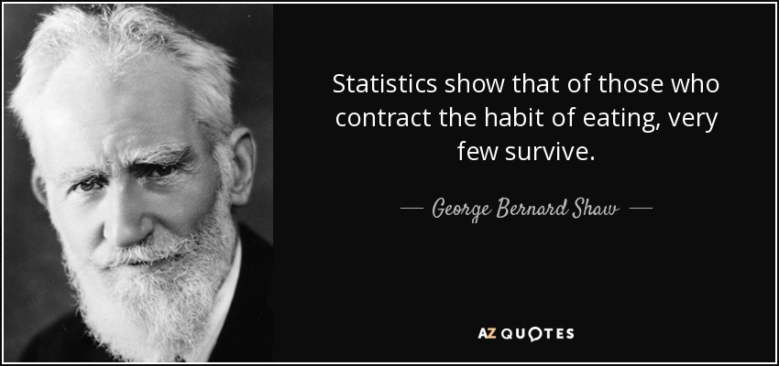
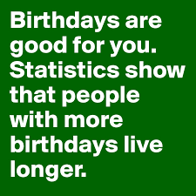
What users want: success, scandals and confirmation
something is terribly wrong
Italy is performing much better/worse than other countries
an indicator shows a sharp increase/decrease
government policies are succesful
the quality of life of women, the elderly, people who live in the south, is much worse than of others

Slide 11
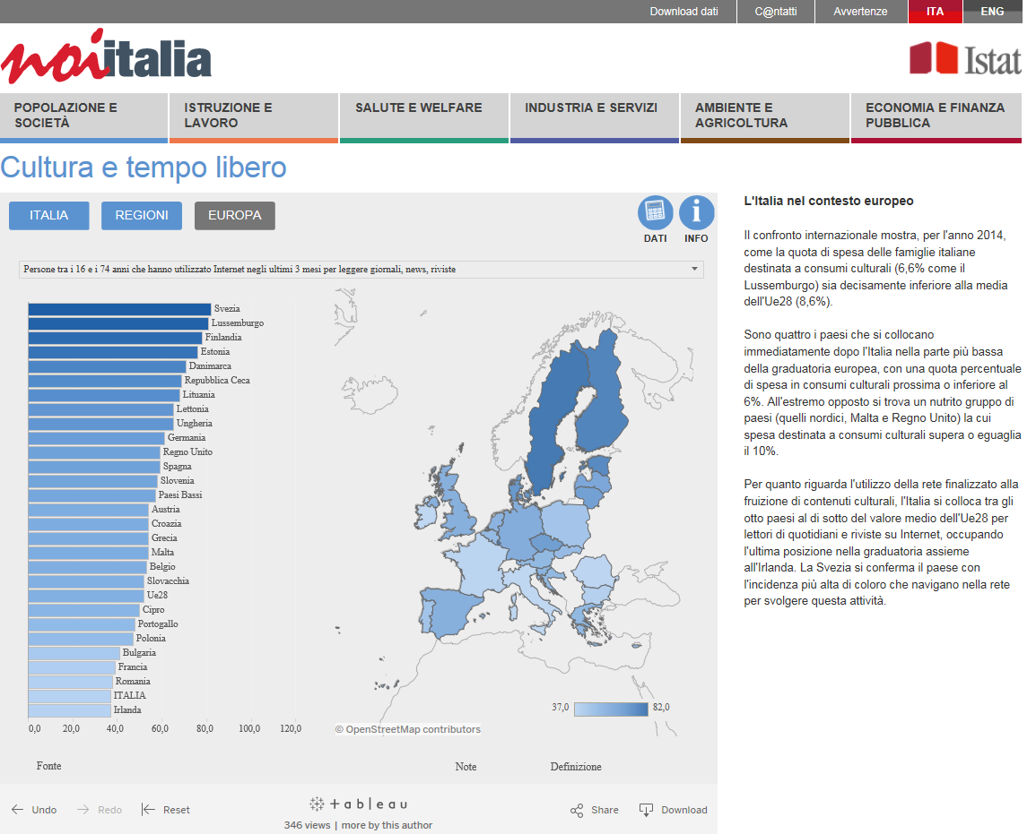

Slide 12
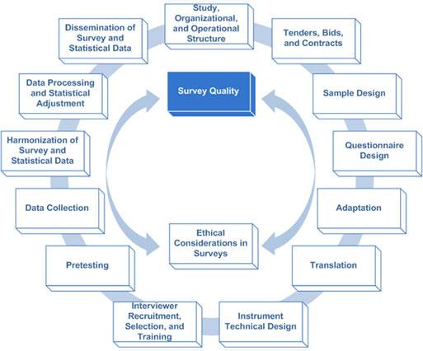
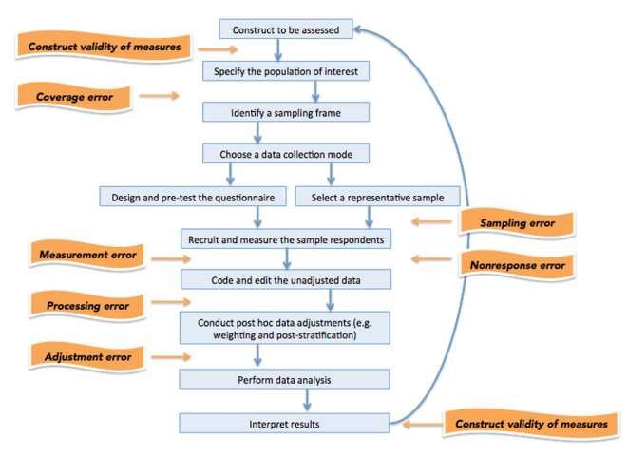
What users need: high quality statistics
Code of Practice
Total Survey Error
TQM
Fit for purpose
Accuracy
Quality
Information about today?
Regional level
Accessibility
Understandability
Indicators, monitors
Policy assessment
TQM
Plan
Do
Check
Act

Slide 13
What users want
Open data
Microdata
Metadata
Maps
Visualisations
Statistics
Indicators
Information/knowledge
Combination of sources
Knowledge from research

Slide 14
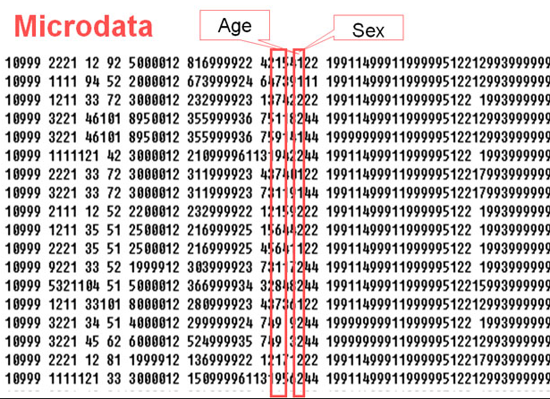
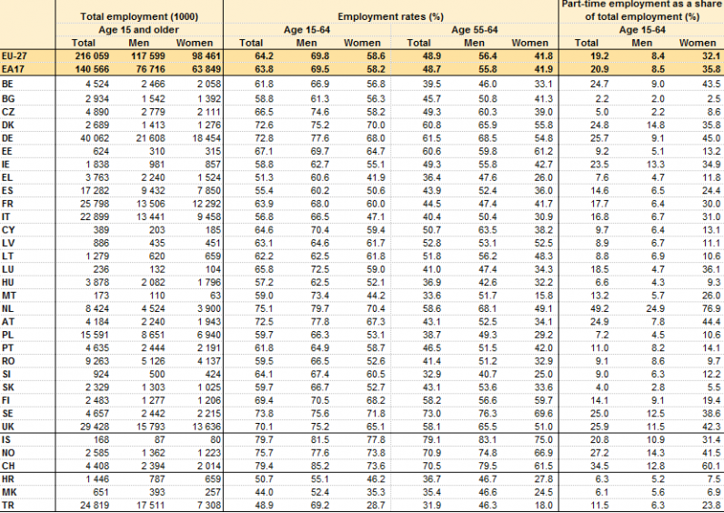
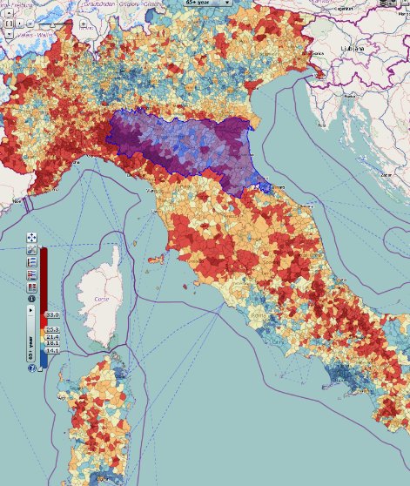
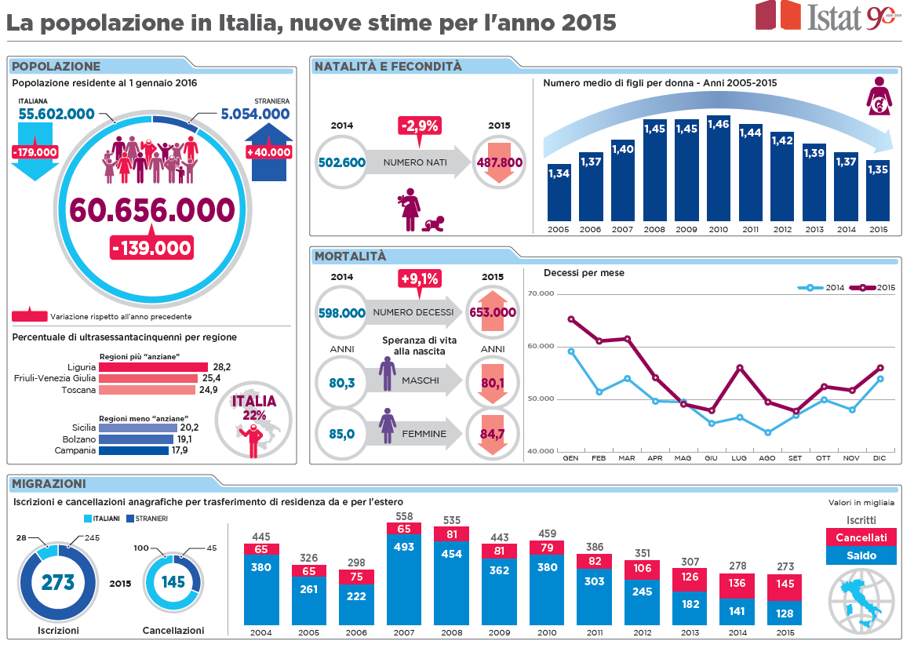
What users need

Slide 15
What users need
Made easy?
Nice visualisations
Statistics is fun
Gamification
Information they need (content, level, form, time)
Don’t underestimate users
Teach them about
Quality of statistics
Strengths and weaknesses
What statistics mean
Provide background, interpretation?

Slide 16
Statistics for our civil societies
Statistical “stamp” enough?
Work on statistical literacy
Able to assess fitness for purpose
Context and interpretation
Role of research
Policy making and evaluation
Theory Litera-ture
Data (statis-tics and other)
Analy-sis Models
Publish Dissem-inate
Institutional, environmental,national context

Slide 17
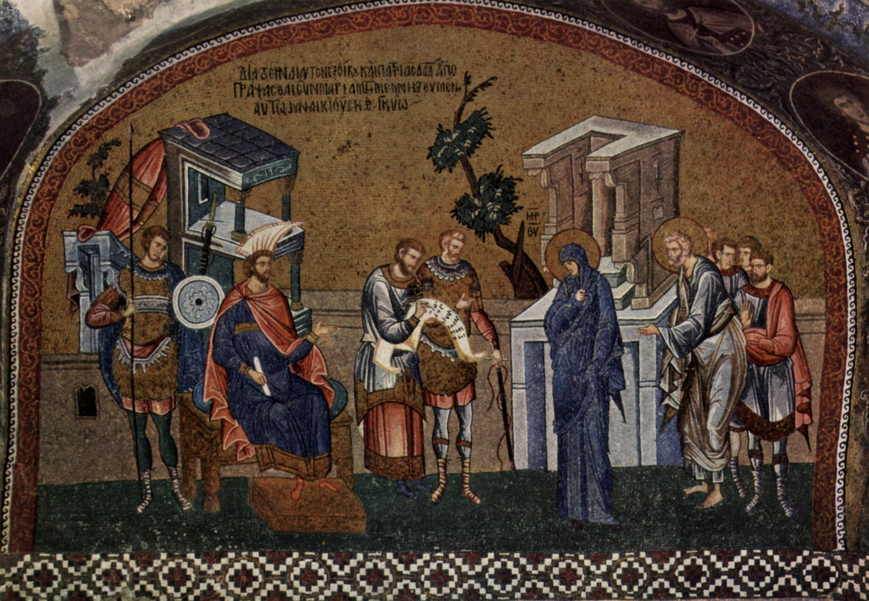
Grazie per l'attenzione
i.stoop@scp.nl

