Slide 1
Climate data past and future: Can we more effectively monitor and understand our changing climate?
Peter Thorne

Slide 2
Talk outline
Global warming is unequivocal …
  But uncertainty remains and is poorly quantified
We can do better at analysing what we have
  Example of surface temperatures
We can do better with observing strategies in the future
  Example of GRUAN
Summary

Slide 3
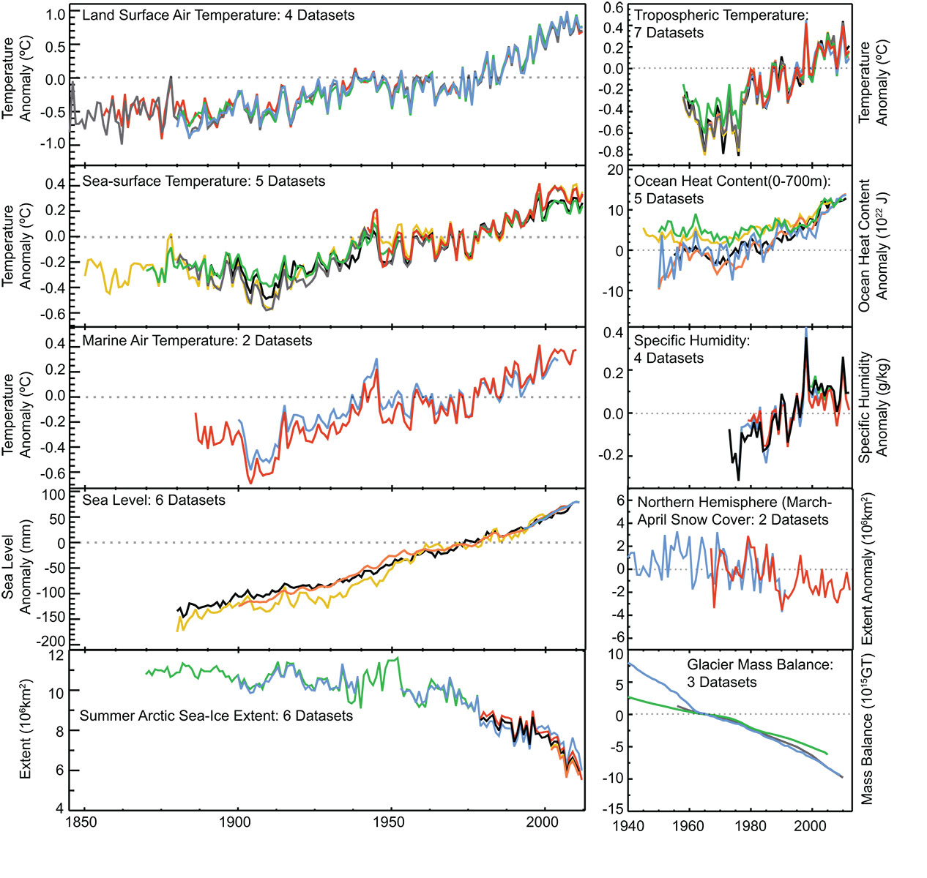

Slide 4
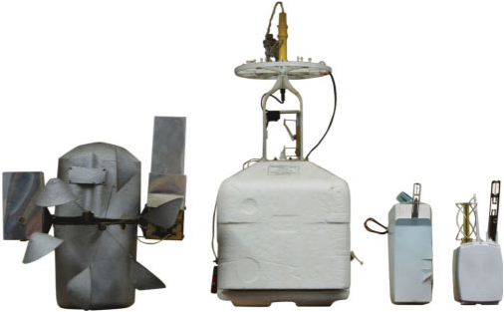

Slide 5
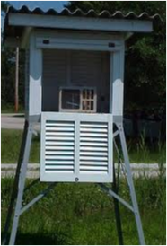
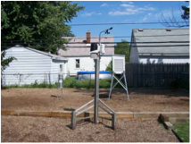
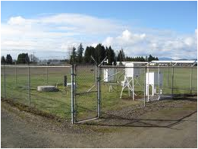
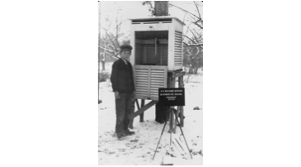
Huge range of instrument types, siting exposures etc. regionally, nationally and globally with many changes over time.

Slide 6
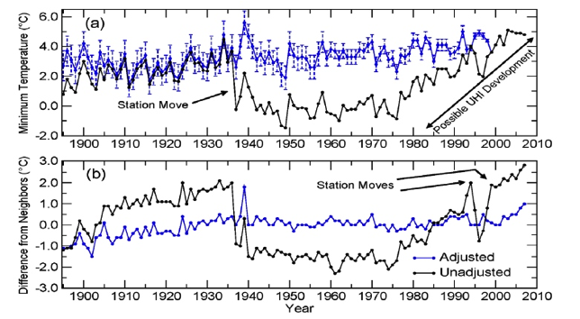
Historical measurement issues have practical consequences

Slide 7
For the surface (similar list would exist for balloon based or remotely sensed data …)
Station moves
Instrument changes
Observer changes
Automation
Time of observation biases
Microclimate exposure changes
Urbanization
And so on and so forth …

Slide 8
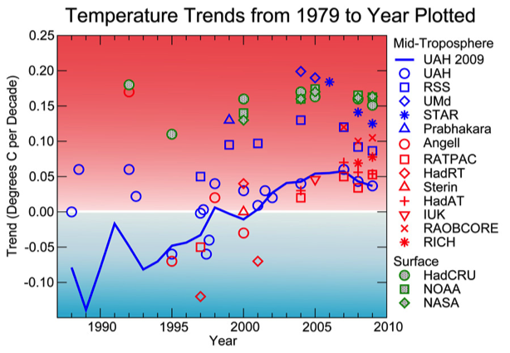
Historical observational uncertainties have real implications

Slide 9
What we have is …
A lack of traceability to absolute or relative standards for most, if not all, of the historical records
A lack of comparability between different measurements
A lack of adequate documentation of the (ubiquitous) changes sufficient to characterize on a station by station basis in an absolute sense their changing measurement characteristics.

Slide 10
Better understanding present observations
We can do better with present observational resources
Example here is International Surface Temperature Initiative
  The themes are broadly transferable to other parameters and observational techniques.
Statistical insights can help us to better estimate the true climate system evolution

Slide 11
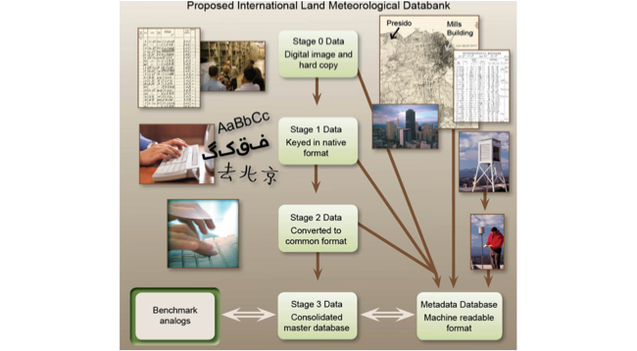
1. Improve data holdings of fundamental basic data

Slide 12
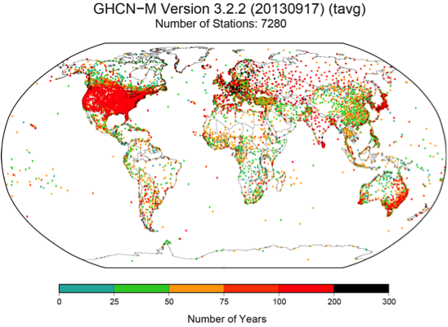

Slide 13
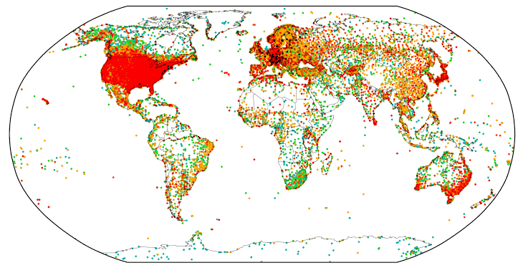

Slide 14
2. Benchmarking
With real world data we do not have the luxury of knowing the truth – we CANNOT measure performance of a specific method or closeness to real world truth of any one data-product.
We CAN focus on performance of underlying algorithms (AKA software testing)
Consistent synthetic test cases, simulating real world noise, variability and spatial correlations potentially enable us to do this

Slide 15
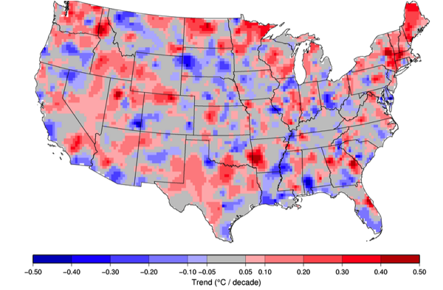

Slide 16
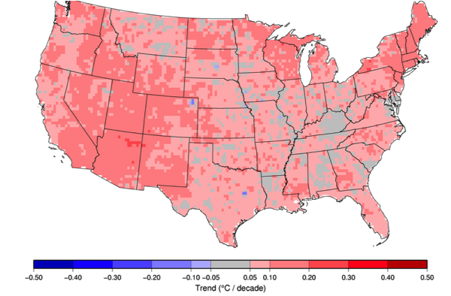

Slide 17
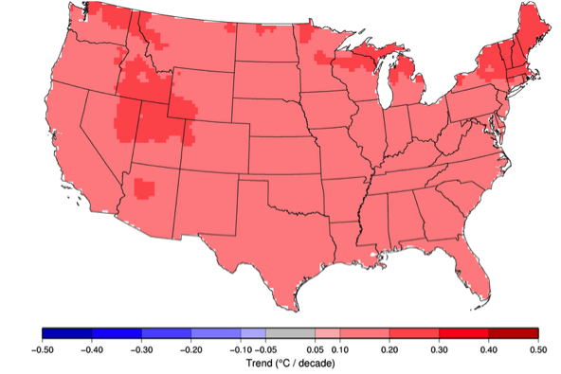

Slide 18
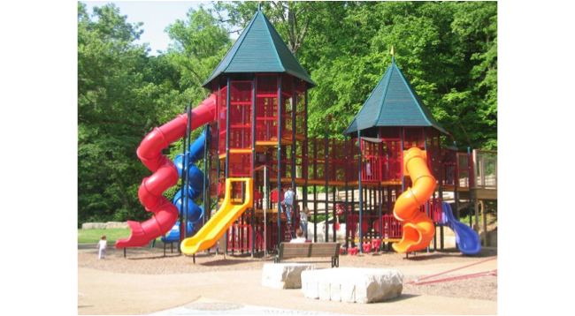

Slide 19
Need multiple approaches
Structural uncertainty is the key
  Raw data is far from traceable to international measurement standards.
  Data artifacts are numerous and have myriad causes
  Metadata describing station histories is patchy at best and often non-existent
  Data is discrete in both space and time
  No “how to” … rather very many cases of “it may work …”
  Multiple subjective decisions required even in automated procedures (thresholds, periods, test type etc.)
  Different approaches may have different strengths and weaknesses
  No single dataset can answer all user needs

Slide 20
Future strategies
Does it always have to be this way?
  No, with a little effort and joined up thinking
  We do not need perfect measures everywhere
  We do need a sufficient set of well characterized measurements to be able to have a chance to understand the remainder of the observations
  Reference quality measurements e.g. US Climate Reference Network and GCOS Reference Upper Air Network, are required on a sustained basis.
  Need a truly multi-point system
        Don’t rob Peter to pay Paul

Slide 21
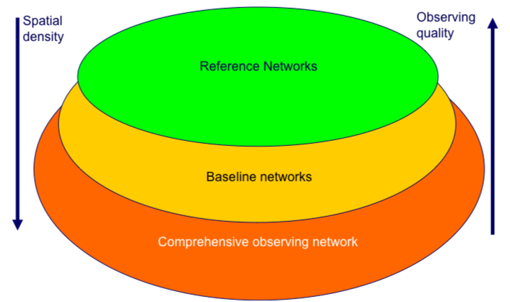

Slide 22
Reference networks can
Provide long-term measurement series in their own right
Constrain measurements from more globally complete measurement systems by providing a finite set of well characterized tie-points
Serve to improve process understanding

Slide 23
A reference quality observation
Is traceable to an SI unit or an accepted standard
Provides a comprehensive uncertainty analysis
Is documented in accessible literature
Is validated (e.g. by intercomparison or redundant observations)
Includes complete meta data description

Slide 24
Establishing reference quality
Uncertainty of input data
Traceable sensor calibration
Transparent processing algorithm
Best estimate
+
Uncertainty
GRUAN Measurement
Black box software
Proprietary methods
Disregarded systematic effects
Literature:
Guide to the expression of uncertainty in measurement (GUM, 1980)
Reference Quality Upper-Air Measurements: Guidance for developing GRUAN data products,
Immler et al. (2010), Atmos. Meas. Techn.

Slide 25
Example – RS92 radiosonde
  Sources of measurement uncertainty:
  Sensor orientation
  Unknown radiation field
  Lab measurements of the radiative heating
  Ventilation
  Ground check
  Calibration
  Time lag

Slide 26
Still a long way to go …
Bring in extra data streams (radiometers, lidars etc.)
Expand the network
  Truly global
  Sufficient stations to characterize climate
Maintain the network for decades to come
  We need continuous and high quality measurements
Do science with the network measurements
  Funding will only be secure if we show reference measurement networks are truly valuable. Saying so does not make it so.

Slide 27
Usage challenges – some Questions (finite list)
If we have multiple measurements of the same variable at the same (nominal) site can we combine to get a better quantified estimate?
How can we compare two (or more) measurements that are non-coincident in space or time or both?
What is the role of other tools such as data assimilation?
GAIA-CLIM (www.gaia-clim.eu) aims to address such Questions for satellite measure characterisation

Slide 28
Summary
No question as to the trajectory of the climate system
Significant ambiguity in the details as a result of past measurement practices
We can do better in the here and now in estimating the past changes using statistical insights
We can also instigate and maintain measurements that better assure the future through instigating traceable and comparable reference measurement networks
It is unambiguous that statistics has a key role to play in all of this
And the good news is that there are many potential ways to get involved
So, let’s make sure that happens ☺

Slide 29

Q&A

