Slide 1
Data warehouse approach to statistical data management and the prospect of its use for scanner data
Antonio Laureti Palma
lauretip@istat.it
Workshop scanner data. Rome 1-2 October 2015

Slide 2
Summary
the context, SBS.Frame, in which the DWH has been developed
INSIDE: INtegrated StatIstical Datawarehouse Environment software
features of INSIDE
    Mapping data
    Extracting data
possible application in the context of the scanner data projec
Workshop scanner data. Rome 1-2 October 2015

Slide 3
SBS-Frame in the contest of business statistics
The Frame, based on administrative data, allows ISTAT to obtain by sum the main economic aggregates required by the Eurostat SBS (Structural Business Statistics) Regulation
The Frame allows ISTAT to overcome the limitations of the estimation domains of the sample surveys; the possibility to have accurate estimates on a relevant number of sub-populations
A detailed and multidimensional mapping of the enterprises is possible
It represents the new base for the National Accounts SEC 2010 estimates;
Workshop scanner data. Rome 1-2 October 2015

Slide 4
The Frame Sources
ID | Source | Description | Supplier | units
FS | Financial Statements | annual profit and loss statements of limited liability companies | Chambers of Commerce | 750K
SS | Sector Studies survey | SMEs with Turnover in [30K-7.5M] euros | Italian Revenue Agency | 3.5M
UN | Tax returns form | unified model of tax declarations by legal form, containing economic information for different legal forms | Italian Revenue Agency | 4.4M
IRAP | Regional Tax on Productive Activities form | Model of declaration for Regional Tax on Productive Activities payment | Italian Revenue Agency | 4.4M
SME | Small Medium Ent. Survey | sample survey on enterprises with less than 100 employees | ISTAT | 100K
RACLI | Labour Cost by Enterprise Reg. | Register of Labour Cost by Enterprise | ISTAT | 1.5M
SBR | Business Register | Italian official Business Register of Active Enterprises44 | ISTAT | 4.4M
Workshop scanner data. Rome 1-2 October 2015

Slide 5
SBS-Frame process features
annual activity
variability of the sources
many actors’ interactions
complex workflow
different actor skills
tracking methodological choices
replicability of results
documenting processes
storing distributed knowledge
Workshop scanner data. Rome 1-2 October 2015

Slide 6
Statistical Data Warehouse (S-DWH)
To support the workflow is used a data-centric approach by a Statistical-Data Warehouse (S-DWH) as a single central data store
Basic requirements for the S-DWH are:
    an easy-to-use environment to access complex data
  control of information visibility
  support of multiple-purpose statistical information in a specific statistical domain
  a metadata-driven model
  a single integrated system
Workshop scanner data. Rome 1-2 October 2015

Slide 7
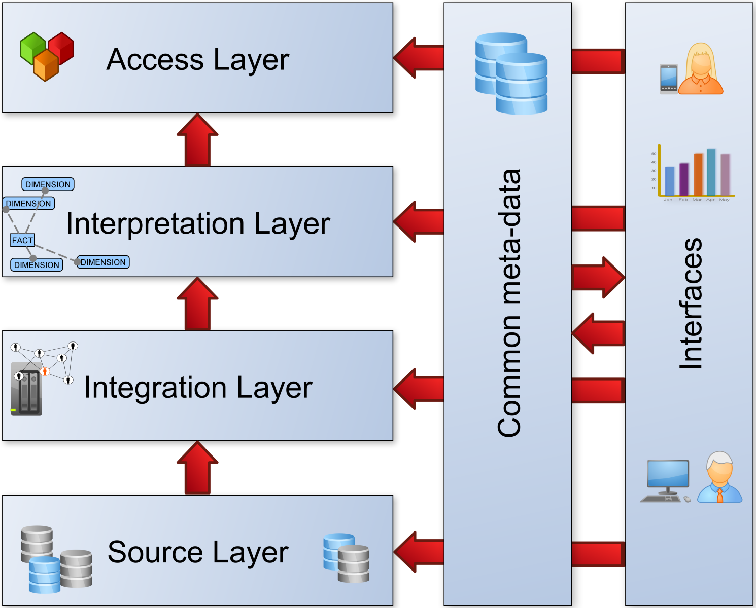
The implementation of INSIDE
To support the SBS-Frame production, the INSIDE (INtegrated StatIstical Datawarehouse Environment) software application has been implemented
INSIDE basic architecture:
Workshop scanner data. Rome 1-2 October 2015

Slide 8
Layered S-DWH
From an architectural point of view, we identify four conceptual layers in the S-DWH:
access layer, for the final presentation, dissemination and delivery of the information sought;
interpretation and data analysis layer enables data analysis or evaluation for statistical design;
integration layer is where all operational activities are carried out; in this layer data are integrated and transformed in order to increase performance and usability of the upper layer;
source layer is the level where data sources are stored; internal data (from surveys or step elaboration) or external data (from administrative provisions).
Workshop scanner data. Rome 1-2 October 2015

Slide 9

INSIDE: user roles
Role | Description | Source | Integration | Interpretation | Access
source mapper | is a source expert responsible for mapping of economic variables
data analyst | performs statistical analysis and is in charge of all or part of the statistical production process
data administrator | responsible for managing the data flows, user authorization and system maintenance
Workshop scanner data. Rome 1-2 October 2015

Slide 10
INSIDE: user mappers
source
integration
“data mapping is the process of creating data element mappings between two distinct data models in order to overcome the lack of control in source provisions”
the mapper is a source expert, specialized in a topic, responsible for the coherent mapping with the internal S-DWH dictionary.
has access permission
  mapping is automatic or manual
Frame
survey
internal dictionary
FS
SS
variables mapping
…
IRAP
Workshop scanner data. Rome 1-2 October 2015

Slide 11
INSIDE: user analysts
  data analysts make the statistical evaluations.
  The access layer is optimized for interacting easily with complex data.
  This allows:
  basic analysis
  creates a view in a private area from a list of selected data sources
  access to the views through standard statistical software
  has access permission
interpretation
access
data analyst
SAS
WF
FRAME
SBS
View
SBS
View
NA
Workshop scanner data. Rome 1-2 October 2015

Slide 12
INSIDE: data administrator synthetic metadata model schemas
source
integration
interpretation
access
timing
docs
facts
view layouts
monitoring
provision
provisions
dictionary
dimensions
user
layouts
Workshop scanner data. Rome 1-2 October 2015

Slide 13
INSIDE: data model synthetic microdata model schemas
source
integration
interpretation
access
tables
data hub
fact tables
views/marts
FS DIM
FS
SBS
provisions
PROVISION
GEO
ATECO
SBR
surveys
JUR. FORM
EMP CLASS
DICTIONARY
derived source
SS
…
UNICO
SBR
SS DIM
Workshop scanner data. Rome 1-2 October 2015

Slide 14

INSIDE software application: user modules
VIEWER
MAPPING
Workshop scanner data. Rome 1-2 October 2015

Slide 15
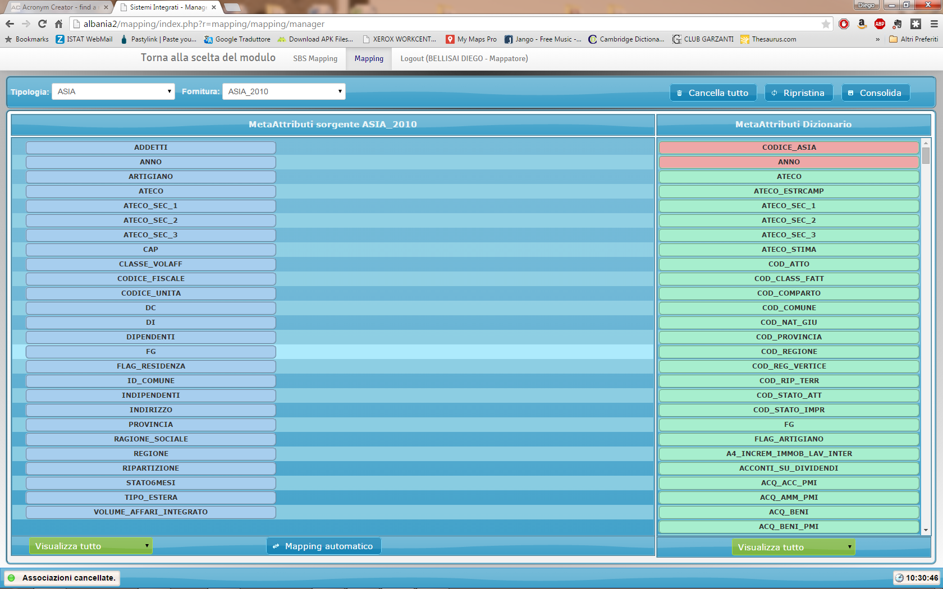
INSIDE software application: mapper
S-DWH dictionary
sources’ variables
mapping view results
Workshop scanner data. Rome 1-2 October 2015

Slide 16
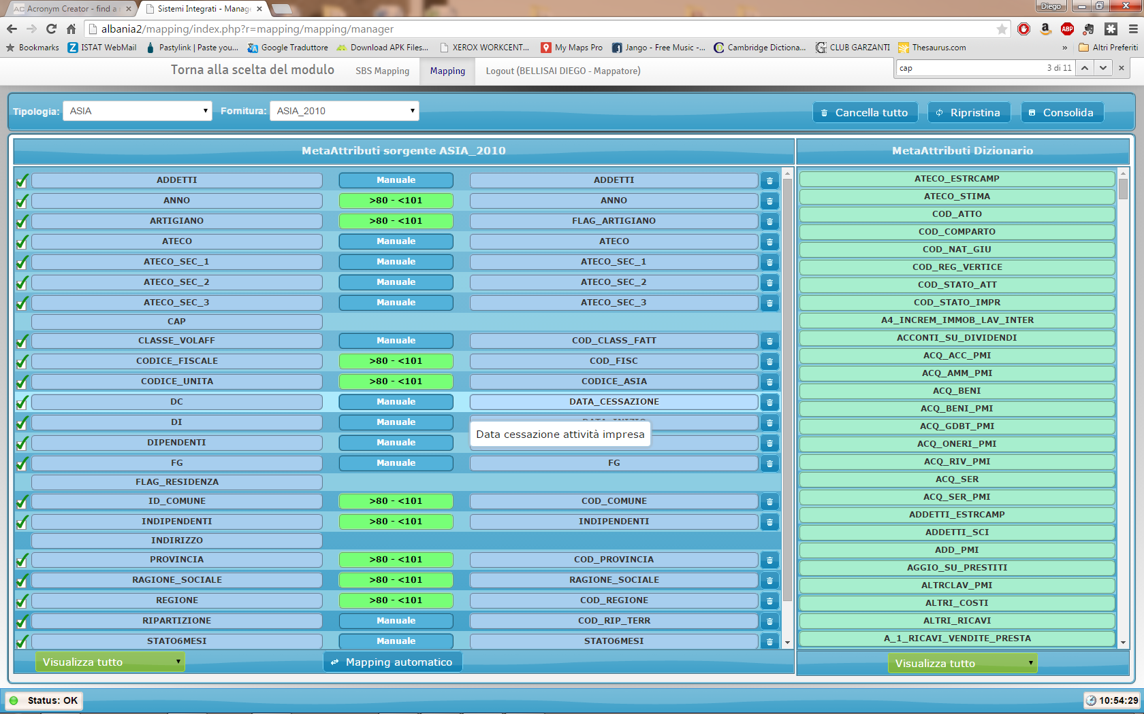
INSIDE software application: mapper
automatic mapping results
probabilistic matching, percentage of association
manual matching
not matched
Workshop scanner data. Rome 1-2 October 2015

Slide 17
INSIDE architecture: two user modules
VIEWER
MAPPING
Workshop scanner data. Rome 1-2 October 2015

Slide 18
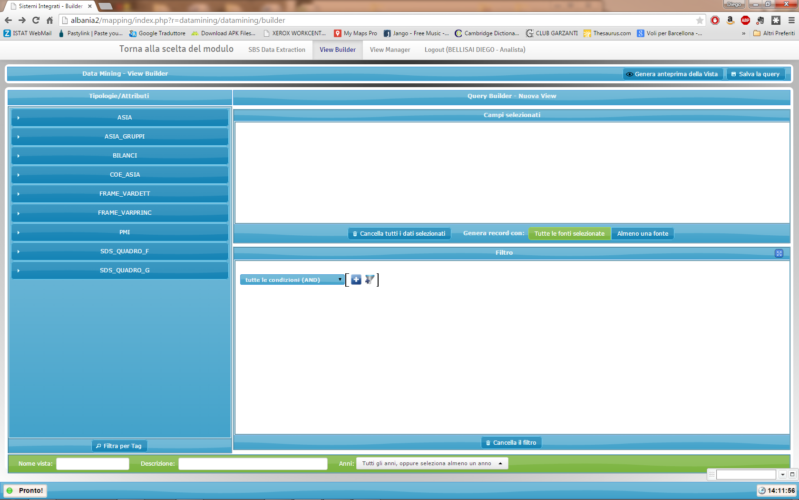
INSIDE software application: view builder
building area: select area
facts list
building area: where area
Workshop scanner data. Rome 1-2 October 2015

Slide 19
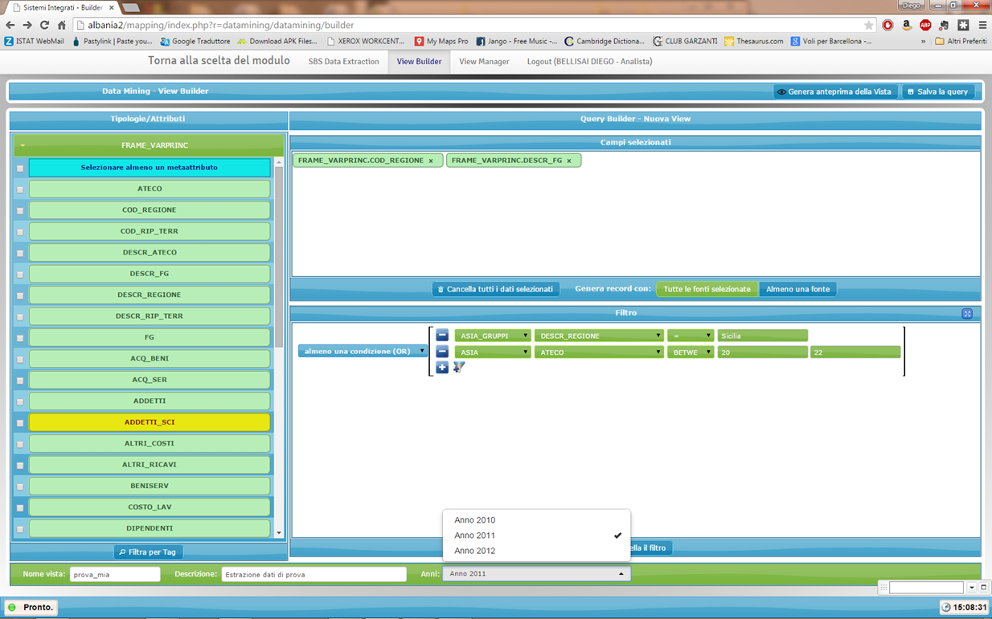
INSIDE software application
viewer: view builder
view preview
view name
Workshop scanner data. Rome 1-2 October 2015

Slide 20
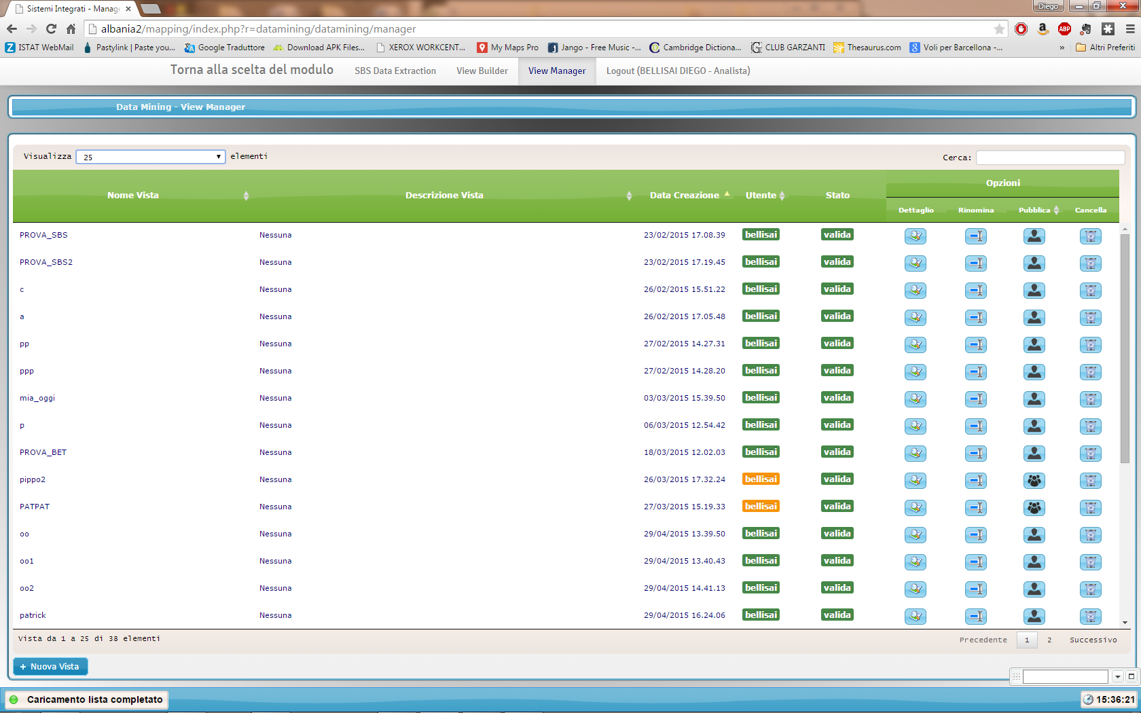
INSIDE software application
viewer: view manager
view manager
Workshop scanner data. Rome 1-2 October 2015

Slide 21







INSIDE architecture: two user modules
data analyst: desktop application environment
INSIDE
2-tier system
PUBLISHING & SHARING SERVICES
CONTENT MANAGEMENT
Workshop scanner data. Rome 1-2 October 2015

Slide 22
Possible application in the context of the scanner data project
Mapping variables
  INSIDE is optimized for the managing of complex sources:
managing the acceptance process of any new (EAN) metadata provision
managing the substitution of products (at GTIN/EAN code level):
  filtering by ECR classification
  mapping by text matching
  temporal data pre-viewing (turnover check)
  code linking the EAN to COICOP classification
articulating the mapping activities within different source competence groups, ECR area or COICOP area
Workshop scanner data. Rome 1-2 October 2015

Slide 23
Possible application in the context of the scanner data project
Data analysis
  INSIDE is optimized for the access to complex data, allowing:
easy access to the micro data at outlet level for several months
control of the data visibility of the users by product area
analysis of microdata (temporally or spatially) by COICOP or ECR classification or both
possibility of using any statistical software for analysis
use of the access layer as standard input for a production processes
Workshop scanner data. Rome 1-2 October 2015

Slide 24
INSIDE software application: mapper
EAN in
EAN matched
EAN internal
Workshop scanner data. Rome 1-2 October 2015

Slide 25

INSIDE software application: mapper
filter by ECR
text match
8004786000164: ACQUA SANTA EGERIA STD TAVOLA MINERALE GAS PLAS 01 050.0 CL
ECR:
02010103
search
8008474011036, ACQUAEFO MERANE ….050.0 CL
8007500050131, NORDA ACQUACHIA...01 050.0 CL
8007500002604, NORDA ACQUACHIA ..06 050.0 CL
8010421000475, SORG.ORTICAIA …….01 050.0 CL
8010421150460, SORG.ORTICAIA …….06 050.0 CL

Slide 26
INSIDE software application: mapper
s
filter by ECR
filter by EAN text
8004786000164: ACQUA SANTA EGERIA STD TAVOLA MINERALE GAS PLAS 01 050.0 CL
DESC EAN:
SORG.ORTICAIA
search
data preview
8010421000475, SORG.ORTICAIA …….01 050.0 CL
8010421150460, SORG.ORTICAIA …….06 050.0 CL

Slide 27
INSIDE software application: mapper
s
filter by ECR
filter by EAN text
data preview
8004786000164: ACQUA SANTA EGERIA STD TAVOLA MINERALE GAS PLAS 01 050.0 CL
DESC EAN:
SORG.ORTICAIA
search
8010421000475, SORG.ORTICAIA …….01 050.0 CL
8010421150460, SORG.ORTICAIA …….06 050.0 CL
data preview
8004786000164: ACQUA SANTA EGERIA STD TAVOLA MINERALE GAS PLAS 01 050.0 CL
Turnover coverage: 8010421150460, SORG.ORTICAIA ACQUA SILVA STD TAVOLA MINERALE GAS PLAS 06 050.0 CL
29 | 28 | 27 | 21 | 21 | 11 | 28 | 30 | 21 | 16 | 27 | 30 | 22 | 15 | 18 | 29 | 12 | 28 | 25 | 24 | 26 | 18 | 20 | 30 | 15 | 10 | 22 | 23 | 21 | 24 | 13 | 29 | 25 | 22 | 13 | 26 | 30 | 22 | 14 | 28 | 26 | 29 | 21 | 26 | 19 | 13
1 | 2 | 3 | 4 | 1 | 2 | 3 | 4 | 1 | 2 | 3 | 4 | 1 | 2 | 3 | 4 | 1 | 2 | 3 | 4 | 1 | 2 | 3 | 4 | 1 | 2 | 3 | 4 | 1 | 2 | 3 | 4 | 1 | 2 | 3 | 4 | 1 | 2 | 3 | 4 | 1 | 2 | 3 | 4 | 1 | 2
-11 |  |  |  | -10 |  |  |  | -9 |  |  |  | -8 |  |  |  | -7 |  |  |  | -6 |  |  |  | -5 |  |  |  | -4 |  |  |  | -3 |  |  |  | -2 |  |  |  | -1 |  |  |  | current

Slide 28
thanks for your attention
Workshop scanner data. Rome 1-2 October 2015

