Slide 1
IT Architectures for Handling
Big Data in Official Statistics: the Case of Scanner Data in Istat
Scanner Data Workshop
Rome 2 October 2015
Gianluca D’Amato, Annunziata Fiore, Domenico Infante, Antonella Simone, Giorgio Vinci, Antonino Virgillito
Istat

Slide 2
About me
Head of unit «Architectures for business intelligence, mobile and big data»
Project manager of the UNECE project Big Data in Official Statistics
Leader of the IT group in the Istat Scanner Data project

Slide 3
Abstract
In this talk we present the issues and challenges related to dealing with datasets of big size such as those involved in the Scanner Data project at Istat
We illustrate the IT architecture backing the testing phase of the project, currently in place, and the ideas for the production architecture
The motivations behind the design are explained as well as the solutions introduced as part of a larger scope approach to the modernisation of tools and techniques used for data storage and processing in Istat, envisioning the future challenges posed by the adoption of Big Data and Data Science in NSIs

Slide 4
Data Size - Current
Received and stored data from
6 chains in 6 provinces
30% of all stores available from Nielsen in these provinces
2 and a half years time span
550 Stores
210,000 Products
426 Million records
Space occupation of 1 year of microdata in the database
18Gb

Slide 5
Data Size - Expected
Further 29 provinces will be received by the end of the year
Estimated size of 1 year of microdata
47Gb
6 chains only
142Gb
All available chains

Slide 6
Actual occupation
2 years of microdata only
Current occupation of DB space
36Gb
200Gb
now
Indexes, views, aggregations, classifications…
?
100Gb
End 2015
29 provinces
6 chains
540Gb
2016?
EVERYTHING!

Slide 7
The Problem with Size…
Query time is not satisfactory
  Aggregated intermediate results in tables
  IT support required
  More space!
«Difficult» to extract data for analysis
Data growth is not predictable
DBAs do not guarantee proper backup when space occupation is over 500Gb

Slide 8
Architectural Elements
Data ingestion
  SFTP
  Custom Java code
Data architecture
  Relational DB
Tools
  SAS, Excel…
  Business Analytics Platform (MicroStrategy)

Slide 9
Business Analyitics Platforms
Allow to access data stored in different data sources and represent it in a common multi-dimensional schema that is easier to query and navigate
  Automatically aggregate measures at different levels of dimentionality
Normally used in enterprise contexts to facilitate management of large-heterogeneous data warehouses
Enable interactive analysis
  Reports: results of queries in a tabular format that can be browsed and downloaded in Excel or CSV file
  Dashboard: free navigation on data through the creation of interactive visualizations in drag-and-drop mode
First example of use in Istat with large data sizes

Slide 10
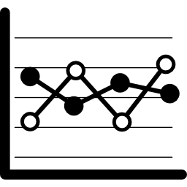





IT Architecture: Testing Phase
Control Dashboard
Reports and Visualizations
Microstrategy
SFTP
Load
Pre-process
SAS
Views
DB

Slide 11

Data Ingestion
Control Dashboard
SFTP
Load
Pre-process
SAS
Data is sent by Nielsen in form of compressed text files via SFTP (secure channel)
The SFTP server is located in Istat data center and it is protected by strict security policies

Slide 12
Data Ingestion
Control Dashboard
SFTP
Load
Pre-process
SAS
Received data are handled by programs written in Java
Load: performs integrity checks on received files, loads data in the DB, logs received files and estimates discounts
Pre-process: performs quality checks at record level, discards dirty data
The whole acquisition process is controlled by a web dashboard

Slide 13
Data Access and Analysis
Reports and Visualizations
Microstrategy
SFTP
Load
Pre-process
SAS
Views
DB
Data can be accessed in two ways:
Extraction from the DB
  Materialized views were created in order to facilitate import in SAS
Use of a business analytics tool (MicroStrategy) for reporting, visualization and browsing of the data

Slide 14
Data Access and Analysis
Reports and Visualizations
Microstrategy
SFTP
Load
Pre-process
SAS
Views
DB
In both access modes the results of common interrogations were pre-computed at different levels of aggregations and were provided as views or reports
This allowed to speed-up access time at the cost of additional space on the DB

Slide 15
Preliminary Analysis
Analysis of quality of data
  Anomalies
  Distributions
  Nulls
  …
Exploratory analysis
  Time series of turnover and quantity
  Distribution per coicop group
  …

Slide 16
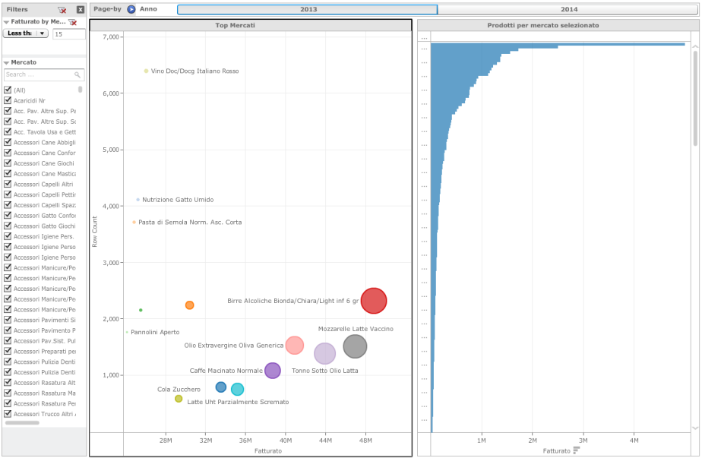
Turnover per Market

Slide 17
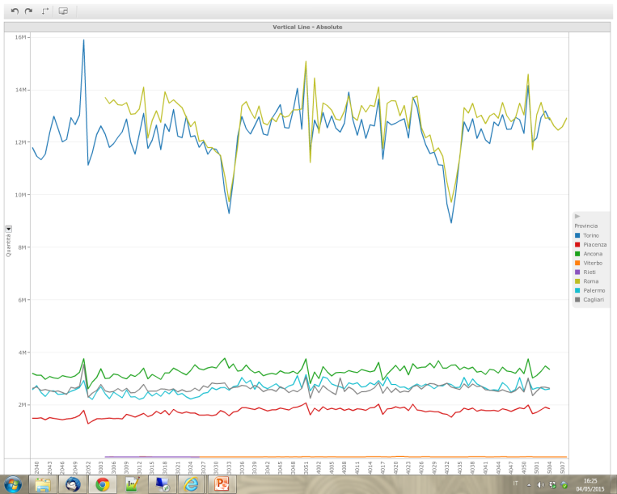
Total quantity per week and province

Slide 18
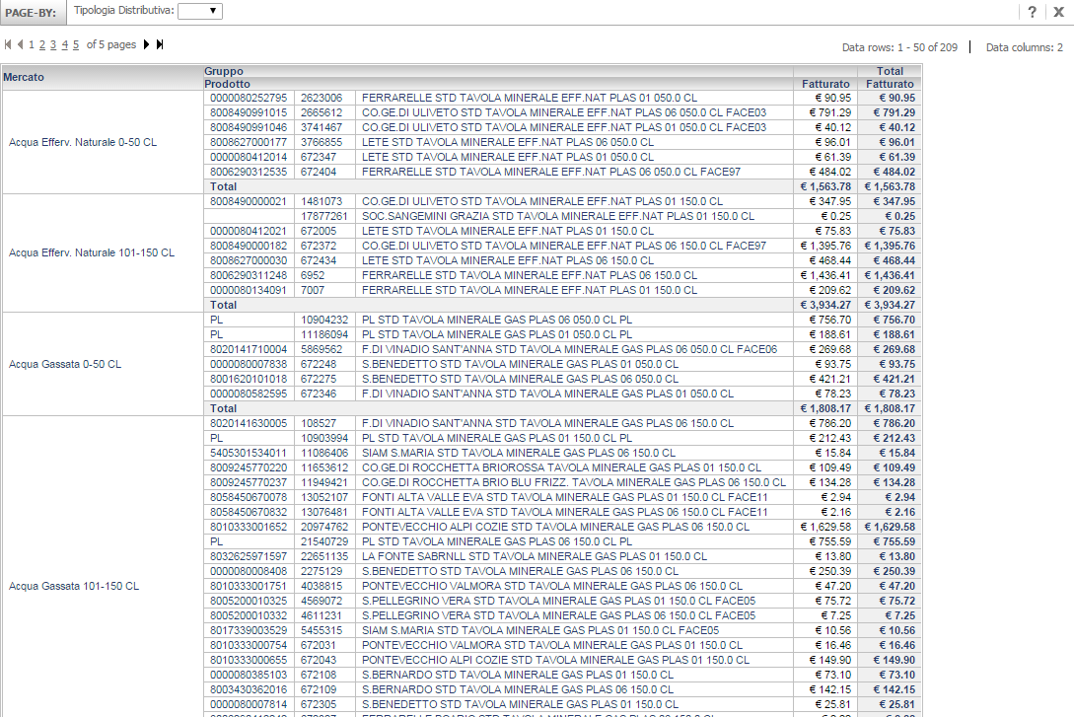
Navigation of DB

Slide 19
Production Data Platform
We are setting up a new data platform for the production architecture based on Big Data tools
  7 nodes Hadoop Cluster
  Hadoop: parallel storage and processing platform, de-facto standard for Big Data
Features:
  All historical data always online for interactive analysis
  Possibility of retaining historical data indefinitely
  Costruction of a global historical data warehouse of prices data
  Database is used only for processing current, online data (computation of indexes)
  Easier to perform large-scale analysis

Slide 20
IT Architecture: Production Phase
Reports and Visualizations
Extraction for offline analysis
SAS
Control Dashboard
Enhanced data warehouse
Current data
Historical data
SFTP
Ingestion
Oracle DB
Hadoop
Processing
of indexes
Sample selection

Slide 21
Conclusions
The scanner data project represents a challenging testbed for experimenting new approaches in the IT support to analysis and production
Objective is get faster results and more efficient processes
The concept of «Big Data» is not merely a matter of size but rather of new opportunities
Technology can give the answers, now it’s time to make new questions

Slide 22
Questions

