Slide 1
The impact of spatial aggregation on price indices with scanner data
Ingolf Boettcher
Rome
2. October 2015

Slide 2


Focus of Presentation –Spatial Aggregation
„How much aggregation is desirable as turn-over and quantities of GTIN/Products/Homogenous-goods are aggregated over outlets?”
Outlet A
Outlet B
Outlet C
VS.
Outlet A
Outlet B
Outlet C

Slide 3
Reasons to aggregate SD over outlets
Limited resources and the need for efficient and transparent processes
Unavailability of scanner data at outlet level
Perception / Opinion / Finding that:
Outlet level data is irrelevant or even obstructive for constructing a robust index

Slide 4
Possible impact of spatial aggregation

Slide 5



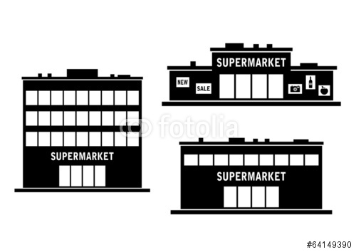


Literature on spatial aggregation with SD
Manuals and Recommendations:
Depends on national circumstances and requirements…
- Spatial aggregation OK with homogeneous products
€
+
€
+
€
24h/7
€

Slide 6
Literature on spatial aggregation with SD
Scanner data project documentation and research:
Index construction with outlet level data has undesirable effects
Chain level SD delivers more robust results
Laspeyres Geomean
outlet substitution effect
(too high contribution of stores with low /decreasing sales volume due to high prices)

Slide 7
Austrian scanner data delivery – August 2015
Delivery of a 2-Year Historical Scanner Data Set Product Segment COICOP 12.1.3. “Personal Care Products”
# of Shops | About 350
# of GTINs/article information per week per shop | About 3.000
# transaction information per week (Month) | About 1.050.000 (About 4.200.000)
# of transmitted weeks | 106 (Dec 2012 – Dec 2014)
Size of datasets in MB per week | About 13 Megabyte

Slide 8
Example analysis of a single GTIN–(1 week)
Before data cleaning
Seemingly high price diversions between Austrian states
Significant difference between Unit Value from outlet level vs. Unit Value from Chain level
Outliers: Min UV of €0,03! → need for data cleaning!

Slide 9
Example analysis of a single GTIN–(1 week)
After data cleaning (simple removal of outliers at outlet level)
Low high price diversions between Austrian States
Negligible differences between Unit Value from outlet level vs.Unit Value from chain level

Slide 10
Conclusion
  In case of national pricing policies, price dispersion is sufficiently low to justify price index construction from scanner data that is aggregated at retail chain level
  However, data cleaning processes and quality control at outlet level are necessary to ensure that the index compiled from aggregated data is not flawed by data errors which are often simple in nature and easy to correct

Slide 11
Dominik‘s Database
http://research.chicagobooth.edu/kilts/marketing-databases/dominicks
http://research.chicagobooth.edu/kilts/marketing-databases/dominicks/category-files

Slide 12
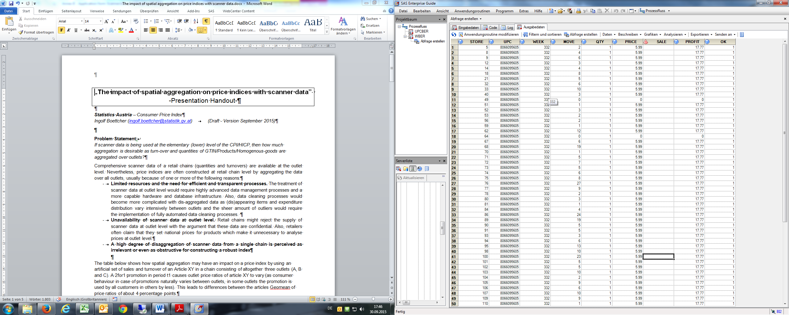
Dominik‘s Database

Slide 13

Contact:
Ingolf Boettcher
Guglgasse 13, 1110 Wien
Tel: +43 (1) 71128-7917
Fax: +43 (1) 7180718
ingolf.boettcher@statistik.gv.at
The impact of spatial aggregation on price indices with scanner data

