Slide 1
The CIA (consistency in aggregation) approach
A new economic approach to elementary indices
Dr Jens Mehrhoff*, Head of Section Business Cycle, Price and Property Market Statistics
Dr Elisabeth Wieland*, Economist-Statistician, Section Business Cycle, Price and Property Market Statistics

Slide 2
Outline
Motivation
Background
Consistency approach
Empirical results
Discussion

Slide 3
1. Motivation
Two-staged index calculation
Practical consumer price indices are constructed in two stages:
  a first stage at the lowest level of aggregation where price information is available but associated expenditure or quantity information is not available and
  a second stage of aggregation where expenditure information is available at a higher level of aggregation.
Although the scope of the discussion is on the choice of the index formula at the elementary level, this choice eventually depends on the target price index at the aggregate level.
  The importance of the elementary index cannot be emphasised enough; biases at this level are more severe than the pros and cons of the formula at the aggregate level.
The consumer price index (CPI) is not intended to measure the cost of living (COLI), rather, it is a cost of goods index (COGI).

Slide 4
1. Motivation
Bilateral price indices
We specify two accounting periods, t ∈ {0, 1}, for which we have micro price and quantity data for n commodities (bilateral index context).
Denote the price and quantity of commodity i ∈ {1, …, n} in period t by p_{i}^{t} and q_{i}^{t}, respectively.
A very simple approach to the determination of a price index over a group of commodities is the (fixed) basket approach.
Define the Lowe (1823) price index, P_{Lo}, as follows:
.
There are two natural choices for the reference basket:
  the period 0 commodity vector q⁰ = (q₁⁰, …, q_{n}⁰) or
  the period 1 commodity vector q¹ = (q₁¹, …, q_{n}¹).

Slide 5
1. Motivation
Laspeyres, Paasche and Fisher
These two choices lead to
  the Laspeyres (1871) price index P_{L}, if we choose q = q⁰, and
  the Paasche (1874) price index P_{P}, if we choose q = q¹:
, .
According to the CPI Manual (ILO et al., 2004), “the Paasche and Laspeyres price indices are equally plausible.”
Taking an evenly weighted average of these basket price indices leads to symmetric averages.
The geometric mean, which leads to the Fisher (1922) price index, P_{F}, is defined as:
.

Slide 6
2. Background
Elementary indices
Suppose that there are M lowest-level items or specific commodities in a chosen elementary category.
Denote the period t price of item m by p_{m}^{t} for t ∈ {0, 1} and for items
m ∈ {1, …, M}.
The Dutot (1738) elementary price index, P_{D}, is equal to the arithmetic average of the M period 1 prices divided by the arithmetic average of the M period 0 prices.
The Carli (1764) elementary price index, P_{C}, is equal to the arithmetic average of the M item price ratios or price relatives, p_{m}¹/p_{m}⁰.
The Jevons (1865) elementary price index, P_{J}, is equal to the geometric average of the M item price ratios or price relatives, p_{m}¹/p_{m}⁰, or the geometric average of the M period 1 prices divided by the geometric average of the M period 0 prices.
, , .

Slide 7
2. Background
Why the Carli index really should be abandoned!
There might be good reasons in practice for relying on geometric averaging, i.e. the Jevons index, even where arithmetic averaging, i.e. the Carli index, would be theoretically superior.
  Notwithstanding that the Carli formula has no bias with respect to the desired aggregate index, it can show large fluctuations in the presence of outliers and in the context of chain indices when weights are not available:
  MSE(P_{J}) = Var(P_{J}) + Bias²(P_{J}) < Var(P_{C}) = MSE(P_{C}) ⇔ Var(P_{J}) << Var(P_{C}).
  The Jevons formula, on the other hand, is more robust in these circumstances, which is due to the fact that it satisfies the circularity test (however, it is noteworthy that when item substitution takes place none of the elementary index formulae will meet the circularity test):
  P_{C}(p⁰, p²) – P_{C}(p⁰, p¹) ⋅ P_{C}(p¹, p²) = Cov[p¹/p⁰, p²/p¹] < 0 for p² = p⁰.
Still, the best solution of course would be disaggregation, i.e. implementing low-level weights in order to make the now-lowest level more homogeneous; or, to paraphrase Galileo Galilei: “Weight what can be weighted and make weightable what is not so.”

Slide 8
3. Consistency approach
Consistency in aggregation
The consistency in aggregation (CIA) approach newly developed (Mehrhoff, 2010, Jahr. Nationalökon. Statist.) fills the void of guiding the choice of the elementary index (for which weights are not available) that corresponds to the characteristics of the index at the second stage (where weights are actually available).
It contributes to the literature by looking at how numerical equivalence between an unweighted elementary index and a weighted aggregate index can be achieved, independent of the axiomatic properties.
Consistency in aggregation means that if an index is calculated stepwise by aggregating lower-level indices to obtain indices at progressively higher levels of aggregation, the same overall result should be obtained as if the calculation had been made in one step.

Slide 9
3. Consistency approach
Elementary index bias
Thus, a relevant, although often neglected, issue in practice is the numerical relationship between elementary and aggregate indices.
This is because if the elementary indices do not reflect the characteristics of the aggregate index, a two-staged index can lead to a different conclusion than that reached by the price index calculated directly from the price relatives.
An elementary index in the CPI is biased if its expectation differs from its measurement objective.
This elementary index bias is applicable irrespective of which unweighted index is used.
In other words, if the elementary index coincides (in expectation) with the aggregate index, the bias will vanish.

Slide 10
3. Consistency approach
A thought experiment
Let six commodities be stratified into two elementary aggregates (three each).
  Assume that the homogeneous preferences can be represented by a Cobb-Douglas function within each stratum, i.e. consumers vary the quantities in inverse proportion to the changes in relative prices so that expenditure shares remain constant (unity elasticity).

Slide 11
3. Consistency approach
Full information on prices and quantities
Elementary aggregate | Commodity | Prices |  | Quantities
 |  | Period 0 | Period 1 | Period 0 | Period 1
I | 1 | 1.0 | 1.2 | 1.6 | 1.7
 | 2 | 1.0 | 3.0 | 1.6 | 0.7
 | 3 | 1.5 | 1.3 | 1.1 | 1.6
II | 4 | 0.5 | 0.7 | 7.0 | 3.8
 | 5 | 1.7 | 1.4 | 2.1 | 1.9
 | 6 | 0.6 | 0.8 | 5.8 | 3.3
 |  | Aggregate index
 |  | P_{L} | P_{P} | P_{F} | P_{GL}
 |  | 1.3437 | 1.1891 | 1.2640 | 1.2429

Slide 12
3. Consistency approach
Limited information on expenditures
Elementary aggregate | Commodity | Prices |  | Expenditure shares
 |  | Period 0 | Period 1 | Period 0 | Period 1
I | 1 | 1.0 | 1.2 | 0.3141 | 0.4348
 | 2 | 1.0 | 3.0
 | 3 | 1.5 | 1.3
II | 4 | 0.5 | 0.7 | 0.6859 | 0.5652
 | 5 | 1.7 | 1.4
 | 6 | 0.6 | 0.8
 |  | Elementary index
Elementary aggregate |  | P_{C} | P_{H} | P_{CSWD} | P_{J}
I |  | 1.6889 | 1.2928 | 1.4776 | 1.4612
II |  | 1.1856 | 1.1200 | 1.1523 | 1.1541

Slide 13
3. Consistency approach
Two-staged calculation of price indices
 |  | Elementary index
Higher-level index |  | P_{C} | P_{H} | P_{CSWD} | P_{J}
P_{L} | 1.3437 | 1.3437 | 1.1743 | 1.2545 | 1.2506
P_{P} | 1.1891 | 1.3621 | 1.1891 | 1.2743 | 1.2702
P_{F} | 1.2640 | 1.3529 | 1.1817 | 1.2644 | 1.2603
P_{GL} | 1.2429 | 1.3250 | 1.1716 | 1.2460 | 1.2429
The two-staged Laspeyres price index with Carli indices at the lower level coincides with the aggregate Laspeyres price index. The Jevons index would have a downward bias for the aggregate Laspeyres price index but it is a reasonable approximation for the Fisher price index. This clearly shows that no statistical one-size-fits-all approach exists. The CIA approach works even without knowing the lower-level quantities!

Slide 14
3. Consistency approach
Generalised means
A single comprehensive framework, known as generalised means, unifies the aggregate and elementary levels.
The generalised mean of order r for the M item price ratios or price relatives, p_{m}¹/p_{m}⁰, is defined as follows:
The generalised mean represents a whole class of unweighted elementary indices, such as the Carli and Jevons indices for r = 1 and r = 0, respectively.

Slide 15
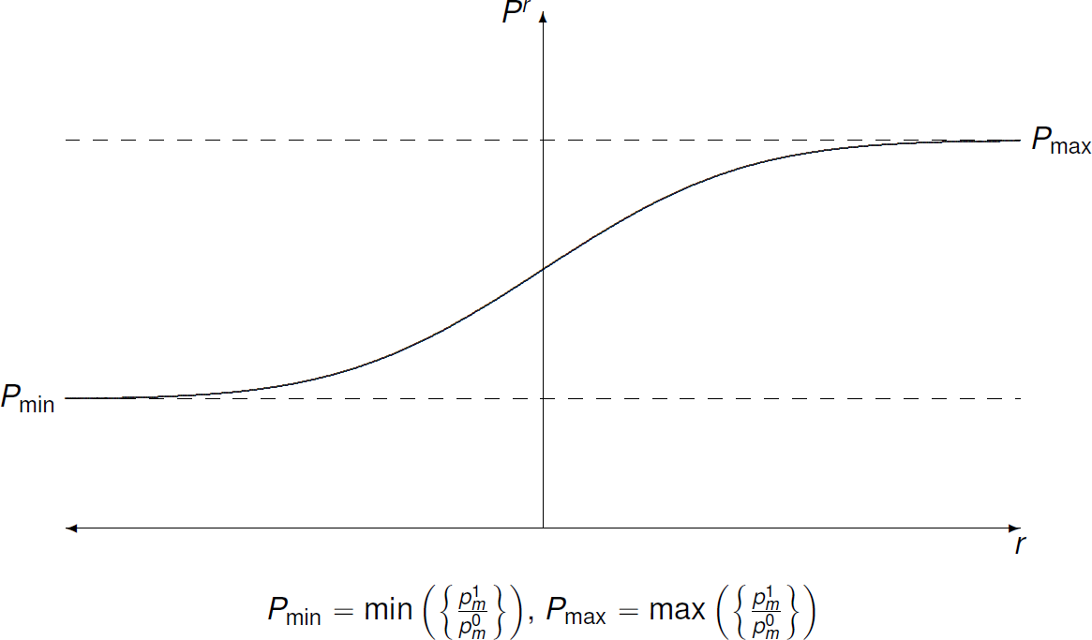
3. Consistency approach
Typical shape

Slide 16
3. Consistency approach
Constant elasticity of substitution
However, an analytical derivation of the concrete generalised mean of a weighted aggregate index is not possible without further assumptions.
Hence, both the generalised mean and the target indices are expanded by a second-order Taylor series approximation around the point ln p_{m}^{t} = ln p^{t} for all
m ∈ {1, …, M}, t ∈ {0, 1}.
Next, it is usually adequate to assume a constant elasticity of substitution (CES) approximation in the context of approximating a consumer’s expenditures on the M commodities under consideration.
Finally, it is shown that the choice of the elementary indices which correspond to the desired aggregate ones can be based on the elasticity of substitution alone.
Thus, a feasible framework is provided which aids the choice of the corresponding elementary index.

Slide 17
3. Consistency approach
CES aggregator function
It is supposed that the unit cost function has the following functional form:
c(p)
where the α_{m} are non-negative consumer preference parameters with
This unit cost function corresponds to a CES aggregator or utility function.
The parameter σ is the elasticity of substitution:
  When σ = 0, the underlying preferences are Leontief preferences.
  When σ = 1, the corresponding utility function is a Cobb-Douglas function.

Slide 18
3. Consistency approach
Laspeyres and Paasche price indices
A generalised mean of order r equal to the elasticity of substitution (σ) yields approximately the same result as the Laspeyres price index.
Hence, if the elasticity of substitution is one (Cobb-Douglas preferences), for example, r must equal one and the Carli index at the elementary level will correspond to the Laspeyres price index as target index.
However, if the Paasche price index should be replicated, the order of the generalised mean must equal minus the elasticity of substitution, in the above example minus one.
Thus, the harmonic index gives the same result and therefore, in this case it should be used at the elementary level.
Only if the elasticity of substitution is zero (Leontief preferences), the Jevons (Dutot) index corresponds to both the Laspeyres and Paasche price indices – which in this case coincide.

Slide 19
4. Empirical results
Alcoholic beverages in the UK
As an empirical application, detailed expenditure data from Kantar Worldpanel for elementary aggregates within the COICOP group of alcoholic beverages in the UK are analysed.
The data cover the period from January 2003 to December 2011; the data set consists of transaction level data, which records inter alia purchase price and quantity, and includes 192,948 observations after outlier identification.
The elasticity of substitution is estimated in the framework of a log-linear model by means of ordinary least squares. (Note that the consumer preference parameters are removed via differencing products common to adjacent months and, thus, there is no need for application of seemingly unrelated regression.)
As a robustness check to the CES model based results, the generalised mean which minimises relative bias and root mean squared relative error to the desired aggregate index is found directly by numerical optimisation techniques. (Rather than at the aggregate transaction level, like the econometric method, this analysis, however, is performed one level above – at the elementary level.)

Slide 20
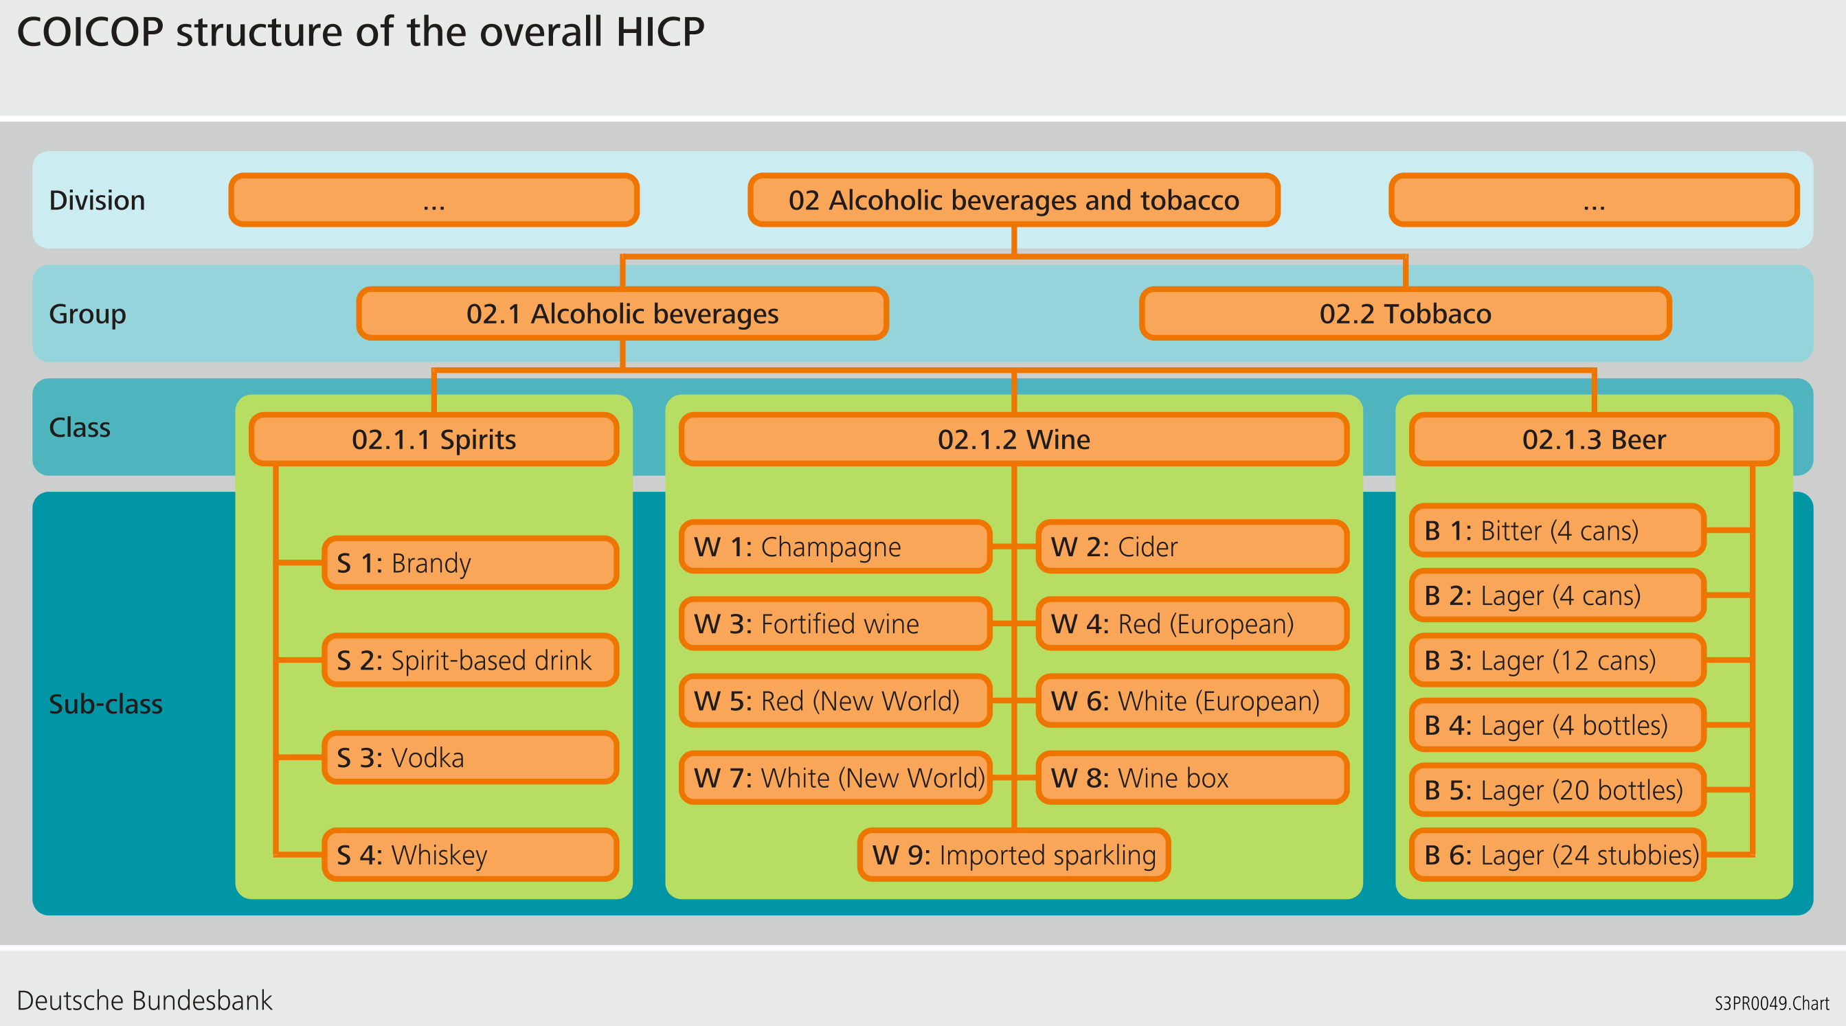
4. Empirical results
COICOP structure for alcoholic beverages

Slide 21
4. Empirical results
Findings on substitution behaviour
The median elasticity of substitution is 1.5, ranging from .7 to 3.8.
All estimates are statistically significantly greater than zero; for 8 out of 19 sub-classes the difference to iso-elasticity is insignificant, while for the remaining 11 sub-classes substitution is found to even exceed unity elasticity.
In spirits, consumers are more willing to substitute between different types of whiskey (S 4) than is the case for brandy or vodka (S 1 and S 2).
For both red and white wines, substitution is more pronounced for the New World (W 5 and W 7) than for European wines (W 4 and W 6).
Also, the elasticity of substitution tends to be higher for 12 cans and 20 bottles of lager (B 3 and B 5), respectively, than for 4 packs (B 2 and B 4).
These results are consistent with the findings of Elliott and O’Neill (2012).
Furthermore, comparing the CES regression results with the direct calculation of the generalised means, the outcomes do not change qualitatively.
In particular, the Carli index performs remarkably well at the elementary level of a Laspeyres price index, questioning the argument of its “upward bias” – in fact, it is the Jevons index that has a downward bias.

Slide 22
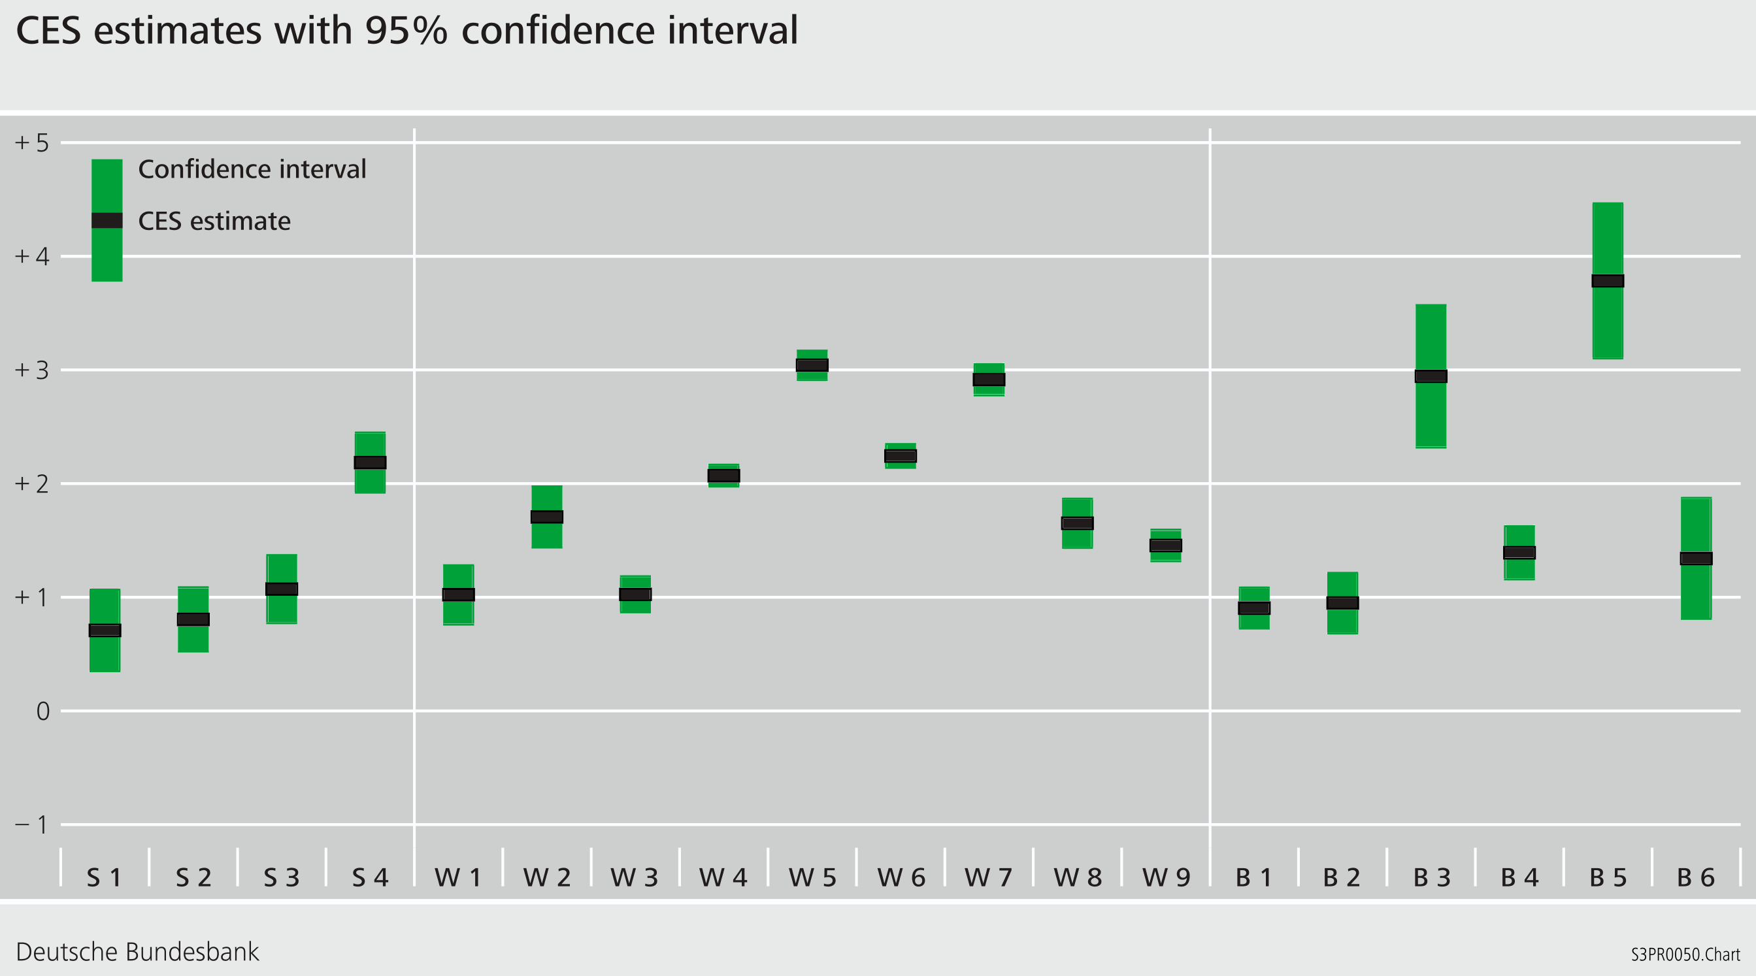
4. Empirical results
CES estimation results

Slide 23
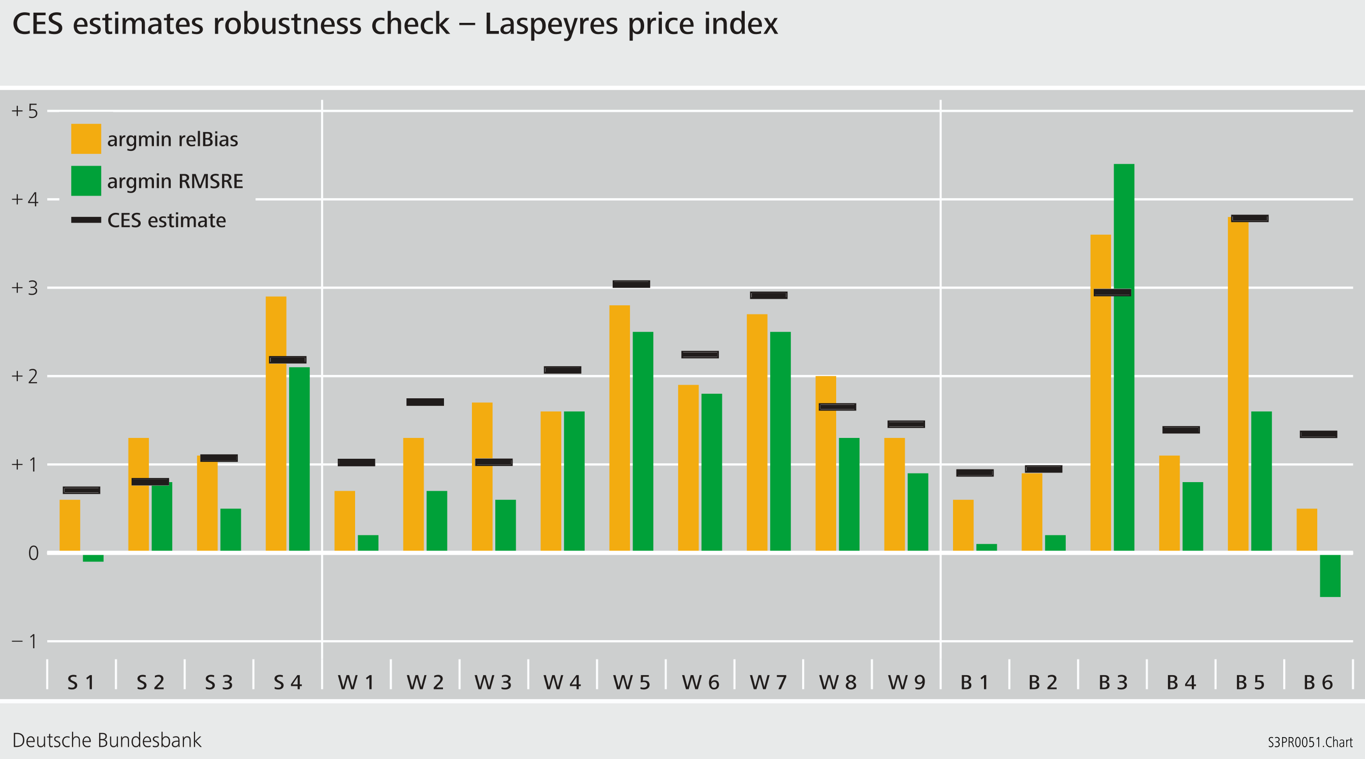
4. Empirical results
Laspeyres price index: robustness

Slide 24
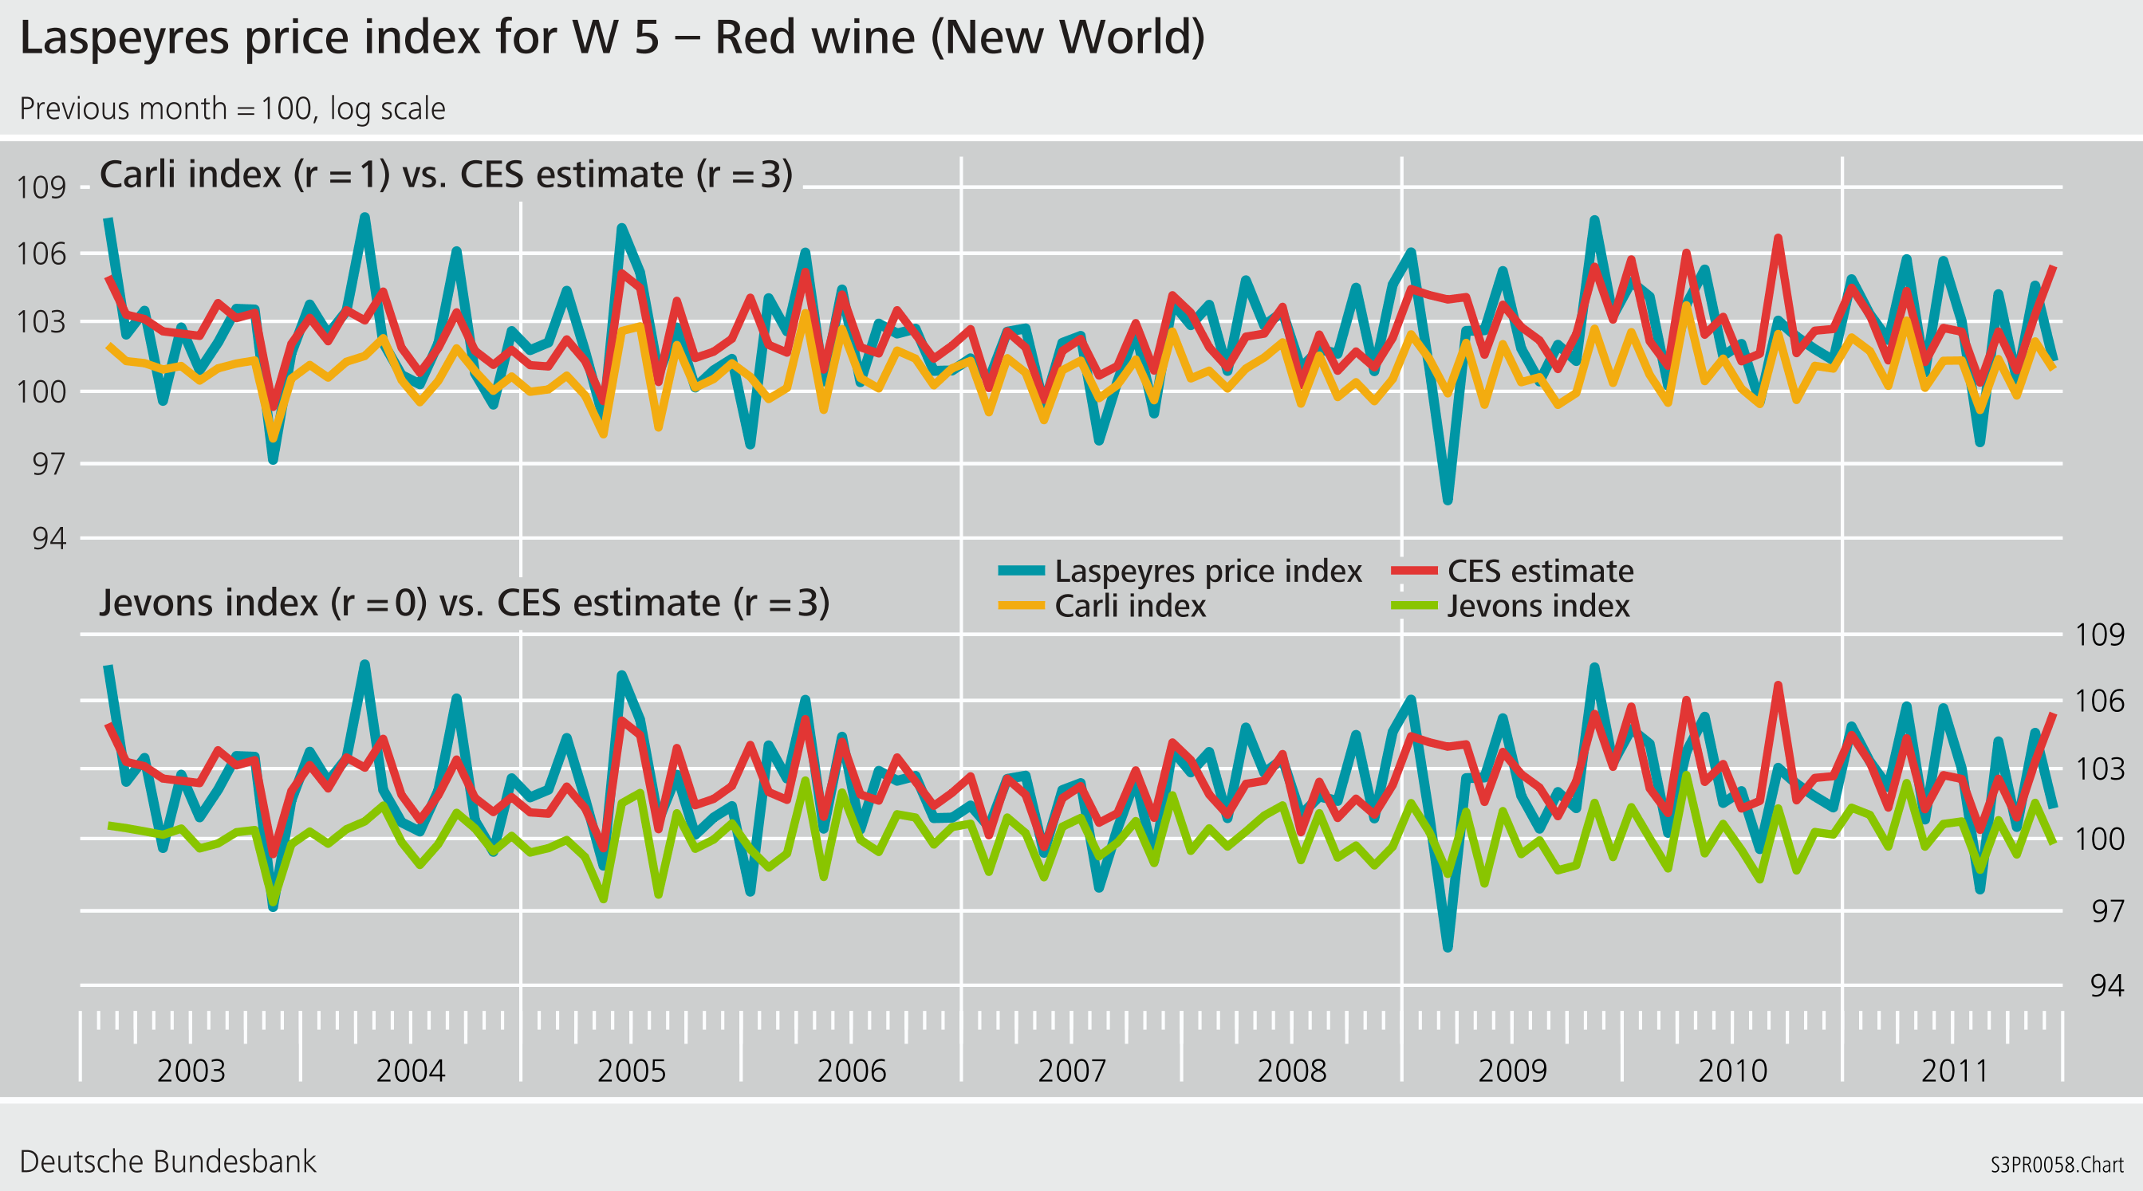
4. Empirical results
Laspeyres price index: time series

Slide 25
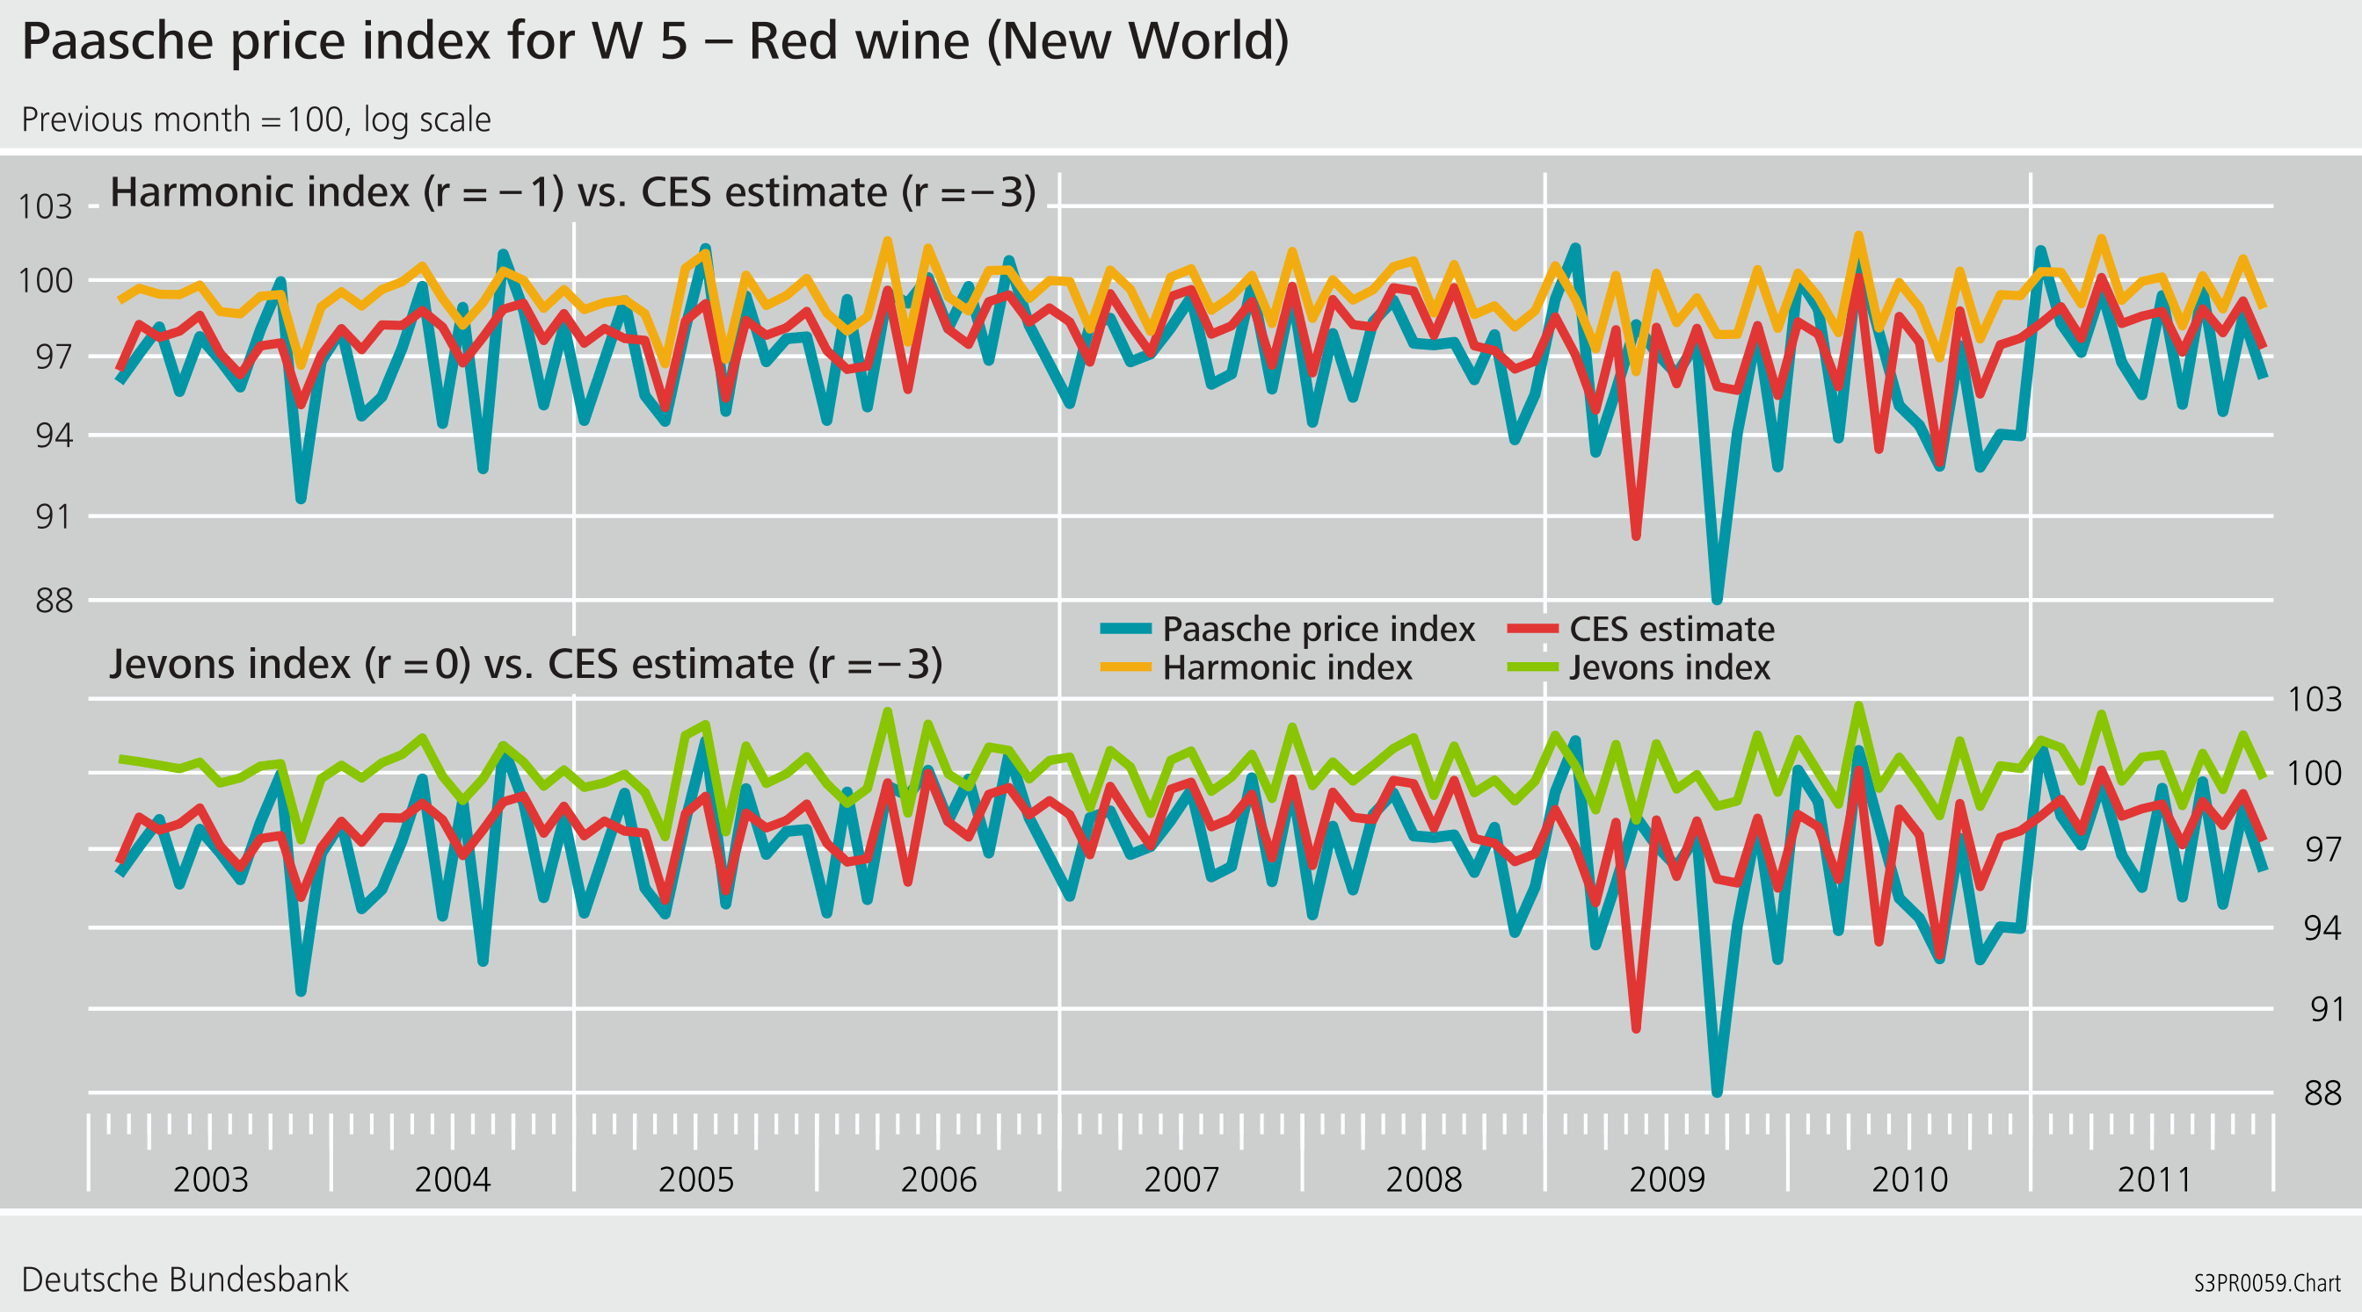
4. Empirical results
Paasche price index: time series

Slide 26
5. Discussion
The problem of aggregational consistency demonstrates the need for a weighting at the lowest possible level.
This would mean that, in the trade-off between estimated weights/weights from secondary sources on the one hand and the elementary bias of unweighted indices on the other, the balance would often tip in favour of weighting.
The biases at the elementary level can, in some cases, reach such large dimensions that they become relevant for the aggregate index.
There is a “price” to be paid at the upper level for suboptimal index formula selection at the lower level; thus, the need for two-staged price indices to be accurately constructed becomes obvious.
Disaggregation is a panacea!
Insofar as no information on weights is available, studies on substitution can help in guiding the choice of the optimal elementary index for a given measurement target.
Often, even an expert judgement on substitutability outperforms the test approach.

Slide 27
Contact
Dr Jens Mehrhoff
Head of Section Business Cycle, Price and Property Market Statistics
Deutsche Bundesbank
Central Office
General Economic Statistics
Wilhelm-Epstein-Strasse 14
60431 Frankfurt am Main, Germany
Tel: +49 69 9566 3417
Fax: +49 69 9566 2941
E-mail: jens.mehrhoff@bundesbank.de
www.bundesbank.de

Slide 28
Annex
What is the relation between “consistency in aggregation” on the one hand and “constant elasticity of substitution” on the other in a Laspeyres-type price index, such as the European Harmonised Index of Consumer Prices, where a fixed set of weights is used at the aggregate level?
To reiterate, the target index is given to be the Laspeyres price index.
In this case, the CES utility function is needed solely to approximate the distribution of the period 0 expenditures among the commodities within each of the elementary aggregates.
That is, all what is needed are relative price levels rather than their changes.
Hence, the only issue here is the structure of the quantities purchased in the base period instead of substitution between items or strata over time!

