Slide 1

Polish scanner data project.
First steps.
THE CENTRAL STATISTICAL OFFICE OF POLAND
Anna Bobel, Retail Prices Section, CSO of Poland, Warsaw
A.Bobel@stat.gov.pl
Tomasz Pietras, Price Statistics Centre of the Statistical Office in Opole
T.Pietras@stat.gov.pl
Scanner Data Workshop, 1-2 October 2015, ISTAT, Rome, Italy

Slide 2

General information
THE CENTRAL STATISTICAL OFFICE OF POLAND
First steps in obtaining scanner data began in 2011, when the cooperation with 1 retail chain was established. The retail chain transmitted a small sample of data on the basis of an oral agreement.
The retail chains were not interested in cooperation with the Central Statistical Office (CSO) and sometimes the management of the retail chains was even openly against it.
It has turned out that the traditional way of distributing letters of intent is ineffective.
The further experience acquired during the project allowed the CSO to refine the model of entering into cooperation with retail chains, including overcoming unwillingness of their management staff.
Scanner Data Workshop, 1-2 October 2015, ISTAT, Rome, Italy

Slide 3
General information (cont.)
THE CENTRAL STATISTICAL OFFICE OF POLAND
In September 2012 first formal agreement with the second chain was concluded and initial data has been transmitted.
Currently the CSO receives the most detailed data from 3 retail chains
(with 2 of them there was a need to renegotiate the scope of delivered data during 2015).
4th large discount retail chain expressed its initial interest in cooperation. Currently, arrangement for technical details are underway.
Retailers did not agree to the transfer of historical data, what makes difficult to conduct experimental works.
Retail chains represent different categories – e.g. hypermarket, discount, delicatessen.
The 3 retail chains have a market share of roughly 17%. The forth retail chain has a market share of just over 30%, bringing the share covered in scanner data to nearly 50% of the supermarket and hypermarket market.
Scanner Data Workshop, 1-2 October 2015, ISTAT, Rome, Italy

Slide 4
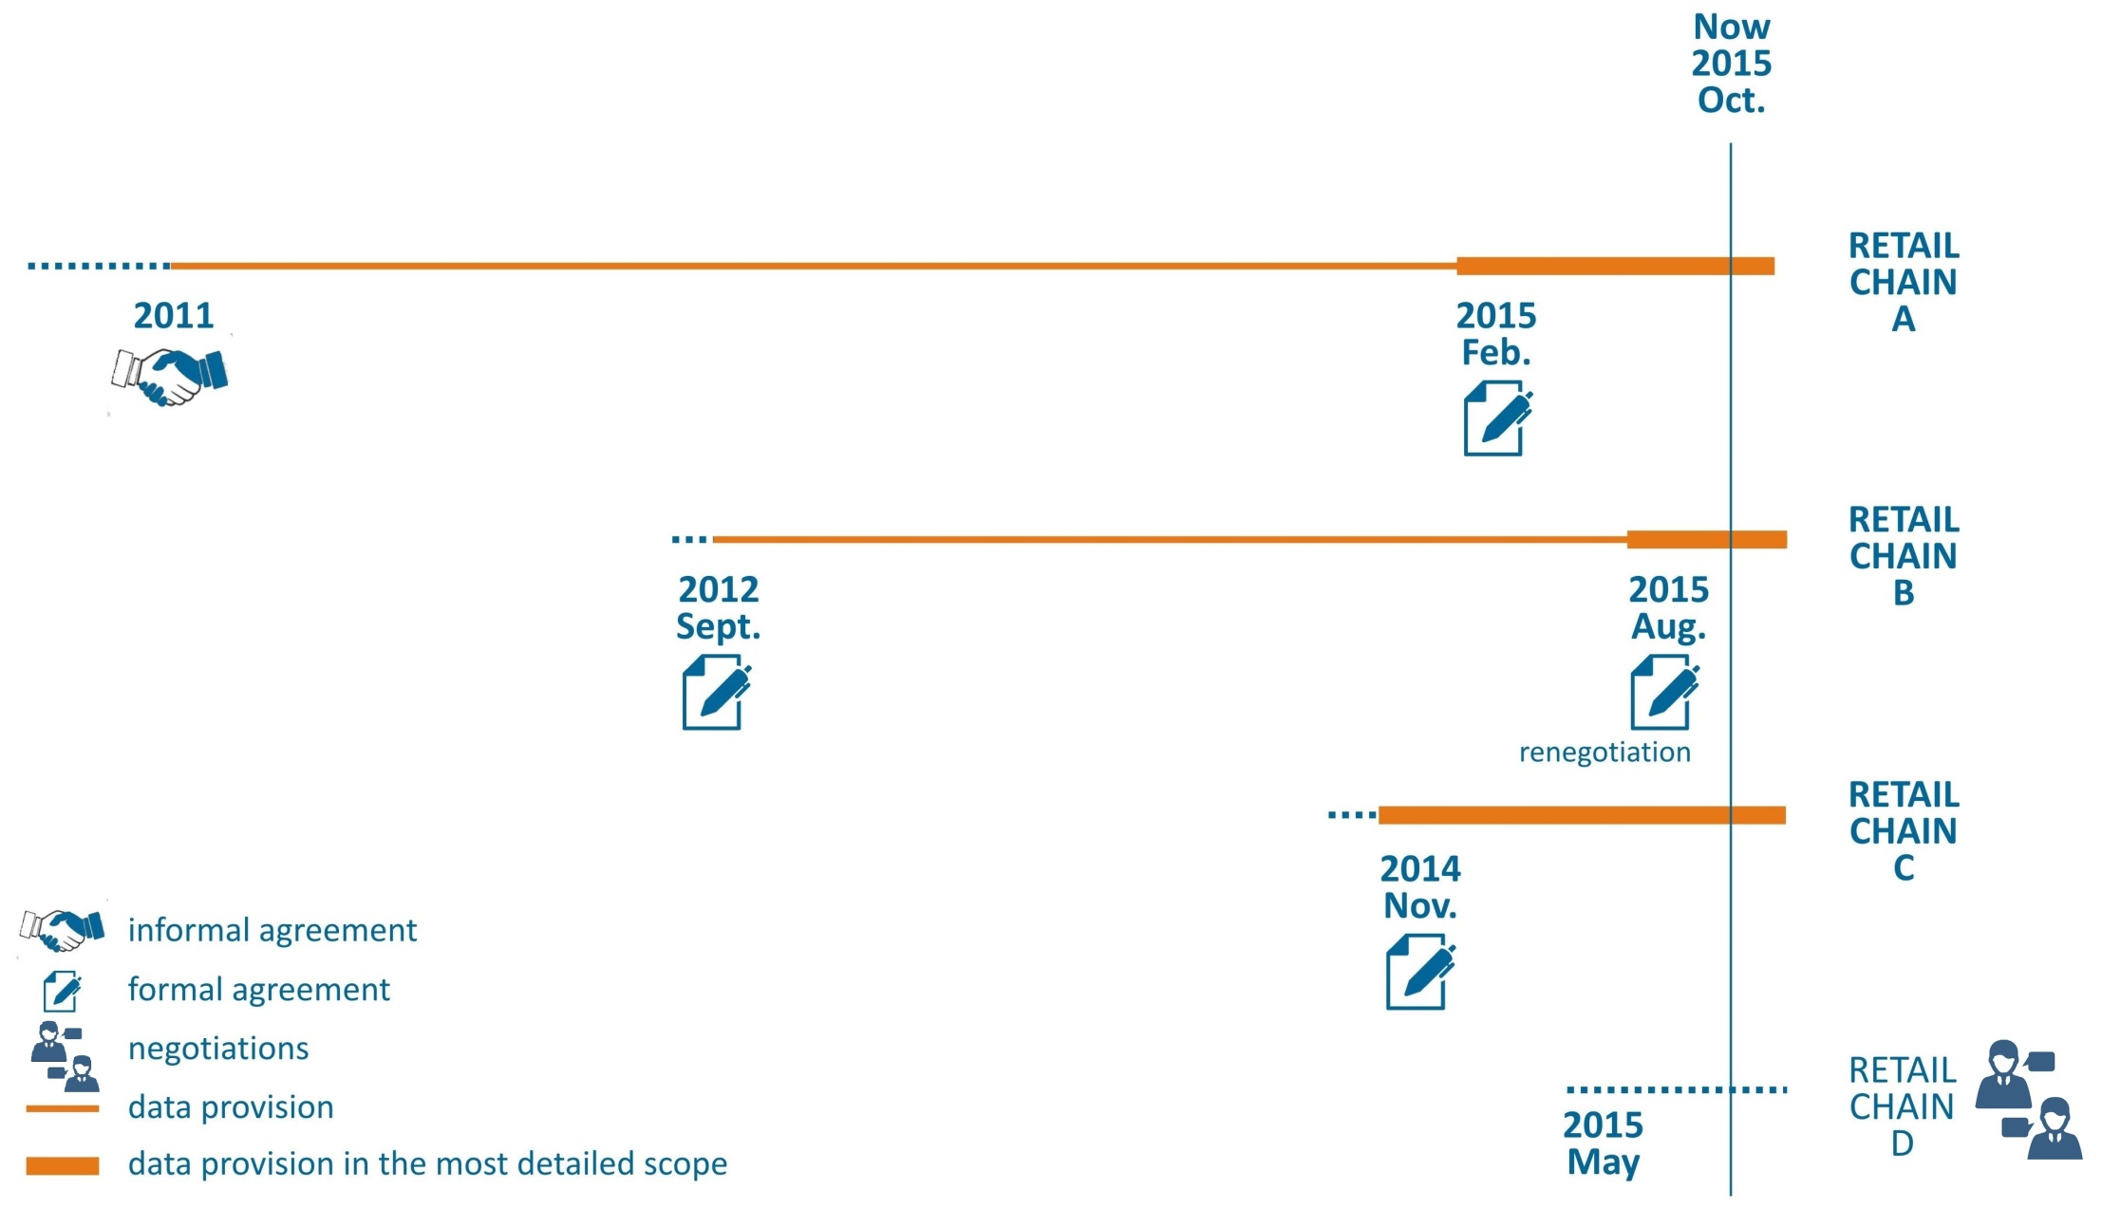
Cooperation with retail chains
THE CENTRAL STATISTICAL OFFICE OF POLAND
Scanner Data Workshop, 1-2 October 2015, ISTAT, Rome, Italy

Slide 5
THE CENTRAL STATISTICAL OFFICE OF POLAND
Selected aspects of cooperation
with retail chains
Currently, written contracts are established with every retail chain.
The data is obtained free of charge.
One of the most important aspects of the negotiation is to ensure a security of data transfer:
  Currently, data are transferred via secure channel designed for the exchange of data – TransGUS system.
  This system allows to transfer data files to the resource server of the Central Statistical Office. Data files are transmitted using SSL 3 technology
  (128-bit key encryption) with the ability to specify IP address of authorized computers.
  Previously, the data has been secured with a password and transferred
  by e-mail.
Scanner Data Workshop, 1-2 October 2015, ISTAT, Rome, Italy

Slide 6
THE CENTRAL STATISTICAL OFFICE OF POLAND
Selected aspects of cooperation
with retail chains (cont.)
Since 2015, the obligation of transmission of data in electronic form
by selected retail chains has been included in the Statistical Surveys Program of Official Statistics (legal basis for conducting statistical surveys in Poland).
The retail chains are very interested in obtaining feedback in the
form of, for example, reports. It is sometimes the condition of joining the project by the retail chain. According to the assessment made by the CSO, the majority of the Member States does not provide retail chains with a feedback.
Scanner Data Workshop, 1-2 October 2015, ISTAT, Rome, Italy

Slide 7
The scope of the data
THE CENTRAL STATISTICAL OFFICE OF POLAND
The data is obtained on the GTIN level in the scope of 6 assortment groups:
  Rice
  Flour
  Milk
  Yoghurt
  Sugar
  Coffee
Depending on a price policy of a retail chain, the data is transferred for all of the retail chain’s stores (for 2 of the retail chains) or for a given format
(1 retail chain transfers data for 3 formats).
Despite the agreed expected scope of the data file, it is still diversified.
Scanner Data Workshop, 1-2 October 2015, ISTAT, Rome, Italy

Slide 8
The scope of the data (cont.)
THE CENTRAL STATISTICAL OFFICE OF POLAND
Variable/Retail chain | retail chain A | retail chain B | retail chain C
Frequency Reference period | once a month 5-22 day of the month | once a month 1-22 day of the month (by weeks) | once a month 5-22 day of the month
Number of stores* | 3 formats (~450) | 44 | 188
Number of data files | 4 | 1 | 4
Store ID | O | P | P
Postal code | O | O | P
Hierarchy* | 26 | 18 | 140
Number of articles* | 621 | 1115 | 2243
Store item ID | P | O | P
EAN code | P | P | P
Type of EAN code | O | O | P
Unit of measure for EAN code | O | O | P
Item discription | P | P | P
Weight converstion ratio | P | P | P
Unit of measure | P | P | P
Price of the item | P | P | P
Turnover | P | P | P
Quantity | P | P | P
VAT | P | P | P
Additional information (for example, promotion) | P | P | P
* On the basis of the data for August 2015
Scanner Data Workshop, 1-2 October 2015, ISTAT, Rome, Italy

Slide 9
THE CENTRAL STATISTICAL OFFICE OF POLAND
Stage 1: Data checking
After receiving the data, they are checked for:
Punctuality
Retail chain | Punctuality (%)* | Reason for a delay
Retail chain A | 80% | the beginnings of cooperation
Retail chain B | 70% | holiday period change of system and cooperation conditions
Retail chain C | 60% | the beginnings of cooperation holiday period
* On the basis of the data from previous 10 months
2. Completeness and compliance with the arrangements, for example:
  transfer of all the files
  accuracy of the files formats
  accuracy of the structure (variables)
  comparison with the data from the previous period
  Any concerns are discussed with the representatives of the retail chains on an on-going basis.
Scanner Data Workshop, 1-2 October 2015, ISTAT, Rome, Italy

Slide 10
Stage 2: Pre-implementation
data analysis
THE CENTRAL STATISTICAL OFFICE OF POLAND
Examples of situations requiring additional consultations with the representatives of the retail chains:
incorrect description of the reporting period
differences in calculations of unit price (gross/net)
lack of selected data
differences between information in the product description and in the other fields
different number of quotation outlets
as regards the data transmitted according to the format of the store, lack of information on the assortment of regional products
negative values
Scanner Data Workshop, 1-2 October 2015, ISTAT, Rome, Italy

Slide 11
THE CENTRAL STATISTICAL OFFICE OF POLAND
Stage 3: Allocation of particular items
to ECOICOP elementary groups – ECOICOP-6 in Poland
Mapping algorithms created for each retail chain.
An attempt to automate the process of mapping to ECOICOP – difficulties
  Large discrepancies between the store classifications and ECOICOP:
    In most cases it is possible to link the product categories on a 1:1 basis. However, there are cases that one category includes several ECOICOP codes (1:n).
    product descriptions incorrect or too general to clearly identify the product (difficulties in creating a dictionary with key words)
    additional analytical works is needed
Establishing „mapping tables” on the basis of one month. In the subsequent months automated coding and manual work as regards mapping of new codes.
Scanner Data Workshop, 1-2 October 2015, ISTAT, Rome, Italy

Slide 12
THE CENTRAL STATISTICAL OFFICE OF POLAND
Stage 3: Allocation of particular items
to ECOICOP elementary groups – ECOICOP-6 in Poland (cont.)
Month | Number of data from all the stores of a given retail chain C | Number of products in a given month | Number of stores | Number of new EANs in n+1 month (IN) | Number of EANs, which did not appear in n+1 month (OUT)
1 | 215895 | 4589 | 183 | 190 | 286
2 | 218603 | 4492 | 183 | 224 | 200
3 | 220859 | 4514 | 183 | 293 | 126
4 | 223417 | 4683 | 184 | 270 | 416
5 | 209013 | 4538 | 184 | 515 | 265
6 | 223899 | 4791 | 187 | 303 | 225
Scanner Data Workshop, 1-2 October 2015, ISTAT, Rome, Italy

Slide 13
THE CENTRAL STATISTICAL OFFICE OF POLAND
Stage 3: Allocation of particular items
to ECOICOP elementary groups – ECOICOP-6 in Poland (cont.)
Software solutions:
Special application for linking EAN codes to ECOICOP was created (in C# programming language).
Data from six months from retail chain C were joined using this tool and „mapping tables”.
The result was only 627 unique EAN's without links to ECOICOP.
Id | Category No. | Product No. | EAN | Description | Average price | Turnover | Quantity | Month | Year | COICOP
1858 | 40805 | 50015 | 42243977 | Muller Mix Yoghurt Apricot & Honey 120 g | 1,99 | 65,67 | 33 | 2 | 15 | 011441
4095 | 240120 | 2406264 | 8000070028012 | Lavazza Cafe Crema 250G VACUM | 17,93 | 161,41 | 9 | 2 | 15 | 012111
Scanner Data Workshop, 1-2 October 2015, ISTAT, Rome, Italy
13

Slide 14
Stage 4: Next planned steps
THE CENTRAL STATISTICAL OFFICE OF POLAND
Linking of particular items from month to month.
Determine the sample size.
Developing objectives for control (including: identification of outliers, data imputation, replacements, conformation of the correctness of the compiled dynamics).
Price index calculation. In prospect, including the indices calculated on the basis of data from retail chains should be proportional to the share of a given chain in total retail sales.
As indicated by experimental calculations carried out during the first project, indices calculated on the basis of data collected in the traditional way are more stable, while indices for scanner data are subject to considerable fluctuations.
Scanner Data Workshop, 1-2 October 2015, ISTAT, Rome, Italy

Slide 15
Plans for the future
THE CENTRAL STATISTICAL OFFICE OF POLAND
Further negotiations with retail chains.
Market monitoring:
  Information on the worsening situation or closure of a retail chain.
  The current economic conditions hinder the process of establishing and maintaining positive relationships with retail chains. However, the difficult economic situation on the retail market causes frequent liquidation of outlets and unwillingness of the stores managers towards price collectors’ visits and providing them with information on prices and additional product characteristics.
  New trends – developing online sales channel and pricing policy in this respect by retail chains.
The implementation of the first data is planned for January 2017, provided there are no interferences in the works.
Scanner Data Workshop, 1-2 October 2015, ISTAT, Rome, Italy

Slide 16

THE CENTRAL STATISTICAL OFFICE OF POLAND
Thank you
for your attention
Scanner Data Workshop, 1-2 October 2015, ISTAT, Rome, Italy

