Slide 1
Scanner data in the Luxembourg HICP/CPI
Scanner Data Workshop
ISTAT
1-2 October 2015
Moving towards implementation
Claude Lamboray
Vanda Guerreiro

Slide 2
Main topics
Introduction
Data Source
Classification
Sampling
Index compilation
Results
Implementation

Slide 3
Introduction
3 major retailers are providing data every month for one shop
Nearly 65% of the market is currently covered
Data is available from January 2012 onwards
Data reference period is the first 14 days of the month
Following a step-by-step approach STATEC chooses some products to begin the implementation
Along a transition period the SD prices are combined with the traditional price collection data
The methodology planned to be adopted is tested and exemplified for: 01.1.1.1 Rice; 01.1.1.2 Flours and other cereals; 01.1.1.6 Pasta products and couscous

Slide 4
  Data received
EAN codes of products
Retailer codes of products
The label of products
Retailer classification codes
Retailer classification labels
Turnover by EAN code *
Number of products sold *
Quantity of products sold *(number of products x quantity per unit)
Reference period (Year, month)
*total for the first 2 weeks

Slide 5
Data consistency
The size of file
The variables contained in the file
The total number of products
The total turnover
The number of digits in the EAN codes
The existence of duplicated data
Incomplete records
The file received is compared with:
  The previous month
  The same month of the previous year
  The files of the 12 previous months, as a “time series” follow up

Slide 6
  Plans to improve data transmission
Receive data weekly (instead of only one transmission per month covering the 15 first days)
Expand the temporal coverage from two to three weeks
Automatized data delivery routines
As the worst case scenario the HICP/CPI could also possibly be compiled with data manually collected by the price collectors.

Slide 7
Classification
  Aggregation structure
No. Digit | COICOP | Class Label
5 | 01.1.1.1. | Rice
6 | 01.1.1.1.1. | Rice
7 | 01.1.1.1.1.1. | Rice – Scanner Data
8 | 01.1.1.1.1.1.1. | Retailer 1 – Rice
8 | 01.1.1.1.1.1.2. | Retailer 2 – Rice
8 | 01.1.1.1.1.1.3. | Retailer 3 - Rice
7 | 01.1.1.1.1.2. | Rice – Traditional Price Collection

Slide 8
Classification
  The linking process
MT is per retailer and is generated from the data of the previous year
Ref. m is updated every month with data from all retailers
Tables | Frequency | Link to 7-digit COICOP | Example
Mapping Table (MT) | Annual | Retailers’ categories | White Rice 01.1.1.1.1.1.
Reference table (Ref. m) | Monthly | individual products | Uncle Bens white rice 01.1.1.1.1.1.

Slide 9
Classification
Obtaining the monthly reference table
Ex. February
SD. file_Feb_{y}
Ref. Jan_{y}
Merge 1
B: Products in both SD. file_Feb_{y} and Ref. Jan_{y} by COICOP
A: Products only in SD. file_Feb_{y} but not Ref. Jan_{y}
MT_{y-1}
Merge 2
+
Table A with COICOP
Ref. Feb_{y}

Slide 10
Classification
Monthly Reference Table
COICOP | EAN | Product - offer
01.1.1.1.1.1.1. | 3596710212392 | PP RIZ LONG BLANC 1KG SACHET
01.1.1.1.1.1.1. | 3596710230730 | RETAILER 1 RIZ ETUVE 20MN KILO
01.1.1.1.1.1.1. | 3596710396955 | RETAILER 1 RIZ ETUVE 20MN KILO
01.1.1.1.1.1.1. | 3254560088269 | RETAILER 1 RIZ ETUVE 10 MN ETUI VR
01.1.1.1.1.1.2. | 3596710396986 | RETAILER 1 RIZ THAI SACHETS CUISSO
01.1.1.1.1.1.2. | 3254560667556 | RETAILER 1 RIZ BASMATI 500G
01.1.1.1.1.1.2. | 5601255312112 | RIZ ROND BLANCHI EXTRA CARACOL
01.1.1.1.1.1.2. | 5601002047076 | RETAILER 1 ARROZ CAROLINO VIDA
01.1.1.1.1.1.2. | 3039820311222 | VIVIEN PAILLE RIZ ROND BLANC
01.1.1.1.1.1.2. | 5601255322128 | RIZ LONG AIGUILLE 1KG
Products which could not be assigned to a COICOP category at this stage will not be taken into account in the index compilation in the current month.

Slide 11
  Plans to improve the classification process
List of EAN codes which have been added to the reference table, which will allow some re-classifications if needed
Combine deterministic methods based on text search with the mapping table
Test methods based on machine learning techniques
Follow up the changes in retailers classification structure over time
Check whether the retailers categories correspond to the same EAN codes overtime
Black list of products which should be excluded from the index and classify those in a fictive residual COICOP category
Adding a flag in the monthly reference table indicating the methodology which was used to classify the products

Slide 12
Sampling
Ex. January
SD. file_Jan_{y}
Ref. Jan_{y}
Merge
C: Products in the SD. file_Jan that are classified in the Ref. Jan_{y} by COICOP, prices and turnover
SD. file_ Dec_{y-1}
Merge
C’: Products in C with prices and turnover of Dec_{y-1} and Jan_{y}
In the future the EANs will be replaced by the Internal Retailers' Codes in the classification and sampling processes

Slide 13
Sampling
Classified products with prices and turnover (table C’)
COICOP | EAN | Label | Dec. |  | Jan.
 |  |  | Turnover | Price | Turnover | Price
01.1.1.1.1.1.1. | 3596710212392 | PP RIZ LONG BLANC 1KG SACHET | 26 | 0.71 | 16 | 0.85
01.1.1.1.1.1.1. | 3596710230730 | RETAILER 1 RIZ ETUVE 20MN KILO | 5 | 1.57 | 7 | 1.88
01.1.1.1.1.1.1. | 3596710396955 | RETAILER 1 RIZ ETUVE 20MN KILO | 30 | 1.57 | 13 | 1.88
01.1.1.1.1.1.1. | 3254560088269 | RETAILER 1 RIZ ETUVE 10 MN ETUI | 22 | 1.48
01.1.1.1.1.1.2. | 3596710396986 | RETAILER 1 RIZ THAI SACHETS | 27 | 1.15 | 9 | 1.38
01.1.1.1.1.1.2. | 5601255312112 | RETAILER 1 RIZ BASMATI 500G | 28 | 1.13 | 30 | 1.36
01.1.1.1.1.1.2. | 5601002047076 | RIZ ROND BLANCHI EXTRA CARACOL | 16 | 1.19 | 10 | 1.42
01.1.1.1.1.1.2. | 3039820311222 | RETAILER 1 ARROZ CAROLINO VIDA | 18 | 2.14 | 13 | 2.56
01.1.1.1.1.1.2. | 5601255322128 | VIVIEN PAILLE RIZ ROND BLANC | 15 | 1.34 | 9 | 1.60

Slide 14
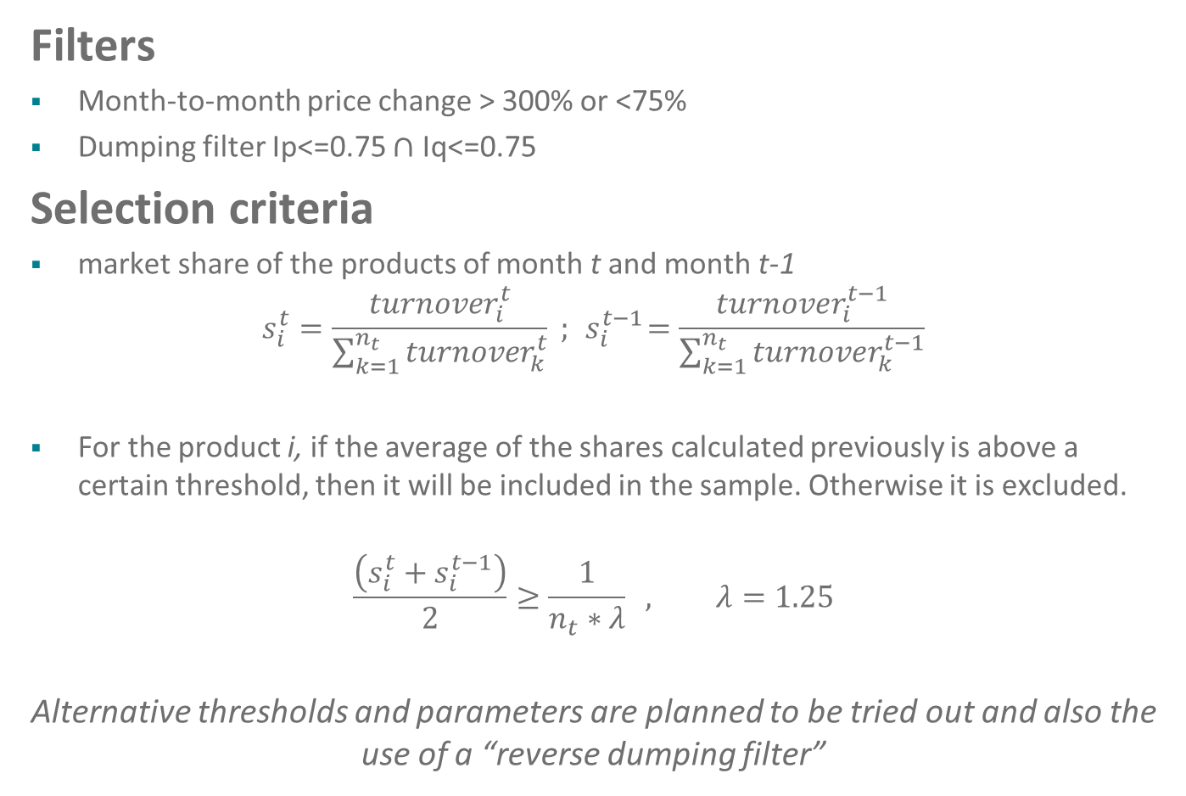
Sampling
Filters
Month-to-month price change > 300% or <75%
Dumping filter Ip<=0.75 $∩$ Iq<=0.75
Selection criteria
market share of the products of month t and month t-1
$$s_{i}^{t}=\frac{{turnover}_{i}^{t}}{\sum_{k=1}^{n_{t}}{{turnover}_{k}^{t}}} ; { s}_{i}^{t−1}=\frac{{turnover}_{i}^{t−1}}{\sum_{k=1}^{n_{t}}{{turnover}_{k}^{t−1}}}$$
For the product i, if the average of the shares calculated previously is above a certain threshold, then it will be included in the sample. Otherwise it is excluded.
$$\frac{\left(s_{i}^{t}+s_{i}^{t−1}\right)}{2}≥\frac{1}{n_{t}∗λ} , λ=1.25$$
Alternative thresholds and parameters are planned to be tried out and also the use of a “reverse dumping filter”

Slide 15
Sampling
  Imputations
Missing prices are imputed for 2 months if these were in the sample before
The 3rd period when a price is missing the series is discontinued
The RoC of the prices of products within the same category is used to estimate prices. As such, it has no impact on the result.
If a price is imputed and reappears, it is always included in the sample . We capture the price change from the estimated to the observed price.
In the future:
  Impute all missing prices including outliers and dumped prices
  The number of periods a missing price is estimated will be further investigated specially in the context of more seasonal products

Slide 16
Index compilation
No. Digit | COICOP | Class Label | Weights used to obtain each level
5 | 01.1.1.1. | Rice | Current HICP/CPI weights
6 | 01.1.1.1.1. | Rice | Retailer turnover from NA or SBS data of year t-2
7 | 01.1.1.1.1.1. | Rice - SD | Retailer turnover from NA or SBS data of year t-2. Turnover at product level provided by retailers.
8 | 01.1.1.1.1.1.1. | Retailer 1 - Rice | Geometric mean of price relatives (Jevons formula)
8 | 01.1.1.1.1.1.2. | Retailer 2 - Rice
8 | 01.1.1.1.1.1.3. | Retailer 3 - Rice
7 | 01.1.1.1.1.2. | Rice – Traditional Price collection | Geometric mean of price relatives (Jevons formula). Implicit weighting by the number of obs.

Slide 17
  Analytics
Nbr of observations in the HICP/CPI sample and on average in the SD monthly sample
Products | Traditional Price Collection | SD (3 shops)
COICOP 01 | 1 800 | 42 000
Rice | 10 | 66
Pasta | 31 | 375
Flour | 13 | 27

Slide 18
  Analytics
  Average monthly number of observations for all retailers
Products | Products classified | Imputed prices | Extreme variations | Dumping filter | Products excluded by Cut - off | Products in the sample | Sample coverage
Rice | 163 | 3 | 0 | 2 | 91 | 66 | 71%
Pasta | 901 | 18 | 0 | 30 | 480 | 375 | 68%
Flour | 95 | 1 | 0 | 1 | 64 | 27 | 70%

Slide 19
    Outputs - Rice

Slide 20
    Outputs - Pasta

Slide 21
    Outputs - Flour

Slide 22
Implementation
Fine tuning of methodology with the improvements previously mentioned
Safe and timely data transmission
The design of a system for data management
Building a production system
Compilation of a shadow index in 2016
All steps in the production system are tested
The timeliness and the quality of the results at each step
New products (COICOP5) will be tested
The increase of shop coverage within the same retailer
Benchmark indices are also being investigated namely RYGEKS
Informing users of the changes in methodology
Target date for Publication 2017

Slide 23
Thank you for your attention!
claude.lamboray@statec.etat.lu
vanda.guerreiro@statec.etat.lu

