Slide 1

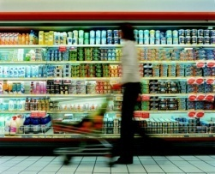
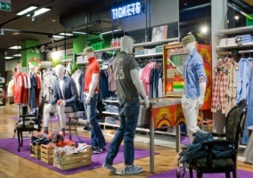

Modern Retail in Italy | Main features and latest trends
Workshop Scanner Data - Rome, 1 October 2015
Hélène Hotellier
Responsabile Ufficio studi e Affari europei
Federdistribuzione per ADM
hh@federdistribuzione.it

Slide 2




ADM represents the Modern Retail sector in dealing with the agro-food / Fast Moving Consumer Goods industry. ADM aims at the improvement of the supply chain, boosting and promoting efficiency in relations between operators.
Members of ADM are the three main representative trade associations of the large Modern Retail sector - Federdistribuzione, ANCC-Coop, ANCD-Conad - and about 800 retail companies operating in Italy.
ADM is a forum where the main retail industry associations can discuss to identify possible common paths on institutional issues.
Federdistribuzione per ADM
2

Slide 3
Focus on Italy | Macroeconomic context and forecasts
Focus on Italy| Household consumption model: structural trends & impact of the crisis
Modern Retail in Italy | Main features, comparison with European countries and latest trends
Modern Retail in Italy | New challenges
3

Slide 4
1. Focus on Italy | GDP, Households consumption, Consumer prices
Source: Istat
4

Slide 5
1. Focus on Italy | Macroeconomics forecasts
 | 2014 | 2015 | 2016
GDP (real terms) | -0,4 | +0,9 | +1,6
Household consumption (real terms) | +0,3 | +0,8 | +1,5
Unemployment rate (%) | 12,7 | 12,3 | 11,9
Consumer prices (% Var.) | +0,2 | +0,3 | +1,0
Deficit (Deficit/GDP) | -3,0 | -2,6 | -2,2
Public debt (Public debt/GDP) | 132,1 | 132,8 | 131,4
Source: DEF Italian Government (18 september 2015)
5

Slide 6
2. Focus on Italy | How has Household spending changed overtime
429
835
986
992
€ billion
38,9%
Food & Non Food goods spending |  |  | 212
 | Non food |  | 98
 | Food |  | 114
24,9%
21,9%
21,4%
Housing / allowances spending |  | 455
 | Housing, power… | 242
 | Transports, communication | 137
 | Health, Education | 39
 | Insurances, Financial services | 37
46,0%
45,8%
43,9%
33,5%
Recreative spending | 325
Restaurants & Hotels, Travels | 134
Wellness, Sport, Culture, … | 191
31,2%
32,1%
32,8%
27,6%
Source: Istat, GNLC Nielsen, Indicod Ecr-TradaLab
6

Slide 7
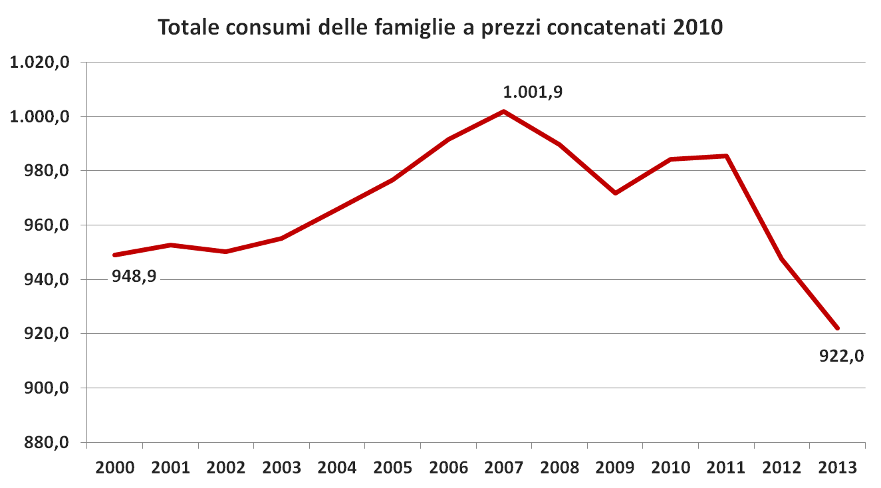
2. Focus on Italy | Household Consumption hit by a 2-phase crisis
Household consumption
- 6,4% = € 63,4 bn
- 8,0% = € 79,9 bn
Source: TradeLab on Istat data
7

Slide 8


3. Modern Retail in Italy| Main features - 2014
Total Modern Retail sales 127,3 bn €
Total Retail sales 212,2 bn €
Every week, 60 million people
enter Modern Retail stores
450.000 co-workers
+131% invested in professional training per FTE in 2014 vs 2006
60%
92% with open-ended contracts
58% women
17% under 30
Source: Federdistribuzione, Istat, Nielsen, TradeLab
8

Slide 9
3. Modern Retail in Italy | Retail formats % market shares - Total retail sales
198,5
226,3
220,4
215,4
212,2
€ billion
58.159* stores
696.886 stores
188.274 stores
Incl. Cash & Carry
Source: AC Nielsen, Istat, Indicod Ecr - TradeLab
9

Slide 10
3. Modern Retail in Italy | Retail formats % market shares - Food retail sales
100,8
117,5
117,3
116,0
114,1
€ billion
72,9%
378 stores
63,1%
1.619 stores
6.969 stores
13.872 stores
4.830 stores
191.540 stores
36.196 stores
Source : AC Nielsen, Istat, Indicod Ecr - TradeLab
10
10

Slide 11
3. Modern Retail in Italy | Retail formats % market shares - Food retail sales (excl. market stalls)
Source: Nielsen - Total Store 2012
11

Slide 12
3. Modern Retail in Italy | Retail formats % market shares - Non food retail sales
100,8
108,8
103,1
99,5
98,1
€ billion
8.966 stores
979 stores
29.127 stores
505.837 stores
152.078 stores
Source: Indicod Ecr - TradeLab
12
12

Slide 13
3. Modern Retail in Italy | Number of stores by retail formats (1)
 | 2010 | 2014 | % Var. 2014 vs. 2010 | Var.
Retail stores | 776.365 | 755.045 | -2,75 | -21.320
Modern Retail | 59.508* | 58.159* | -2,27 | -1.349
Small traditional shops | 716.857 | 696.886 | -2,79 | -19.971
Market stalls | 170.845 | 188.274 | 10,20 | 17.429
Total stores | 947.210 | 943.319 | -0,41 | -3.891
Incl. Cash & Carry
Source: Osservatorio del commercio (MISE) - Nielsen
13
13

Slide 14
3. Modern Retail in Italy | Number of stores by retail formats (2)
 | 2010 | 2014 | Var. | % Var. 2014 vs. 2010
Food Modern Retail stores | 29.366 | 27.668 | - 1.698 | - 5,8
Hypermarkets > 4500 sq.m. | 382 | 378 | - 4 | - 1,0
Superstores 1500-4500 sq.m. | 1.456 | 1.619 | + 163 | + 11,2
Supermarkets 400-1500 sq.m. | 7.279 | 6.969 | - 310 | - 4,3
Convenience stores 100-400 sq.m. | 15.867 | 13.872 | - 1995 | -12,6
Discounts | 4.382 | 4.830 | + 448 | + 10,2
Cash & Carry | 396 | 385 | -11 | -2,8
Non Food Modern Retail stores | 29.746 | 30.106 | 360 | +1,2
Source: Osservatorio del commercio (MISE) - Nielsen
14
14

Slide 15
3. Modern Retail in Italy | Total sales surface - Grocery market
sq.m. (‘000)
% Var. new sq.m.
Source: Nielsen GNLC - January ed.
15
Notes:
15

Slide 16
3. Modern Retail in Italy| Top 10 food retailers: % market shares
Source: AC Nielsen - January 2015
16
Notes:
16

Slide 17


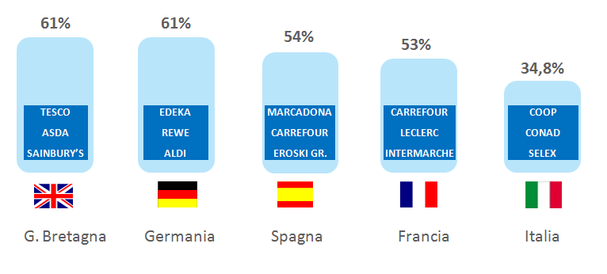
3. Modern Retail in Italy | A low level of market concentration
% market share of TOP 3 food retailers
62,5%
61,0%
56,0%
38,0%
36,1%
TESCO
ASDA
J SAINBURY’S
EDEKA
REWE
SCHWARZ Gr.
CARREFOUR LECLERC
INTERMARCHE
MERCADONA
CARREFOUR
DIA
COOP
CONAD
SELEX
TESCO
ASDA
SAINBURY’S
EDEKA
REWE
ALDI
CARREFOUR
LECLERC
CASINO
COOP
CONAD
SELEX
UK
Germany
Spain
France
Italy
Source: Nielsen, Kantar - 2014
17
Notes:
17

Slide 18
3. Modern Retail in Italy | Investments pre & post-crisis
€ 4,0 - 4,5 bn
of investments in the pre-crisis phase
€ 2,5 - 3,0 bn
of investments today
1 bn € of investments generates
750 mln € of value added &
involves 15.000 persons
Source: PwC study for Federdistribuzione - 2014 figures
18

Slide 19
% Var. (2006 = base 100)
3. Modern Retail in Italy| Sales vs. Costs
Sales by FTE
Costs by FTE
19

Slide 20
3. Modern Retail in Italy | Consumption crisis and costs increase has led to a negative profitability
2006
2010
2013
Net sales = 100
Cost of sales + labour costs + other expenses
EBIT
Net income
Source: TradeLab on a representative sample of retailers’ income statement
20

Slide 21
3. Modern Retail in Italy| National vs. Foreign-capital retailers
RETAILERS | Market shares (%)
Retailers with National capital | 80,3%
Retailers with Foreign capital | 19,7%
Auchan (FR) | 7,2 %
Carrefour (FR) | 6,2 %
Lidl (DE) | 2,6 %
Despar (Aspiag - AT) | 2,2 %
Penny Market (DE) | 1,5 %
Metro (Cash & Carry - DE) not taken into account (wholesale format)
Source: Nielsen
21

Slide 22
3. Modern Retail in Italy| Priority to price convenience to sustain purchasing power
Source: Nielsen Trade*Mis - Hyper+Super+LS
22

Slide 23
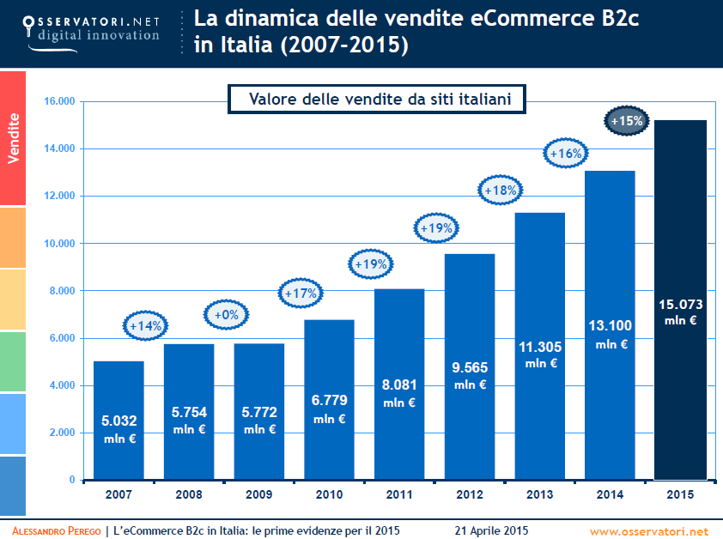
4. Modern Retail challenges | Omni-channel business model
Online sales trend
Source: Politecnico di Milano
23

Slide 24
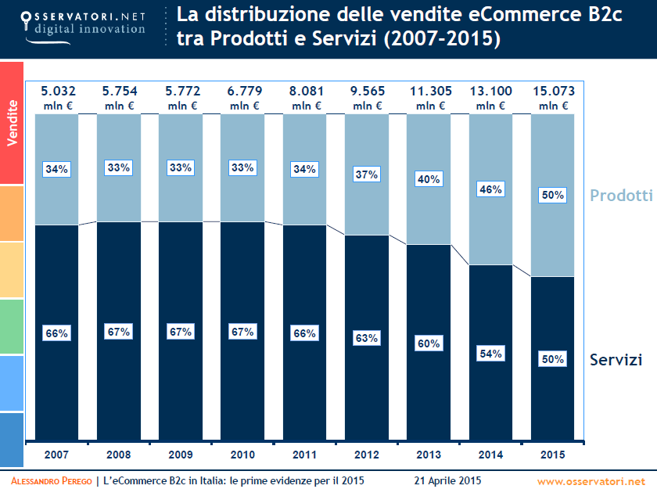
4. Modern Retail challenges | Omni-channel business model
Online sales trend
Goods
Services
Source: Politecnico di Milano
24

