Slide 1
Innovation in statistical processes and products: a European view
Dodicesima Conferenza nazionale di statistica
"Più forza ai dati: un valore per il Paese"
Rome, June 22-24 2016

Slide 2
Innovation4Statistics
change in paradigm
innovation@work
new processes for new services
success factors

Slide 3
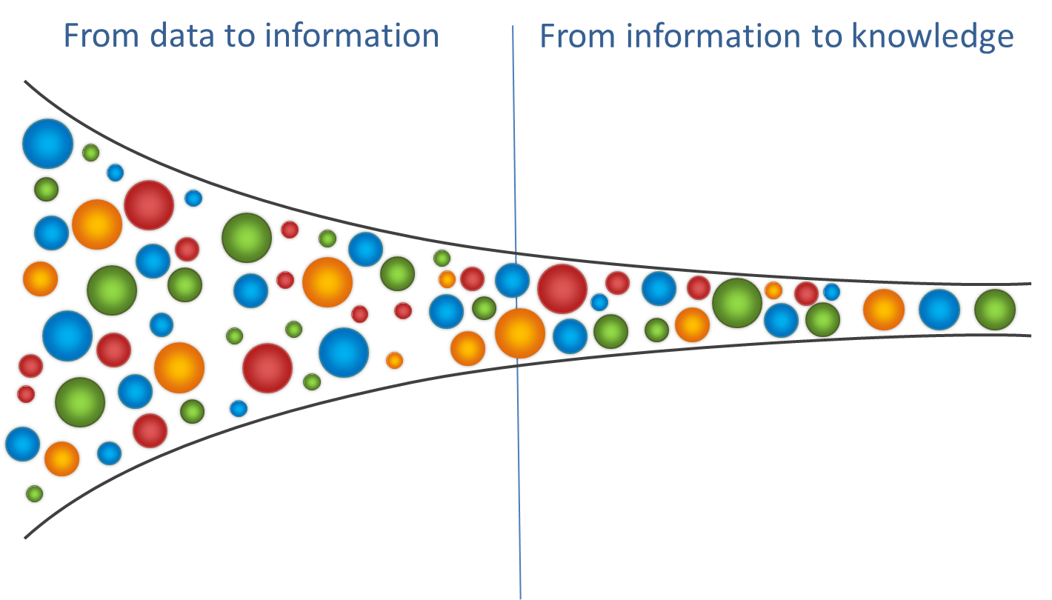
A Shift in Paradigm
Notes:
Big Data will make available a lot of geo-referenced/detailed data, which are very relevant for economic agents and policy makers.
Timeliness is the other challenge. If statisticians are not able (with the desired level of accuracy) what other claim to be able to do or do, they will be seen as less relevant and therefore people/politicians will be less ready to finance statistical infrastructures.

Slide 4
The Change Drivers
Data revolution
New metrics
Price of statistics
Future
of Europe
Digital transformation
Globalisation
Quality vs. resources
Enhanced economic governance
New data sources
Complex reality
Reduced budgets
Evidence based policy making
Competition among data providers
Geo-details
Cutting
the red tape
Objectives, thresholds, quality requirements

Slide 5
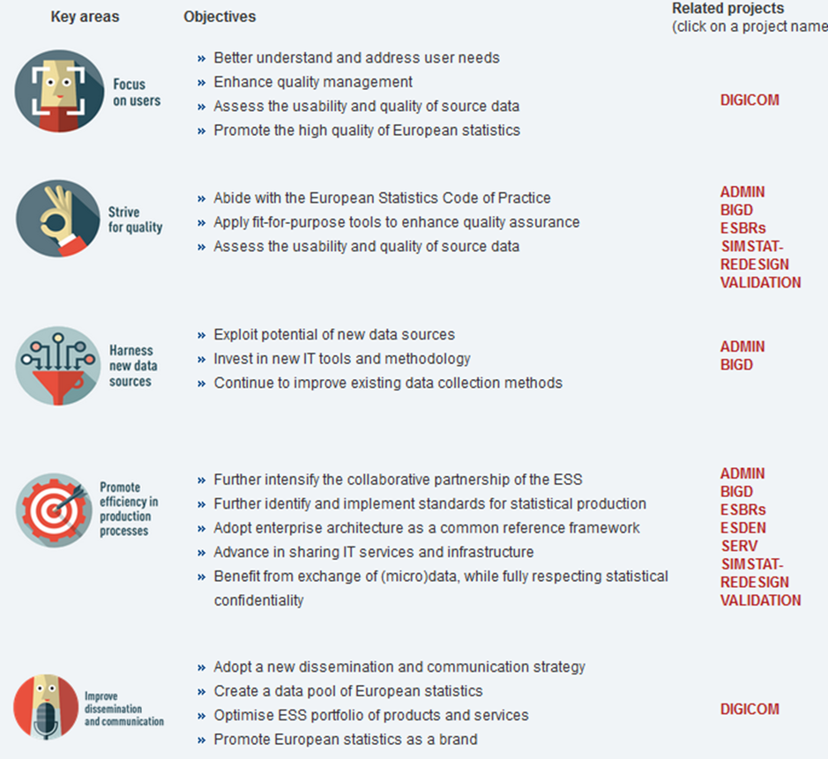
ESS Vision 2020

Slide 6
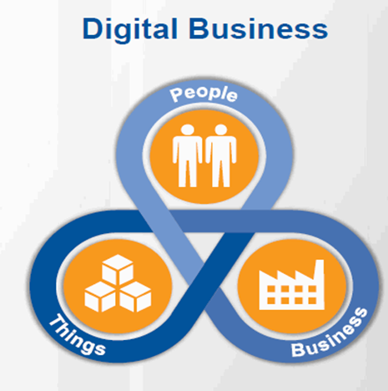
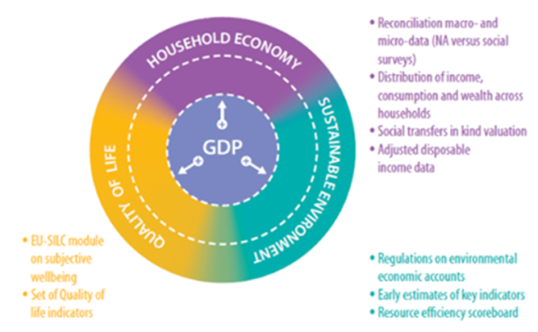
Innovation@work:

Slide 7
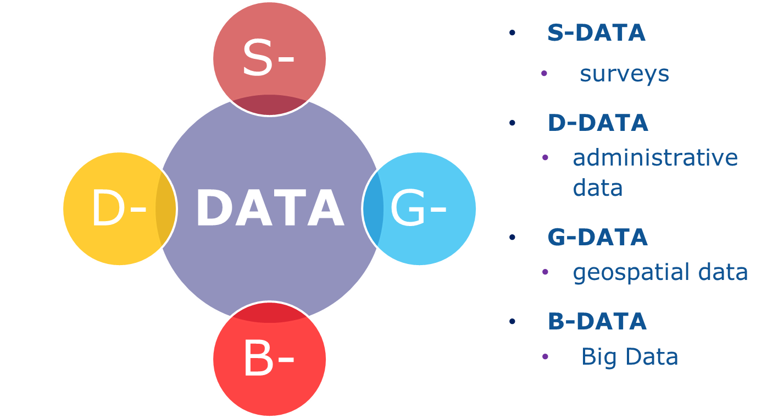
Multi-Source

Slide 8
Processes
Collect
Process
Analyse
Disseminate
Modernisation
Statistical domain1
Statistical domain 2
Standardised tools
Statistical domain1
Data engineering
Statistical domain1
….
….
….
Statistical domain n
Statistical domain 2
….
….
….
Statistical domain n
Statistical domain 2
….
….
….
Statistical domain n
Access raw information
Survey, Administrative, big data sources
New modes of data collection
Combining multiple sources
New methods, new quality indicators
Data platform
Data analytics
New analytical tools, new indicators
New analytical/theoretical frameworks
Users' needs driven
Data integration
Complexity, uncertainty measurement
New services
Unified data entry point
Data analytics services
Web services on the cloud

Slide 9
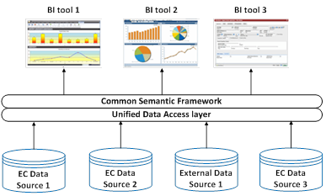


Platforms

Slide 10






Skills
Data engineering increasingly demanded in NSIs to complement domain statistical expertise.
Needs to share and re-use knowledge towards cross-cutting activities
Partnership based output with international organisations and academic world.

Slide 11

New Services
STATISTICS ON DEMAND
DATA ANALYTICS
Notes:
DA INSERIRE DEI GRAFICI

Slide 12


Going Forward
SMART STATISTICS
Notes:
Do you want to be google?

Slide 13

Building Blocks
Communication
Administrative data
Governance
Users
Big Data
Validation
Shared tools
Methods
Services
Quality
Enterprise Architecture
Standards
Network

Slide 14

Joining Hands
Sharing, Reusing, Assembling

Slide 15
Thank you for your attention!
  ESS Vision newsletter
    http://ec.europa.eu/eurostat/web/ess/about-us/ess-vision-2020/newsletters
  ESS Vision 2020 on the ESS website:
    http://ec.europa.eu/eurostat/web/ess/about-us/ess-vision-2020
  CROS (Collaboration in Research and Methodology for Official Statistics)
    https://ec.europa.eu/eurostat/cros
Emanuele Baldacci,
Eurostat Director,
Directorate B: Methodology, Corporate statistical and IT services
emanuele.baldacci@ec.europa.eu

